Slide 1
A task setting PowerPoint Pack on how to use commas.

Slide 2
Can you make this sentence mean different things by using commas?
The antiques shop sells silver paper lanterns drawers and vases.
Photo courtesy of shrinkin’violet (@flickr.com) - granted under creative commons licence - attribution

Slide 3
The antiques shop sells silver, paper, lanterns, drawers and vases.
The antiques shop sells silver paper, lanterns, drawers and vases.
The antiques shop sells silver paper lanterns, drawers and vases.

Slide 4
Recap
Commas tell the reader to make a brief pause, not as long as the pause for a full stop.
They are a little bit more complicated than other punctuation marks because they have lots of uses.

Slide 5
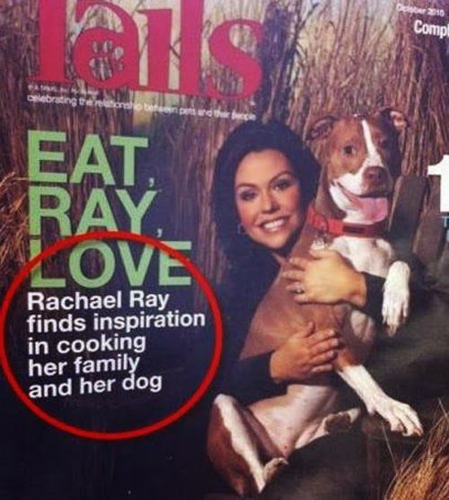

Slide 6
“A panda walks into a cafe. He orders a sandwich, eats it, then draws a gun and fires two shots in the air. "Why?" asks the confused waiter, as the panda makes towards the exit. The panda produces a badly punctuated wildlife annual and tosses it over his shoulder. "I'm a panda," he says, at the door. "Look it up."
Eats, Shoots & Leaves: The Zero Tolerance Approach to Punctuation by Lynne Truss

Slide 7
The waiter turns to the relevant entry and, sure enough, finds an explanation. Panda: Large black-and-white bear-like mammal, native to China. Eats, shoots and leaves.

Slide 8
W.A.L.T. use commas to create meaning.
We use commas:
to separate items in a list;
to separate extra information in a sentence;
between main clauses;
after fronted adverbials (how, when, where);
to show direct speech after a clause.

Slide 9
Commas are used in lists,
Commas separate items in lists
…but ‘and’ is used instead of a comma for the last item.
He packed a bucket, spade and swimming costume.
Can you punctuate this list with commas?
My three favourite foods are fish pie stir fry and pizza.

Slide 10
Commas separate extra information
(imbedded clauses) in a sentence.

Slide 11
Commas break up
two main clauses.

Slide 12
H
Commas are used
after fronted adverbials.
The dog sat.
WHEN? After being told off, the dog sat.
WHERE? Reaching its basket, the dog sat.
HOW? Reluctantly, the dog sat.
The child cried.
WHEN?
WHERE?
HOW?

Slide 13
Commas introduce
speech or a speaker.
Tommy shouted, “Please help me; I’m stuck in here!”
“Please help me,” Tommy shouted, “I’m stuck in here!”
“Mum ” he cried “don’t forget bread milk and cheese.”
“Mum,” he cried, “don’t forget bread, milk and cheese.”

