Slide 2
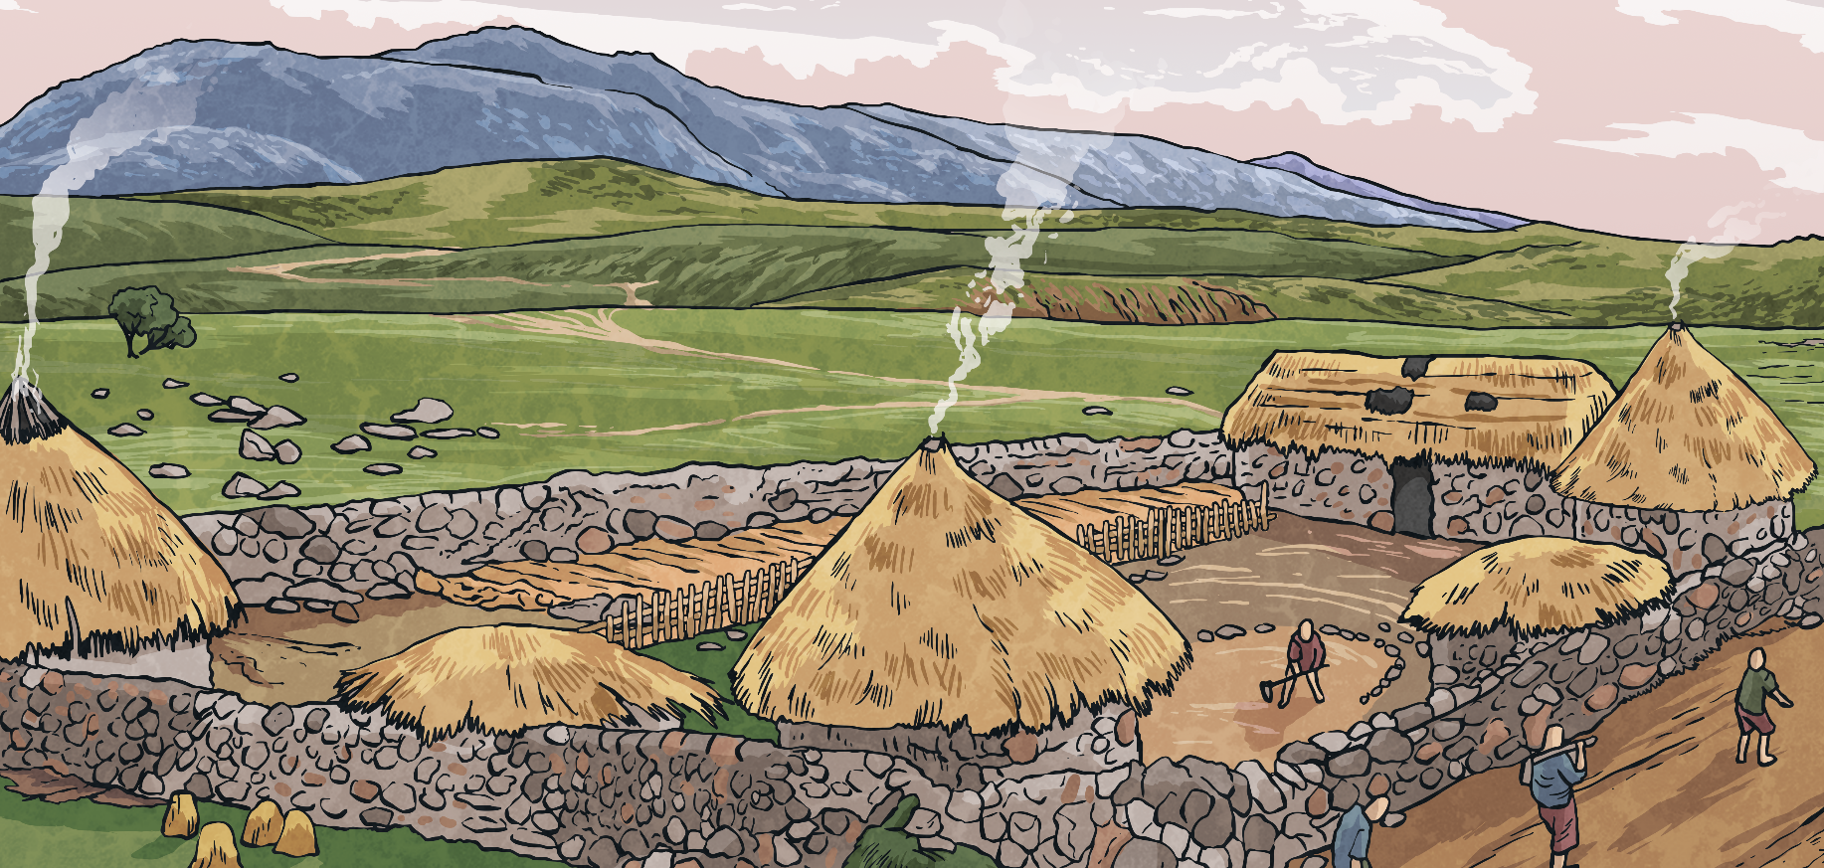
Before the Roman Roads
Before the Romans arrived, Britain had no proper roads. The Celts rode horses, walked and travelled in carts pulled by oxen along paths and tracks. These paths and tracks connected local farms and hamlets, and there were some longer routes for trade. These tracks were often in very poor condition.
Why do you think the Romans wanted to build new roads?
Can you think of three possible reasons?

Slide 3
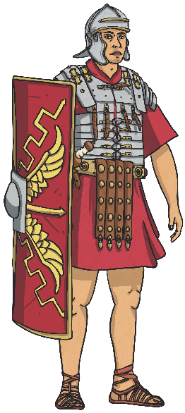
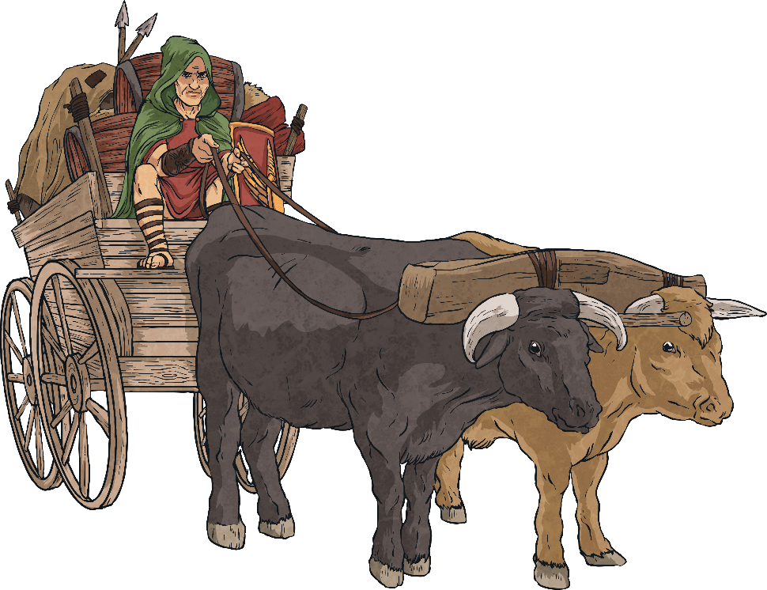
Roman Roads
Why did the Romans want better roads?
Did you think of any of these reasons?
Troops could be quickly moved from one place to another.
Supplies could be sent to different areas of the country.
The Emperor had more control if messages could be sent quickly.
Better links between places was good for trading.

Slide 4
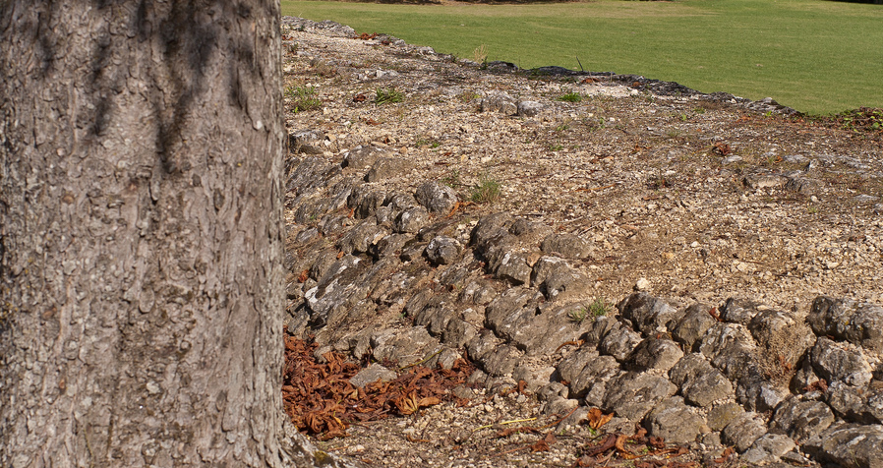
Roman Roads
The Romans were famous for their long, straight roads. You can still see some Roman roads today, two thousand years after they were built.
Photo courtesy of sybarite48 (@flickr.com) - granted under creative commons licence - attribution

