Slide 1
Reception
plural s /z/

Slide 2
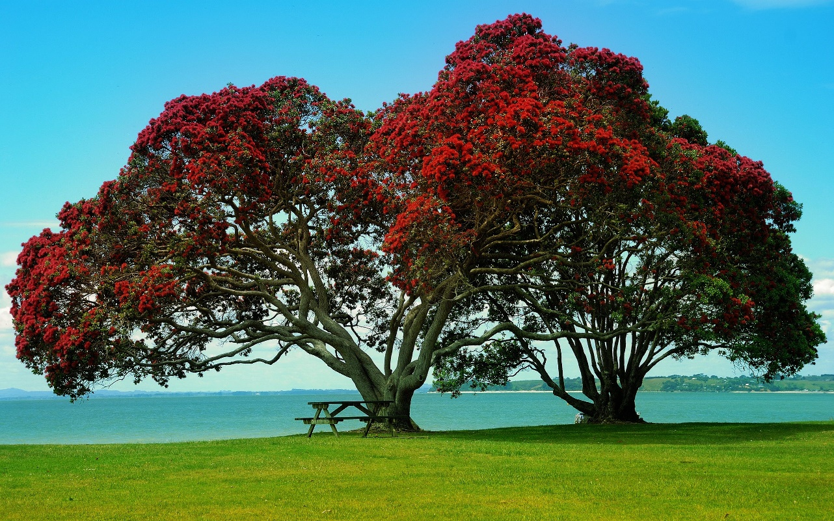
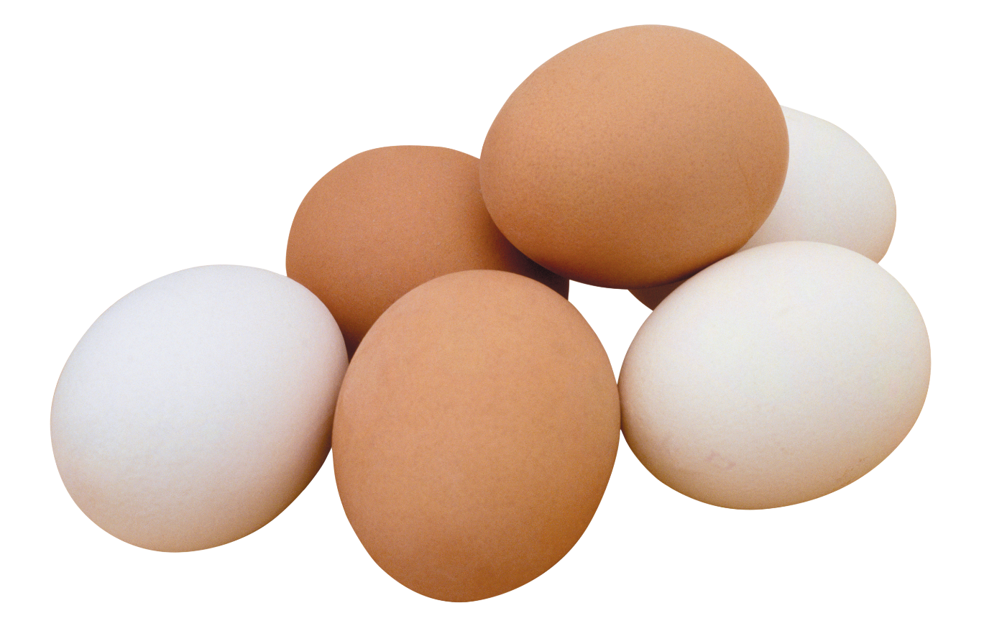
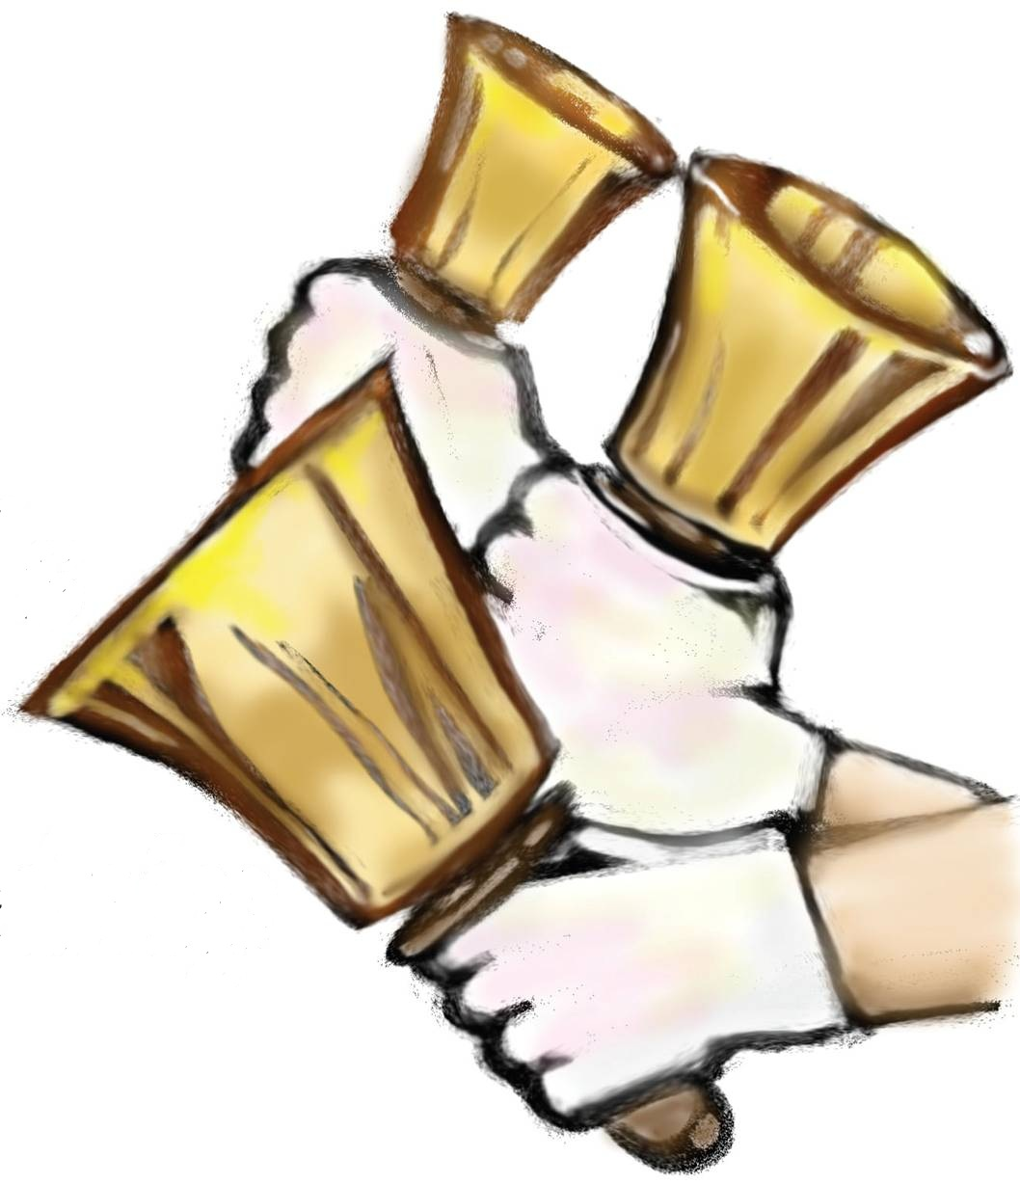
Explain to the children that all of these words end in the sound /z/, but that this is spelled using the grapheme ‘s’

Slide 3
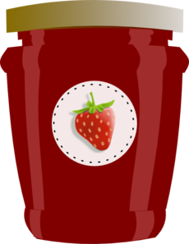
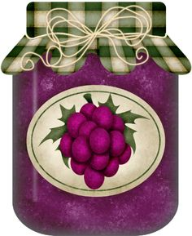
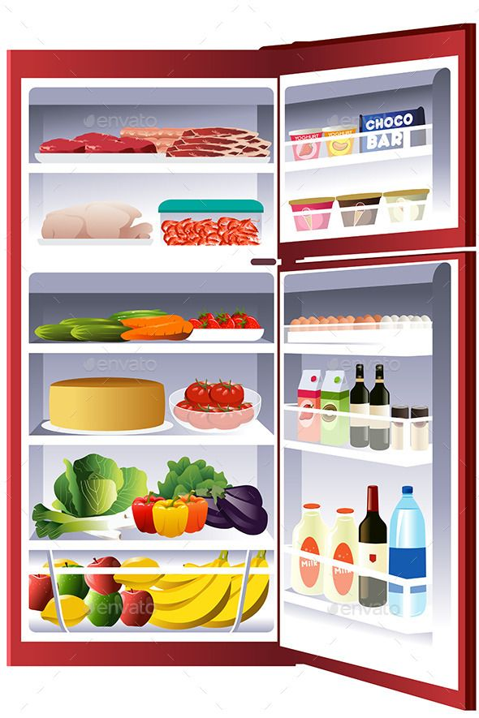
jams
bangs
yawns
chills

Slide 4
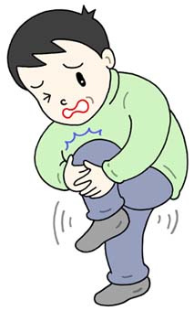
Different meanings for the word ‘bangs’

Slide 5
chills
jogs
bells
yells
wags
vans
rings
Read and write

Slide 6
fizz
quack
Underline the diagraphs.
dash
cuffs

Slide 7
Tricky words to learn to read and write.
we
be

Slide 8
Read the caption
She picks up the eggs and runs to her dogs.

