Slide 1
Finding pairs of values – reasoning and problem solving

Slide 2
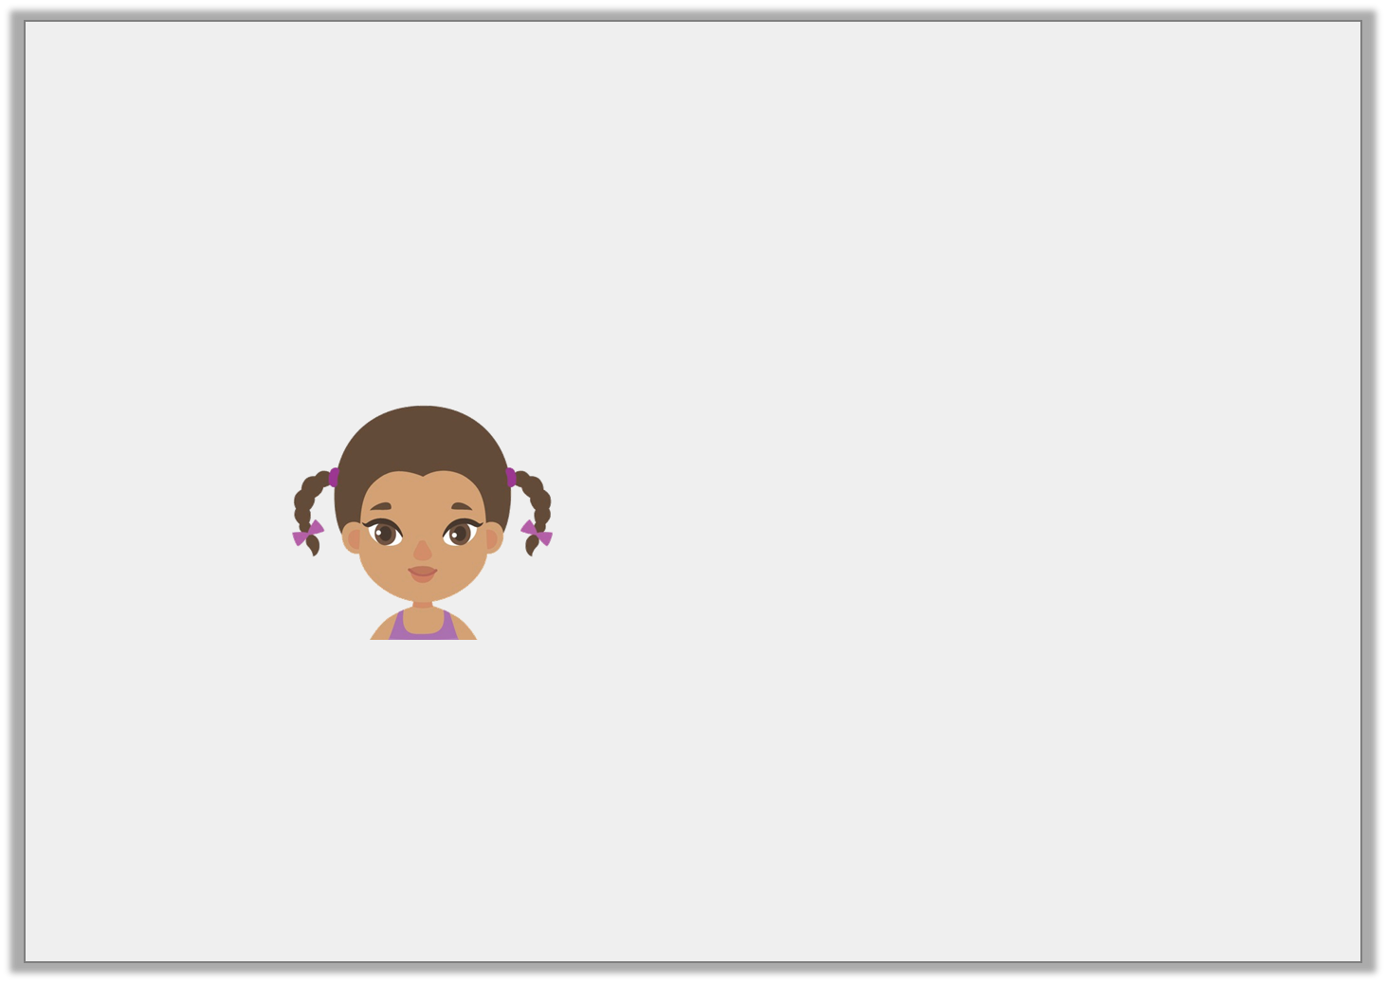
Reasoning 1
Razia is finding possible values for h and i.
Is Razia correct? Explain your answer.
3h + 11i = 60
If h equals 9, i must equal 33.
© Classroom Secrets Limited 2019

Slide 3
Reasoning 1
Razia is finding possible values for h and i.
Is Razia correct? Explain your answer.
Razia is incorrect because…
3h + 11i = 60
If h equals 9, i must equal 33.
© Classroom Secrets Limited 2019

Slide 4
Reasoning 1
Razia is finding possible values for h and i.
Is Razia correct? Explain your answer.
Razia is incorrect because 3 x 9 = 27 and 60 – 27 = 33. 33 ÷ 11 = 3 so i = 3.
3h + 11i = 60
If h equals 9, i must equal 33.
© Classroom Secrets Limited 2019

Slide 5
Reasoning 2
If a is an odd number and b is 50, which of these could be true?
Convince me.
A. 2a + 3b = 156
B. a + a – 3b = 4
C. 4a + 5b = 258
D. 2a ÷ 3b = 2
© Classroom Secrets Limited 2019

Slide 6
Reasoning 2
If a is an odd number and b is 50, which of these could be true?
Convince me.
A and B could be true because…
A. 2a + 3b = 156
B. a + a – 3b = 4
C. 4a + 5b = 258
D. 2a ÷ 3b = 2
© Classroom Secrets Limited 2019

Slide 7
Reasoning 2
If a is an odd number and b is 50, which of these could be true?
Convince me.
A and B could be true. For example: A. a = 3; B. a = 77
A. 2a + 3b = 156
B. a + a – 3b = 4
C. 4a + 5b = 258
D. 2a ÷ 3b = 2
© Classroom Secrets Limited 2019

Slide 8
Problem Solving 1
Sweety Treaty sell 2 medium sweet boxes and 4 small sweet boxes for £36. What possible prices can you find for each sweet box?
2m + 4s = £36
m | s
© Classroom Secrets Limited 2019

Slide 9
Problem Solving 1
Sweety Treaty sell 2 medium sweet boxes and 4 small sweet boxes for £36. What possible prices can you find for each sweet box?
Various answers, for example:
m = 8, s = 5; m = 9, s = 4.5; m = 10, s = 4
2m + 4s = £36
m | s
© Classroom Secrets Limited 2019

Slide 10
Star Challenge Time!
Go to Maths – Algebra Part 4 and choose your star challenge. As usual, the first page will give you a challenge that is slightly easier than the introduction challenge, the second page will give you a challenge that is similar to the questions in the presentation and the third page will give you challenges that will stretch you further. You can

