Slide 1
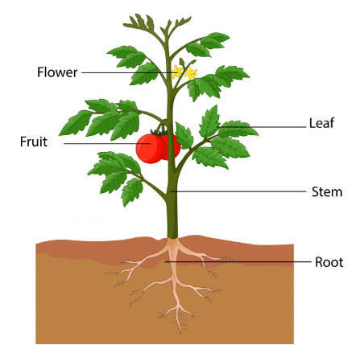
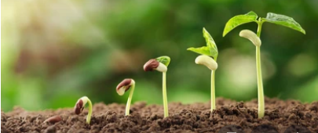
What does a seed need?
Key Vocabulary
Roots- These anchor the plant into the ground and absorb water and nutrients from the soil.
Stem- This holds the plant up and carries water and nutrients from the soil to the leaves. A trunk is the stem of a tree.
Leaves- These make food for the plant using sunlight and carbon dioxide from the air.
Flowers- These make seeds grow into new plants. Their petals attract pollinators to the plant.
Nutrients- Important ingredients in food that help living things to grow and be healthy. Plants get nutrients from the soil and also make their own food in their leaves.

