Slide 2
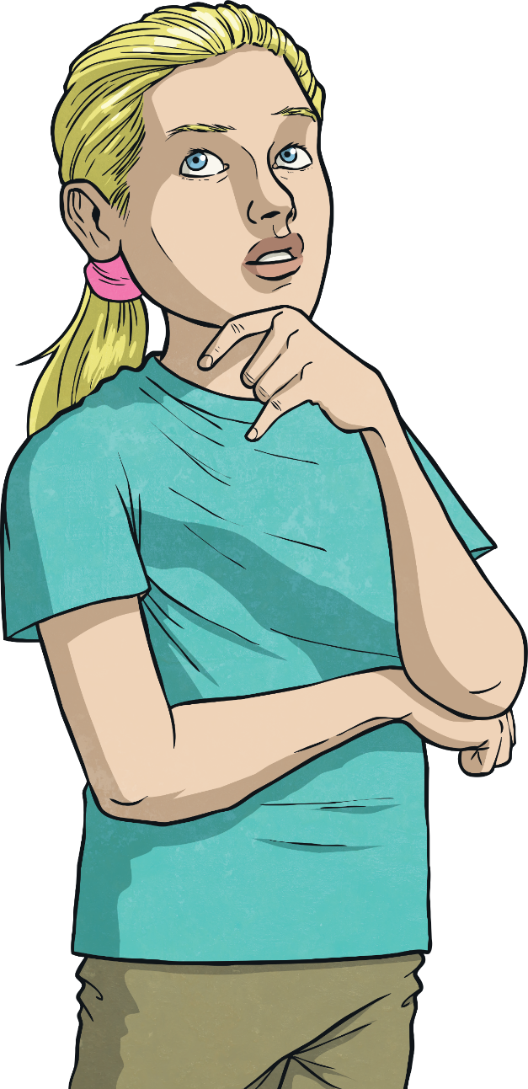
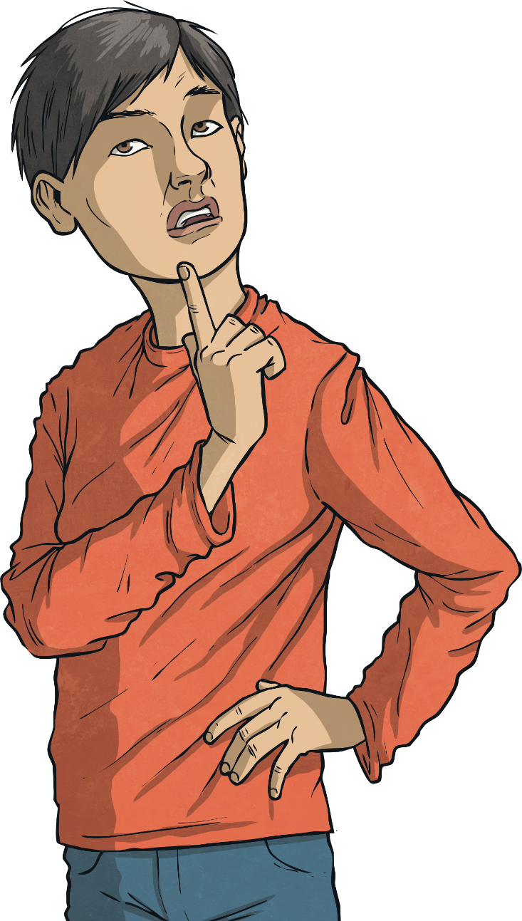
Why do people borrow money?
What are the consequences of borrowing money?

Slide 3
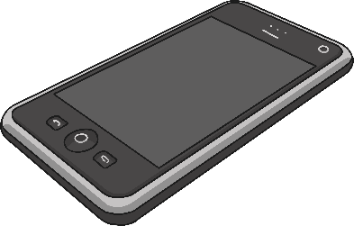
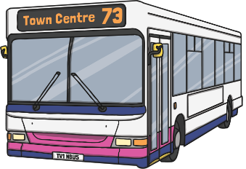
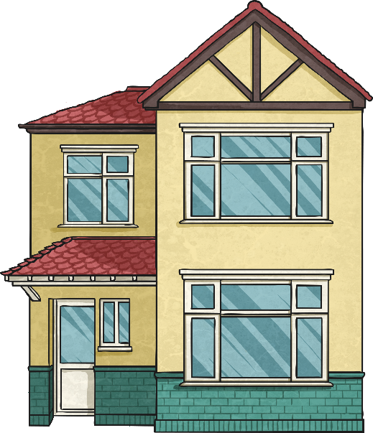
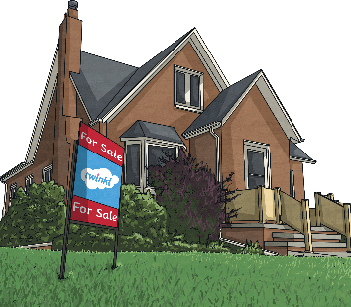
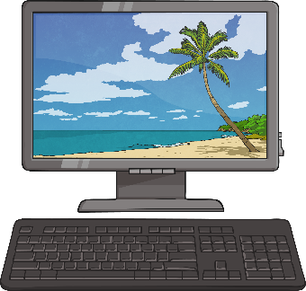
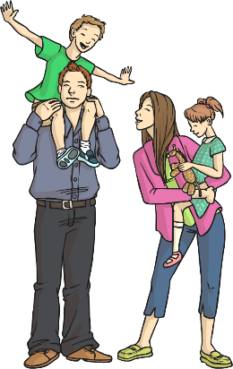
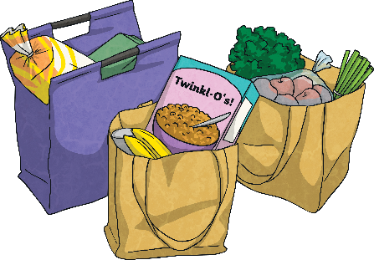
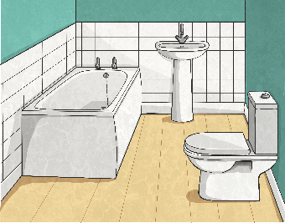
Where Does the Money Go?
In our lessons we have been looking at where money comes from and why we need it.
But what happens if people can’t afford to pay for what they want or what they need?

Slide 4
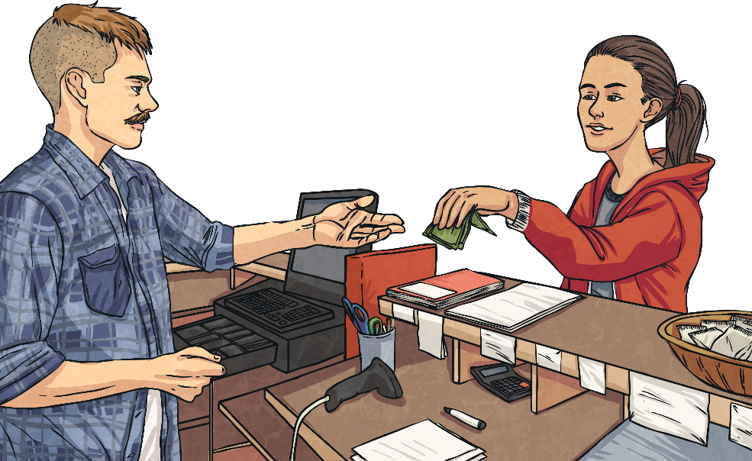
Where Does the Money Go?
If people can’t afford to buy what they need, they might have to borrow money.
What does it mean to ‘borrow’ something?
When we borrow something we will need to give it back. We are only lending it temporarily. There are companies that lend people money and get the money back in repayments (a little at a time). These companies also charge interest for the time that it takes money to be paid back.
Have you seen advertisements for any companies that can lend money to people who need to borrow it?

Slide 5
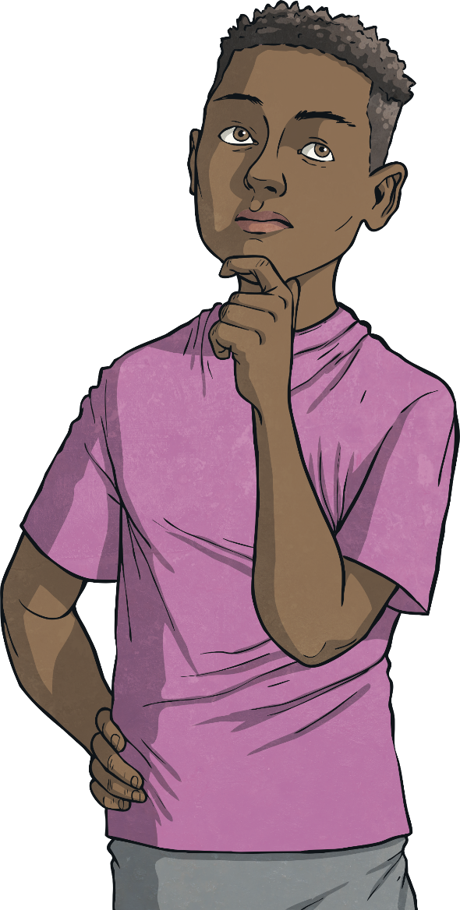
What is Debt?
Look at the following words.
Can you think of a definition for any of these words?
debt
loan
interest
VAT
tax

Slide 6
Definitions
Let’s share some definitions:
VAT – Value Added Tax. This is a charge added on to certain goods and services that we buy. Most food and drink bought in shops has no VAT added. However, food bought in restaurants or from takeaways has VAT added because it is providing a service.
Interest – A fee charged by the lender when money is borrowed.
A deposit (money) given to you by a bank when you save money in your bank account.
Loan – An amount of money you can borrow. It must be paid back and interest will be charged.
Debt – When people owe lots of money and cannot afford to repay it.
Tax – An amount of money you must pay charged by the government. When you earn money at work you pay income tax. You are also charged council tax on the home you live in. The government uses money from tax to pay for public services, like the police service and the fire brigade.
Can you remember what these were from your previous lesson?

Slide 7
What’s Happening Here?
People might feel they need to borrow money when they are unable to afford things they want or need. If they then cannot afford the repayments on the money that has been borrowed, this debt becomes unmanageable and can cause distress and worry.
By saving money when people can afford to do so, they can try to avoid the need to borrow money by creating savings to use for more expensive items.

Slide 8
Manage Your Money
You are now going to make your own posters to advise people on how to manage their money to avoid getting into unmanageable debt.
Word Bank
money
debt
VAT
interest
loan
bank account
debt
owe
borrow
repay
repayments
credit card
unmanageable
savings

