Slide 1
3.1 The part–whole relationship Step 2:1

Slide 2
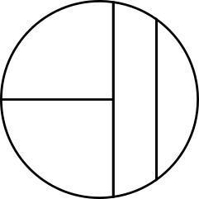
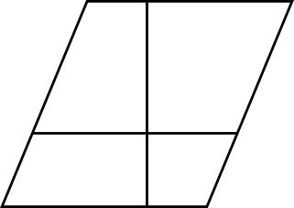
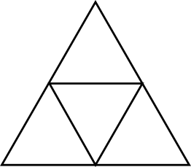
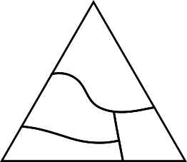
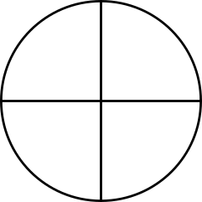
3.1 The part–whole relationship Step 2:2
Equal parts
Unequal parts

Slide 3
3.1 The part–whole relationship Step 2:2
Equal or unequal parts?
Notes:
Explain to children that these are three equal-sized squares.

Slide 4
3.1 The part–whole relationship Step 2:2
Equal or unequal parts?

Slide 5
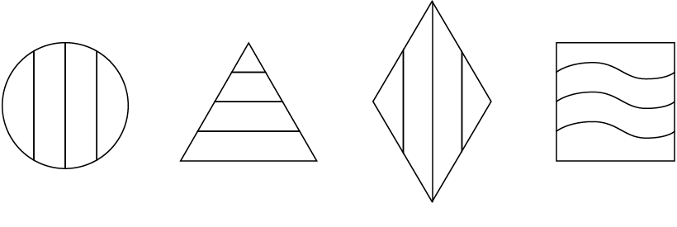
3.1 The part–whole relationship Step 2:2
Equal or unequal parts?

Slide 6
3.1 The part–whole relationship Step 2:3
Notes:
It is only possible to divide a whole into parts using straight lines.
Do you agree with this statement?

