Slide 1
Phonics and Reading Workshop
for Parents

Slide 2
Phonics at Western Road
We use Letters and Sounds, which is a national publication written by the DFeS. It is the advised programme for the teaching of synthetic phonics in England. We use this to follow the order of introducing new sounds, high frequency words and tricky words.

Slide 3
m

Slide 4
l

Slide 5
f

Slide 6
s

Slide 7
t

Slide 8
There are approximately 44 single sounds in the English language
Consonant
b (c k ck) d f g h j l m n p r s t v w x(k/s)y z
Consonant digraphs
qu ng nk zh ch sh th (unvoiced) th (voiced)
vowels
a ai e ee i ie or ue oo (little) oo (long)
oi ow er air ar ur or ear ure

Slide 9
Blending
Blending the correct sounds will help your child to read.
M(uh) + A + T(uh) = Muhatuh
M + A + T = MAT

Slide 10
Combinations of Letters
Sounds can be represented by one or more letter Diagraph shop
The same sound can be represented in more than one way
Bee key quay
Be lady
Brief phoenix
Bleat receive

Slide 11
Segmenting and Blending Tricky Words
Segmenting is chopping up a word – The skill used to write
Blending is putting the sounds together – The skill used in reading
Tricky words are so called because they are irregular and can’t be segmented or blended.

Slide 12
Finger Twister

Slide 13
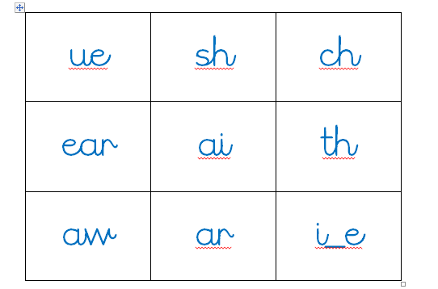
Bingo

Slide 14
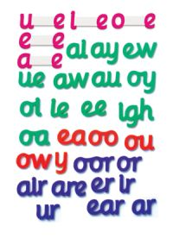
Magnetic letters

Slide 15
How you can support your child in phonics
Singing
Rhyming
Reading to them
I spy
Spotting words and sounds in book and the environment
Finding out what they have been learning and get them to show you how clever they are! Ask them to explain things to you.

Slide 16
Letters and Sounds
Broken down in to 6 Phases.
Phase 1 – Nursery and Reception
Phase 2 – Reception
Phase 3 – Reception
Phase 4 – Reception/Year 1
Phase 5 – Year 1
Phase 6 (Support for Spelling) – Year 2

Slide 17
Phase 1
Phase One of Letters and Sounds concentrates on developing children's speaking and listening skills and lays the foundations for the phonic work which starts in Phase 2. The emphasis during Phase 1 is to get children attuned to the sounds around them and ready to begin developing oral blending and segmenting skills.

Slide 18
Phase 2
Phase 2
In Phase 2, letters and their sounds are introduced one at a time. A set of letters is taught each week, in the following sequence:
Set 1: s, a, t, p Set 2: i, n, m, d Set 3: g, o, c, k Set 4: ck, e, u, r Set 5: h, b, f, ff, l, ll, ss
The children will begin to learn to blend and segment to begin reading and spelling. This will begin with simple words.

Slide 19
Terminology
Phoneme - It is the smallest unit of sound and a piece of terminology that children like to use and should be taught.
Blend - Blending is the process that is involved in bringing the sounds together to make a word and is how /c/ /a/ /t / becomes cat.
Segment – Chopping up the word into their sounds

Slide 20
Phase 3
By the time they reach Phase 3, children will already be able to blend and segment words containing the 19 letters taught in Phase 2.
Over the twelve weeks which Phase 3 is expected to last, twenty-five new graphemes are introduced (one at a time).
Set 6: j, v, w, x
Set 7: y, z, zz, qu
Consonant digraphs: ch, sh, th, ng
Vowel digraphs: ai, ee, igh, oa, oo, ar, or, ur, ow, oi, ear, air, ure, er

Slide 21
Phase 4
By Phase 4 children will be able to represent each of 44 phonemes with a graphemes. They will blend phonemes to read CVC words and segment CVC words for spelling. They will also be able to read two syllable words that are simple. They will be able to read all the tricky words learnt so far and will be able to spell some of them.
This phase consolidates all the children have learnt in the previous phases.

Slide 22
Phase 5
Children will be taught new graphemes and alternative pronunciations for these graphemes and graphemes they already know. They will begin to learn to choose the appropriate grapheme when spelling.
ay day | oy boy | wh when | a-e make
ou out | ir girl | ph photo | e-e these
ie tie | ue blue | ew new | i-e like
ea eat | aw saw | oe toe | o-e home
 |  | au Paul | u-e rule

Slide 23
Phase 6
In phase 6, the focus is on learning spelling rules for word endings or suffixes.
They will learn how words change when you add certain letters. There are 12 different suffixes taught:
-s -es -ing -ed
-er -est -y -en
-ful -ly -ment -ness

Slide 24
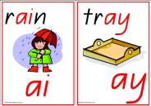
Year 1
Phonics
Screening

Slide 25
Why are the children being screened?
Every Year 1 child in the country will be taking the phonics screening check in the same week in June.
The aim of the check is to ensure that all children are able to read by the end of year two.
This ‘midpoint check’ will ensure that we have a clear understanding of what the children need to learn in year 2.

Slide 26
What will the children
be expected to do?
The check is very similar to tasks the children already complete during phonics lessons.
Children will be asked to ‘sound out’ a word and blend the sounds together.eg d-o-g - dog
The focus of the check is to see which sounds the children know and therefore the children will be asked to read made up ‘nonsense’ words.
THIS IS NOT A READING TEST.

Slide 27
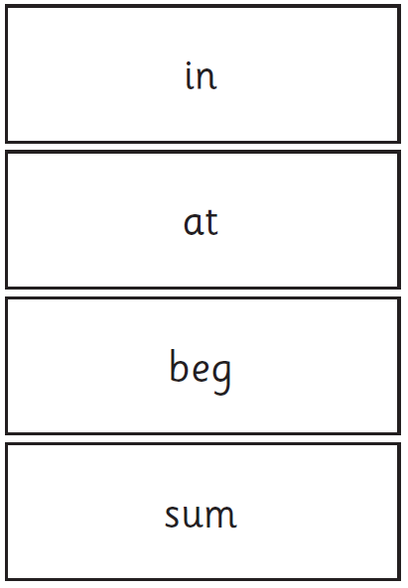
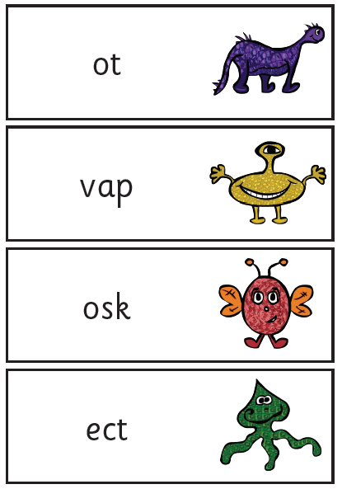
Examples of words:

Slide 28
When will the
screening take place?
The screening will take place throughout the week beginning Monday 12th June 2017. The children cannot retake the test at any other time so it is very important your child is in school during this week.
The check has been designed so that children of all abilities will be able to take part.

Slide 29
Who will complete the check?
The children will complete the check one at a time in a quiet area of the school.
Miss Mackinnon will conduct all of the screening checks with the children in Year 1.
The screening will only take
10 – 15 mins with each child.

Slide 30
How can you help?
Encourage your child to ‘sound out’ when reading or writing. Focusing particularly on spotting more unusual sound patterns.
Eg
Digraph- 2 letters making one sound
cow
Trigraphs- 3 letters making one sound
night
Split digraphs- 2 vowels with a consonant in between.
spine - i_e

Slide 31
How can you help?
REMEMBER: Phonics is not the only thing needed to become a fluent reader.
Please continue to read with your child every day and encourage them to:
Sound out
Re-read to check it makes sense.
Use pictures for clues.
Ask questions about the book.
And most importantly ENJOY READING!

Slide 32
What do early readers have to do?
Point to the words to match what is read to the words in the print
Use phonic skills – sound out and blend the sounds in new words
Think about what would make sense, perhaps by checking the picture and then checking the word to see if it looks right
Notes:
Beginning readers need to match one-one and focus on the first letters of words - we encourage this by pointing.

Slide 33
Questions?

