Slide 2
What Does Cautious Mean?
Someone who is cautious tries to avoid problems or risks.

Slide 3
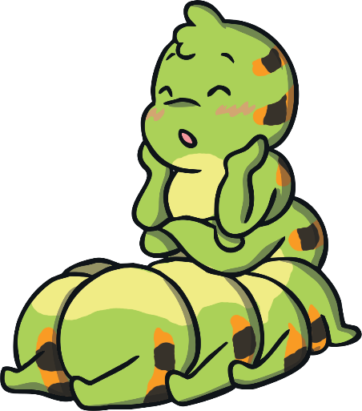
Cody the Cautious Caterpillar
How did Cody feel about becoming a butterfly?
scared
unsure
nervous
worried
anxious
not looking forward to change
Click on the picture to find out!

Slide 4
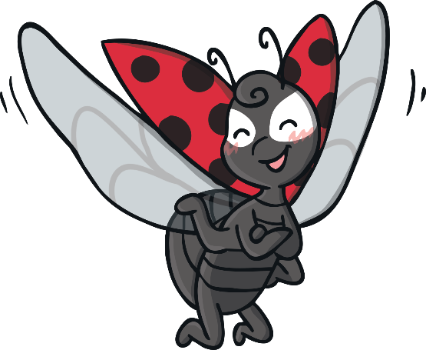
How did Cody feel about flying?
“Flying looks very tiring,” said Cody. “I wish I could stay as a caterpillar forever!”

Slide 5
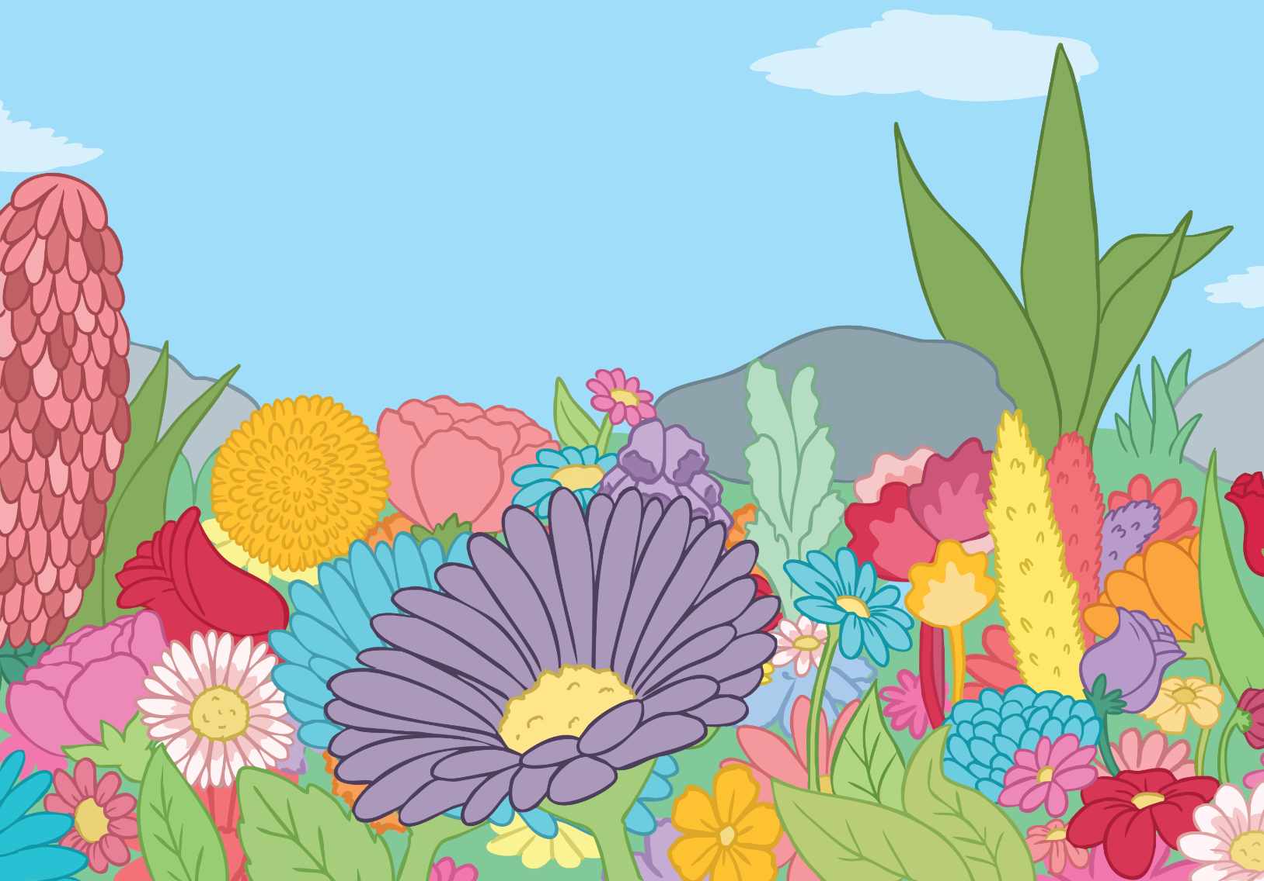
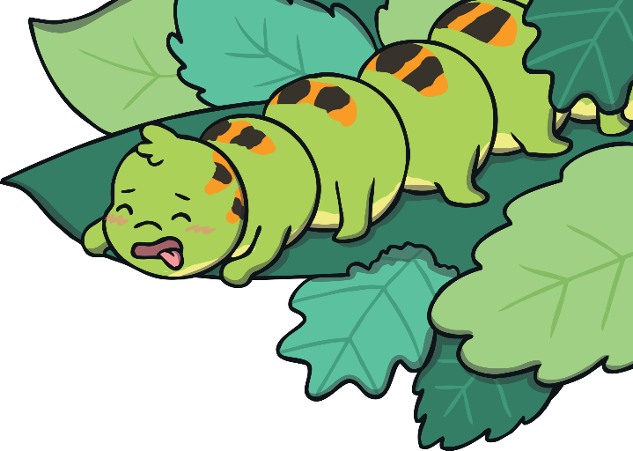
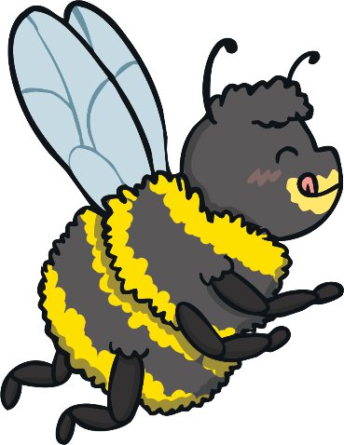
How did Cody feel about drinking nectar?
“I don’t think I will like nectar,” said Cody. “I wish I could stay as a caterpillar forever!”

Slide 6
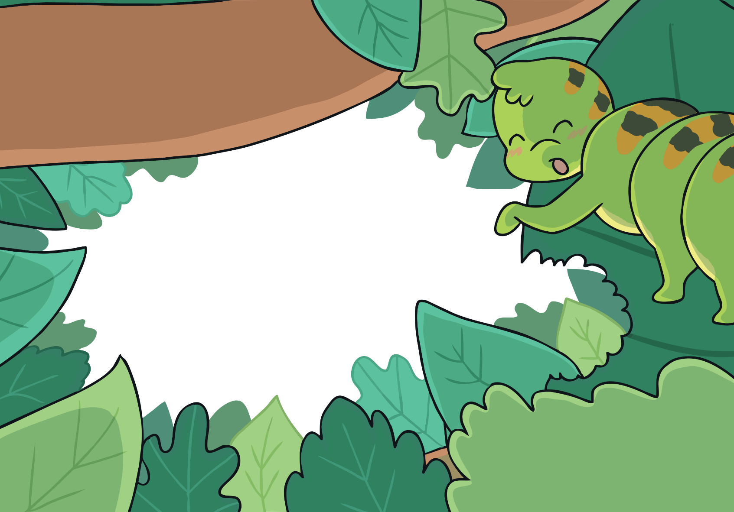
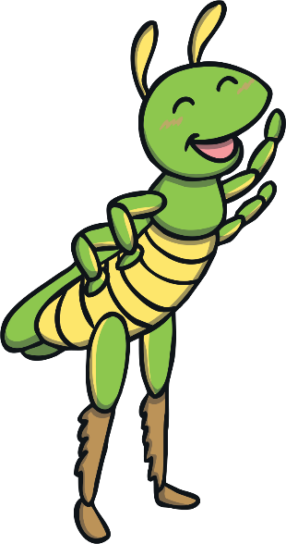
How did Cody feel about having six legs?
“I like having sixteen legs,” said Cody. “I wish I could stay as a caterpillar forever!”

Slide 7
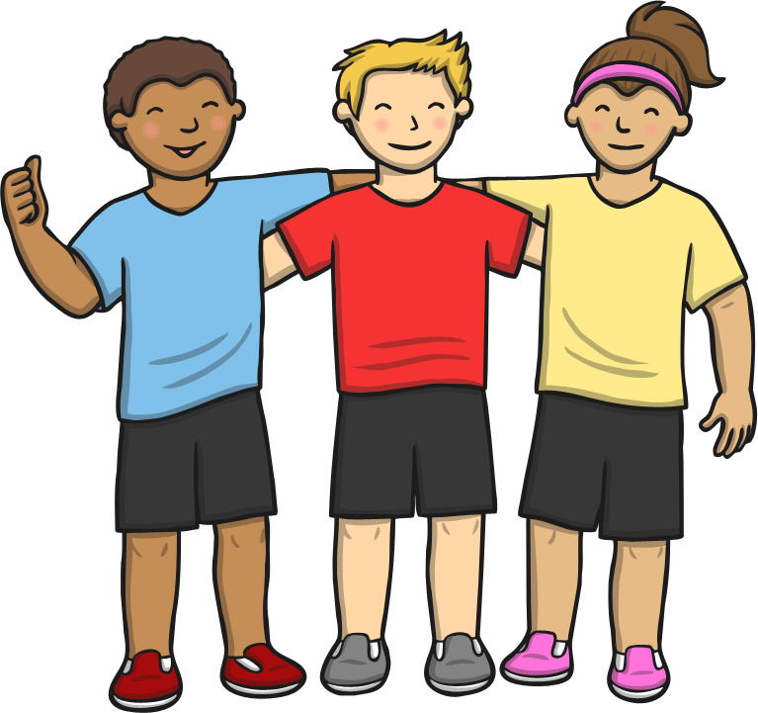
Are You Feeling Cautious?
Is there anything that you are feeling cautious or worried about when you move up to your next class?
Talk to your friends and teacher about how you are feeling.

Slide 8
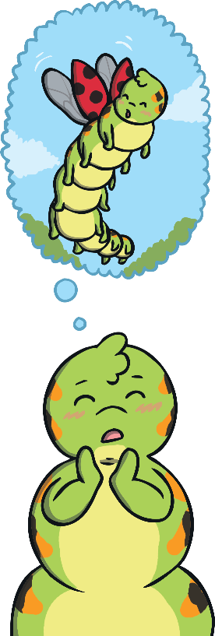
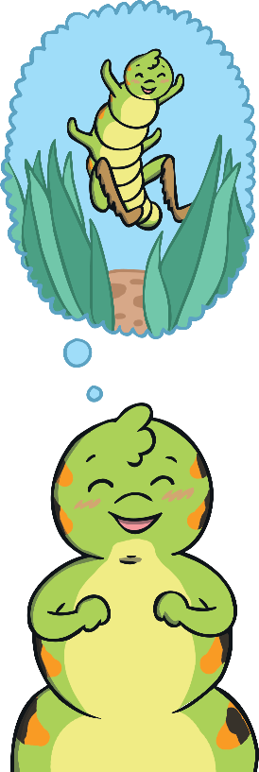
Change Can Be Good!
Can you think about the things you might enjoy when you change class?
She thought about everything her friends had told her and decided to brave.

Slide 9
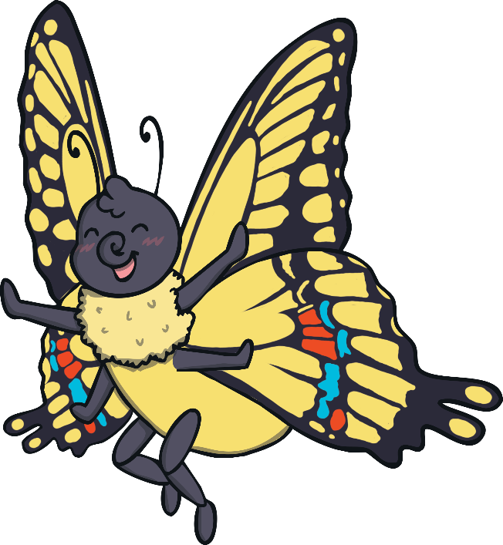
How Did Cody Feel When She Became a Butterfly?
happy
proud
relieved
excited
lucky
She thought it was great.
Click on the picture to find out!

Slide 10
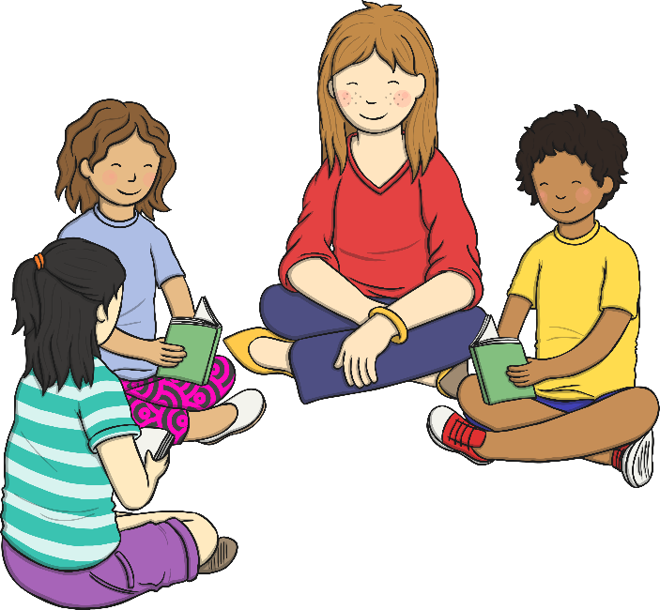
What Are You Looking Forward to in Your New Class?
Is there anything that you are really looking forward to doing in your new class?
Talk to your friends and teacher about how you are feeling.

