Slide 2
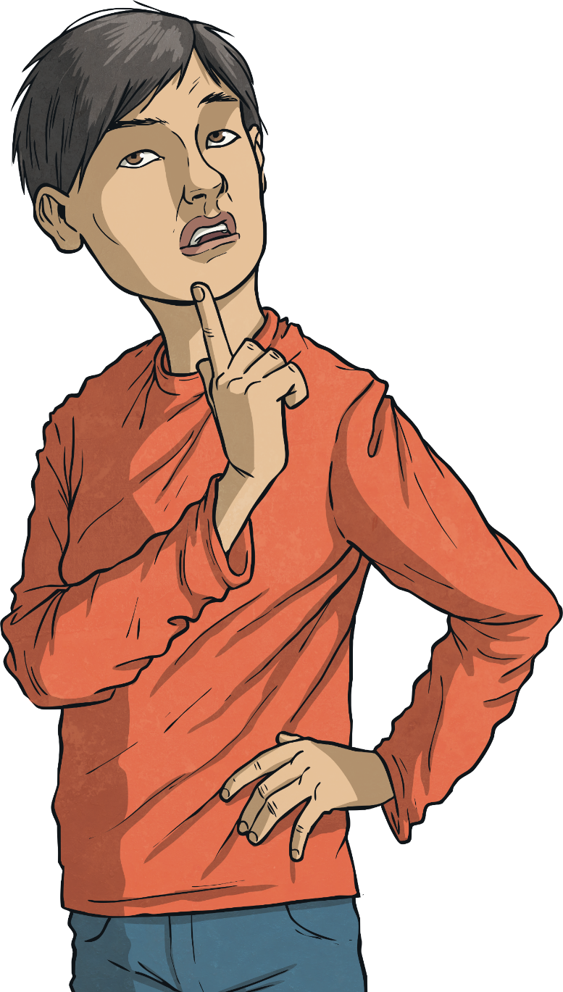
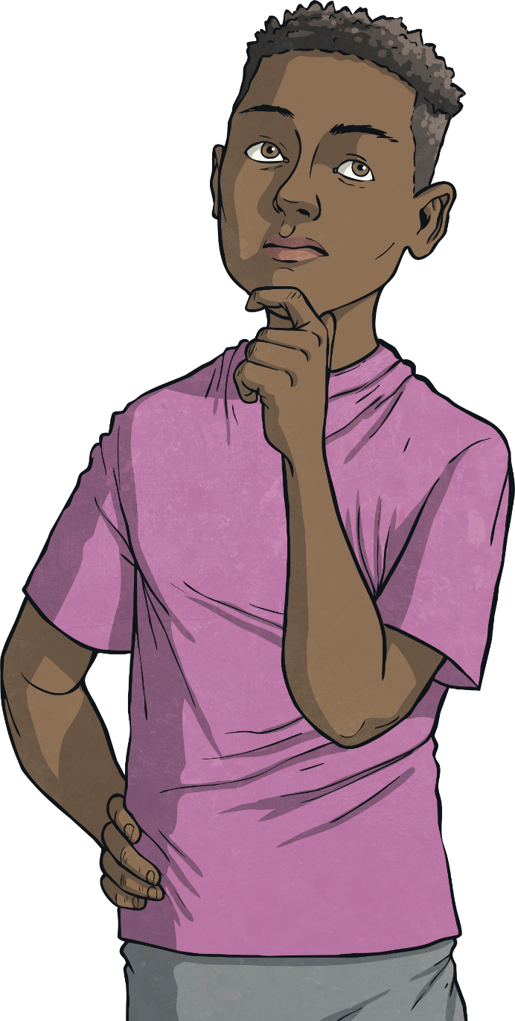
What are notes, coins, debit and credit cards, cheques and bank accounts?
What do they do?

Slide 3
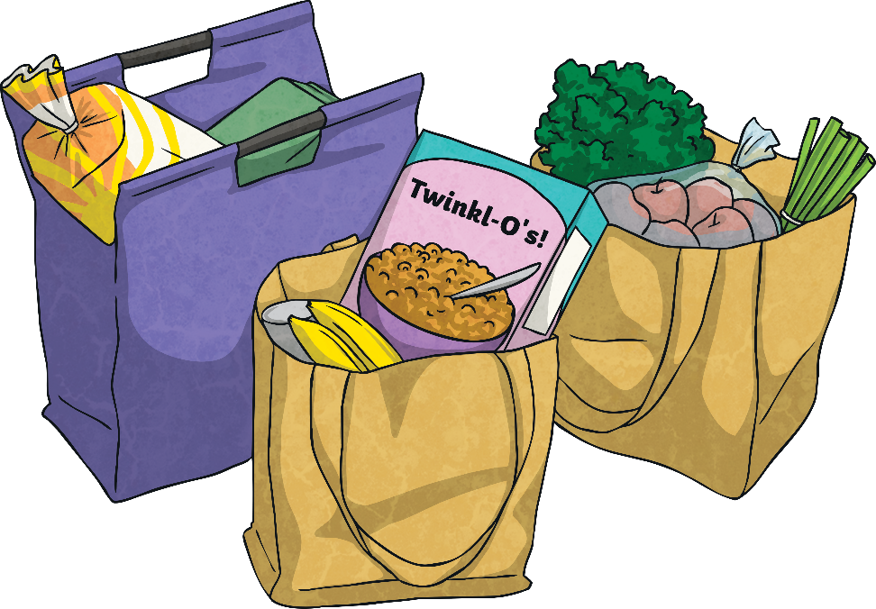
How Will You Pay?
You have just finished the weekly shopping trip for your family and are now at the checkout. How could you pay for your shopping?
Ways We Could Pay:

Slide 4
Ways to Pay
Ways to Pay
Description
A card that you can use to spend money ‘on credit’. This means money that you are being lent but is not yours. You can spend money on a credit card but then pay back the company that provides it in regular payments, with a rate of interest, which can sometimes be quite high.
Credit Card
Debit Card
This is a card that is linked to a bank account where you keep your money. A debit card allows you to spend your own money.
A bank account is a safe place to store your money. It is looked after by a bank and you can use your money when you want. This will often be by using a debit card or chequebook linked to the account.
Bank Account
Cheque
A cheque is a special piece of paper that you can write on to pay someone money from your bank account.
Interest – this can mean a fee for borrowing money that increases the longer it is not paid back.
Interest – this can also mean money you are given by your bank to encourage you to save money with them.

Slide 5
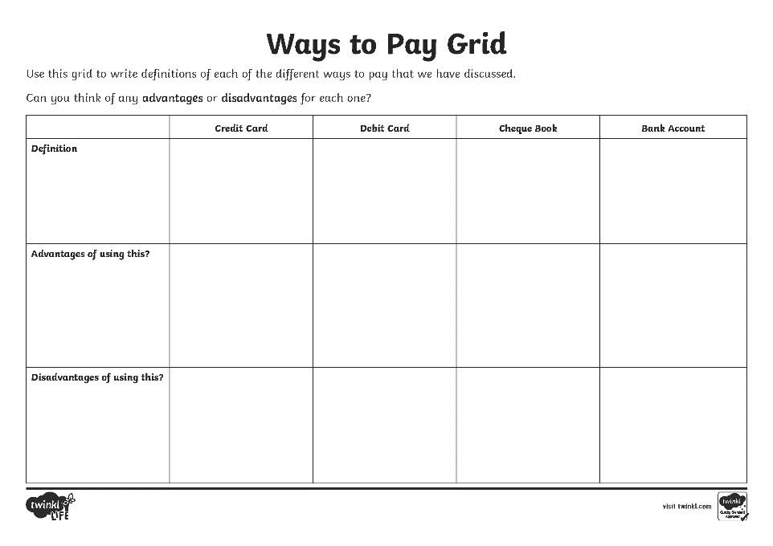
Which Way to Pay?
You are now going to show what you have learnt today by writing your own definitions for each of the payment methods and thinking about advantages and disadvantages of each.
Word Bank
cheque
debt
owe
interest
money
cash
credit
debit
save
borrow
bank account

Slide 6
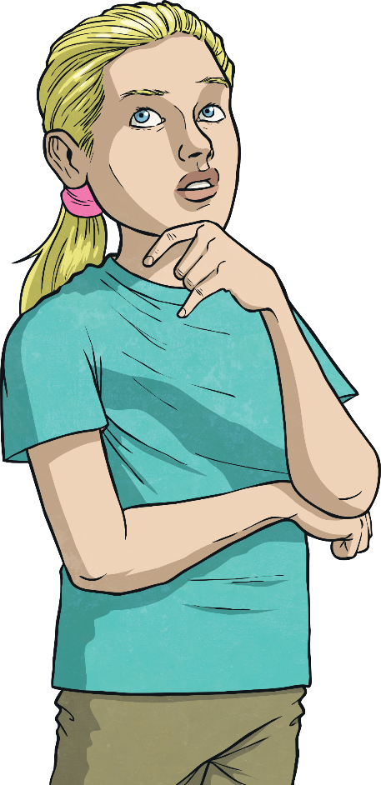
Why Pay That Way?
In this lesson you have learnt about some of the ways we can pay for things we want to buy. Think for a moment about what you have learnt about each of the different ways we can pay.
Now, let’s think about some different things people pay for and the ways they might choose to pay.
As each picture appears, think about why the shopper might have chosen a particular way to pay rather than another way.

Slide 7
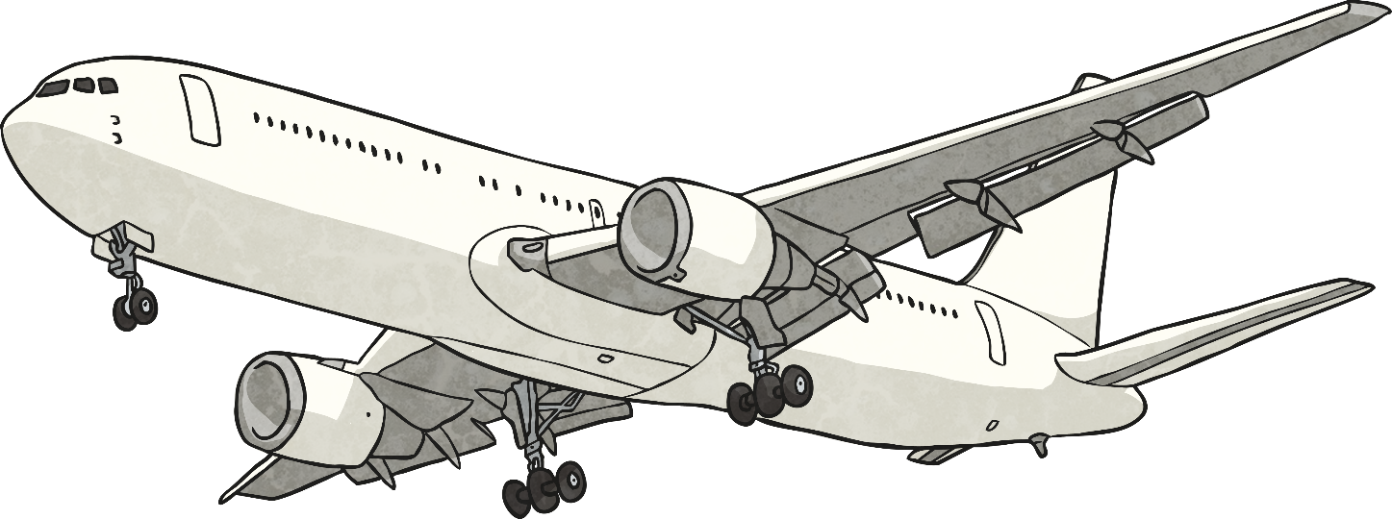
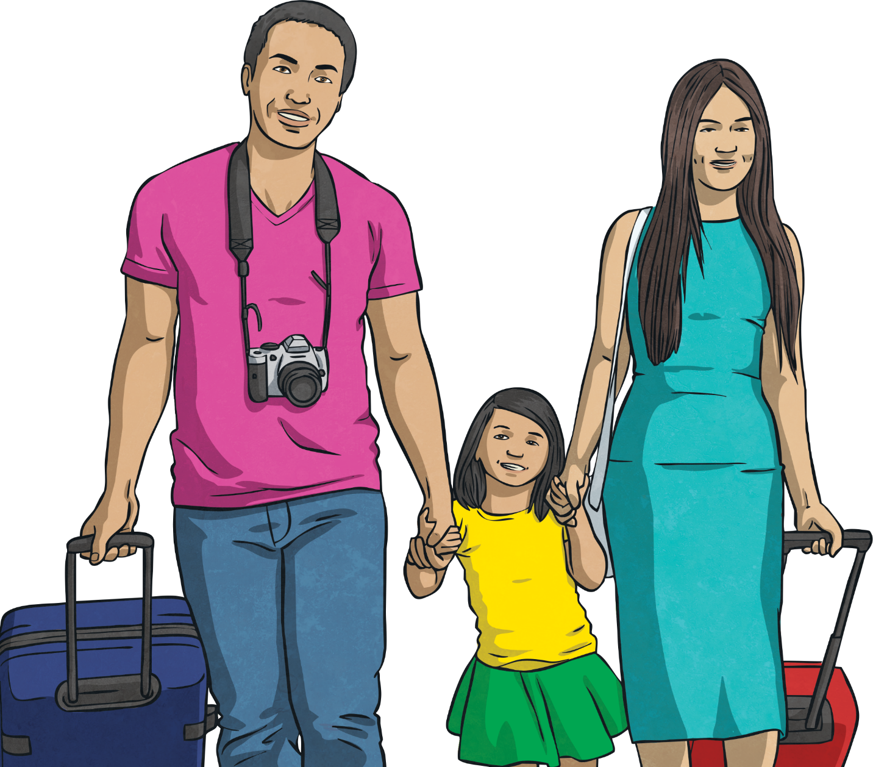
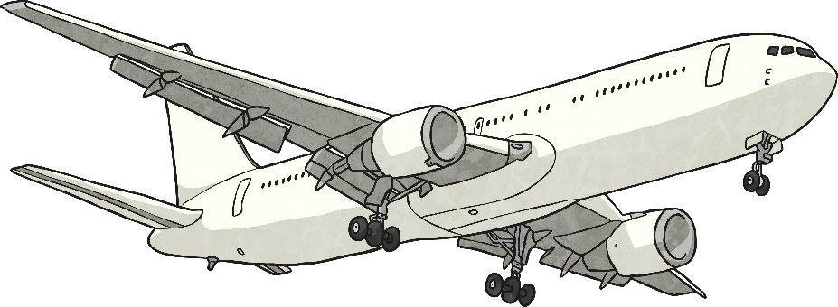
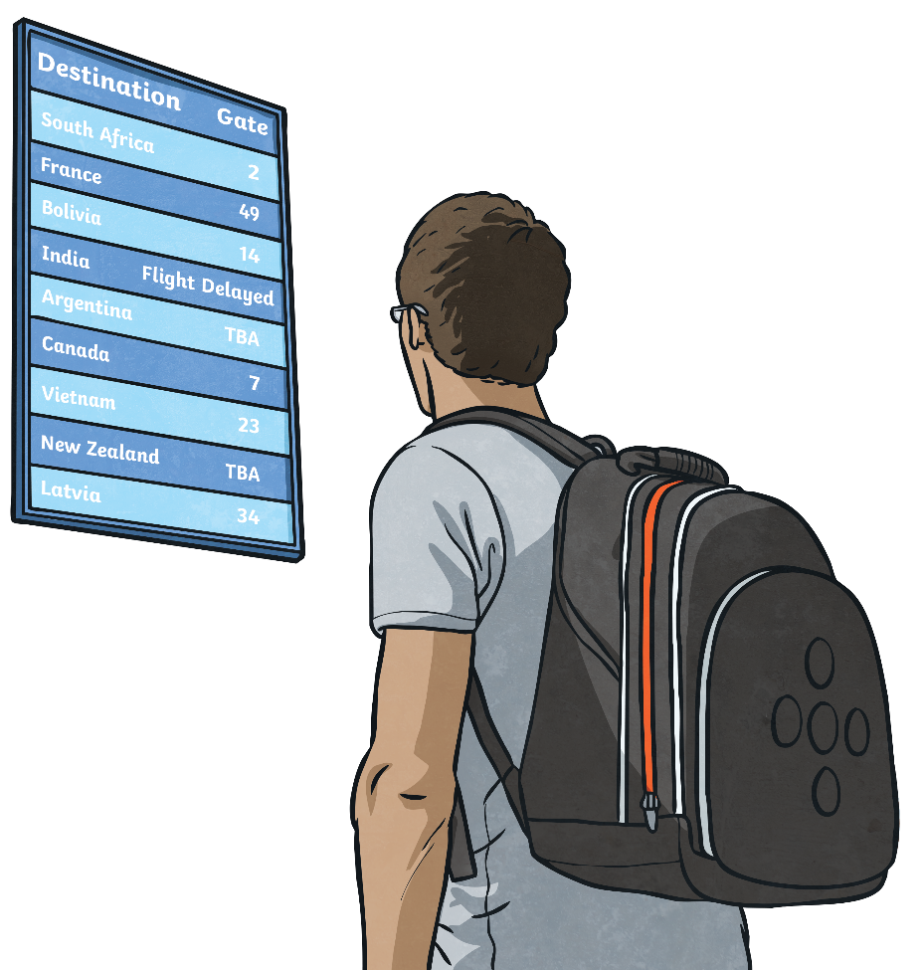

Slide 8
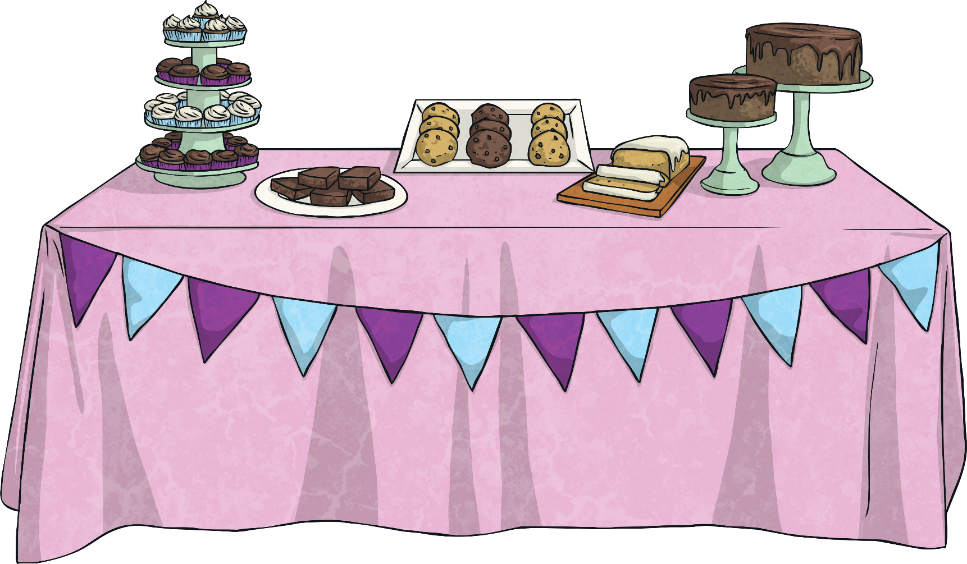
£2
90p
£1.20
70p
£1.50

Slide 9
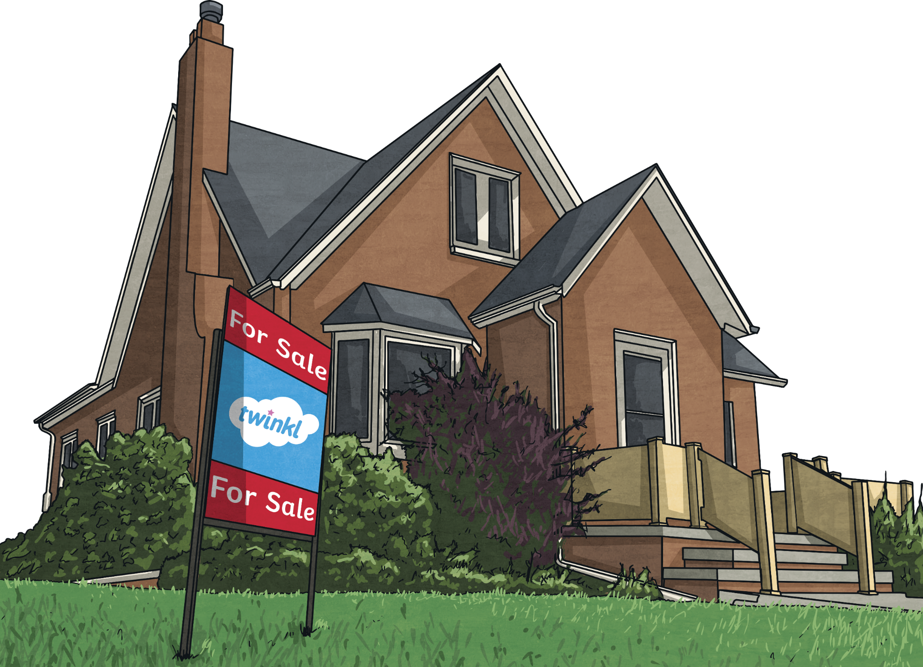

Slide 10
