Slide 2
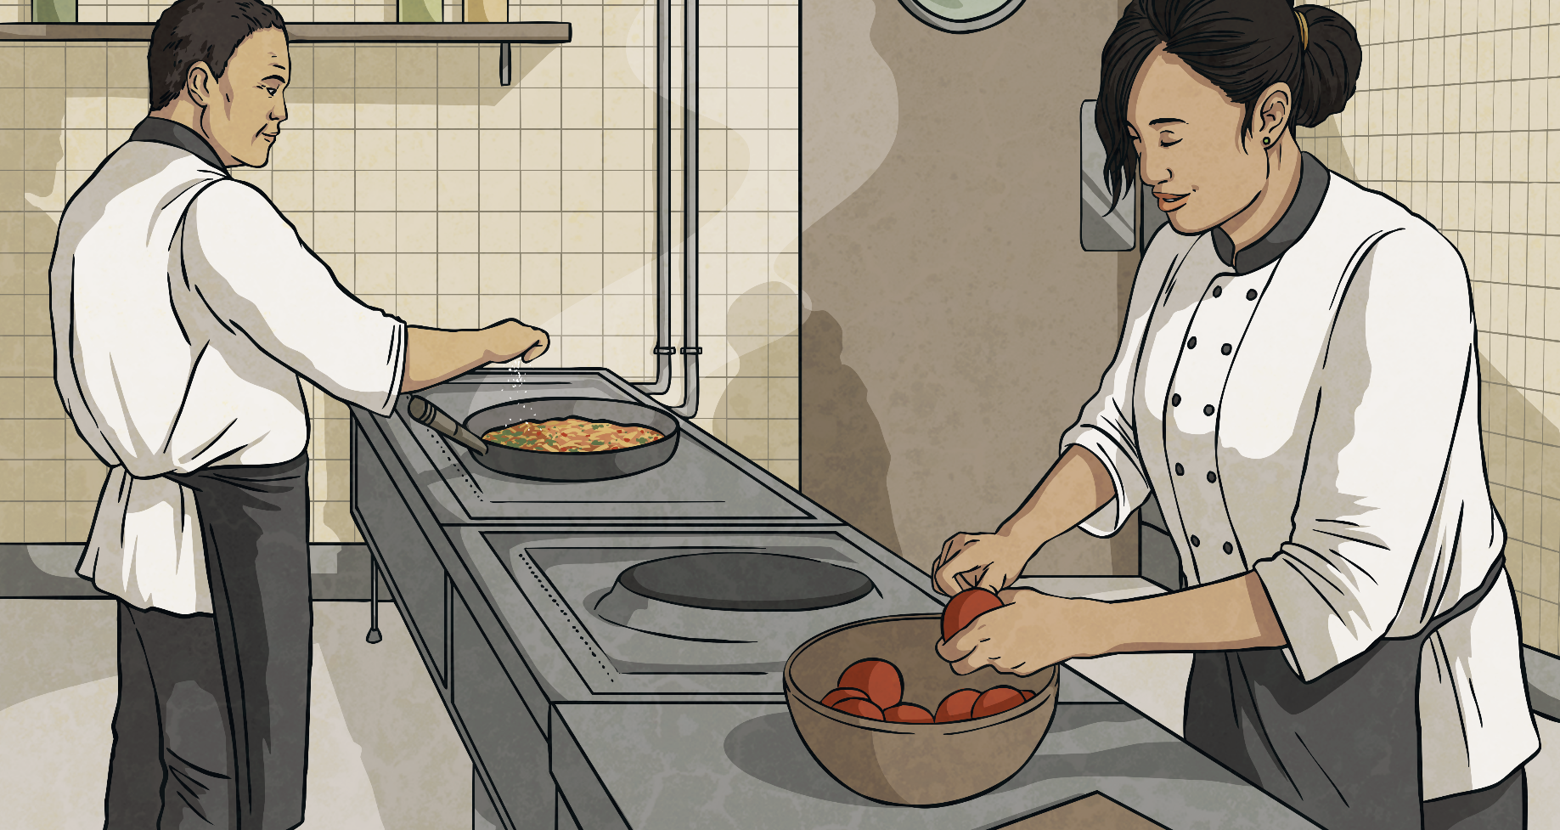
Closest to a Kilogram
The aim of the game is to get closest to a kilogram.
1kg = 1000g
Takes turns to roll a dice four times each. Choose where in a four-digit number to place each number you roll.
When you have created a four-digit number, the person who is closest to 1kg wins a point.
Click here for an example.

Slide 3
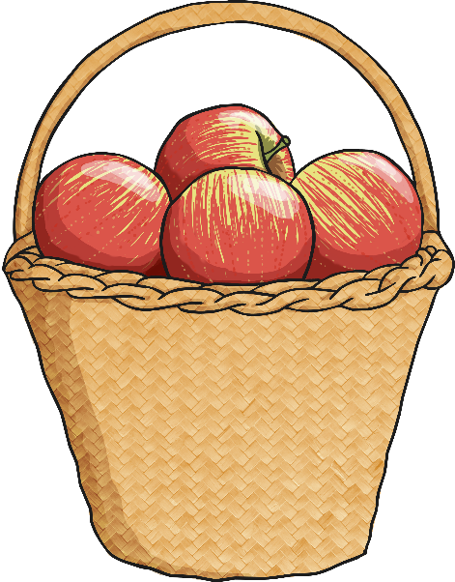
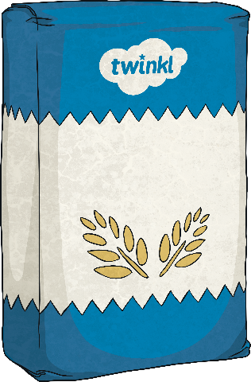
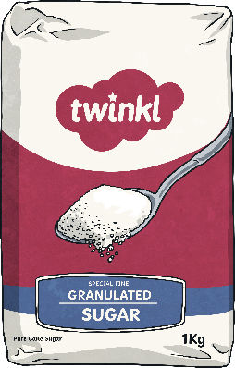
What’s the Mass?
?
What is the combined mass of all three items in kilograms?
6kg
?
How would you write this in grams?
6000g
sugar
1kg
flour
2kg
apples
3kg

Slide 4
What’s the Mass?
?
What is the combined mass of two bags of flour?
4kg
?
How would you write this in grams?
4000g
sugar
1kg
flour
2kg
apples
3kg

Slide 5
What’s the Mass?
?
What is the combined mass of 2 baskets of apples and 2 bags of flour?
10kg
?
How would you write this in grams?
10 000g
sugar
1kg
flour
2kg
apples
3kg

Slide 6
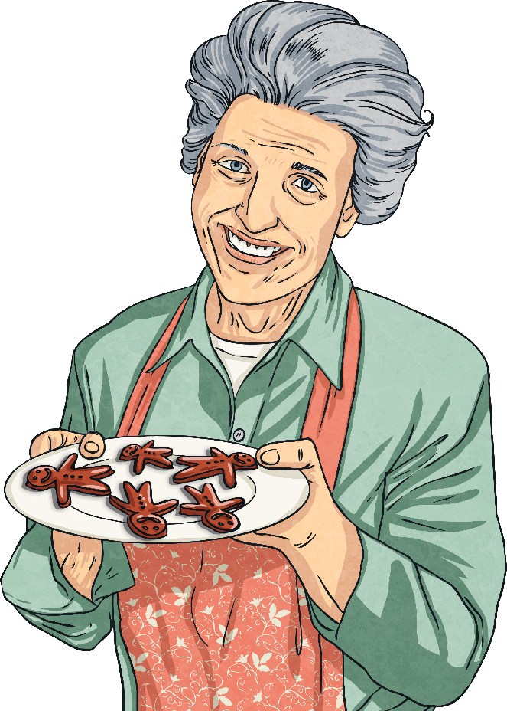
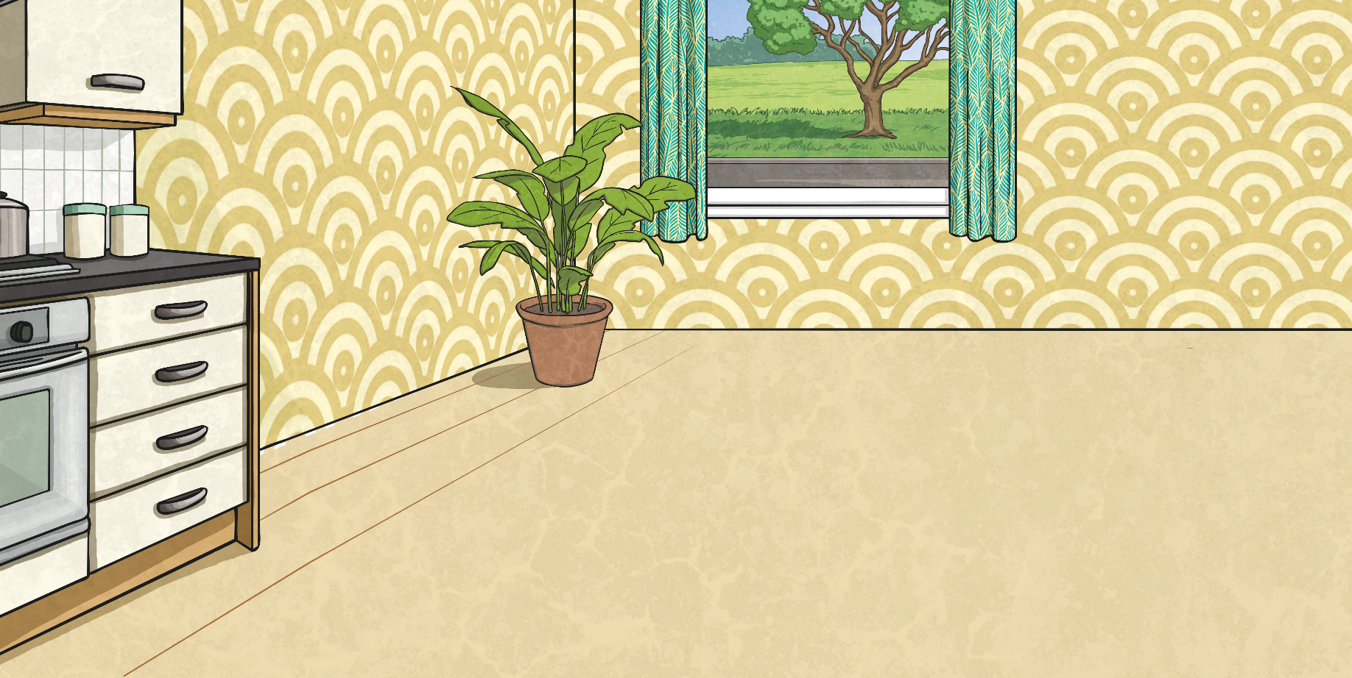
What’s the Mass?
Mixed Units
Sometimes, mass is given in mixed units: kg and g.
1kg 300g
2kg 600g
4kg 350g
How could we convert these measurements into grams?
We need to multiply the kilogram measurement by 1000, then add on the gram measurement.
1kg 300g = 1000g + 300g = 1300g

Slide 7
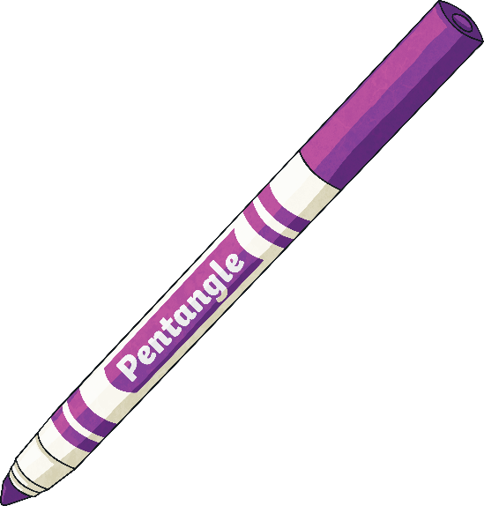
What’s the Mass?
Mixed Units
Write the following in grams:
2kg 450g
3kg 700g
5kg 250g
6kg 800g
7kg 210g
2450g
3700g
5250g
6800g
7210g

Slide 8
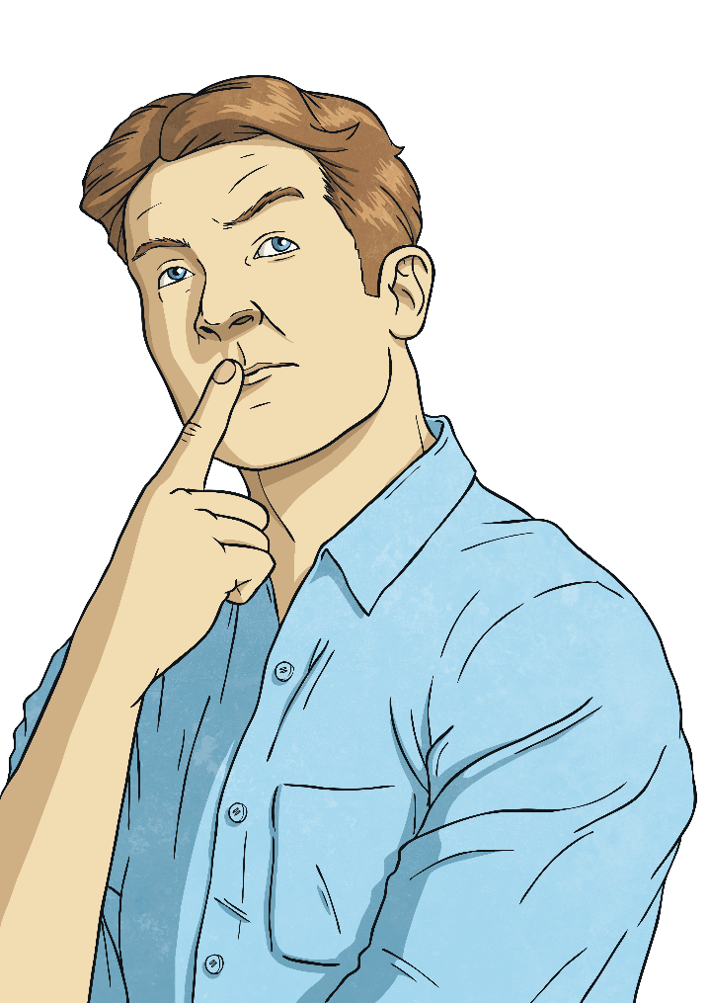
Converting Grams
to Kilograms
To convert from grams to kilograms, we divide the number of grams by 1000: 5000g ÷ 1000 = 5kg
If this creates a decimal number, the thousandths become grams:
2500g ÷ 1000 = 2.500 = 2kg 500g

Slide 9
Converting Grams
to Kilograms
Convert these grams measurements into kilograms:
8000g
4800g
6400g
4000g
7250g
9840g
8kg
4kg 800g
6kg 400g
4kg
7kg 250g
9kg 840g

Slide 10
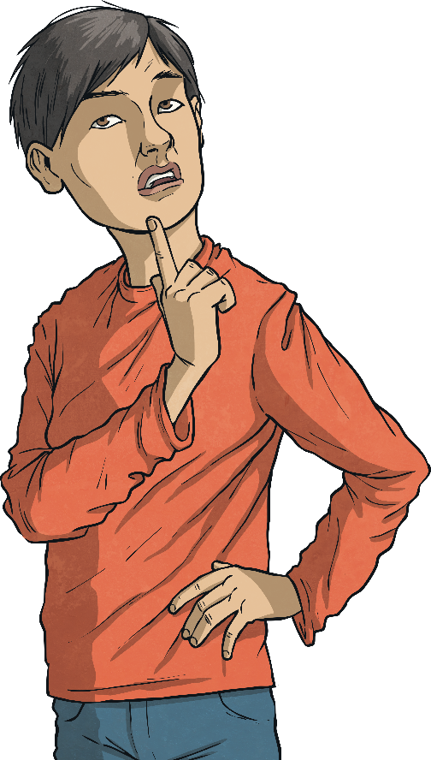
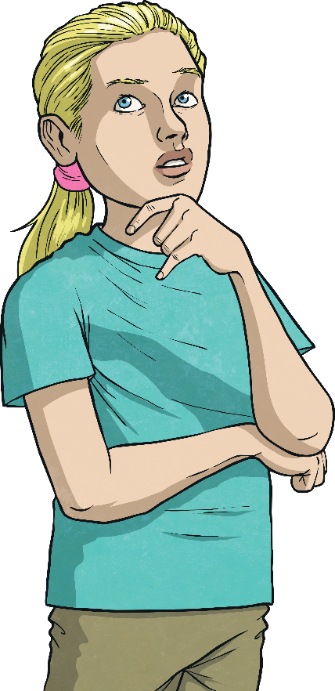
Ordering Mixed Units
Order these mass measurements from the lightest to heaviest:
2400g
4kg 100g
7kg
3kg 450g
5kg
850g
7kg
2400g
850g
3kg 450g
5kg
4kg 100g

