Slide 2
National Curriculum Objective
Interpret and present discrete and continuous data using appropriate graphical methods, including bar charts and time graphs.

Slide 3
Today we are going to be looking at the following types of graphs Pictograms Tables Bar charts. You should remember looking at each one in year 3!

Slide 4
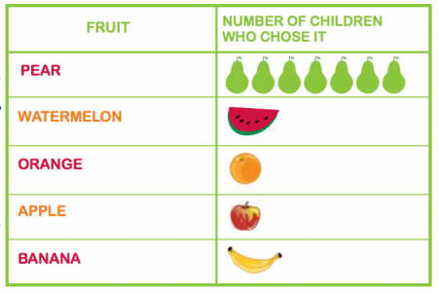
Pictograms A pictogram is a chart that uses pictures to represent data. Pictograms are set out the same as bar charts but use pictures to show numbers.

Slide 5
Tables A table is very similar to a pictogram but it uses numbers and words in boxes to show the data.

Slide 6
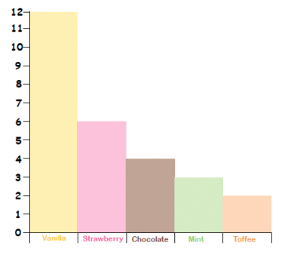
Bar graphs A bar graph displays information (data) by using rectangular bars of different heights. It has a verticle axis with numbers on it and a horizontal axis showing values of something that has been investigated.

Slide 7
Interpret Charts
Deeper
Leo has recorded the favourite types of birthday cake in his class.
These are the types of cake and the number of children who voted for each.
Chocolate: 5 boys and 10 girls
Sponge: 6 boys and 3 girls
Fruitcake: 1 boy and 2 girls
Would you present this data in a table, bar chart or pictogram? Click to see examples of each:
Table
Bar Chart
Pictogram

Slide 8
Interpret Charts
Deeper
Table
Type of Cake | Boys Who Liked It | Girls Who Liked It
Chocolate | 5 | 10
Sponge | 6 | 3
Fruitcake | 1 | 2
What is clear?
What is unclear?
Discuss the reasons for and against using the method to present results.

Slide 9
Interpret Charts
Deeper
Bar Chart
What is clear?
What is unclear?
Discuss the reasons for and against using the method to present results.
Number of Children

Slide 10
Interpret Charts
Deeper
Pictogram
Type of Cake | Number of Children Who Liked It
Chocolate
Sponge
Fruitcake
Key
= 1 boy
= 1 girl
What is clear?
What is unclear?
Discuss the reasons for and against using the method to present results.

