Slide 1
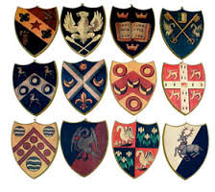
I can create my own coat of arms
Sunday, 12 July 2020

Slide 2
What is a coat of arms?
Coats of Arms date back to the early medieval period.
(Pre-Tudor)
At this time, people wore helmets and other armour in battle, which made it hard to tell friends from enemies.
To help stop this each knight and solider painted something personal on their shield.

Slide 3
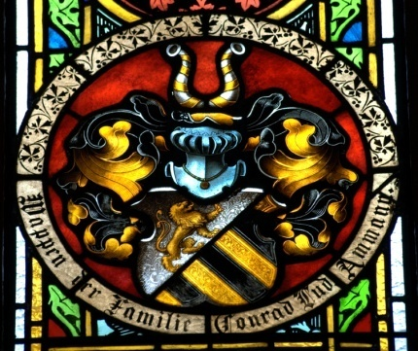
Not just for armour!
By Tudor times, it had become fashionable for rich families to have a coat of arms.
It was included on items in the house, saddles, blankets, rings and (wax seal) stamps.

Slide 4
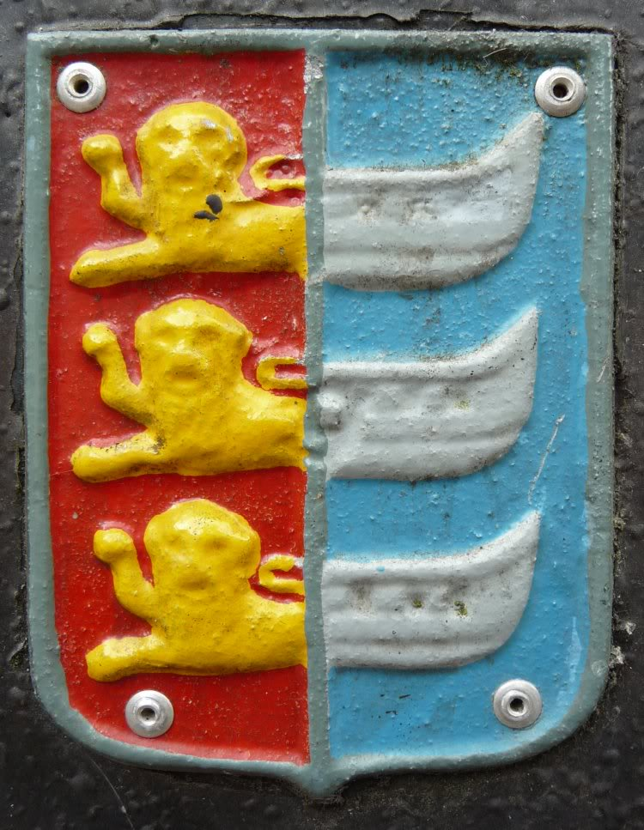
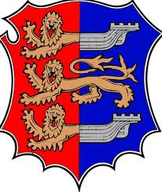
Hastings has a coat of arms
You can see it at the Town Hall
It is even printed on lamp posts (check next time you walk down Robertson Street!)

Slide 5
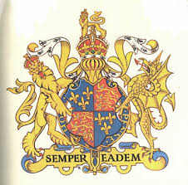
This is Queen Elizabeth I’s coat of arms
The motto in Latin means ‘always the same’

Slide 6
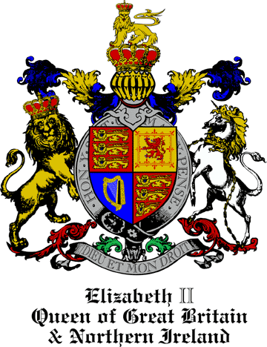
This is the Queen’s coat of arms
The motto here means God and my Right and it refers to the Divine Right of Kings to rule – as we learnt during Macbeth, Kings believed they were chosen by God.
England
Ireland
Scotland

Slide 7
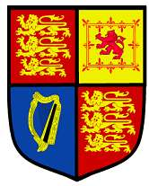
Coats of arms were used to identify people and families and a way of showing off your power and wealth!
The colours have meanings
The animals have meanings
The symbols have meanings
Symbols were easily recognisable and understandable when the majority of people could not read.
Nowadays, we do this too – think of car symbols and company logos.

Slide 8
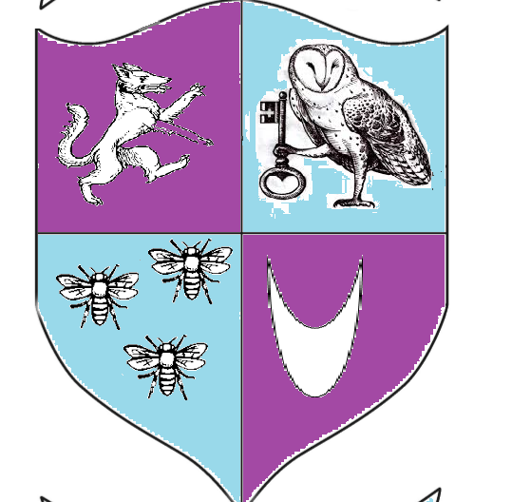
Miss Butler’s Coat of Arms
(I made it up – it celebrates learning –the fox symbolises wisdom, the bees, hard work and the owl being observant. The crescent is because I am the second born in my family.)
You can choose animals or objects to represent the values and activities that are most important to you.
You can say if you are the first born, second born, third born, fourth born etc. using a symbol.

Slide 9
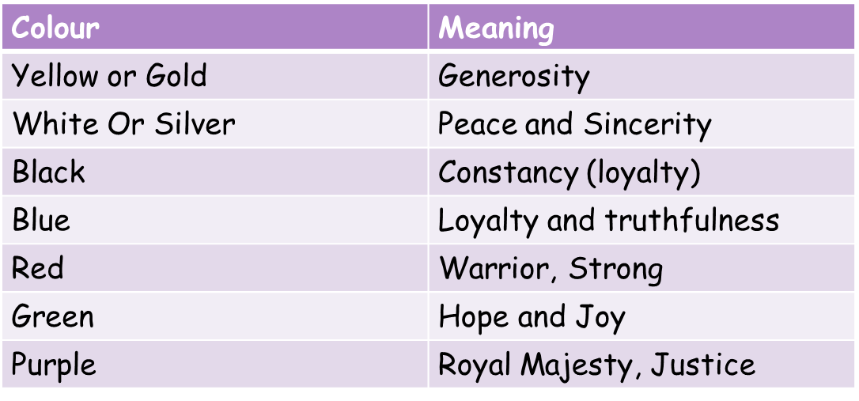
Colours and their meanings

Slide 10
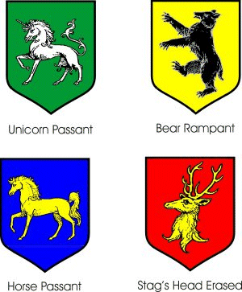
Animals and their meanings
Bear | Protectiveness
Dog | Loyal
Double Eagle/Eagle | Leader and Decisiveness
Dragon | Defender of treasure
Fox | Clever
Lion | Courage
Snake | Ambition
Unicorn | Extreme courage

Slide 11
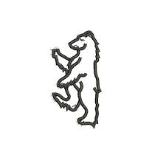


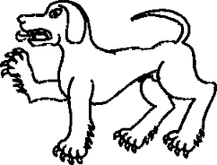
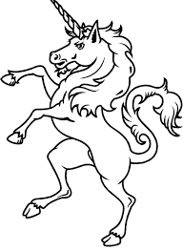

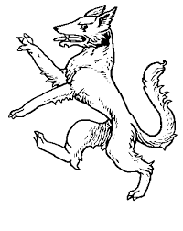
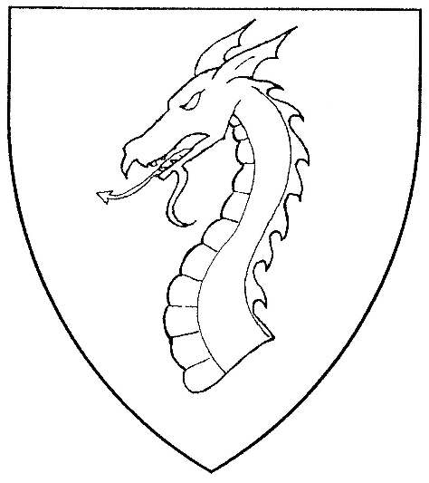
lion - courage
Snake - Ambition
Dog - loyalty
Bear - protectiveness
unicorn - extreme courage
Fox - clever
Eagle - leader
Dragon - guard

Slide 12
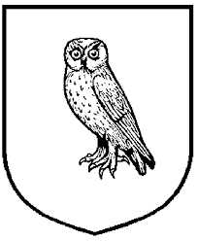









owl - vigilance
Dolphin - charity
Dove - innocence
Dagger - power
Anchor – hope
Royal, or religious, or pure.
First Born
Second Born
Third Born
Fourth Born
Fifth Born

Slide 13
