Slide 1
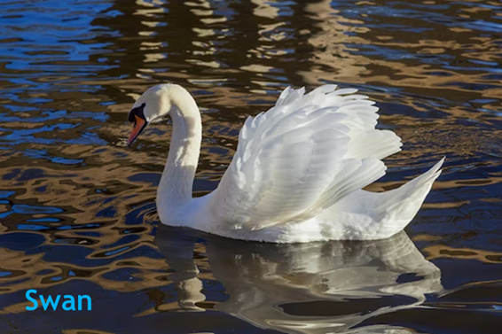
Swan - Wesley
https://www.britannica.com/animal/swan
https://www.rspb.org.uk/birds-and-wildlife/wildlife-guides/bird-a-z/mute-swan/

Slide 2
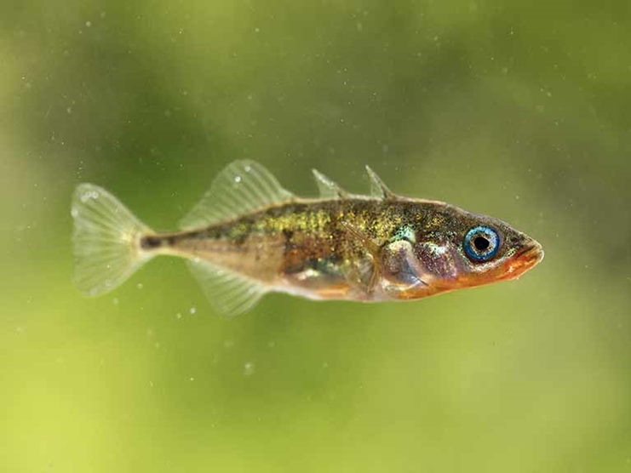
Stickleback - Amelia
https://www.wildlifetrusts.org/wildlife-explorer/freshwater-fish/three-spined-stickleback
https://www.britannica.com/animal/stickleback

Slide 3
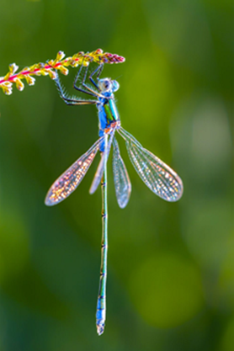
Dragonfly - Rudy
https://www.treehugger.com/things-you-never-knew-about-dragonflies-4864302
https://british-dragonflies.org.uk/odonata/dragonflies-2/
https://www.nationalgeographic.com/animals/invertebrates/facts/dragonflies-insects

Slide 4
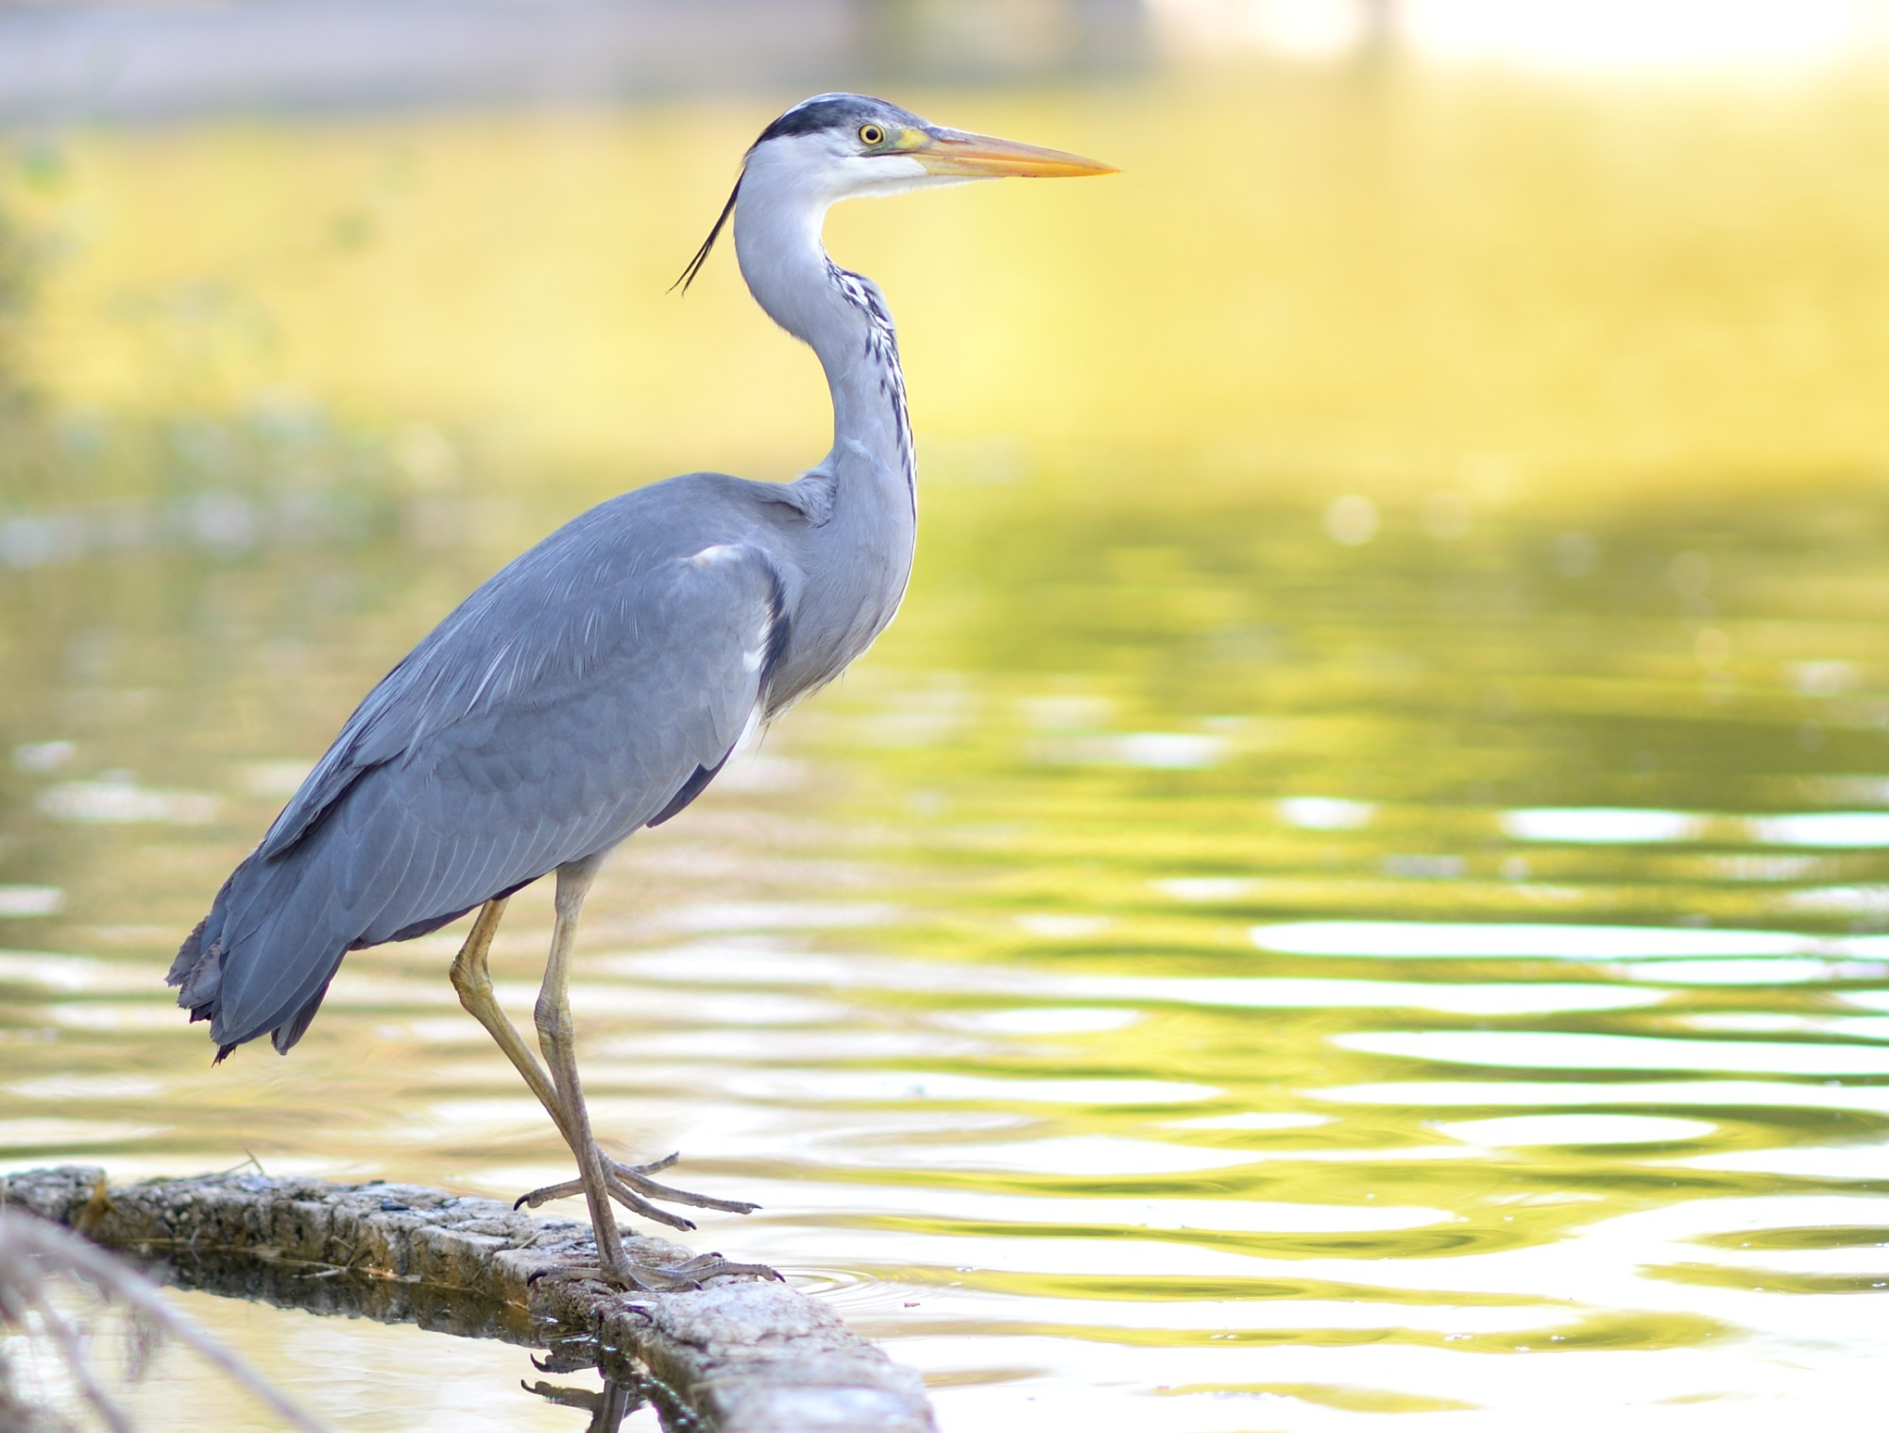
Heron - Violet
https://www.rspb.org.uk/birds-and-wildlife/wildlife-guides/bird-a-z/grey-heron/
https://www.britannica.com/animal/heron
https://canalrivertrust.org.uk/enjoy-the-waterways/canal-and-river-wildlife/a-spotters-guide-to-waterway-wildlife/heron-waterway-wildlife

Slide 5
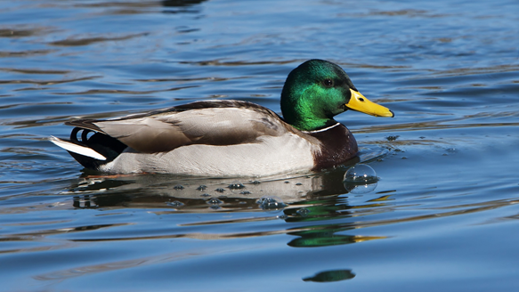
Mallard - Alice
https://www.rspb.org.uk/birds-and-wildlife/wildlife-guides/bird-a-z/mallard/
https://www.wildlifetrusts.org/wildlife-explorer/birds/waterfowl/mallard
https://www.waterfowl.org.uk/wildfowl/true-ducks/mallard/

Slide 6
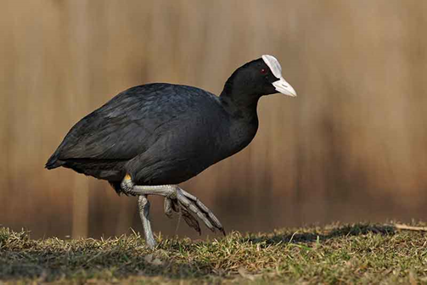
Coot - Reuben
https://www.rspb.org.uk/birds-and-wildlife/wildlife-guides/bird-a-z/coot/
https://www.wildlifetrusts.org/wildlife-explorer/birds/wading-birds/coot
https://www.birdspot.co.uk/bird-identification/coot

Slide 7
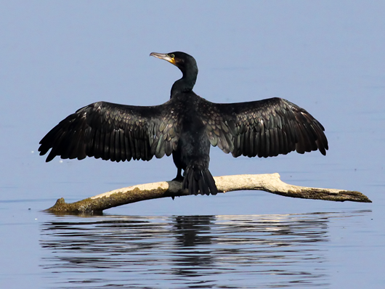
Cormorant - Remy
https://www.rspb.org.uk/birds-and-wildlife/wildlife-guides/bird-a-z/cormorants-and-shags/
https://www.wildlifetrusts.org/wildlife-explorer/birds/seabirds/cormorant
https://www.britannica.com/animal/cormorant

Slide 8
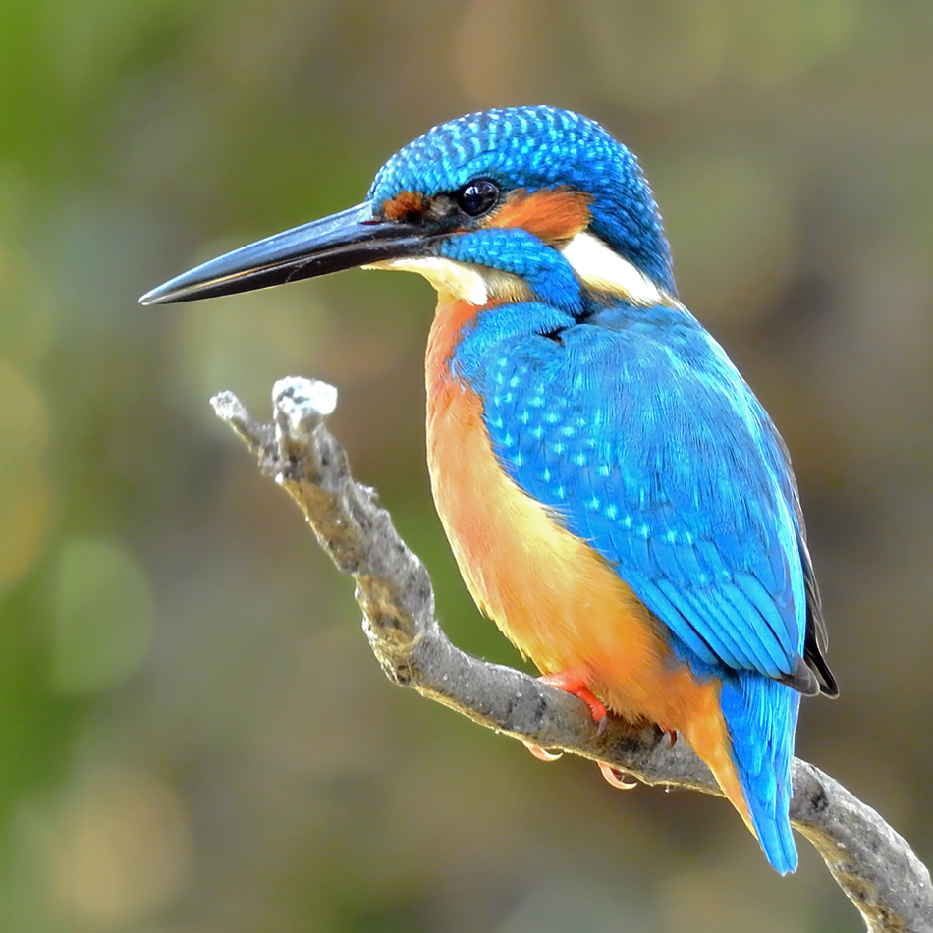
Kingfisher - Buddy
https://www.rspb.org.uk/birds-and-wildlife/wildlife-guides/bird-a-z/kingfisher/
https://www.wildlifetrusts.org/wildlife-explorer/birds/woodpeckers-cuckoo-kingfisher-and-waxwing/kingfisher
https://www.woodlandtrust.org.uk/trees-woods-and-wildlife/animals/birds/kingfisher/

Slide 9
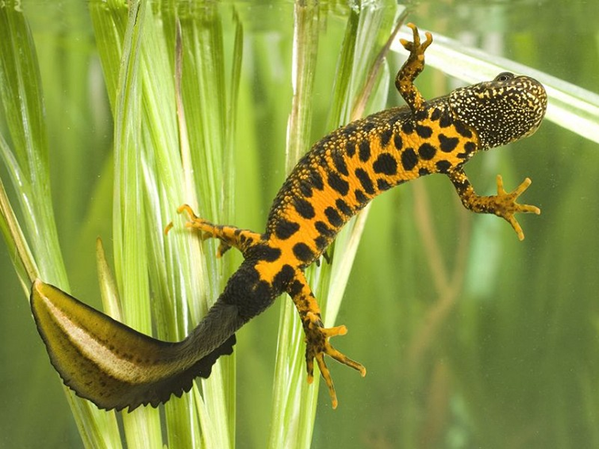
Crested Newt - Lily
https://www.discoverwildlife.com/animal-facts/amphibians/facts-about-great-crested-newts/
https://www.woodlandtrust.org.uk/blog/2020/02/british-newt-id/

Slide 10
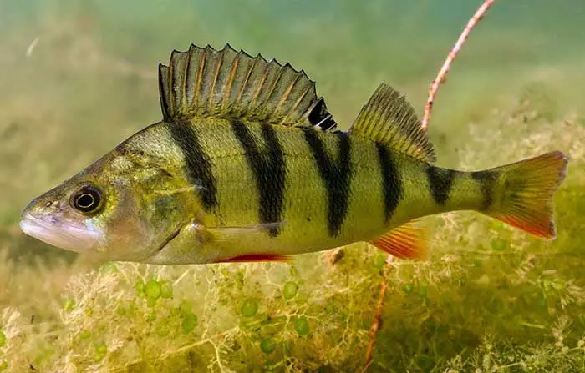
Perch - Florence
https://canalrivertrust.org.uk/enjoy-the-waterways/fishing/caring-for-our-fish/freshwater-fish-species/perch
https://www.wildlifetrusts.org/wildlife-explorer/freshwater-fish/perch
https://www.britannica.com/animal/perch

Slide 11
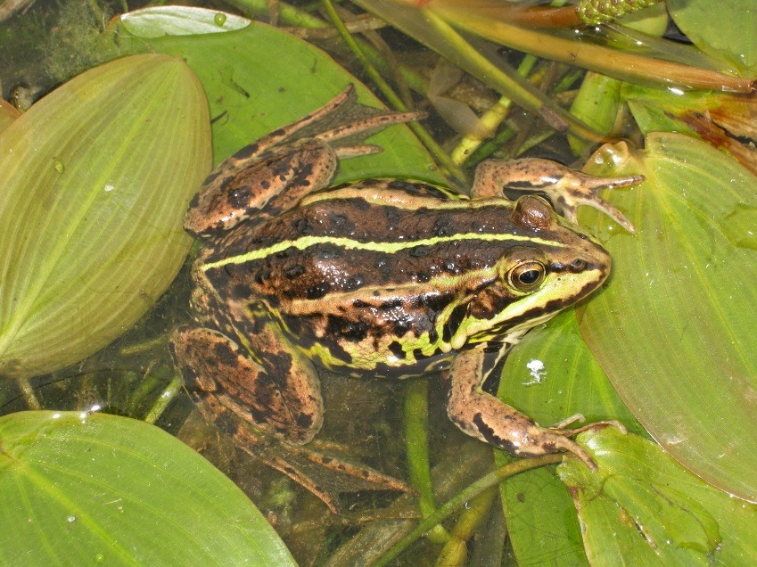
Frog - Ruby
https://www.wildlifetrusts.org/wildlife-explorer/amphibians/common-frog
https://www.rspb.org.uk/birds-and-wildlife/wildlife-guides/other-garden-wildlife/amphibians-and-reptiles/common-frog/

Slide 12
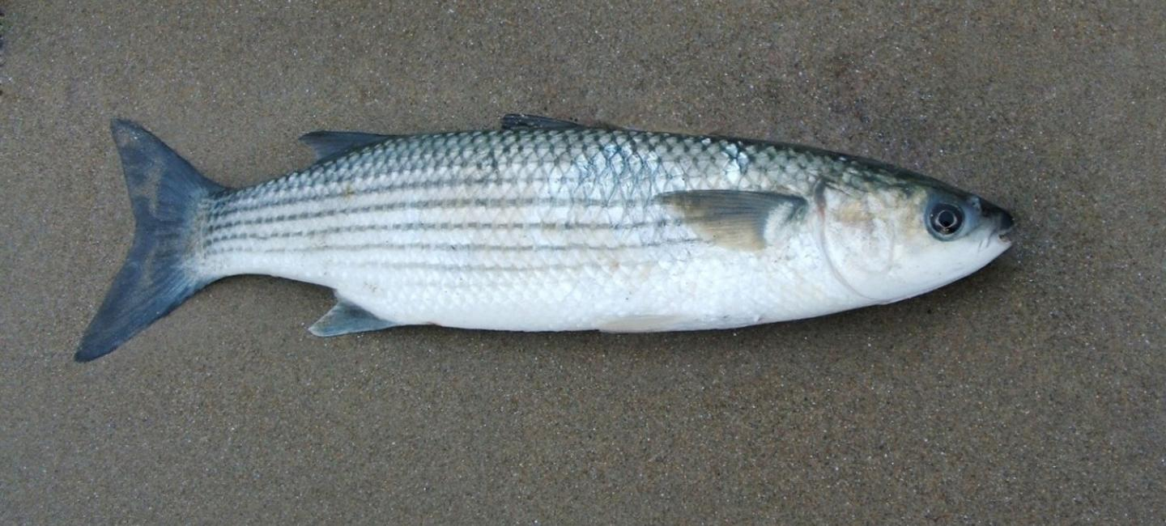
Trout - Sam
https://www.woodlandtrust.org.uk/trees-woods-and-wildlife/animals/fish/brown-trout/
https://canalrivertrust.org.uk/enjoy-the-waterways/fishing/caring-for-our-fish/freshwater-fish-species/brown-trout

Slide 13
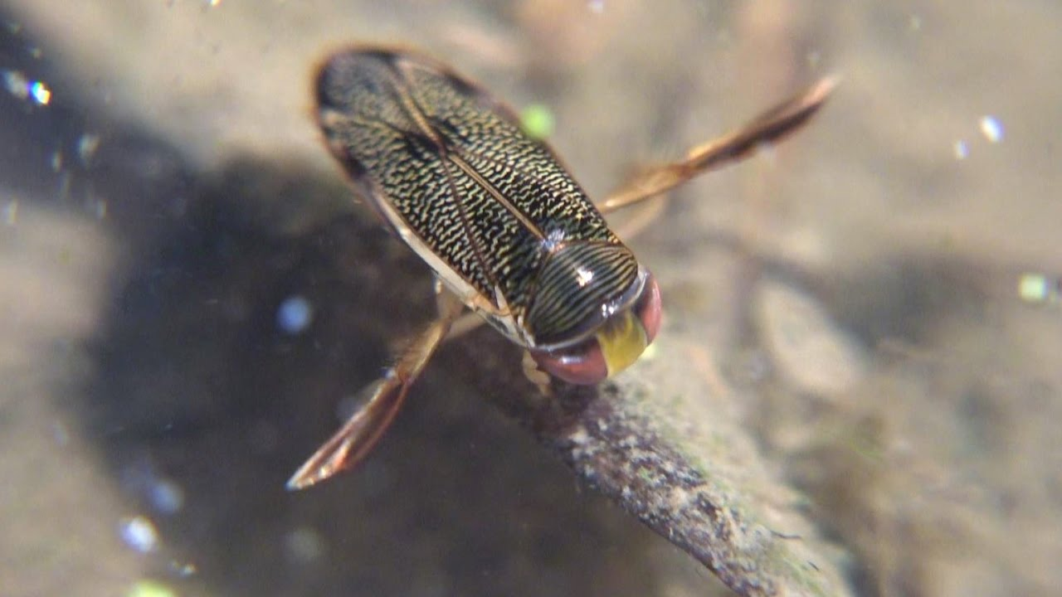
Water Boatman - Lucas
https://www.rspb.org.uk/birds-and-wildlife/wildlife-guides/other-garden-wildlife/insects-and-other-invertebrates/beetles-and-bugs/water-boatman/
https://www.britannica.com/animal/water-boatman
https://www.wildlifetrusts.org/wildlife-explorer/invertebrates/bugs/lesser-water-boatman

Slide 14
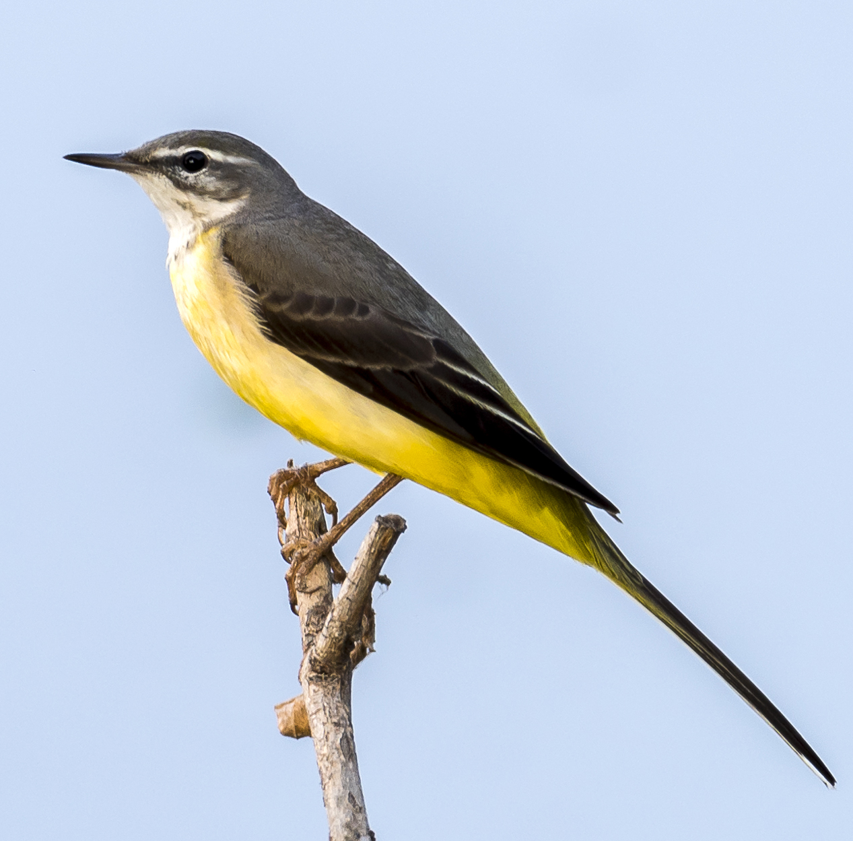
Grey Wagtail - Conor
https://www.rspb.org.uk/birds-and-wildlife/wildlife-guides/bird-a-z/grey-wagtail/
https://www.wildlifetrusts.org/wildlife-explorer/birds/larks-sparrows-pipits-wagtails-and-dunnock/grey-wagtail

Slide 15
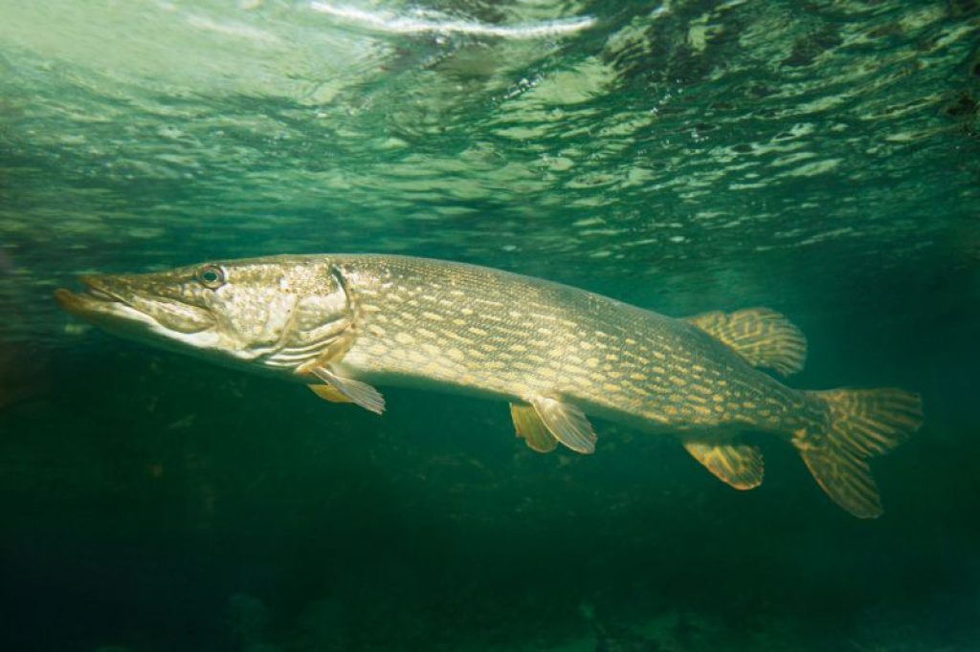
Pike - Sofia
https://www.wildlifetrusts.org/wildlife-explorer/freshwater-fish/pike
https://canalrivertrust.org.uk/enjoy-the-waterways/fishing/caring-for-our-fish/freshwater-fish-species/pike

Slide 16
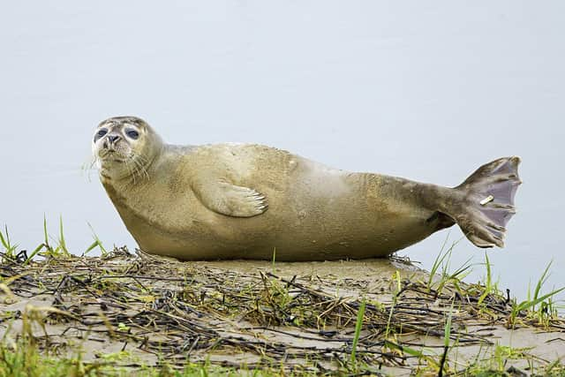
Seal - Hunter
https://www.rspca.org.uk/adviceandwelfare/wildlife/seals
https://www.wildlifetrusts.org/wildlife-explorer/marine/marine-mammals-and-sea-turtles/common-seal

Slide 17
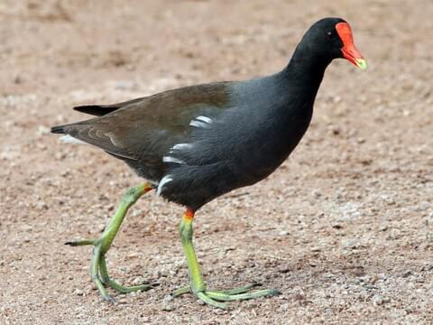
Moorhen - Joseph
https://www.rspb.org.uk/birds-and-wildlife/wildlife-guides/bird-a-z/moorhen/
https://www.wildlifetrusts.org/wildlife-explorer/birds/wading-birds/moorhen

Slide 18
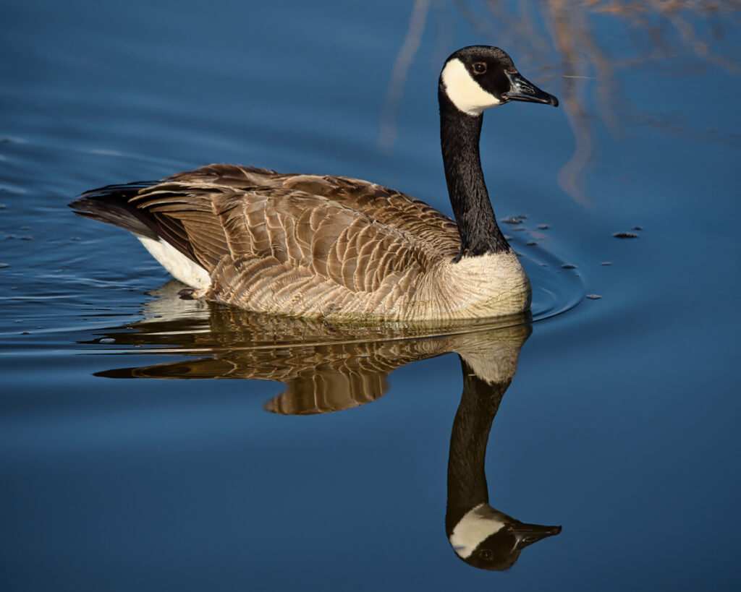
Canada Goose – Heloise?
https://www.rspb.org.uk/birds-and-wildlife/wildlife-guides/bird-a-z/canada-goose/
https://www.wildlifetrusts.org/wildlife-explorer/birds/waterfowl/canada-goose

Slide 19
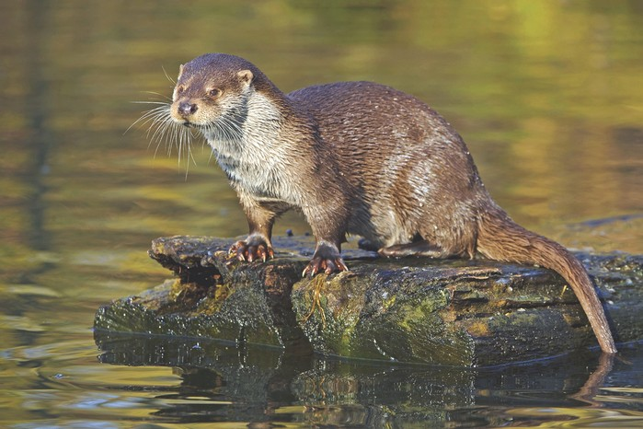
Otter -
https://www.wildlifetrusts.org/wildlife-explorer/mammals/european-otter

Slide 20
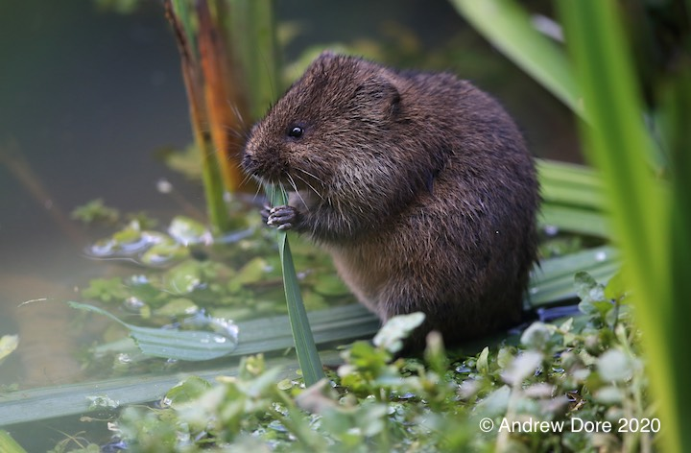
Water Vole - Bo
https://www.wildlifetrusts.org/wildlife-explorer/mammals/water-vole
https://ptes.org/get-informed/facts-figures/water-vole/

Slide 21
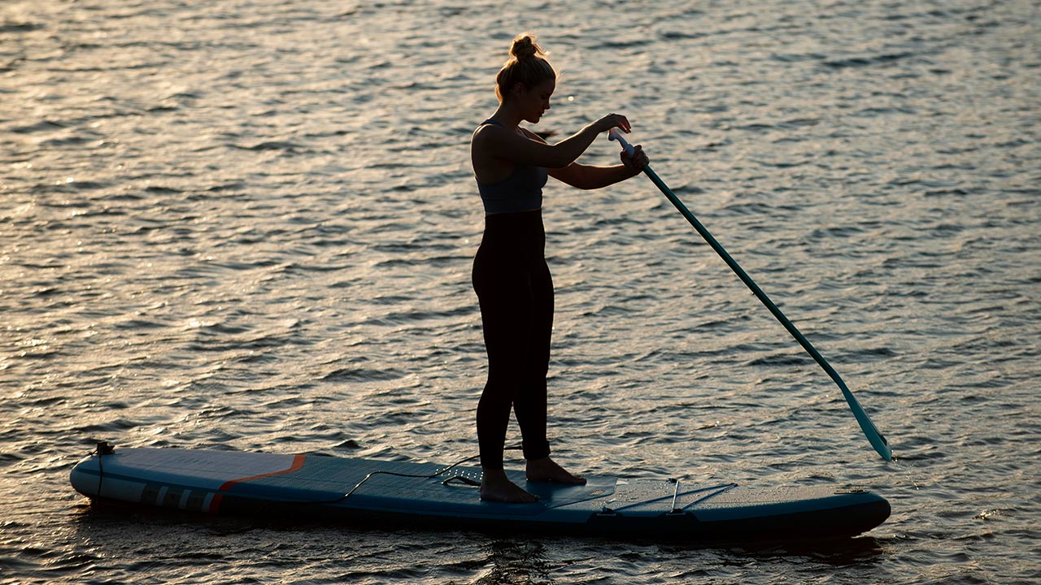
Paddleboarder - Isaac

Slide 22
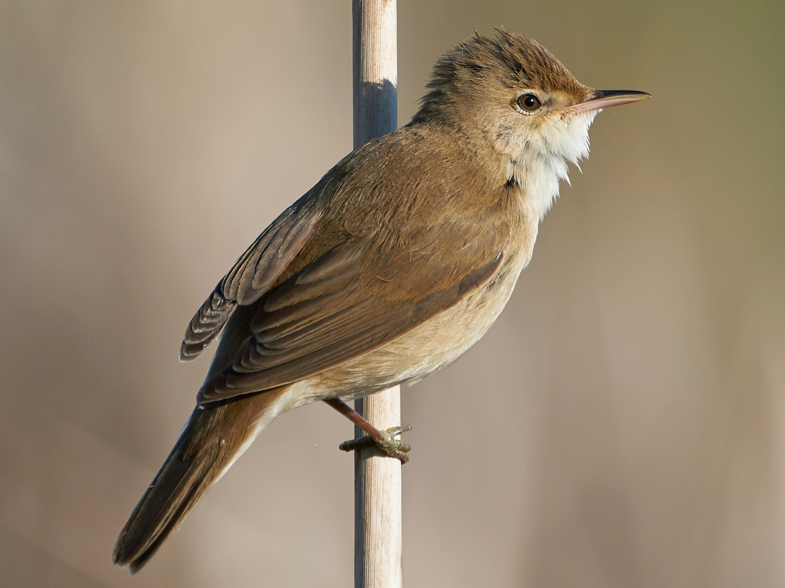
Reed Warbler - Walter
https://www.rspb.org.uk/birds-and-wildlife/wildlife-guides/bird-a-z/reed-warbler/
https://www.wildlifetrusts.org/wildlife-explorer/birds/tits-crests-and-warblers/reed-warbler

Slide 23
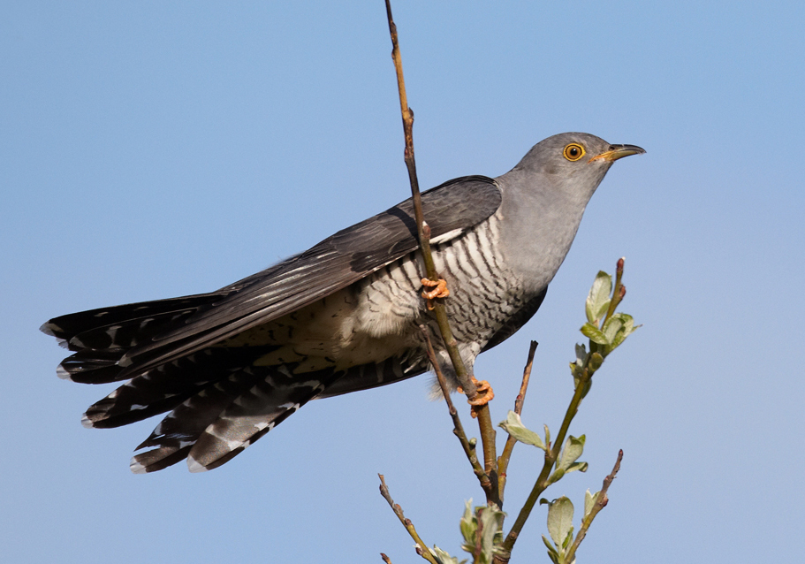
Cuckoo - William
https://www.wildlifetrusts.org/wildlife-explorer/birds/woodpeckers-cuckoo-kingfisher-and-waxwing/cuckoo
https://www.woodlandtrust.org.uk/trees-woods-and-wildlife/animals/birds/cuckoo/

Slide 24
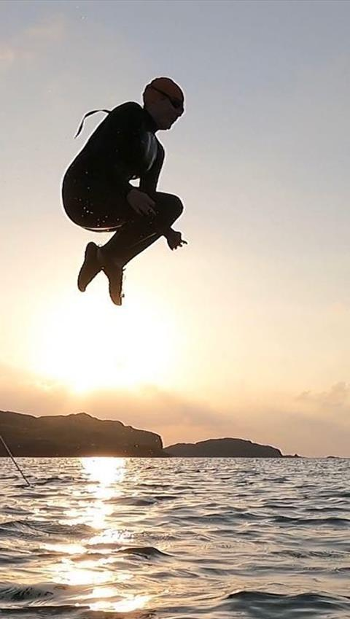
Wild Swimmer - Alex
https://www.bbc.com/travel/article/20210603-why-wild-swimming-is-britains-new-craze
https://www.wildswimming.co.uk/wild-swimming-for-beginners/

Slide 25
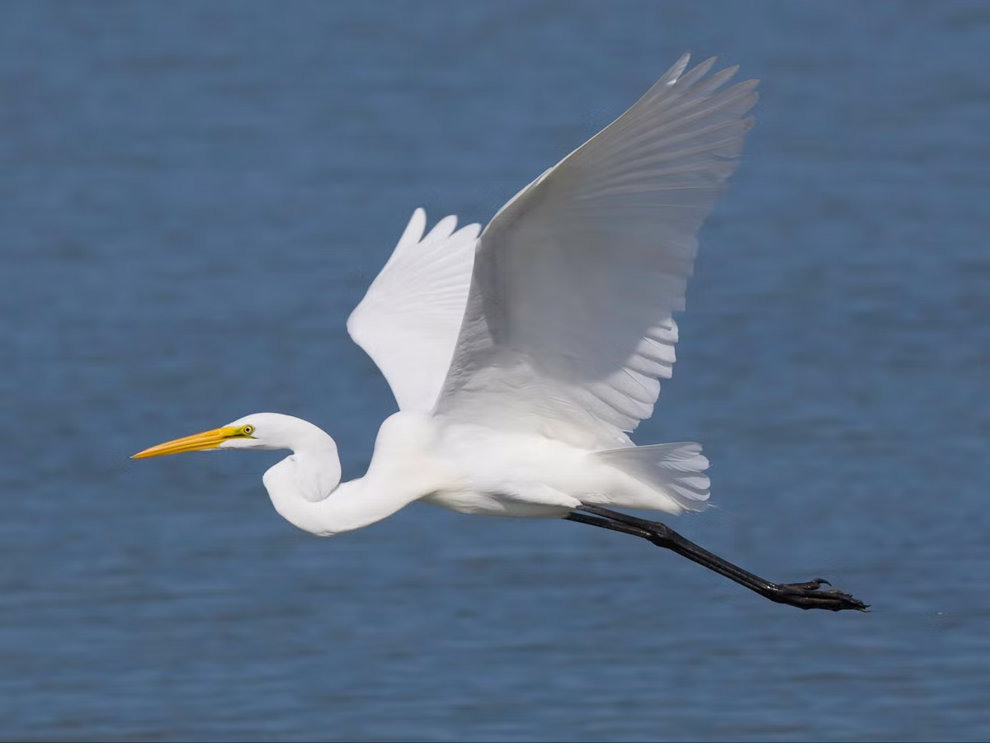
Little Egret - Amber
https://www.rspb.org.uk/birds-and-wildlife/wildlife-guides/bird-a-z/little-egret/
https://www.bto.org/understanding-birds/birdfacts/little-egret

Slide 26
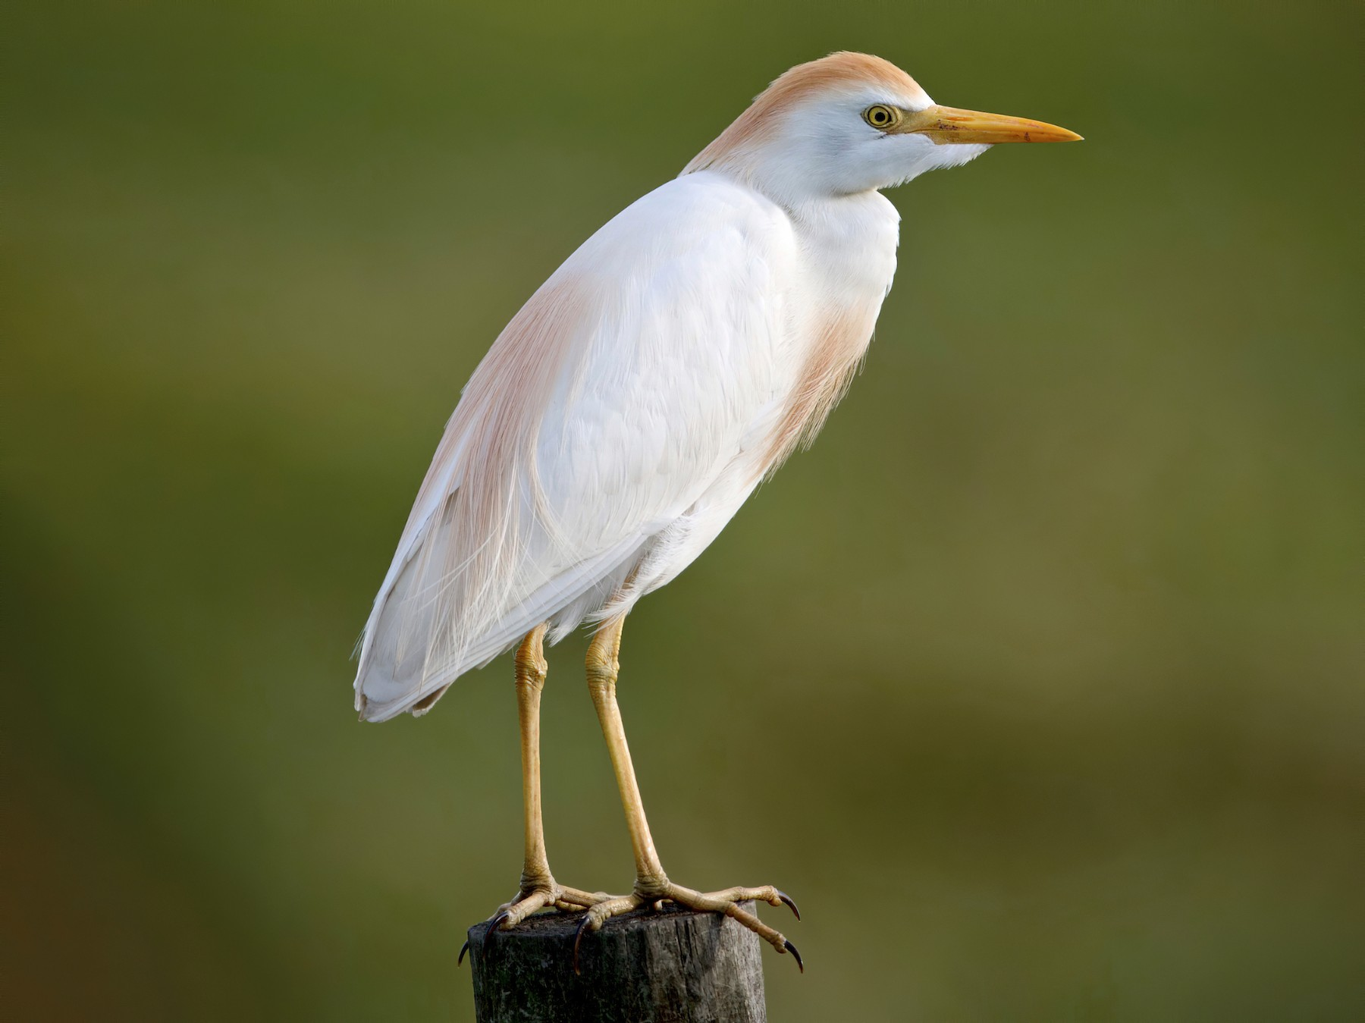
Cattle Egret - Albie
https://www.rspb.org.uk/birds-and-wildlife/wildlife-guides/bird-a-z/cattle-egret/
https://www.wildlifetrusts.org/wildlife-explorer/birds/herons-egrets-spoonbill-and-crane/cattle-egret

Slide 27
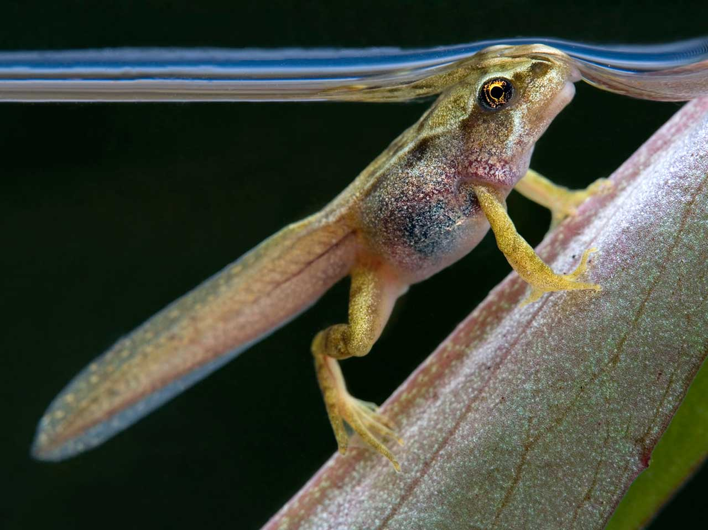
Common frog tadpole - Poppy
https://www.rspb.org.uk/birds-and-wildlife/natures-home-magazine/birds-and-wildlife-articles/features/tadpole-tale/
https://www.lrwt.org.uk/blog/lifecycle-frog

Slide 28
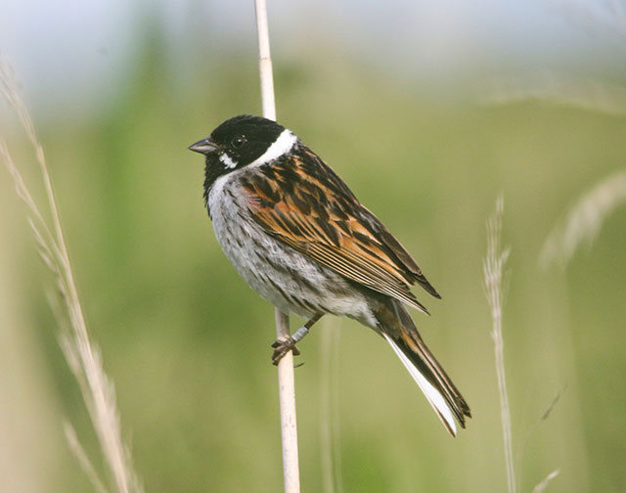
Reed Bunting - Martha
https://www.wildlifetrusts.org/wildlife-explorer/birds/finches-and-buntings/reed-bunting
https://www.rspb.org.uk/birds-and-wildlife/wildlife-guides/bird-a-z/reed-bunting/

Slide 29
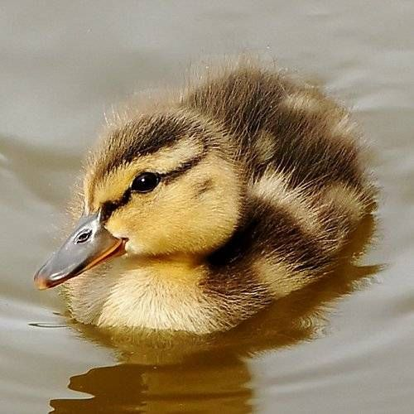
Mallard Duckling - Odette
https://www.rspb.org.uk/birds-and-wildlife/advice/how-you-can-help-birds/where-do-ducks-nest/mallard-ducklings/
https://www.wwt.org.uk/news-and-stories/blog/when-do-mallard-ducklings-appear/

Slide 30
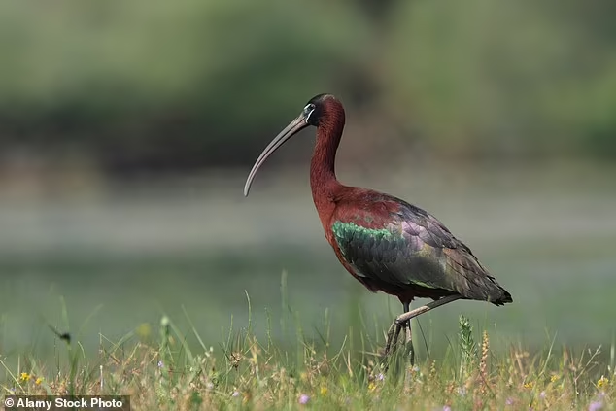
Glossy Ibis - Olive
https://www.wildlifetrusts.org/wildlife-explorer/birds/herons-egrets-spoonbill-and-crane/glossy-ibis
https://www.naturespot.org.uk/species/glossy-ibis
https://en.wikipedia.org/wiki/Glossy_ibis

Slide 31
