Slide 1
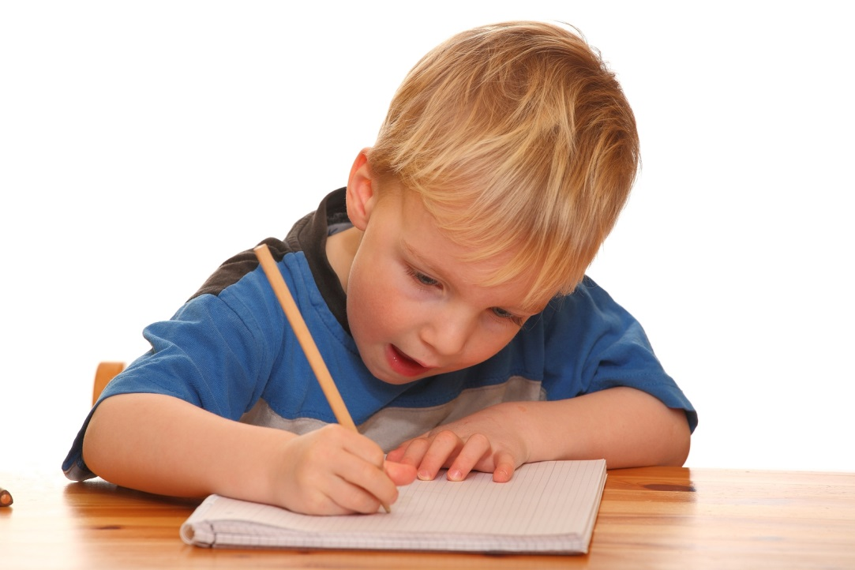
Supporting Literacy in Reception

Slide 2
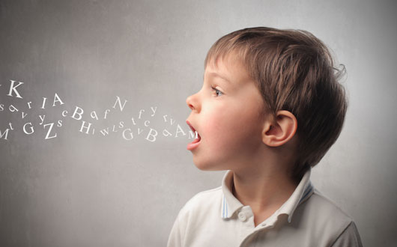
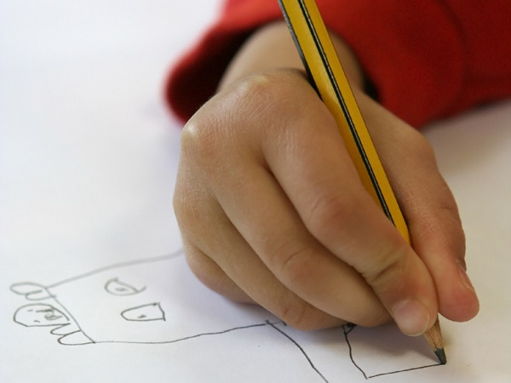
Before Writing
Before children begin to write, they must be confident with speaking in full sentences and able to share their ideas with others. Children should also have good fine motor control to be ready to hold a pencil.

Slide 3
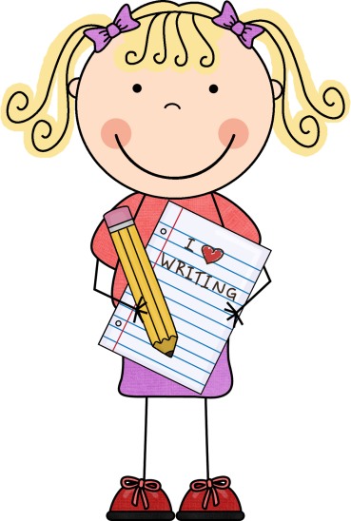
The Process of Writing
Letter like shapes
Mark making
Using letters to represent words
Simple words
Beginning to write simple sentences

Slide 4
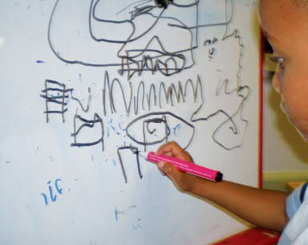
The Process of Writing
Mark making
This is the first stage of writing when a child begins to make marks.

Slide 5
Developing fine motor skills
It is important children are given opportunities to develop their fine motor skills to aid their mark making and letter formation.
You may see that often we have activities such as peg boards, tweezers and playdoh.
These activities help the children to develop their muscles in their fingers and hands so that they are able to grip and hold a pencil to begin to form letters.

Slide 6
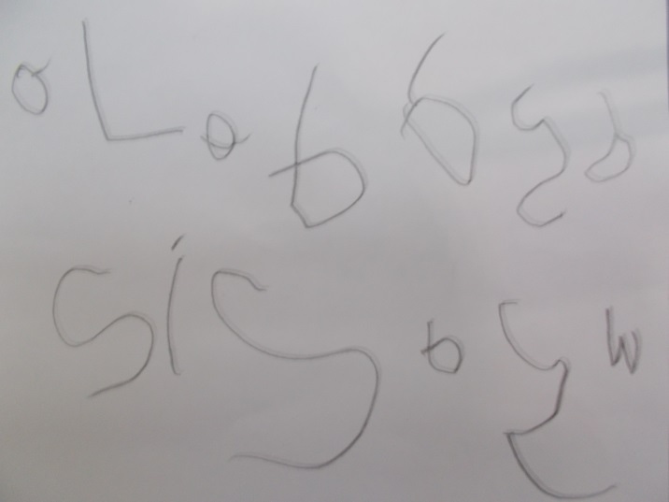
The Process of Writing
Letter like shapes
This is when children begin to understand that letters have meaning. They begin to identify letters in the environment and know some of the sounds they make.

Slide 7
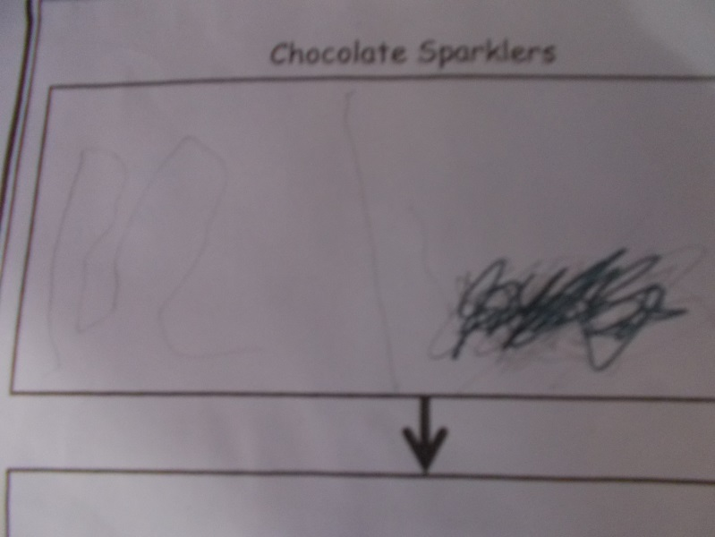
The Process of Writing
Using letters to represent words
Children will then begin to write the initial sounds for the words they want to write and say their meaning e.g. ‘s’ means ‘snake.’

Slide 8
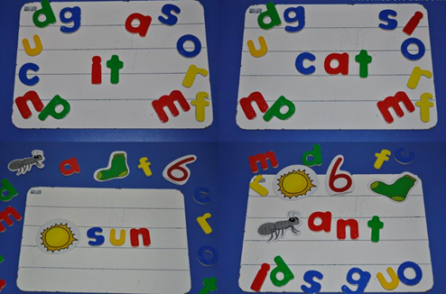
The Process of Writing
Simple words
Children then begin to segment sounds in words and write sounds in order.

Slide 9
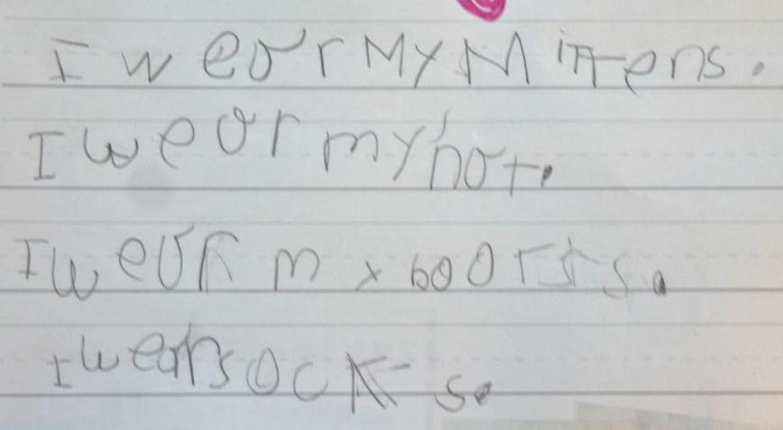
The Process of Writing
Beginning to write simple sentences
The final stage is when children can have ideas about what they want to say, and attempt to write this down. They will write a simple sentence, writing sounds in order for each word and beginning to use finger spaces between words.

Slide 10
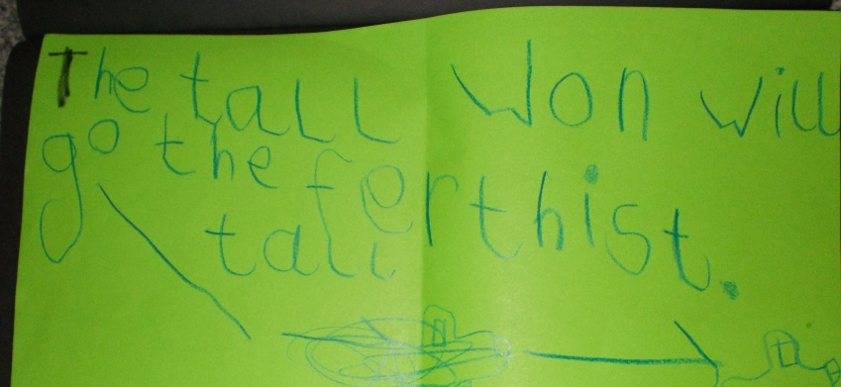
The Process of Writing
Writing simple sentences
Children can confidently use their skills to write a ‘super sentence.’ This would include a capital letter to start the sentence, a finger space between each word and a full stop at the end.

Slide 11
End of Year Expectations for Writing
Children use their phonic knowledge to write words in ways which match their spoken sounds.
They write some irregular common words.
They write simple sentences which can be read by themselves and others. Some words are spelt correctly and others are phonetically plausible.

Slide 12
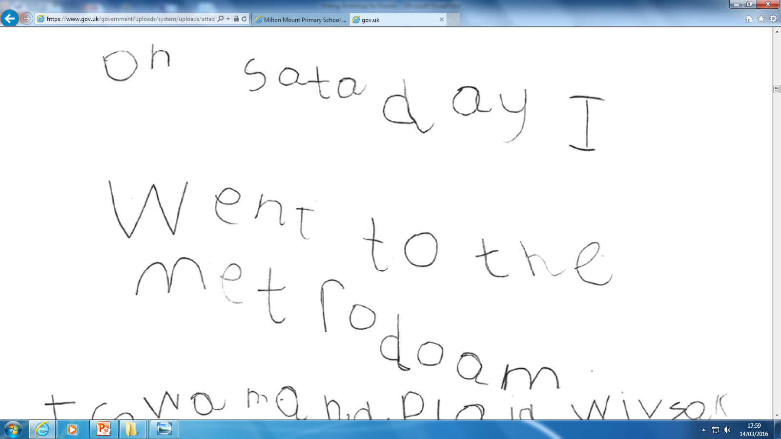
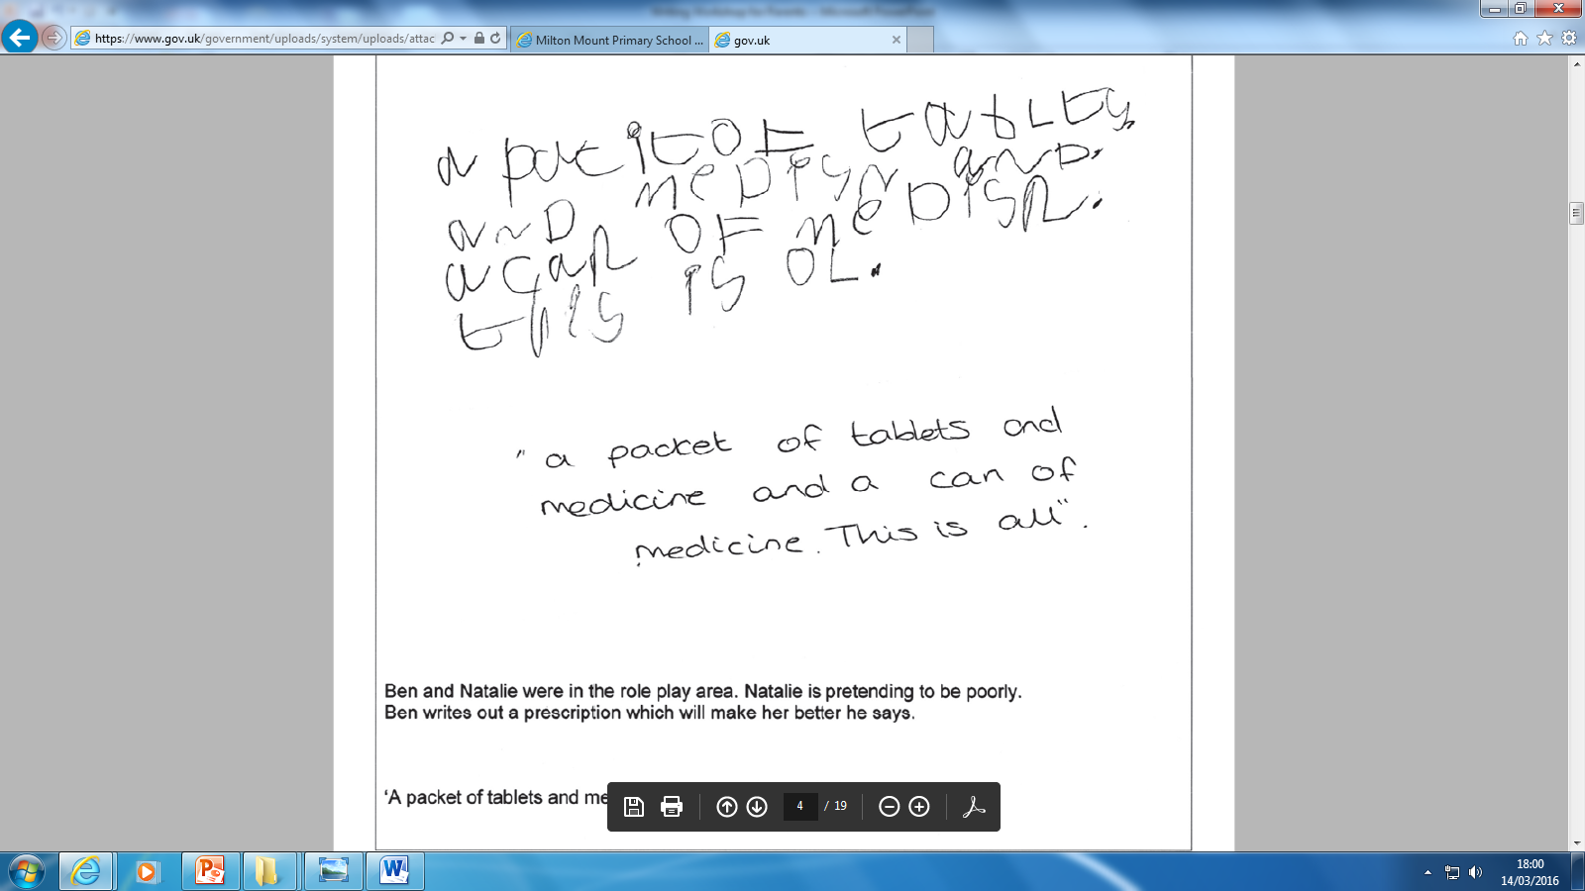
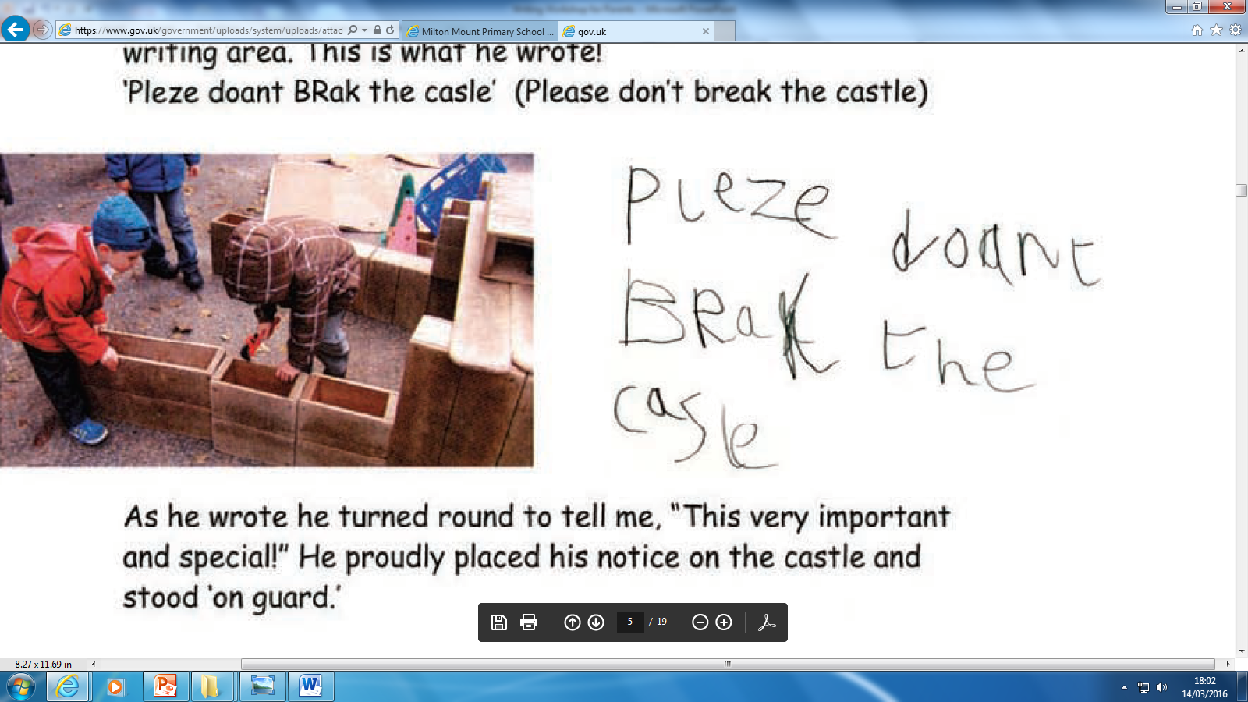
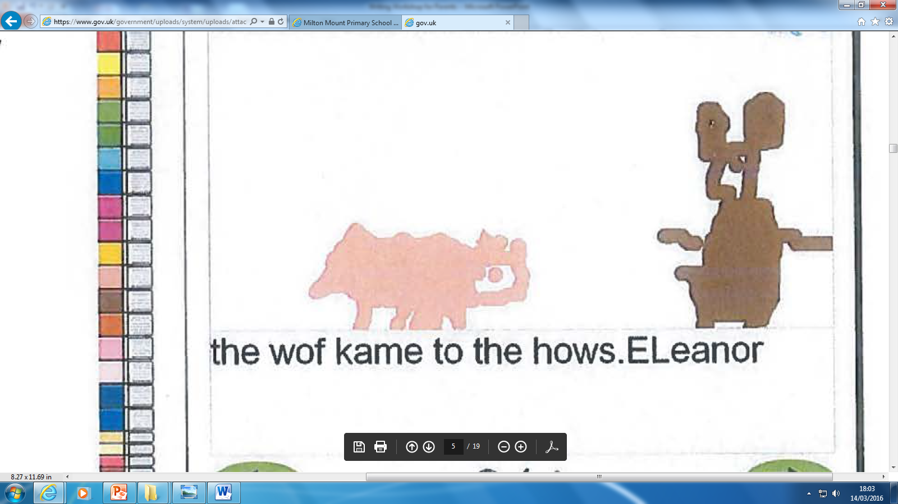
Examples of end of year expectations

Slide 13
Phase 1 Phonics
We start by teaching oral blending and segmenting.
Oral blending- blending sounds together to hear the word they make. For example if I say c-a-t can I blend those sounds together to hear cat? This is an early reading skill.
Oral segmenting- taking a whole word and splitting it up into the sounds that make it. For example if I say dog can you hear the 3 sounds d-o-g.
We also work on being able to hear rhymes and alliteration. Cam they hear the first sound in a word. Do sausages and sock start with the same sound? Can you hear that?

Slide 14
Phase 2 Phonics
We then introduce what we call grapheme to phoneme correspondence. What sound does each letter make?
Phase 2 sounds are…
s,a,t,p
i,n,m,d
g,o,c,k
ck,e,u,r,
h,b,f,l
ll,ss,ff
the, to, no, go, I
We also teach ‘tricky words’ that cannot be blended. The idea is that children remember what these words look like. This makes their reading more fast and fluent.

Slide 15
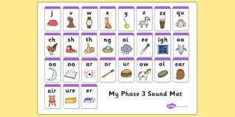
Phase 3 Phonics
We learn a series of digraphs – this is where 2 letters make one sound. We teach all the sounds using jolly phonics songs and actions. Please see the following few slides for examples.
.

Slide 16
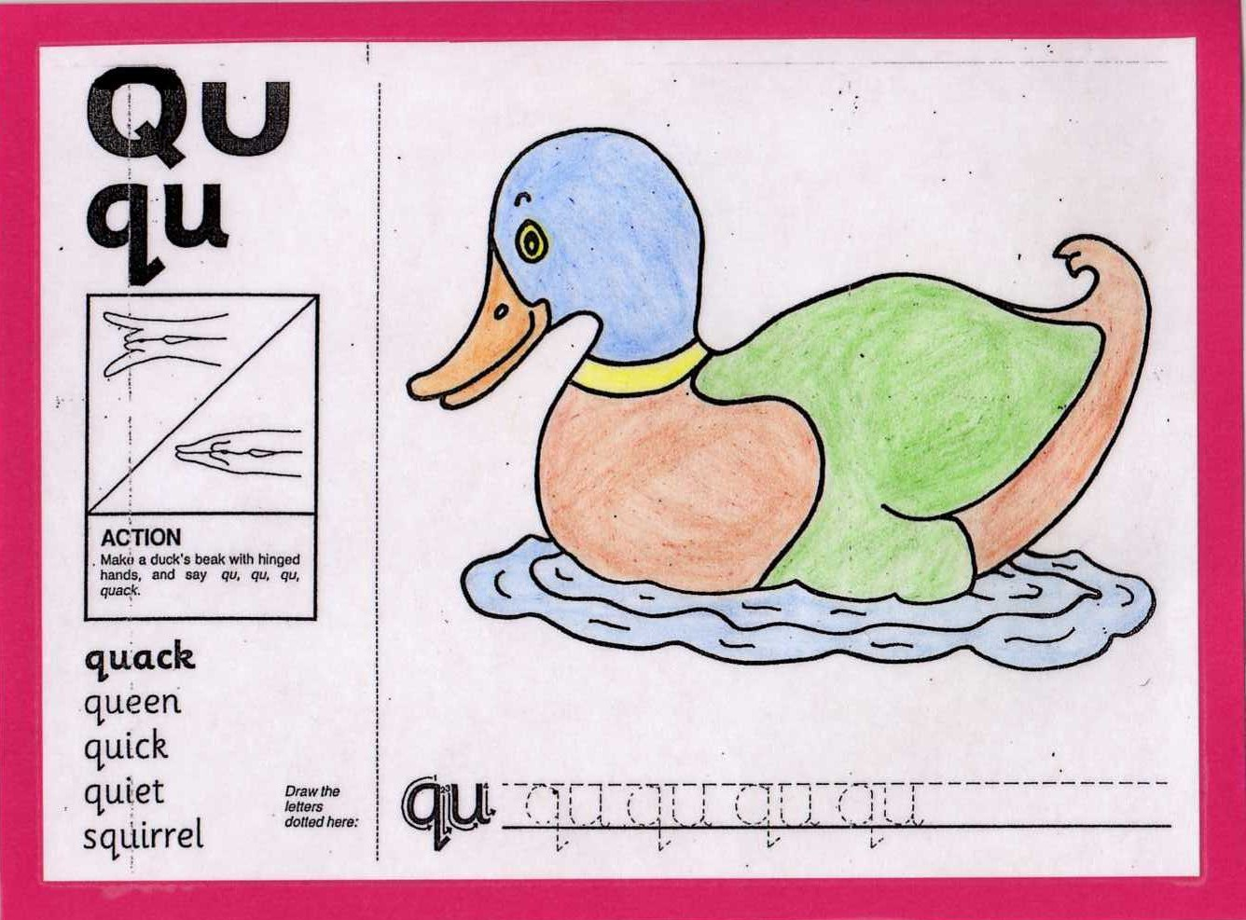

Slide 17
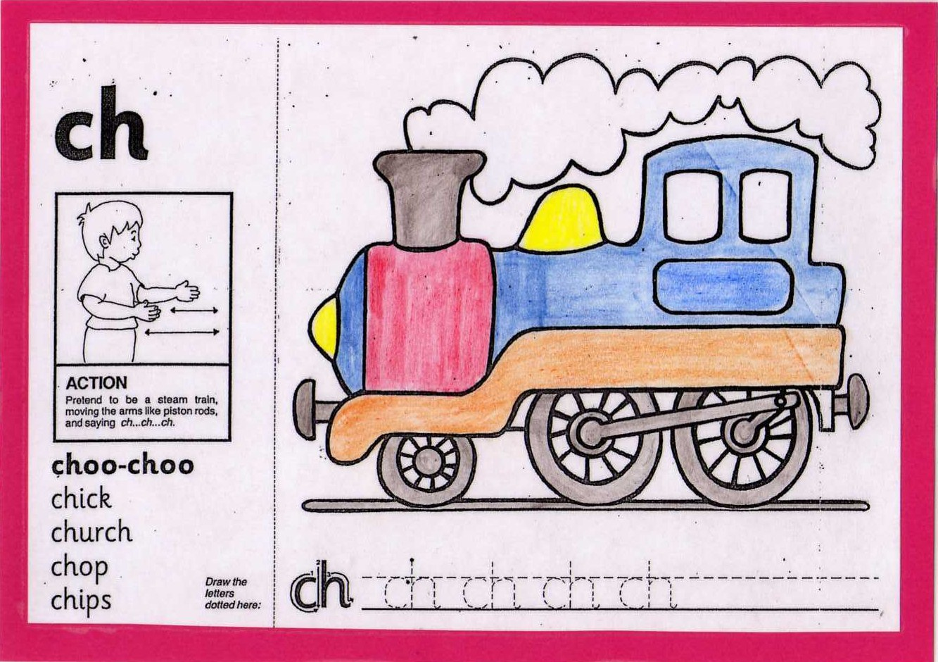

Slide 18
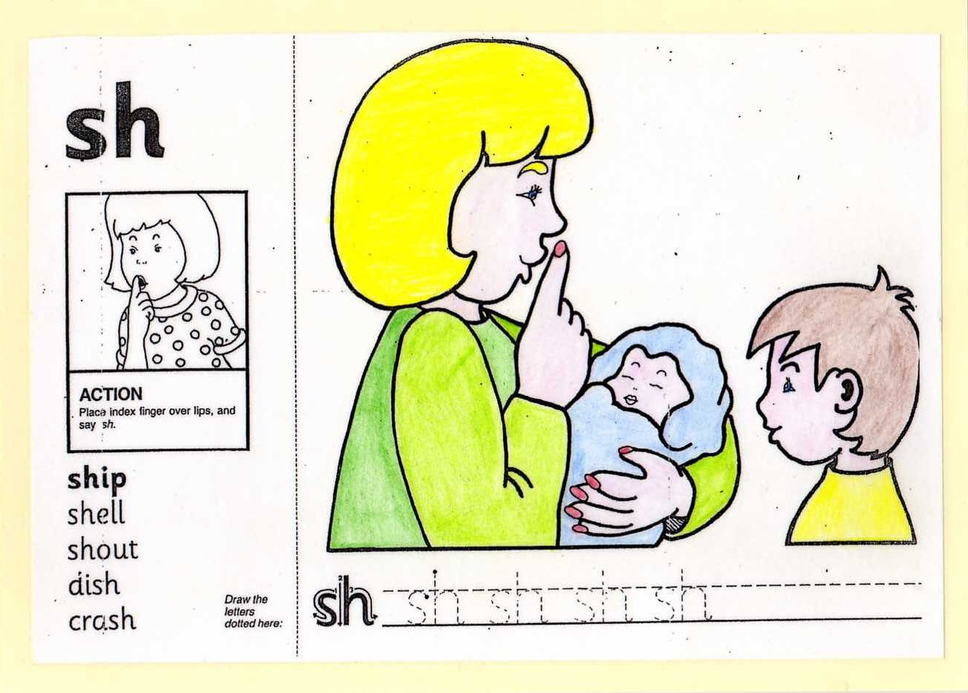

Slide 19
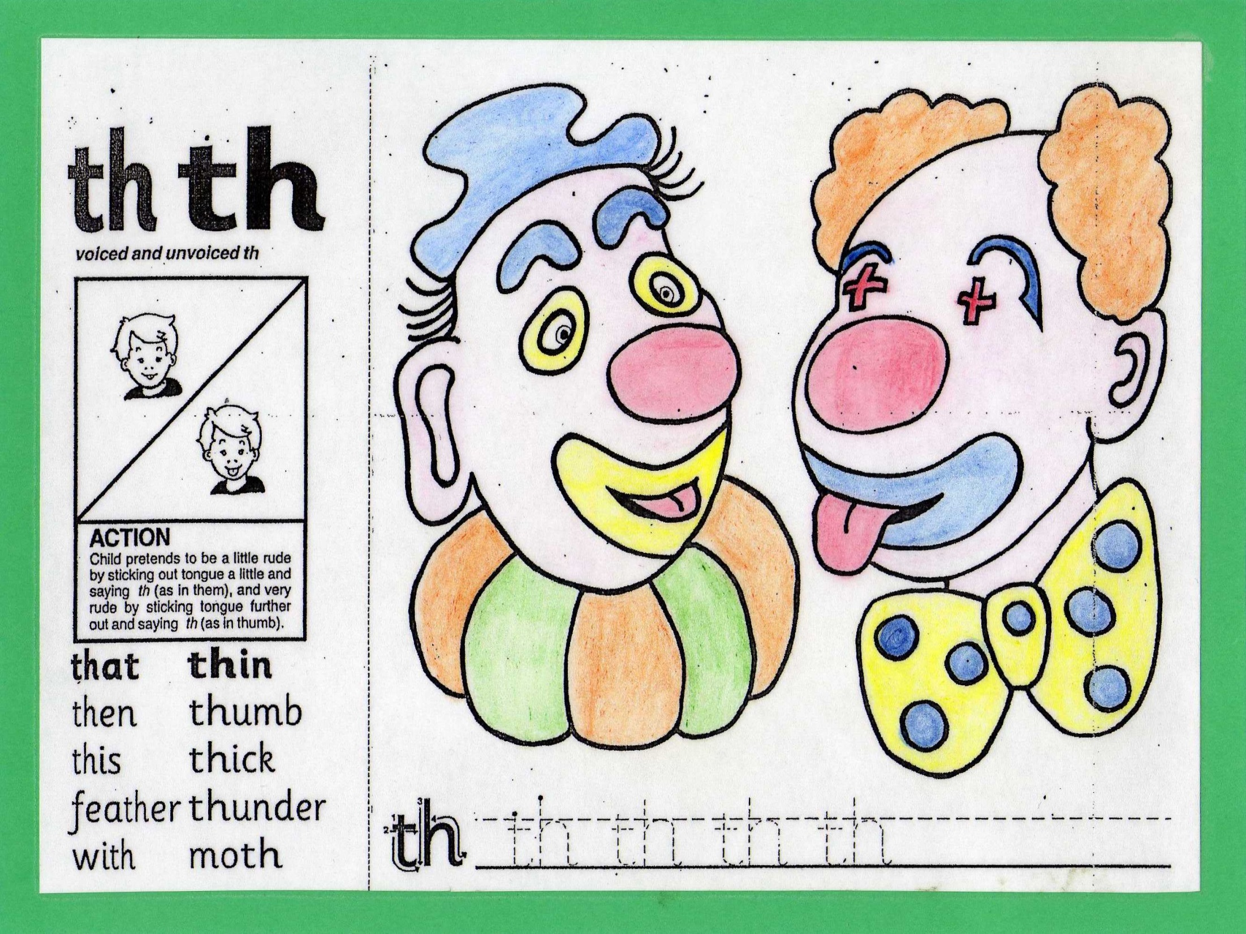

Slide 20
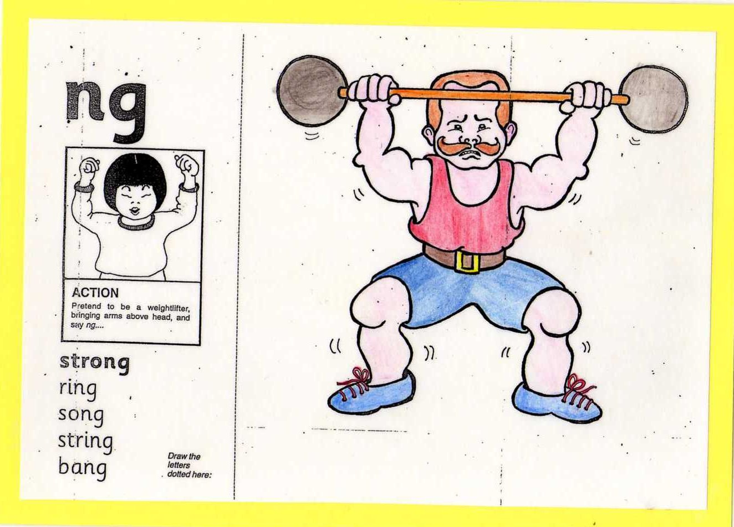

Slide 21
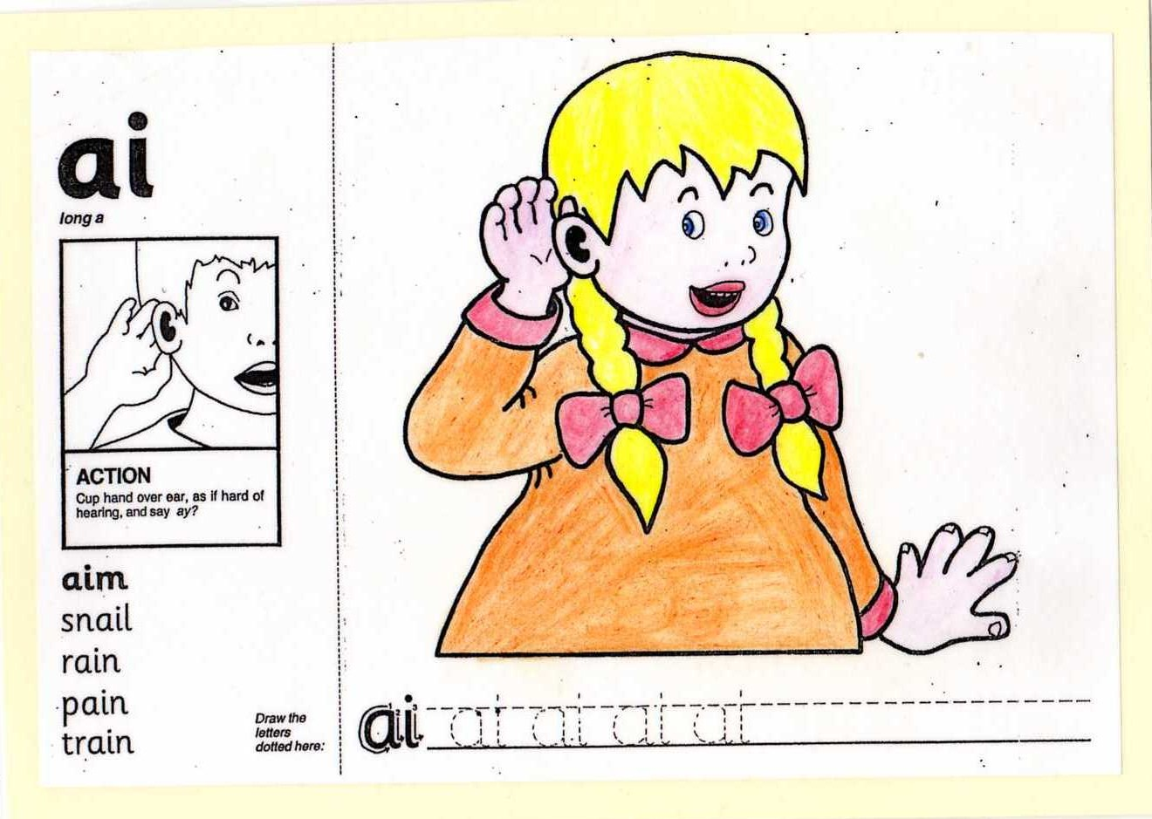

Slide 22
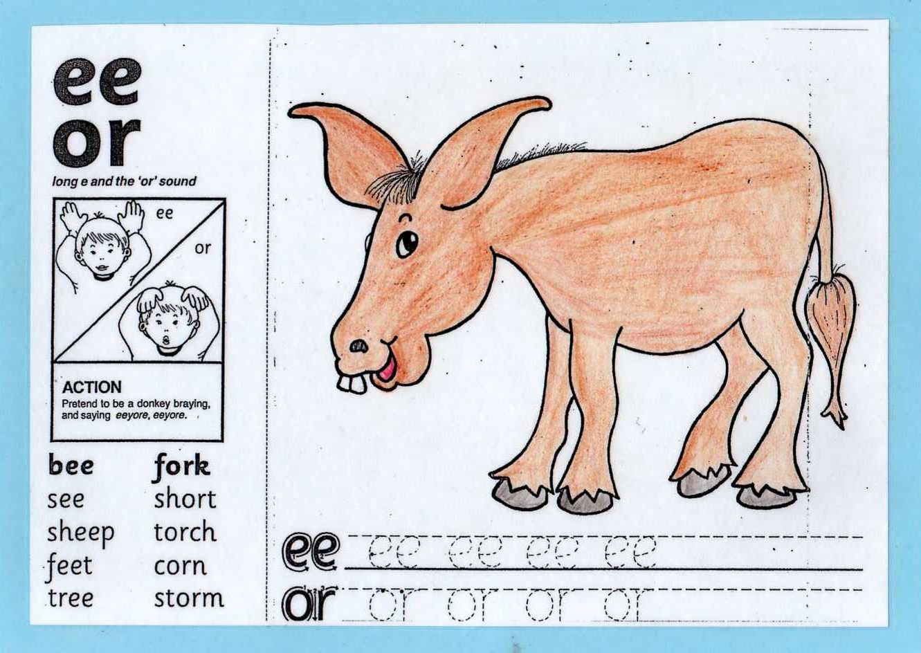

Slide 23
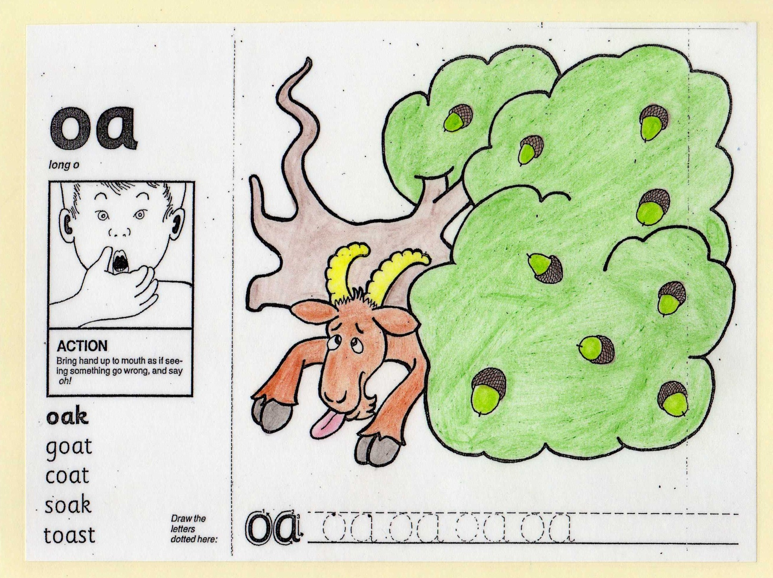

Slide 24
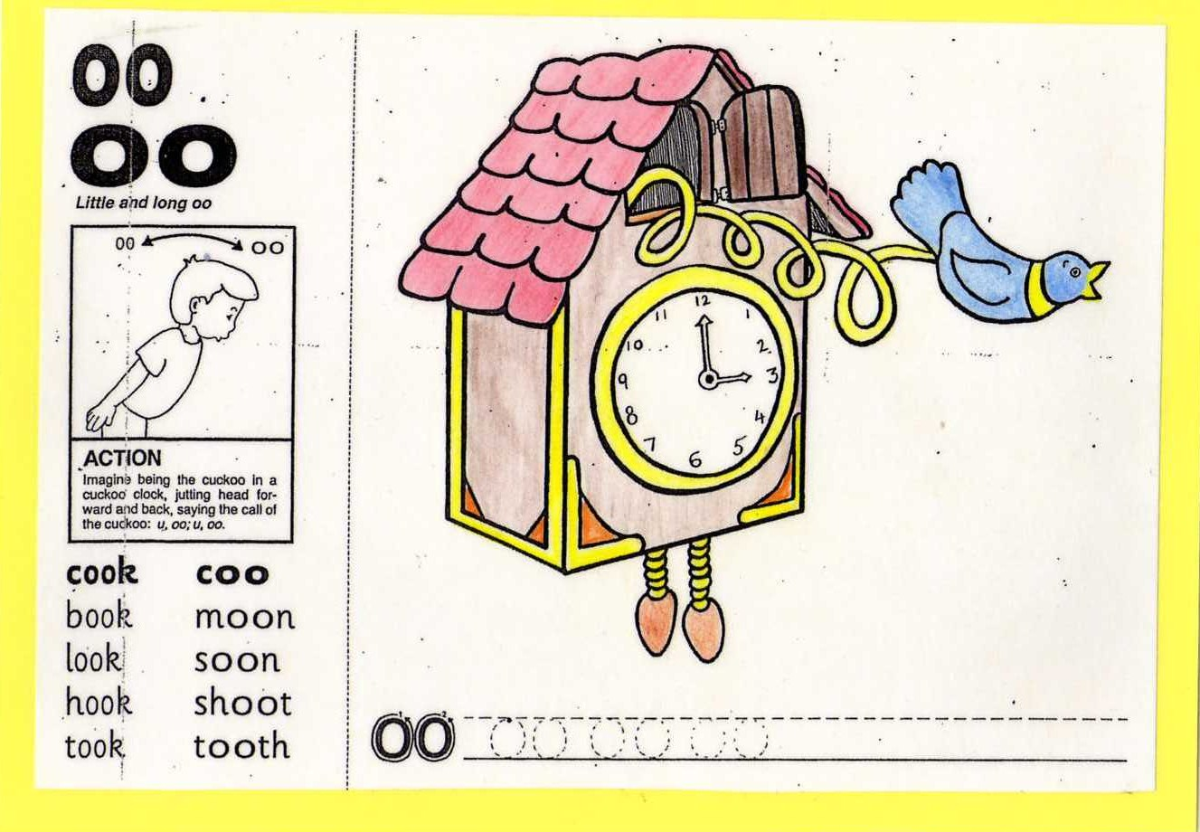

Slide 25
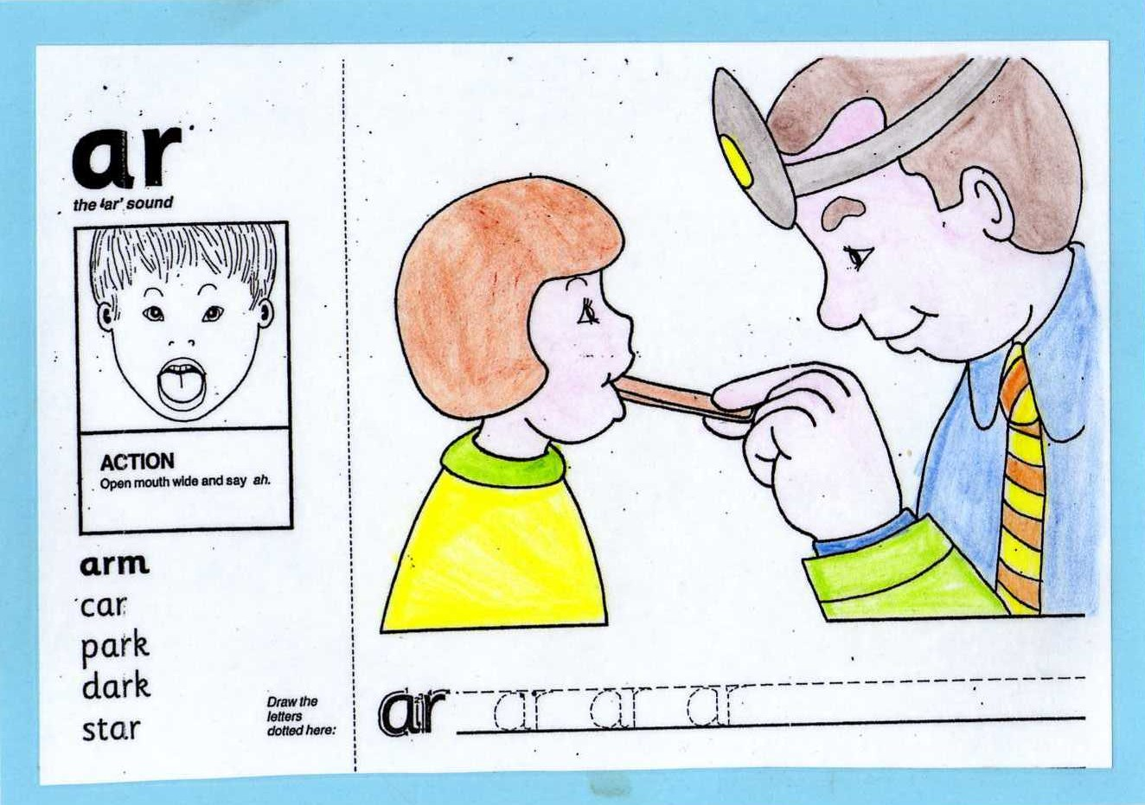

Slide 26
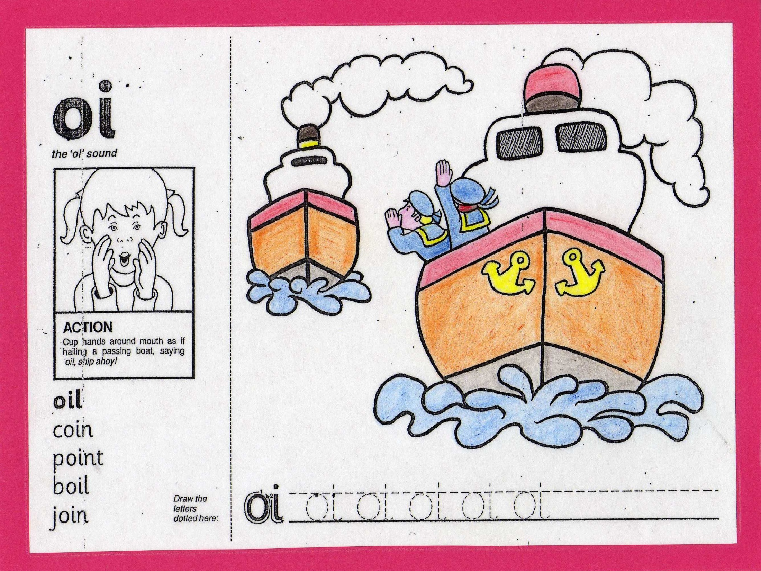

Slide 27
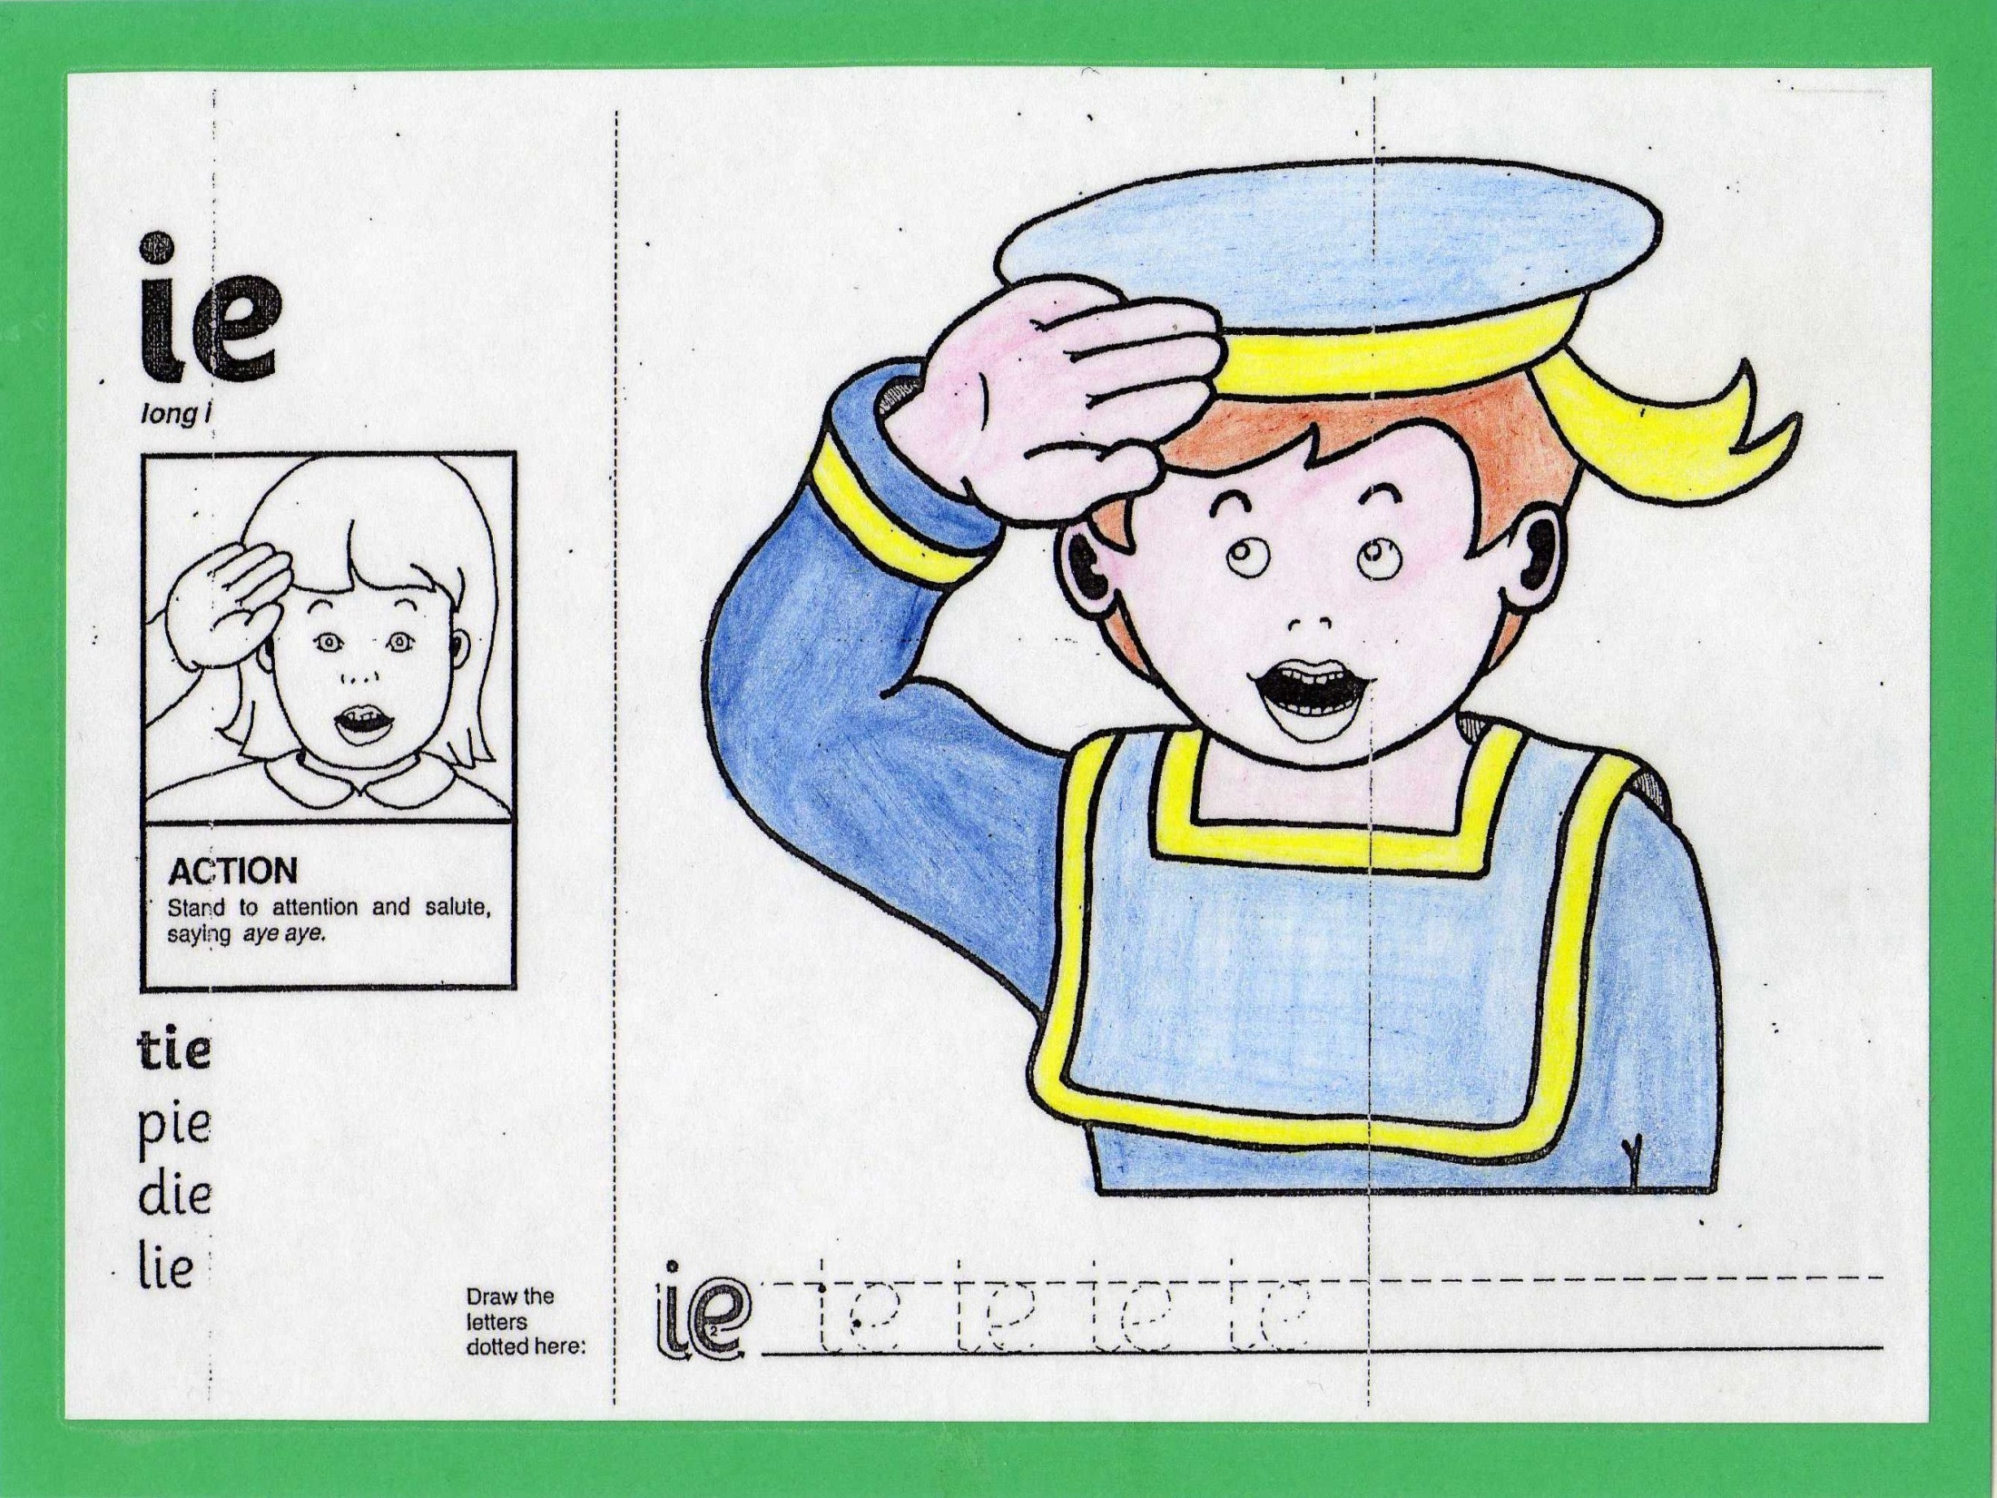

Slide 28
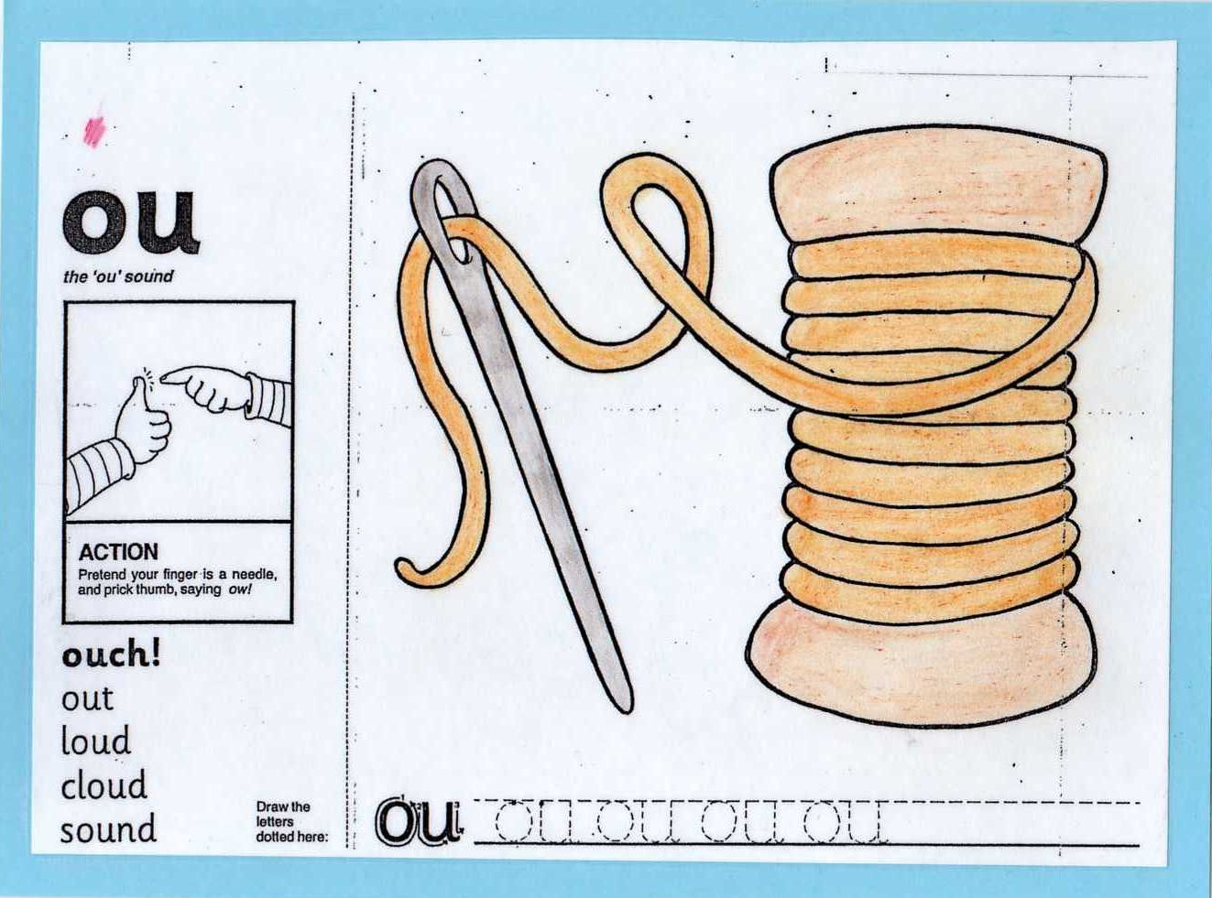

Slide 29
How can you help reading at home?
- Locate title, look and discuss front cover. Use words such as characters, setting.
- Look at the pictures first and tell the story
- Read together, look for letters you know especially at the beginning of words
- Look for familiar parts of the words to help you read
Sound out words and encourage to read tricky words
Support reading on a daily basis

Slide 30
Website links
https://www.phonicsplay.co.uk/BuriedTreasure2.html
https://www.phonicsplay.co.uk/DragonsDen.html
https://www.phonicsplay.co.uk/PicnicOnPluto.html

Slide 31
Developing your child as a writer
Help children understand the purpose for writing (e.g. shopping list, cards and letters)
Writing should be fun!
Help develop fine motor skills by doing activities like playdough, bead threading etc.
Help you child learn how to write their names accurately.

Slide 32
Finally…
Reading and writing are huge skills to master – it takes time and practise!
Thank you for your support! If you have any questions please do let us know.

