Slide 1
Year 4 – Summer Block 5 – Properties of Shape
WALT: understand lines of Symmetry
© Classroom Secrets Limited 2018

Slide 2
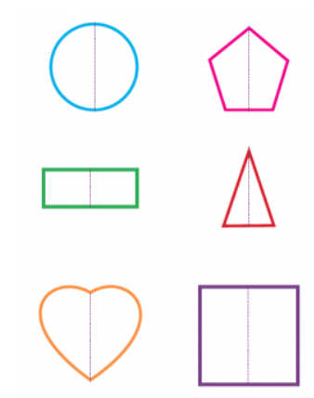
Introduction
What is symmetry? What does it mean if something is symmetrical?
Something is symmetrical when it is the same on both sides. A shape has symmetry if a central dividing line (a mirror line) can be drawn on it, to show that both sides of the shape are exactly the same.
© Classroom Secrets Limited 2018

Slide 3
Introduction
Which of the following shapes have more than one line of symmetry?
© Classroom Secrets Limited 2018

Slide 4
Introduction
Which of the following shapes have more than one line of symmetry?
© Classroom Secrets Limited 2018

Slide 5
Varied Fluency 1
Which shape has the correct lines of symmetry marked?
A
B
C
© Classroom Secrets Limited 2018

Slide 6
Varied Fluency 1
Which shape has the correct lines of symmetry marked?
Shape A
A
B
C
© Classroom Secrets Limited 2018

Slide 7
Varied Fluency 2
Match the halves which go together to make symmetrical shapes.
B
C
A
D
F
E
© Classroom Secrets Limited 2018

Slide 8
Varied Fluency 2
Match the halves which go together to make symmetrical shapes.
A and C; B and D; E and F
B
C
A
D
F
E
© Classroom Secrets Limited 2018

Slide 9
Varied Fluency 3
Pair the lines of symmetry with the shapes they match.
A
B
C
E
D
F
© Classroom Secrets Limited 2018

Slide 10
Varied Fluency 3
Pair the lines of symmetry with the shapes they match.
A and B; C and F; D and E
A
B
C
E
D
F
© Classroom Secrets Limited 2018

Slide 11
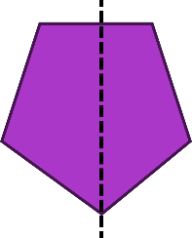
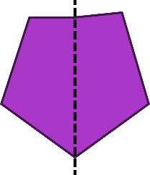
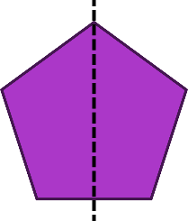
Reasoning 2
Here are 3 attempts at drawing reflections.
Find the reflections that are not symmetrical. Explain why.
A
B
C
© Classroom Secrets Limited 2018

Slide 12
Reasoning 2
Here are 3 attempts at drawing reflections.
Find the reflections that are not symmetrical. Explain why.
Shapes A and B are not symmetrical. The right-hand part of shape A is narrower than the left-hand side. The top-right-hand corner of reflection B is higher and further out than the top-left-hand corner.
A
B
C
© Classroom Secrets Limited 2018

