Slide 1




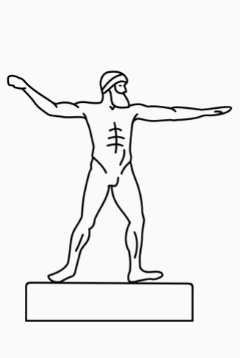

















Ancient Greece
Key Vocabulary:
Acropolis – A fortified part of an ancient Greek city, typically built on a hill. The Parthenon is built within the acropolis at Athens.
Bio – Greek word meaning ‘life’.
Democracy – ‘cracy’ means power and ‘demo’ means people. A democracy is where people have the power to vote and govern for themselves.
Geo – Greek word meaning ‘earth’.
Graph – Greek word meaning ‘write’. Example ‘biography’ = writing about someone’s life or ‘geography’ = writing about the earth.
Kilo – Greek word meaning ‘one thousand’.
Mount Olympus – The highest mountain in Greece and believed to be the birthplace of the Olympian gods.
Myth – From the Greek word ‘mythos’ meaning speech. Myths are traditional stories, which are likely to be fictional, told through time and explain events from the past.
Oligarchy – ‘Oligos’ means few, and ‘archy’ means to rule. An oligarchy is a type of government where the power is in the hands of only a few people.
Polytheistic – In Greek ‘poly’ = many and ‘theos’ = god. Polytheistic means to believe in more than one god.
Important mythological figures:
Key events:
Gods – The Ancient Greeks were polytheistic.
776 BC
750 BC
508 BC
490 BC
432 BC
386 BC
336 BC
146 BC
The first Olympic games take place.
Zeus – King of the gods on Mount Olympia who had several wives and children to gods and mortals.
Aphrodite – Daughter of Zeus and goddess of love.
Athena – Daughter of Zeus and goddess of wisdom and war.
Hades – Ruler of the dead and the underworld.
Hermes – Son of Zeus and messenger of the gods.
Apollo – God of knowledge and prophecy.
Poseidon – God of the sea.
Hephaestus – God of blacksmiths and craftsmen.
Thanatos – God of death.
Hypnos – Twin brother of Thanatos, god of sleep.
Nike – Goddess of victory.
Nemesis – Goddess of revenge.
The Greek poet Homer begins to write the Odyssey and the Iliad.
Cleisthenes, introduces democracy to Greek laws.
The battle of Marathon, where the Greeks defeated the Persians.
The most famous building in Athens, the Parthenon, is completed.
People
Achilles – Hero of the Trojan war.
Heracles – The mortal son of Zeus and Greek hero.
Midas – A king who turned things he touched to gold.
Pluto, the Greek philosopher and student of Socrates, creates the first institution of learning, called The Academy.
Historical context:
Saxons and Vikings
Alexander the Great becomes king and expands the Greek empire.
Ancient Egypt
Ancient Greece
Ancient Rome
Normans
Tudors
Victorians
World War I
World War II
Present Day
The Romans defeat the Greeks at Corinth, making Greece part of the Roman Empire.
3100 BC –
310 AD
1200 BC –
146 AD
800 BC –
500 AD
450 AD –
1066 AD
1066 AD – 1154 AD
1485 AD – 1603 AD
1837 AD – 1901 AD
1914 AD – 1918 AD
1939 AD – 1945 AD
2020 AD

