Slide 1
Maths
Position and Direction
Year One
Maths | Year 1 | Position and Direction | Position | Lesson 2 of 3: Under the Sea

Slide 2
Under the Sea

Slide 3
Aim
I can describe the position of objects.
Success Criteria
I can ask questions using positional vocabulary.
I can follow instructions about position.
I can draw items in a given position.

Slide 4
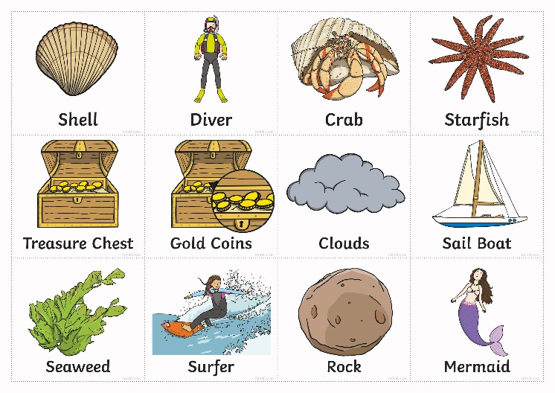
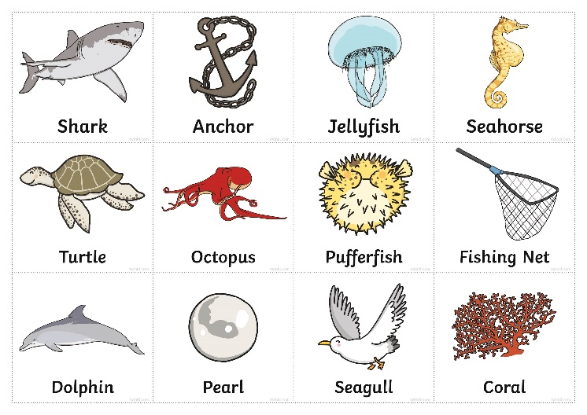
Under the Sea Board Game
How to Play
Play the game in pairs. Place the cards face down and take turns picking a card from the top. The player with the card must keep it a secret but describe where the picture is under the sea. Their partner must try and guess the answer. If a player guesses the picture correctly, they get to steal the card and if not, their partner keeps the card. The player with the most cards wins the game. The picture is on the next slide.

Slide 5
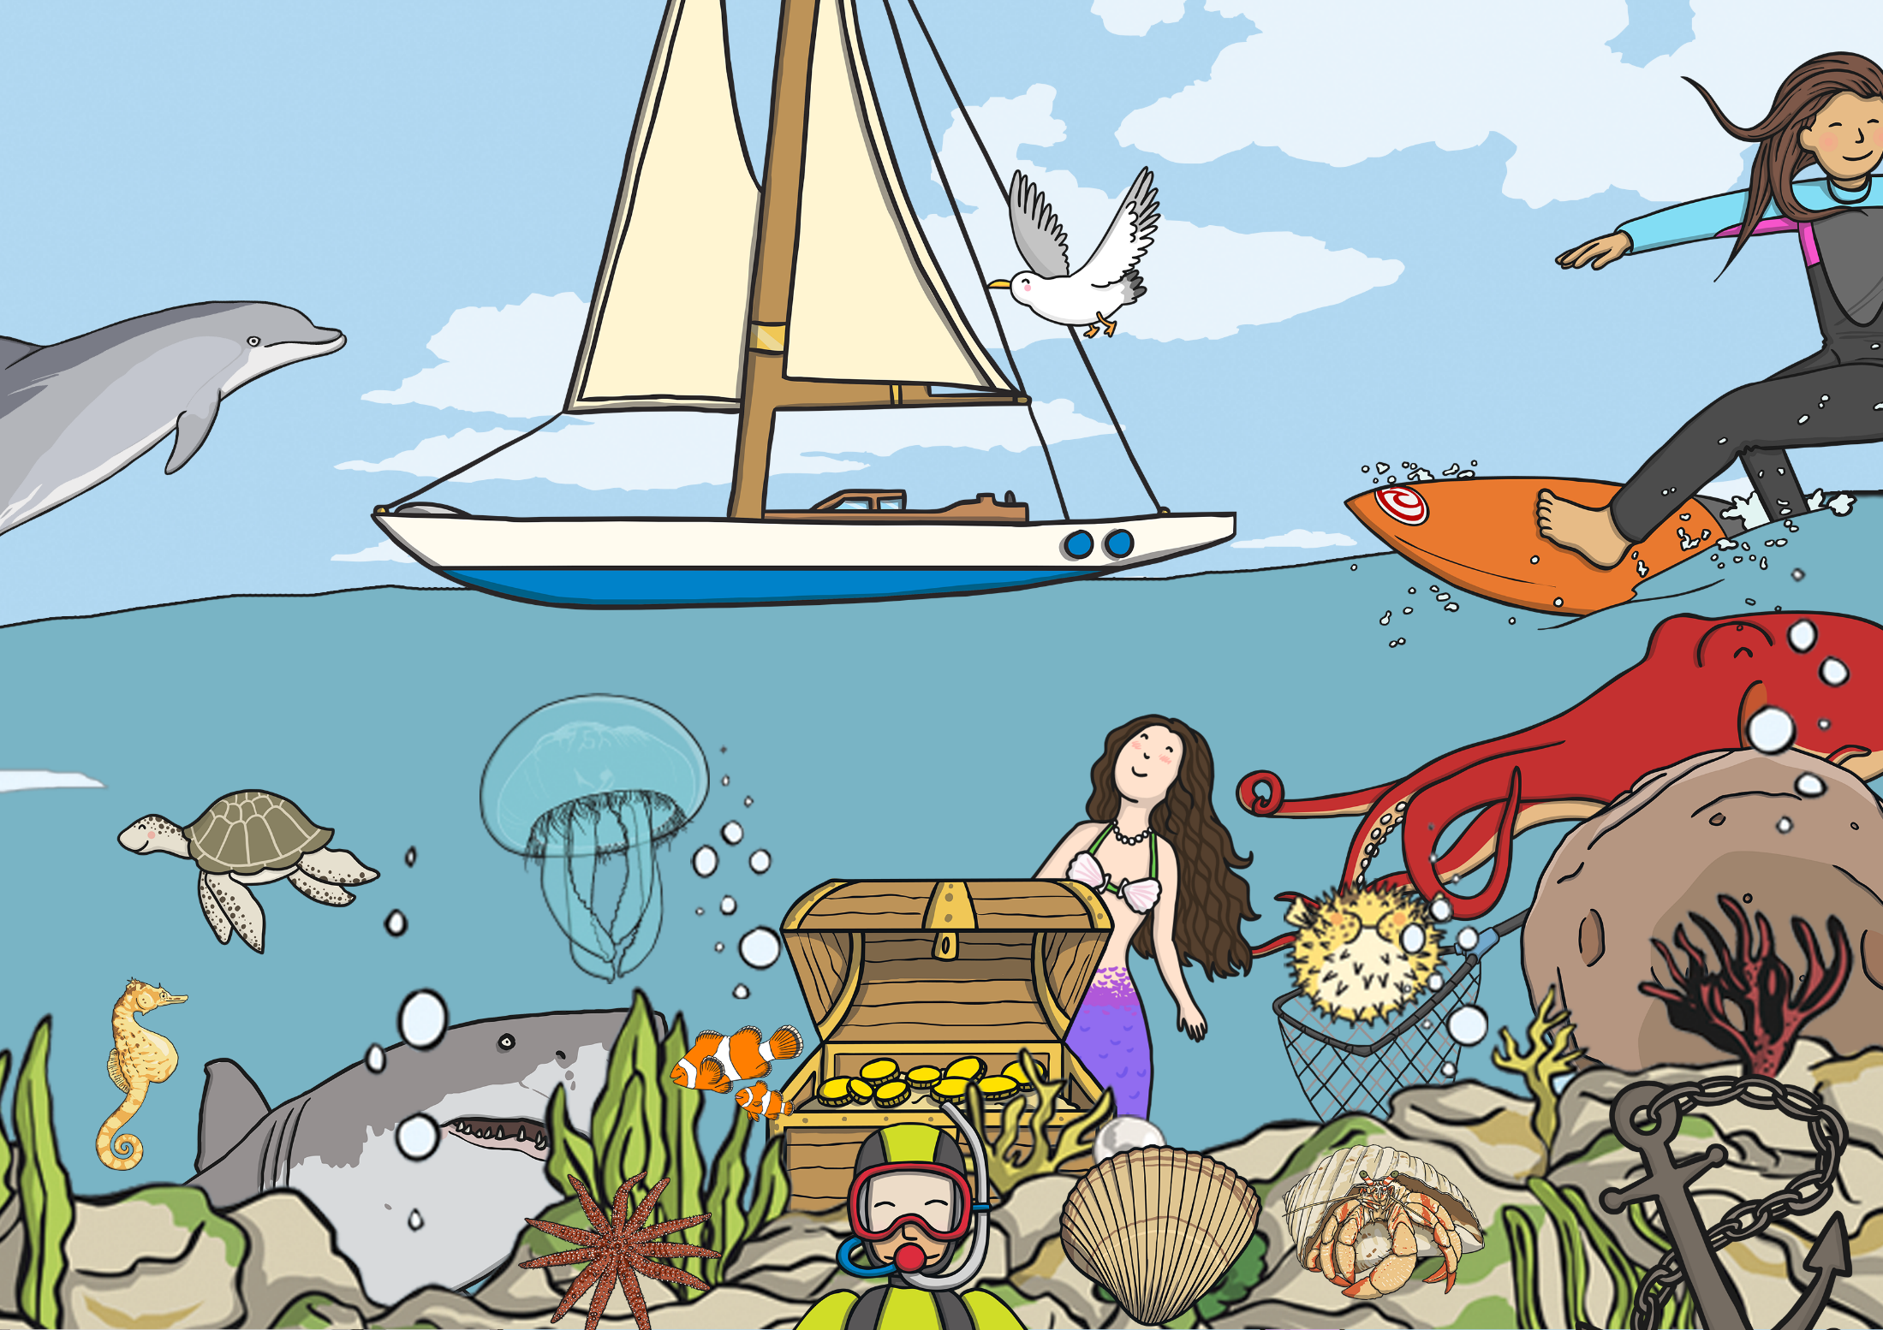
I Spy
Click here for picture

Slide 6
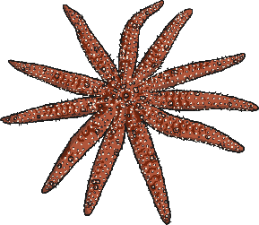
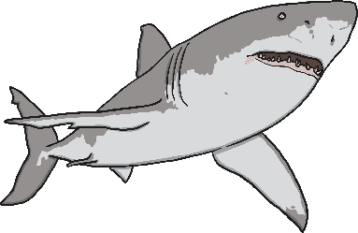
Seascape
Draw the sandy seabed halfway across your mini whiteboard.
Draw a big shark behind the treasure chest.
Draw a rock on the far right of the seabed.
Draw a starfish on the far left of the seabed.
Draw a small fish swimming close to the top of the water.
Draw a jellyfish just above the rock.
Draw a treasure chest in-between the rock and the starfish.

Slide 7
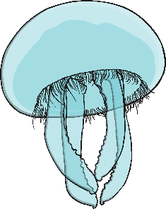
Sea Scape

Slide 8
Aim
I can describe the position of objects.
Success Criteria
I can ask questions using positional vocabulary.
I can follow instructions about position.
I can draw items in a given position.

