Slide 1
3.1 The part–whole relationship Step 2:7
Equal or unequal parts?

Slide 2
3.1 The part–whole relationship Step 2:7
What is the same about each part? What is different?

Slide 3
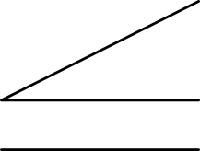
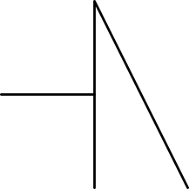
3.1 The part–whole relationship Step 2:7
Equal or unequal parts?
Notes:
Has the square been divided into equal or unequal parts?
What is the same about each part? What is different?

Slide 4
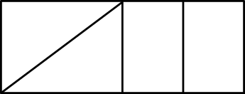
3.1 The part–whole relationship Step 2:7
Equal parts?
✗
✓

Slide 5
3.1 The part–whole relationship Step 3:1
What is the same? What is different?
Notes:
The yellow part is a larger part of the whole circle than the red part.
The red part and the blue part are equally-sized parts of the whole circle.

