Slide 1

Year 4 – Autumn Block 1 – Ready to Write
Step 9: Present Perfect
or Simple Past?
© Classroom Secrets Limited 2018

Slide 2
Reasoning 1
Which sentence is the odd one out?
Auntie Donna has sat in my dad’s chair at the dinner table.
Frankie washed the dishes with his mum in the kitchen.
Pamela has worn her new, sparkly dress.
Explain your reasoning.
© Classroom Secrets Limited 2018

Slide 3
Reasoning 1
Which sentence is the odd one out?
Auntie Donna has sat in my dad’s chair at the dinner table.
Frankie washed the dishes with his mum in the kitchen.
Pamela has worn her new, sparkly dress.
Explain your reasoning.
Sentence 2 is the odd one out because…
© Classroom Secrets Limited 2018

Slide 4
Reasoning 1
Which sentence is the odd one out?
Auntie Donna has sat in my dad’s chair at the dinner table.
Frankie washed the dishes with his mum in the kitchen.
Pamela has worn her new, sparkly dress.
Explain your reasoning.
Sentence 2 is the odd one out because it has been written in the simple past tense. Sentences 1 and 3 are in the present perfect tense.
© Classroom Secrets Limited 2018

Slide 5
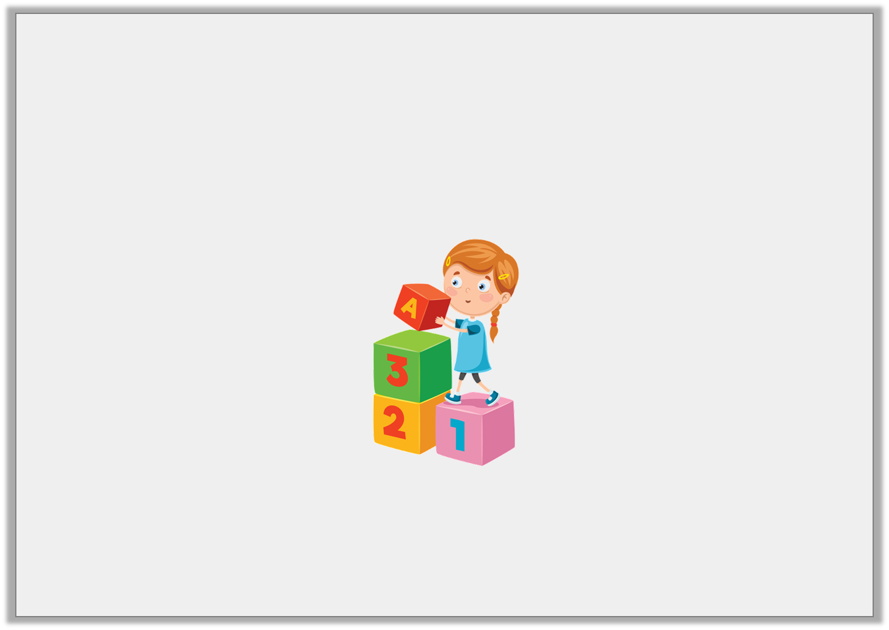
Application 1
Using the verb below, write one sentence in the present perfect tense and one in the simple past tense.
build
© Classroom Secrets Limited 2018

Slide 6
Application 1
Using the verb below, write one sentence in the present perfect tense and one in the simple past tense.
build
Various answers, for example:
Present Perfect – Holly has built a tower of bricks in the playroom.
Simple Past – Arnold built a new housing estate with his team.
© Classroom Secrets Limited 2018

Slide 7

Reasoning 2
Ollie has written the sentence below.
He says,
Is Ollie correct?
Explain your reasoning.
Our school team has winned the championship trophy.
My sentence is in the present perfect tense.
© Classroom Secrets Limited 2018

Slide 8
Reasoning 2
Ollie has written the sentence below.
He says,
Is Ollie correct?
Explain your reasoning.
Ollie is incorrect because…
Our school team has winned the championship trophy.
My sentence is in the present perfect tense.
© Classroom Secrets Limited 2018

Slide 9
Reasoning 2
Ollie has written the sentence below.
He says,
Is Ollie correct?
Explain your reasoning.
Ollie is incorrect because ‘win’ in the present perfect tense is ‘won’.
Our school team has winned the championship trophy.
My sentence is in the present perfect tense.
© Classroom Secrets Limited 2018

