Slide 2
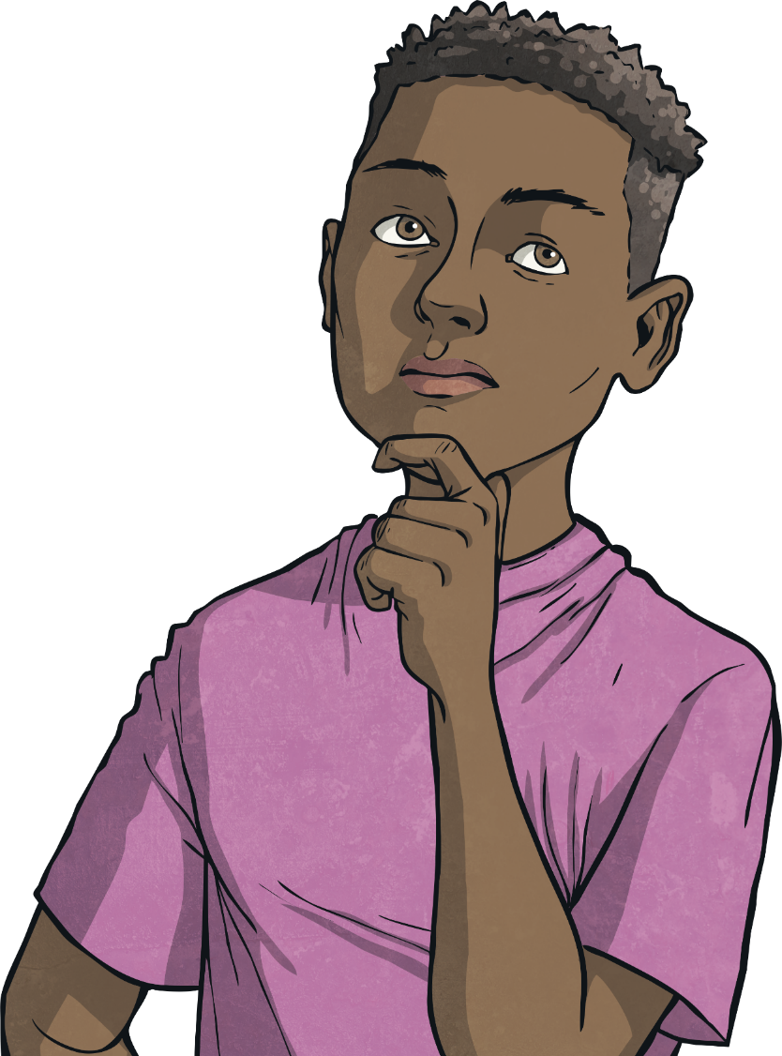
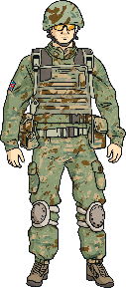
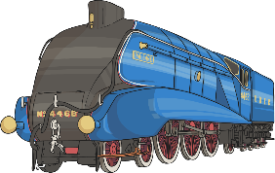
What Can Change a Place?
?
Why might a city, town, or village change?
Think about:
natural disasters;
new buildings;
a large employer closing down;
transport links;
war.

Slide 3
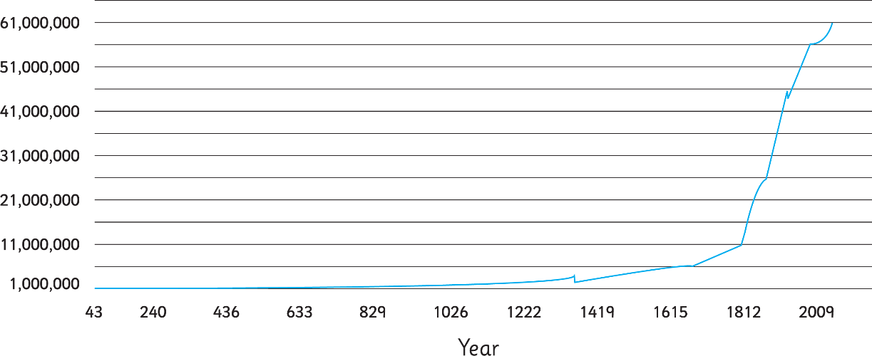
How Has the Population
of the UK Changed?
?
What story does the graph tell us?
AD1642-9
The Black Death
AD1801 – AD1901
Many people came to work in the UK from the growing British Empire
AD1911 – AD1921
Many British soldiers died in the First World War
AD1921 – AD1970
People from different parts of the world came to the UK after the Second World War
Look at the dates. Do any of them fit with events you have learnt about?
?

Slide 4
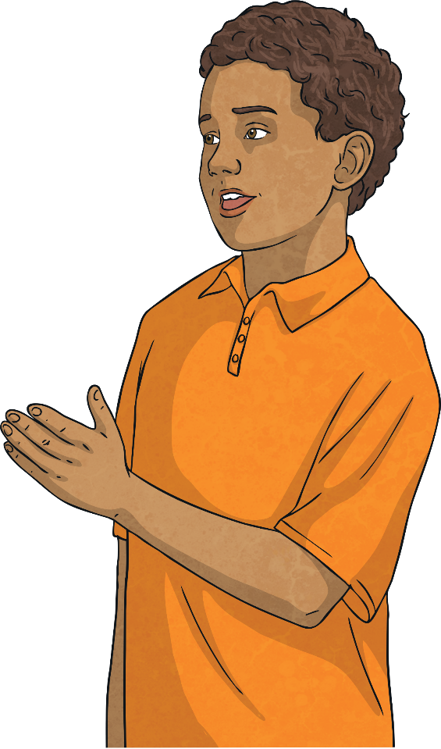
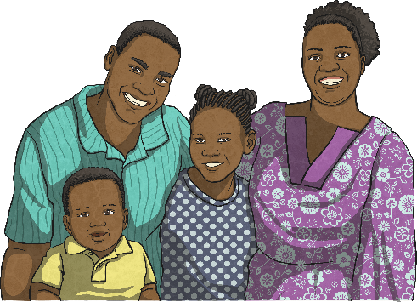
What is Immigration?
?
Have you heard of immigration before? What do you think it is?
Immigration is when someone moves from one country to live permanently in a foreign country.
People move to other countries for all kinds of reasons. Can you think of any?
To be near family
For work
For a different lifestyle

Slide 5
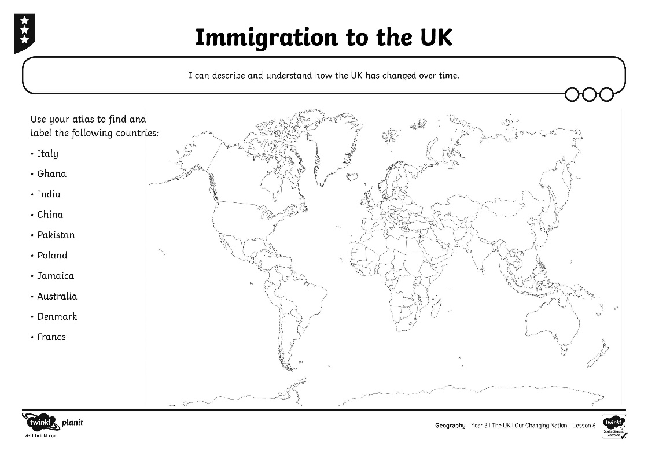
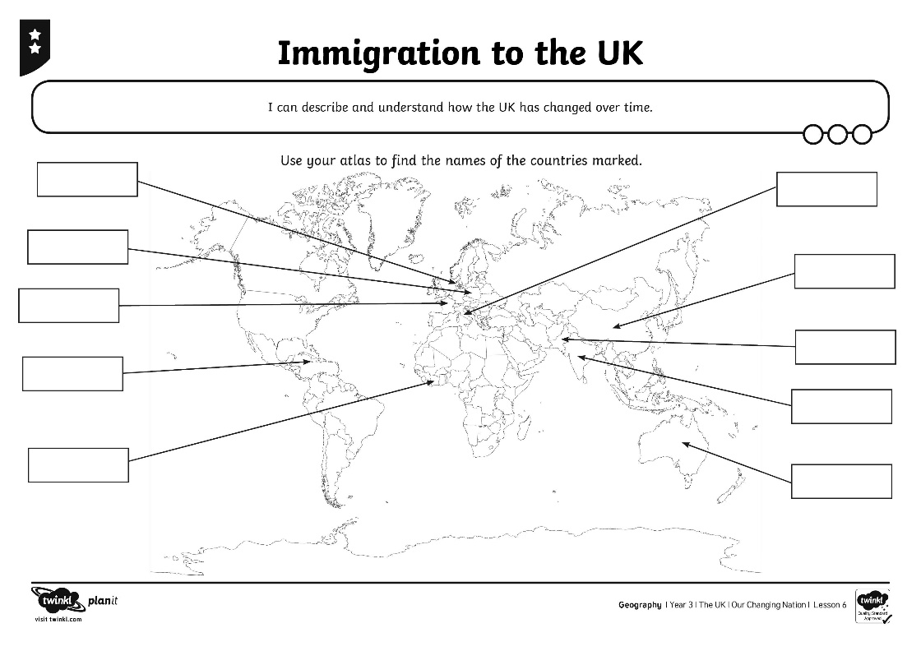
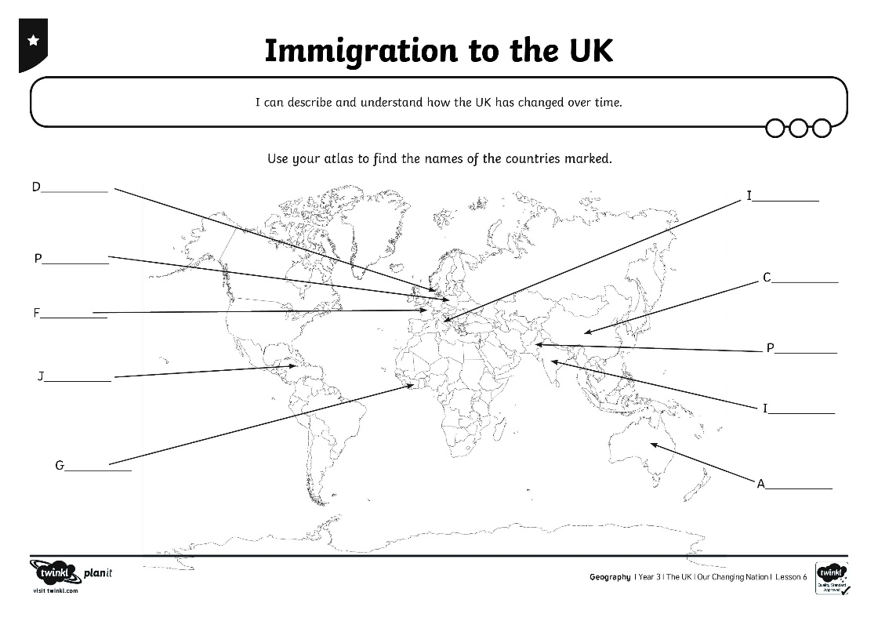
Where Do People
Come From?
Use your atlas to find and label the countries that people travelled to the UK from.

