Slide 1
Year 4 – Summer Block 3 – Consolidation of Lower KS2
Step 4: Consolidating Adverbs
© Classroom Secrets Limited 2019

Slide 2
Introduction
Arrange the adverbs by their type.
Time | Place | Frequency | Manner | Cause
yesterday |  | due to |  | usually
 | upstairs |  | soon |  | because
always |  | quietly |  | there
© Classroom Secrets Limited 2019

Slide 3
Introduction
Arrange the adverbs by their type.
Time | Place | Frequency | Manner | Cause
yesterday soon | upstairs there | always usually | quietly | because due to
© Classroom Secrets Limited 2019

Slide 4
Varied Fluency 1
Use the word bank to complete the sentences below with an adverb of time.
A. “We are looking forward to going to the seaside ______________!” remarked Brian’s mum.
B. Miranda and Betsy are going to see their new puppy ________________ .
tomorrow slowly yet ever before now
© Classroom Secrets Limited 2019

Slide 5
Varied Fluency 1
Use the word bank to complete the sentences below with an adverb of time.
A. “We are looking forward to going to the seaside tomorrow!” remarked Brian’s mum.
B. Miranda and Betsy are going to see their new puppy now.
tomorrow slowly yet ever before now
© Classroom Secrets Limited 2019

Slide 6
Varied Fluency 2
Tick the adverb of place in the sentence below.
Eliza had searched everywhere in her parents’ house for her phone but unfortunately she still couldn’t find it!
© Classroom Secrets Limited 2019

Slide 7
Varied Fluency 2
Tick the adverb of place in the sentence below.
Eliza had searched everywhere in her parents’ house for her phone but unfortunately she still couldn’t find it!
✓
© Classroom Secrets Limited 2019

Slide 8
Varied Fluency 3
Circle the odd one out.
nowhere
abroad
smoothly
inside
© Classroom Secrets Limited 2019

Slide 9
Varied Fluency 3
Circle the odd one out.
‘Smoothly’ is the only adverb of manner.
VF4 - Not sure V/A works here, because we're not actually asking them to provide an alternative. It might be better to say, 'False, the adverbs, X, Y or Z would be more suitable'
A1 - highlighted 'outside' because I wasn't sure whether it was a prep.
nowhere
abroad
smoothly
inside
© Classroom Secrets Limited 2019

Slide 10
Varied Fluency 4
True or false? The adverb of manner rapidly could be added to the sentence below.
The fashion designer’s summery shirts and dresses are all arranged in her walk-in wardrobe.
© Classroom Secrets Limited 2019

Slide 11
Varied Fluency 4
True or false? The adverb of manner rapidly could be added to the sentence below.
The fashion designer’s summery shirts and dresses are all arranged in her walk-in wardrobe.
False. The adverbs neatly, properly, logically would be more suitable.
© Classroom Secrets Limited 2019

Slide 12
Application 1
Choose an adverb from each pair of brackets to complete these sentences.
Last Christmas Eve, Santa’s elves worked ________________ (reluctantly/hard) to put the finishing touches on all of the shiny toys. The obedient reindeers __________ (fast/quickly) positioned themselves at the front of Santa’s sleigh which was waiting __________ (ahead/outside).
© Classroom Secrets Limited 2019

Slide 13
Application 1
Choose an adverb from each pair of brackets to complete these sentences.
Last Christmas Eve, Santa’s elves worked hard (reluctantly/hard) to put the finishing touches on all of the shiny toys. The obedient reindeers quickly (fast/quickly) positioned themselves at the front of Santa’s sleigh which was waiting outside (ahead/outside).
© Classroom Secrets Limited 2019

Slide 14
Reasoning 1
Circle the odd one out.
A. The Turkish couple had been happily married for twenty-six years.
B. Brandon was deliberately ignoring his teacher so he was given an official warning.
C. Trisha has subscribed to three monthly magazines because she enjoys sewing in her spare time.
Explain your answer.
© Classroom Secrets Limited 2019

Slide 15
Reasoning 1
Circle the odd one out.
A. The Turkish couple had been happily married for twenty-six years.
B. Brandon was deliberately ignoring his teacher so he was given an official warning.
C. Trisha has subscribed to three monthly magazines because she enjoys sewing in her spare time.
Explain your answer.
Sentence C is the odd one out because…
© Classroom Secrets Limited 2019

Slide 16
Reasoning 1
Circle the odd one out.
A. The Turkish couple had been happily married for twenty-six years.
B. Brandon was deliberately ignoring his teacher so he was given an official warning.
C. Trisha has subscribed to three monthly magazines because she enjoys sewing in her spare time.
Example answer:
Explain your answer.
Sentence C is the odd one out because it is the only sentence that includes an adverb of frequency (monthly). ‘Happily’ and ‘deliberately’ are both adverbs of manner.
© Classroom Secrets Limited 2019

Slide 17
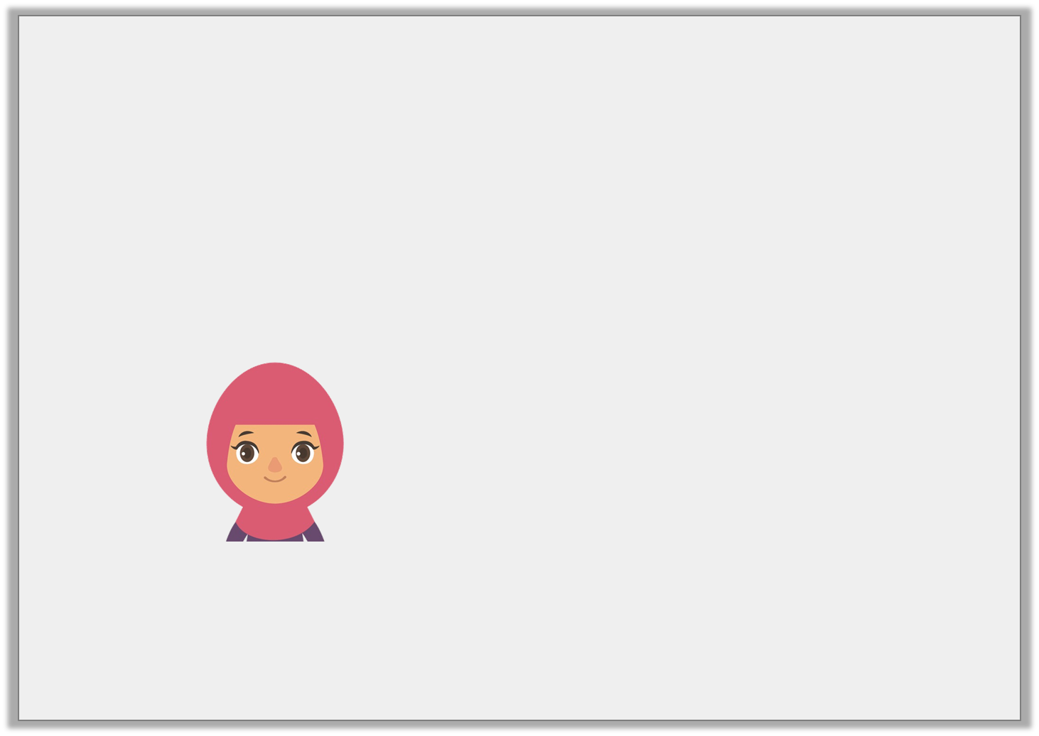
Reasoning 2
Mr Cole shares the sentence below with Class R.
When I was younger, I took the bus to work until I had finally passed my driving test.
Scarlett says,
Is Scarlett correct? Explain your answer.
There are two adverbs used in the sentence.
© Classroom Secrets Limited 2019

Slide 18
Reasoning 2
Mr Cole shares the sentence below with Class R.
When I was younger, I took the bus to work until I had finally passed my driving test.
Scarlett says,
Is Scarlett correct? Explain your answer.
Scarlett is correct because…
There are two adverbs used in the sentence.
© Classroom Secrets Limited 2019

Slide 19
Reasoning 2
Mr Cole shares the sentence below with Class R.
When I was younger, I took the bus to work until I had finally passed my driving test.
Scarlett says,
Is Scarlett correct? Explain your answer.
Scarlett is correct because ‘until’ and ‘finally’ are both adverbs of time.
There are two adverbs used in the sentence.
© Classroom Secrets Limited 2019

