Slide 1
Maths
Fractions
Year One
Maths | Year 4 | Fractions | Rounding Decimals | Lesson 1 of 1: Round It

Slide 2
Round It

Slide 3
Aim
I can round a decimal number.
Success Criteria
I can place a decimal number on a number line.
I can round a decimal number to the nearest whole number.

Slide 4
Rounding
When we are rounding numbers to the nearest 10, how do we know whether to round up or down?
5 is the golden number.
3
6
0
5
10
If the ones digit is less than 5, we round down.
If the ones digit is 5 or greater, we round up.

Slide 5
Rounding
For each number, we have to identify the multiples of 10 below and above it. If we are rounding 32 to the nearest 10, what would the multiples of 10 above and below it be?
32
30
35
40
What would the golden number be?
Where would 32 be on the number line?
What is 32 rounded to the nearest 10?
32 rounded to the nearest 10 is 30.

Slide 6
Rounding
What is 8 rounded to the nearest 10?
8
0
5
10

Slide 7
Rounding
What is 24 rounded to the nearest 10?
24
20
25
30

Slide 8
Rounding
What is 65 rounded to the nearest 10?
60
65
70

Slide 9
Rounding To Whole Numbers
When we round numbers with one decimal place, 5 is still the golden number but now we look at the tenths digit instead of the ones.
Where would 0.7 be on the number line?
0.7
0
0.5
1
0.7 rounded to the nearest whole number is 1.

Slide 10
Rounding To Whole Numbers
For each number, we have to identify the integers below and above it. If we are rounding 2.7 to the nearest whole number, what would the integers above and below it be?
2.7
2
2.5
3
What would the golden number be?
Where would 2.7 be on the number line?
What is 2.7 rounded to the nearest whole number?
2.7 rounded to the nearest whole number is 3.

Slide 11
Rounding To Whole Numbers
What is 0.5 rounded to the nearest whole number?
0
0.5
1

Slide 12
Rounding To Whole Numbers
What is 6.4 rounded to the nearest whole number?
6.4
6
6.5
7

Slide 13
Rounding To Whole Numbers
What is 45.1 rounded to the nearest whole number?
45.1
45
45.5
46

Slide 14
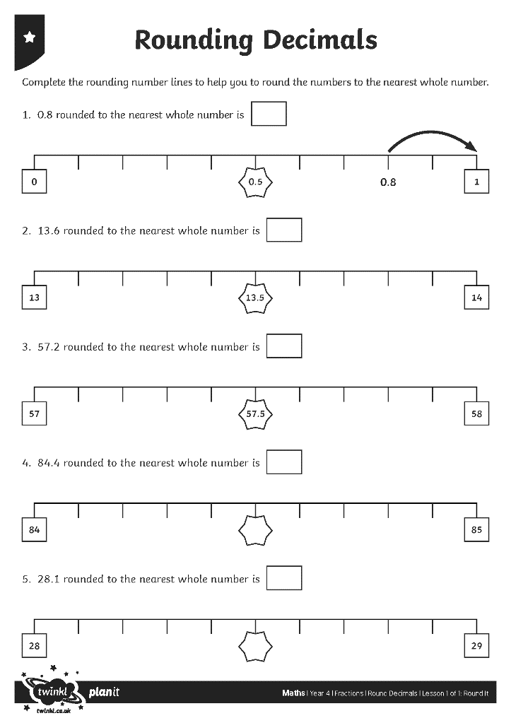
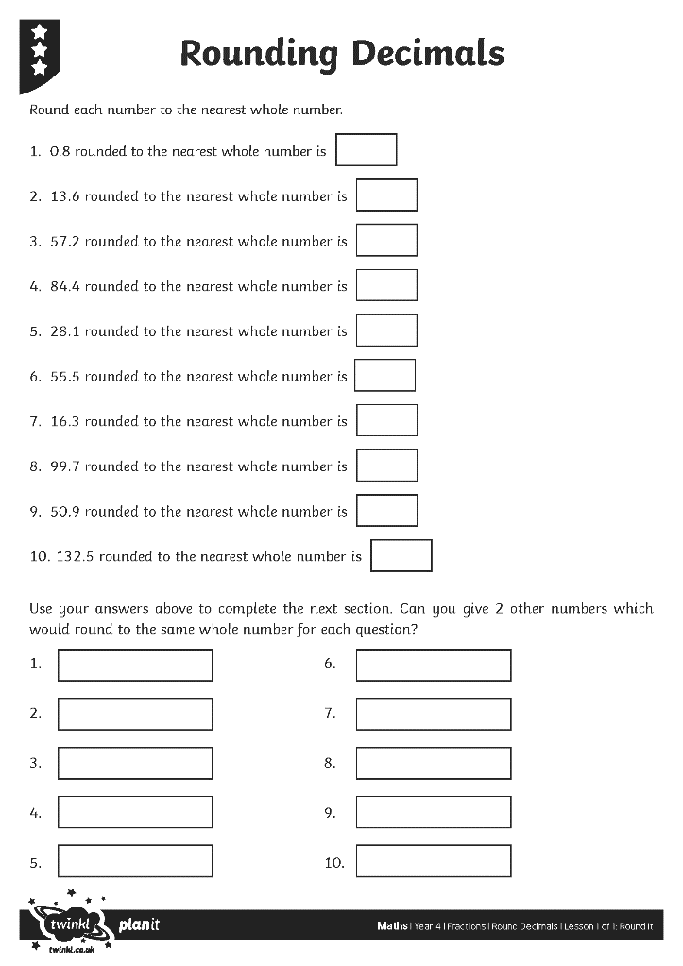
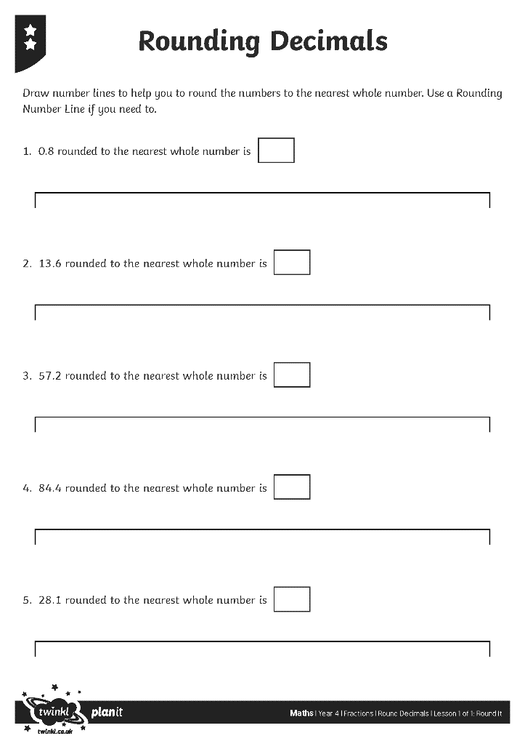
Rounding Decimals

Slide 15
Aim
I can round a decimal number.
Success Criteria
I can place a decimal number on a number line.
I can round a decimal number to the nearest whole number.

