Slide 1

Parents and Carers Information Meeting

Slide 2
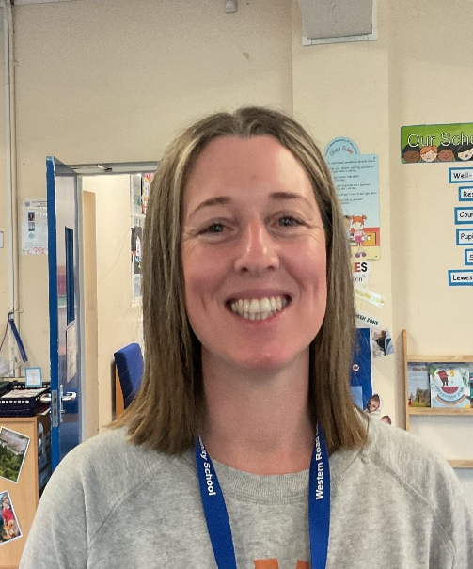
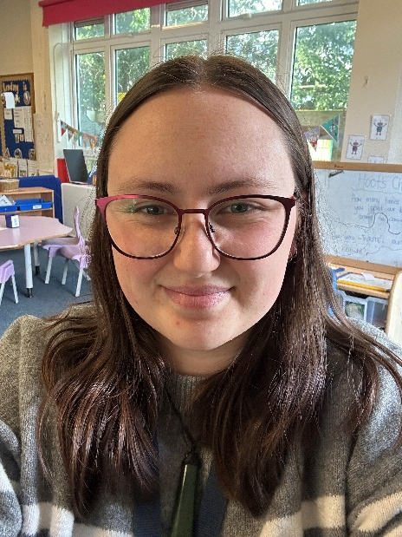
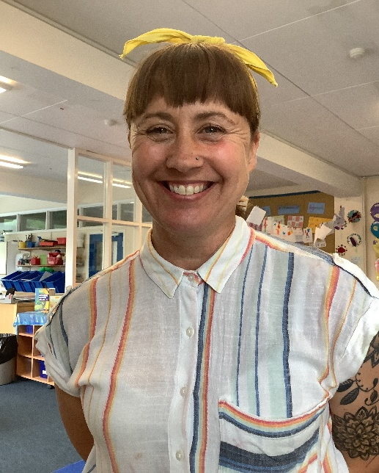
Teaching Team
Mrs Mottram Mrs Starnes Mrs Reed

Slide 3
Aims of the Session
Today we aim to:
Give you a little bit of information about Reception and starting school
To help you to feel more relaxed about the transition into school

Slide 4

Settling In
All children will have a phased introduction to give them time to settle in
The most important aspects of the first half term are…
  For your child to feel settled at school
  To make friends
  To learn the routines of the classroom

Slide 5

Helping at Home
Talk to your child about school
Show your child their new uniform
Pick a new water bottle
Practise dressing and undressing (make it fun!)
Ensure all items are named

Slide 6
    We follow the Early Years Foundation Stage (EYFS) curriculum.
    Communication and Language
    Physical Development
    PSED
    Literacy
    Mathematics
    Understanding of the World
    Expressive Arts and Designs
Learning in Reception

Slide 7
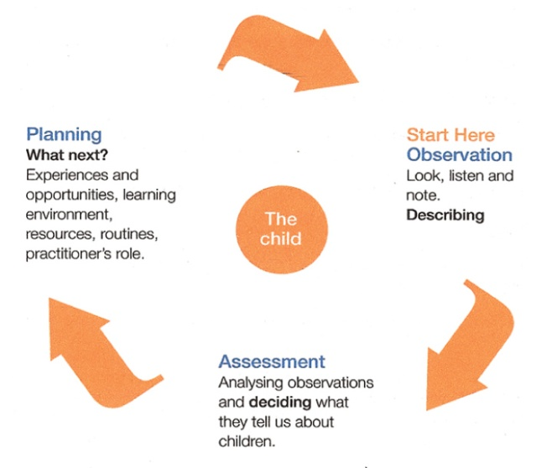
    We monitor children’s progress through observations, which we then use to inform our planning and your child’s next steps in learning.
    The EYFS Curriculum enables practitioners to teach children through a play based curriculum.
The Teaching-Learning Cycle

Slide 8

    Each child is unique and has individual ways of learning.
    The Reception team will make sure that the learning is suited to your child’s unique interests, needs and abilities.
Learning in Reception

Slide 9
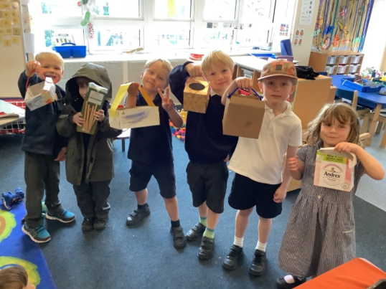
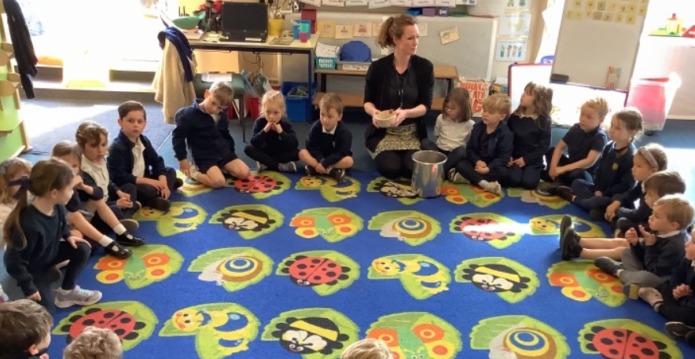

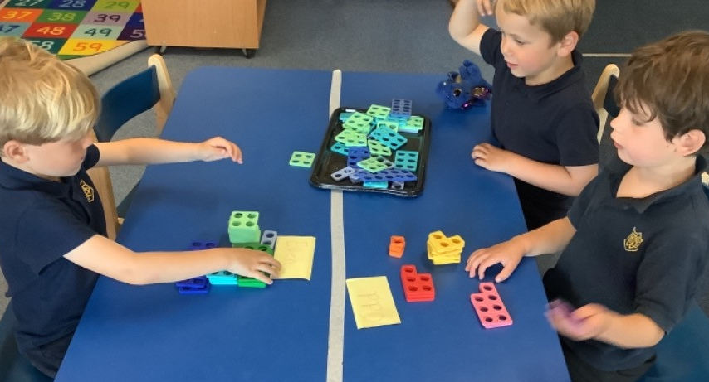
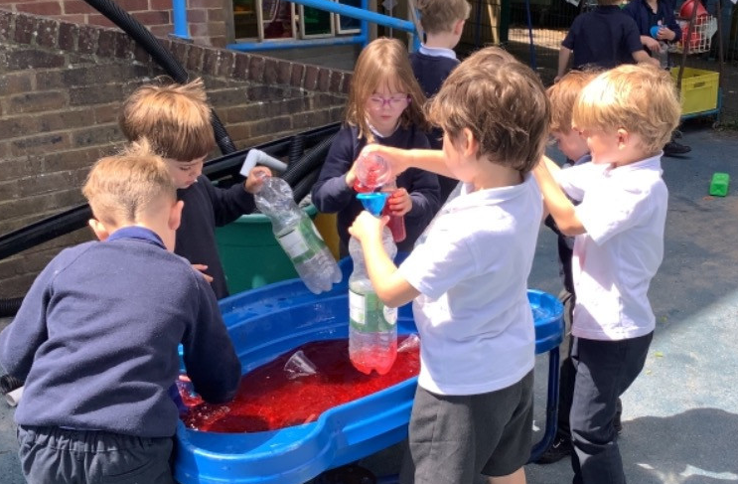
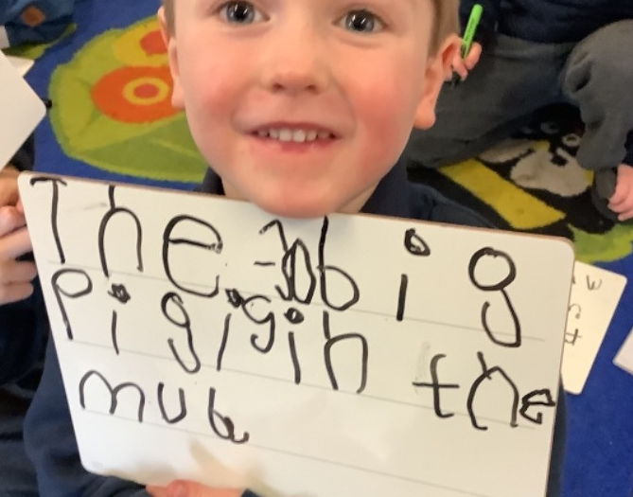
Class Activities and Lessons
In Reception we offer an extensive range of lessons and activities.
There are a mixture of guided and independent activities throughout the day.
Learning takes place both inside and outside the classroom.

Slide 10
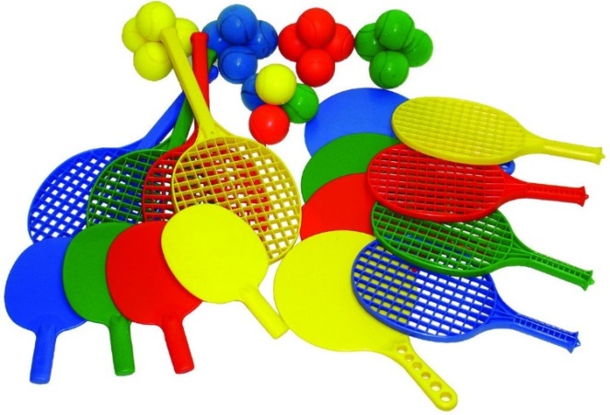
PE
    Children take part in a range of learning opportunities which promotes physical development
    P.E. in Reception takes place every week
    We ask that your child comes into school wearing PE kit on
PE days. See our uniform policy/welcome pack for more information

Slide 11

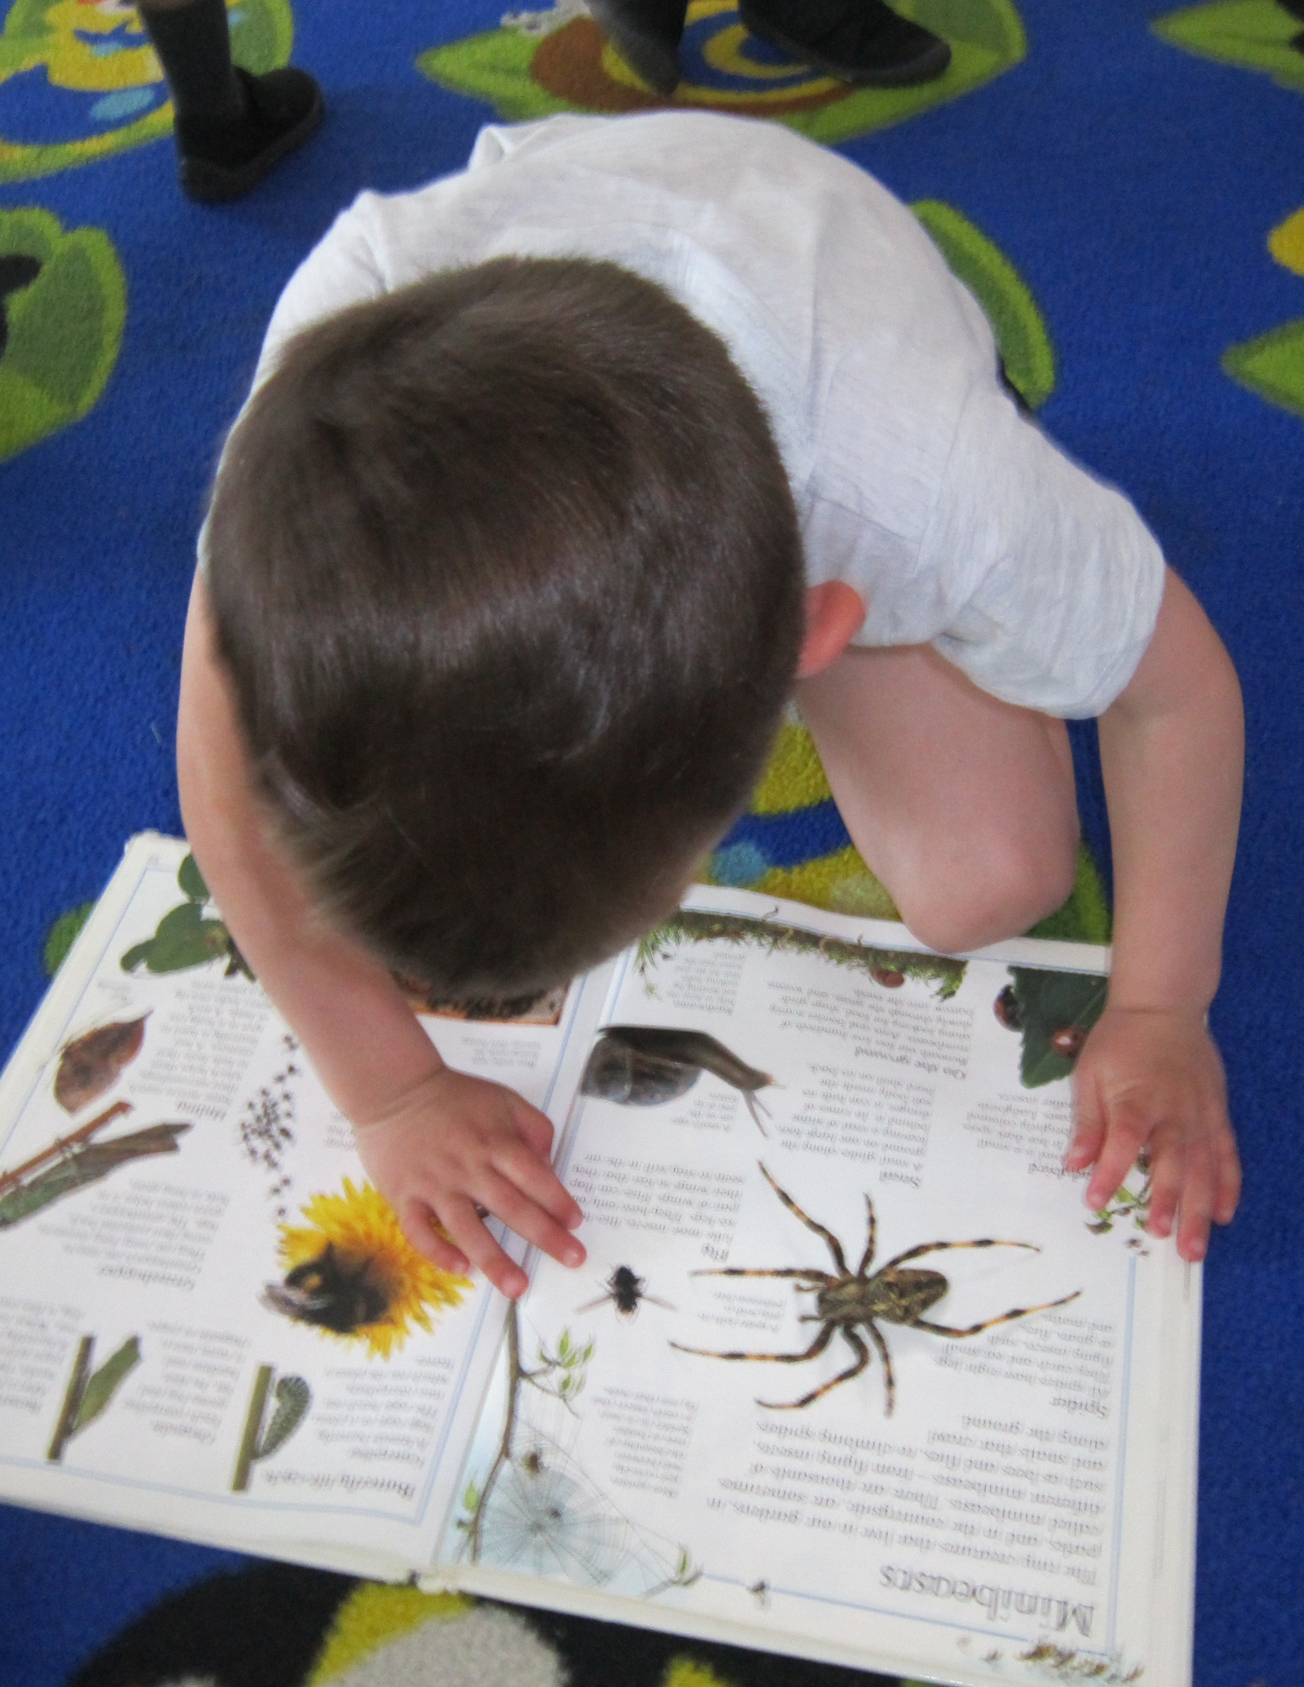
In Reception your child will be given books each week to read at home we will change these regularly.
We send home 2 books per week and a copy of the phonics focus for each unit of Sounds Write. We send home one ‘fully decodable’ book which links with the phonemes we have learnt in the previous week. Please practise the phonics and read daily, logging this in the reading record provided.
We also send home a library book of their choice, which is for you to share with your child.
We will hold a parent meeting in the Autumn Term to explain phonics and reading in more detail.
We read with the children regularly at school.
This will be 1:1 and in small groups, with the teacher or the TA.
Reading Information

Slide 12


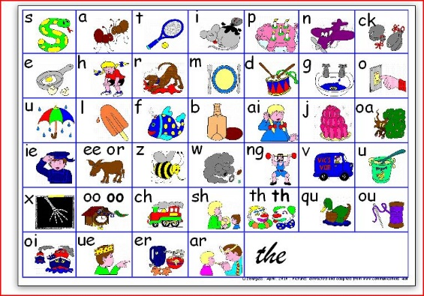
We use an online learning journal called Tapestry. We upload photos of the children learning at school for you to see. You can also upload photos of your child learning at home.
We share a weekly update through Tapestry to keep you informed about our learning. This will sometimes include suggestions and ideas of how you could support your child’s learning at home.
Please sign the consent form found in your pack and return to school as soon as possible.
Learning at Home

Slide 13
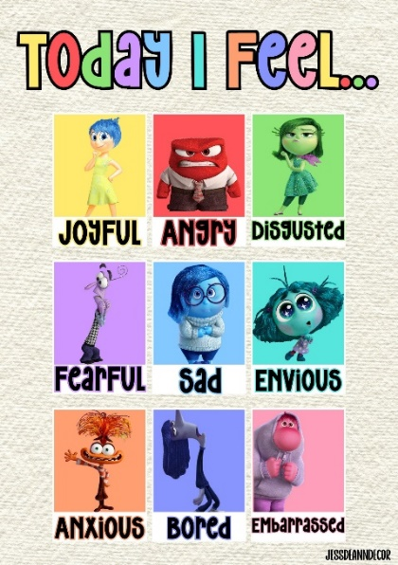
Supporting Positive
Behaviour
In the classroom we talk to and teach the children about emotional literacy and regulation. We use a variety of strategies to help the children identify how their bodies feel when they are experiencing different emotions, and strategies that they can adopt to help themselves and each other. This enables children to begin to regulate their own emotions independently. We regularly talk to the children about the behavioural expectations of our classroom and school community.
Children’s achievements are celebrated with parents and carers during fortnightly assemblies where children in each class receive the Headteacher’s Award. Parents are informed in advance of their children’s awards and invited to attend. (We don’t let the children know until they hear their name being called).
In addition, we send home WOW Slips for you to share successes from home. These are celebrated in class.

Slide 14
Food and Drink
Government Legislation means that from Sept 2014, all Reception and KS1 children are entitled to a free school meal.
You can still opt to provide your child with a healthy packed lunch if you wish to do so. We ask that packed lunches contain healthy options for your child and no foods containing nuts or sesame.
Reception children are also entitled to a piece of fruit mid-morning. You are welcome to provide an alternative healthy snack.
Water bottles need to have a sports cap or straw (no open top) to avoid spills in the classroom.

Slide 15

Year 6 pupils support the Reception children at playtimes and lunchtimes.
Buddy System

Slide 16
Preschool Visits
We know that transition to school can be a nerve-wracking and exciting time for children and adults. To help the children have a smooth transition from their nursery to school, we have started visiting some of the nurseries that your children go to.
During the visit we will get a chance to speak to your child’s key worker and hopefully see your child in action.
If we are not able to visit, we will arrange phone calls with your child’s key worker.

Slide 17

Settling Sessions and Parent Consultations
We are looking forward to meeting and getting to know the children over the coming weeks at the two settling sessions which will be held on
Thursday 2nd July at 9.15-10.15am (A-L)
OR
Thursday 2nd July at 10.30-11.30am (M-Z)
Please sign up for a 1:1 Parent Consultation with the Reception Teachers. These will take place in the classroom. These will be held on
Friday 4th September and Monday 7th September
Staggered start from Tuesday 8th September.

Slide 18
What is school readiness?
Your child can…
Put on their own jumper/cardigan and coat
Do up their own shoes
Open and close their bag on their own
Open their snack or peel their fruit
Go to the toilet by themselves

Slide 19

If you have any concerns or questions, please come and speak to one of us.
Many thanks for coming. We look forward to meeting you and your child!
Finally

