Slide 1


Maths
Position and Direction
Year One
Maths | Year 1 | Position and Direction | Turns | Lesson 1 of 3: Tile Turns

Slide 2
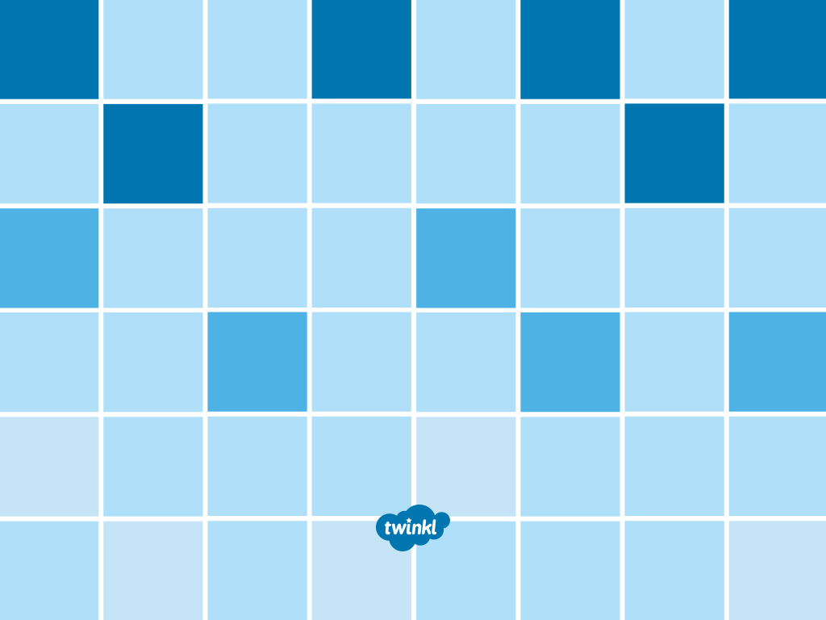
Tile Turns

Slide 3
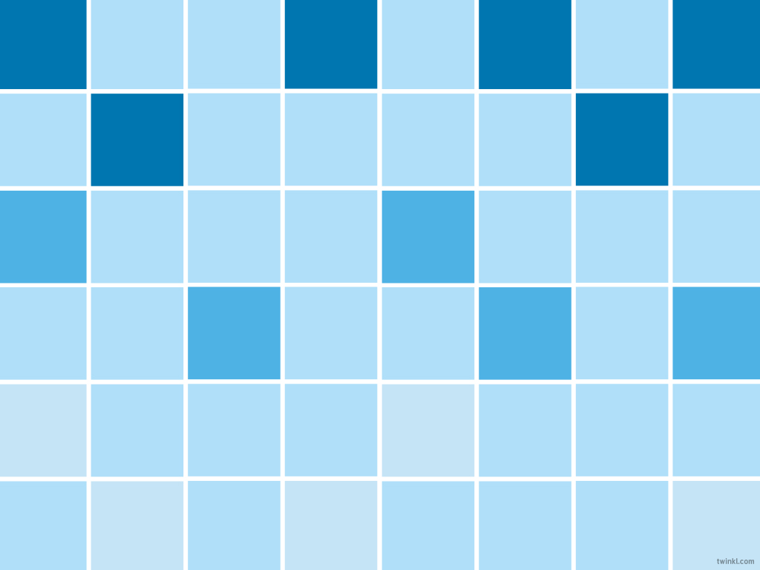
Aim
I can move a quarter turn, half turn, three-quarter turn and whole turn.
Success Criteria
I can turn in a full circle.
I can move a quarter turn.
I can move a half turn.
I can move a three-quarter turn.
I can complete patterns using turns.

Slide 4
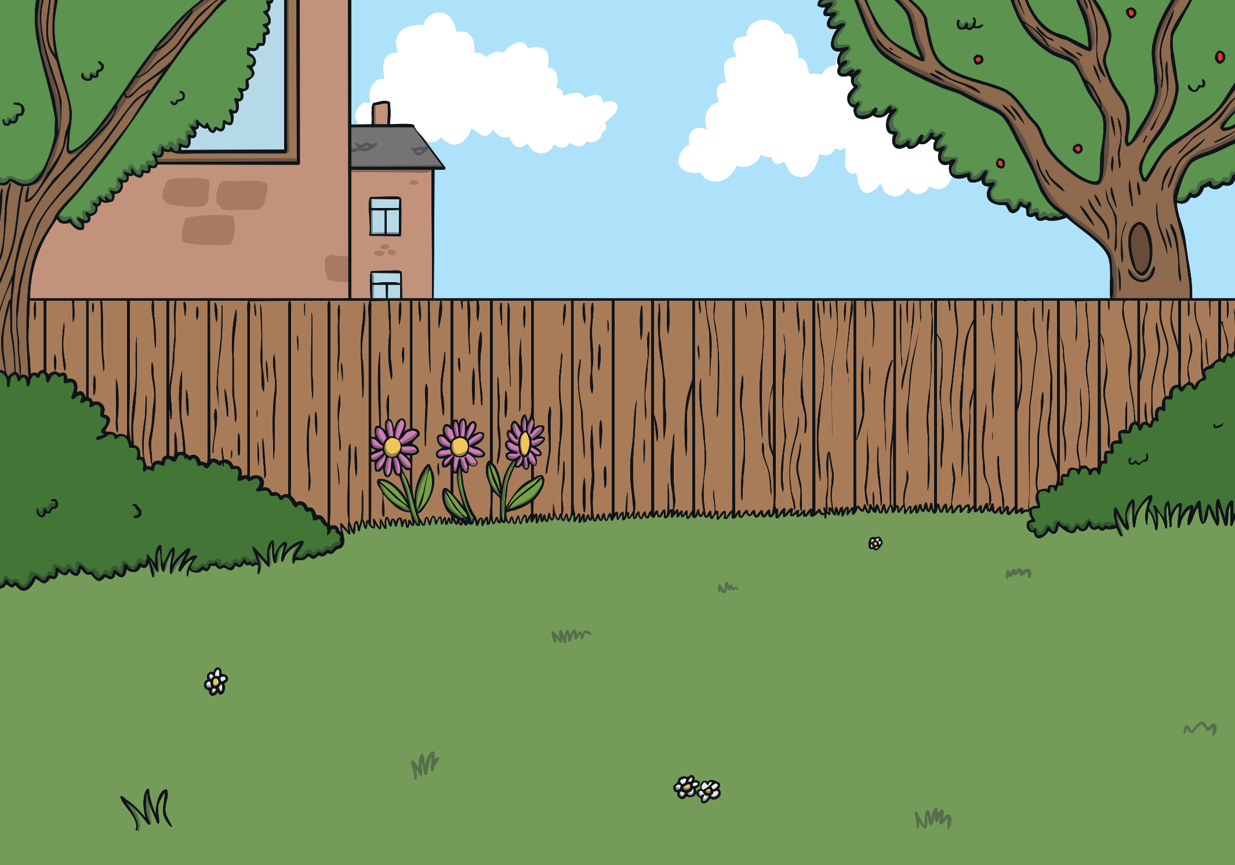

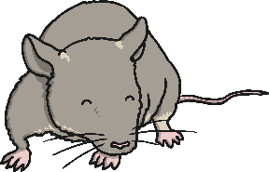
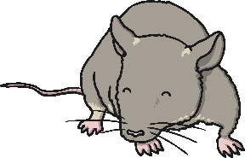
Left and Right Mice
Which direction are the mice running to?
Click here for the next mouse

Slide 5



Listen and Move
Face the front and march on the spot.
Turn in a full circle.
Step to the left then step to the right.
Jump backwards and jump forwards.
Slide to the left and slide to the right.
Turn half way round in a circle.
Face the front and march on the spot.

Slide 6

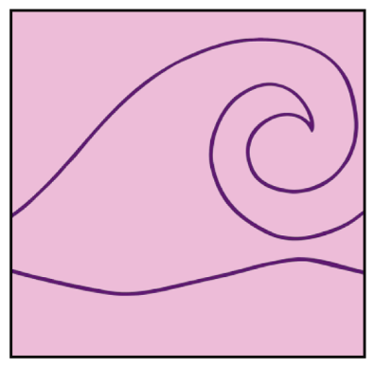
Tile Explore
Click the tiles to reveal turns!
a full turn or a whole turn
a half turn
a three-quarter turn
a quarter turn
What patterns you can make using turns with your Tiling Together Cards? All of these tiles have been turned in a 'clockwise' direction.

Slide 7
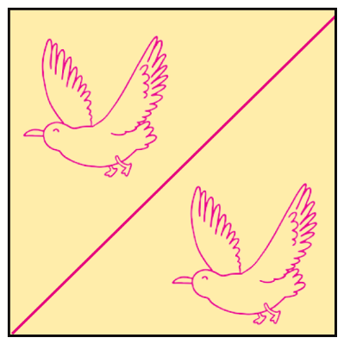
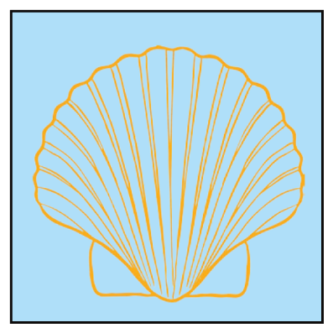
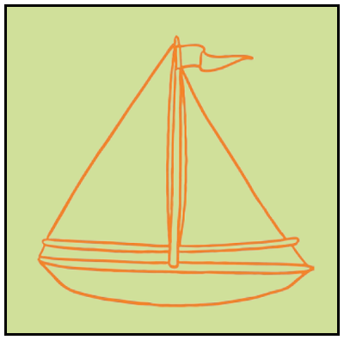
Tile Explore
Click the tiles to reveal the turns!
A full turn or a whole turn.
A half turn.
A quarter turn.
A three-quarter turn.
What patterns you can make using turns with your Tiling Together Cards?

Slide 8

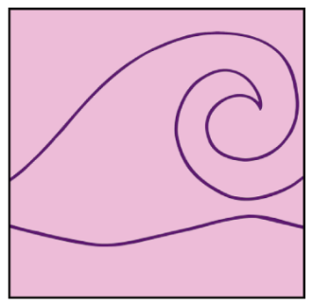
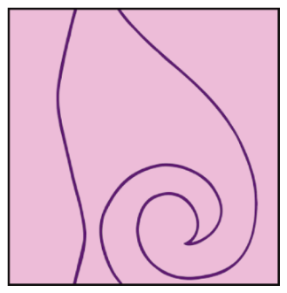
Tile Turns
Complete the tile pattern.
What turns did you use?

Slide 9
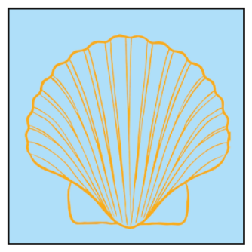
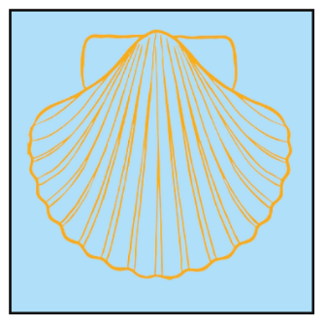
Tile Turns
Complete the tile pattern.
What turns did you use?

Slide 10
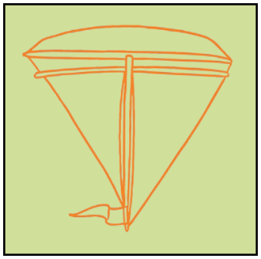

Tile Turns
Complete the tile pattern.
What turns did you use?

Slide 11
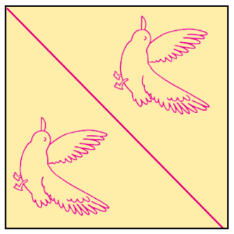
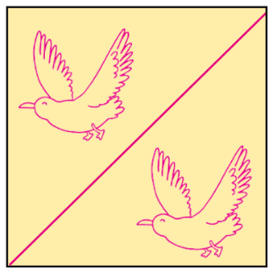
Tile Turns
Complete the tile pattern.
What turns did you use?

Slide 12
Aim
I can move a quarter turn, half turn, three-quarter turn and whole turn.
Success Criteria
I can turn in a full circle.
I can move a quarter turn.
I can move a half turn.
I can move a three-quarter turn.
I can complete patterns using turns.

Slide 13
