Slide 1
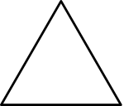
3.1 The part–whole relationship Step 4:1
What is the whole?
one part

Slide 2
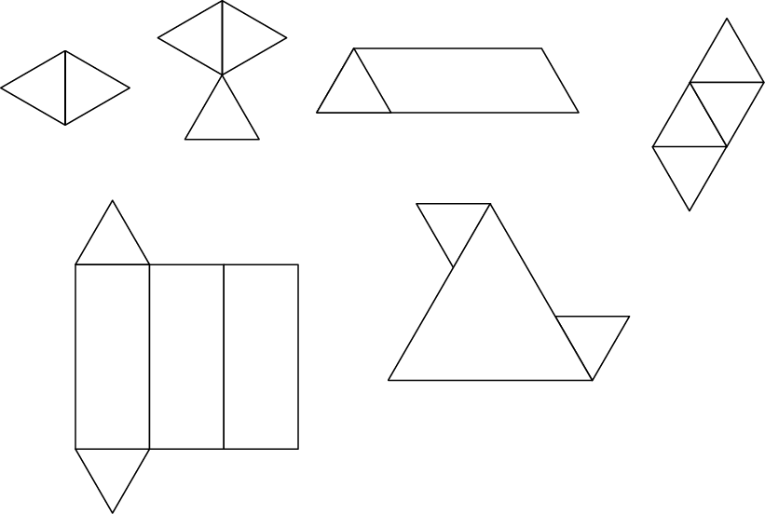
3.1 The part–whole relationship Step 4:1
The wholes might be…

Slide 3
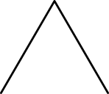
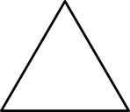
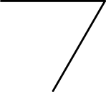
3.1 The part–whole relationship Step 4:2
What is the whole?
Notes:
This triangle is one part of a whole made out of three equal parts.

Slide 4
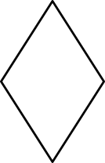
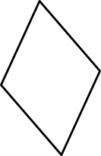

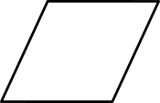
3.1 The part–whole relationship Step 4:2
What is the whole?
What is the same? What is different?
Notes:
The rhombus is one part of a whole made out of three equal parts.

Slide 5

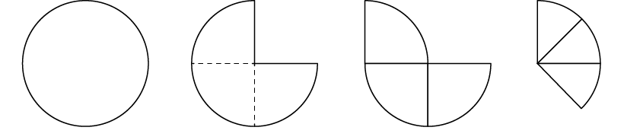
3.1 The part–whole relationship Step 4:2
Who has drawn the correct shape? Why?
One part of
a whole made out of
three equal parts.
Max
Beth
Ellen
Florent
✗
✓
✓
✗
Notes:
Four children have been given a part of a shape and have been asked to
draw the whole shape. Who has drawn a correct shape? Why?

Slide 6
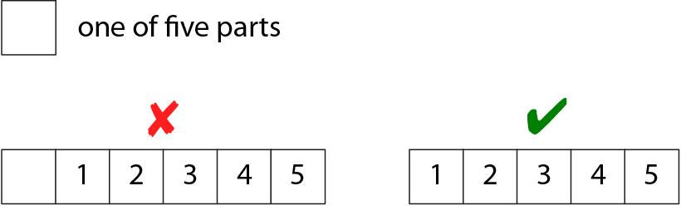
3.1 The part–whole relationship Step 4:3
What is the whole?
one of 5 parts

Slide 7
3.1 The part–whole relationship Step 4:4
1 part of 5 parts. Draw the whole ribbon.
Notes:
I have cut a ribbon into five equal parts.
Here is one part of my ribbon.
How long was my ribbon to start with?

Slide 8



3.1 The part–whole relationship Step 4:4
1 part of 4 parts. What is the whole rod?
Notes:
Here is a red Cuisenaire® rod. It is one of four equal parts of another rod.
What is the whole rod?

Slide 9
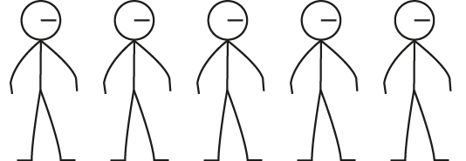
3.1 The part–whole relationship Step 4:4
1 of 4 equal teams in the class. Draw the whole class.
Notes:
The class has been divided into four equal teams. Here is one of the teams.
How many children are in the class? Draw the whole class.

Slide 10
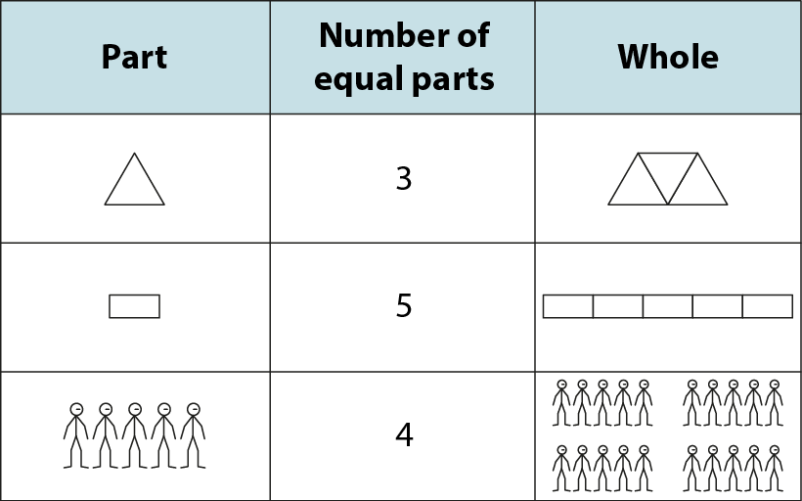
3.1 The part–whole relationship Step 4:5

