Slide 2
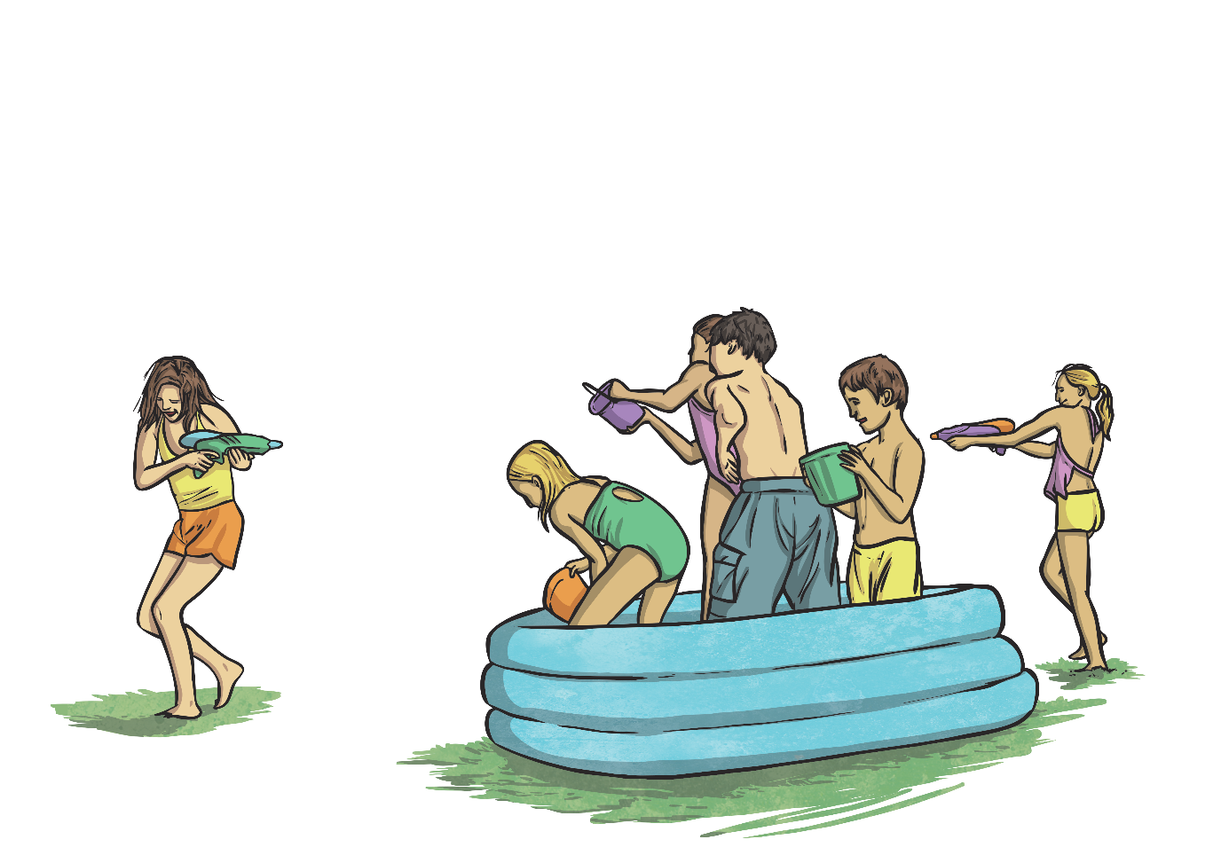
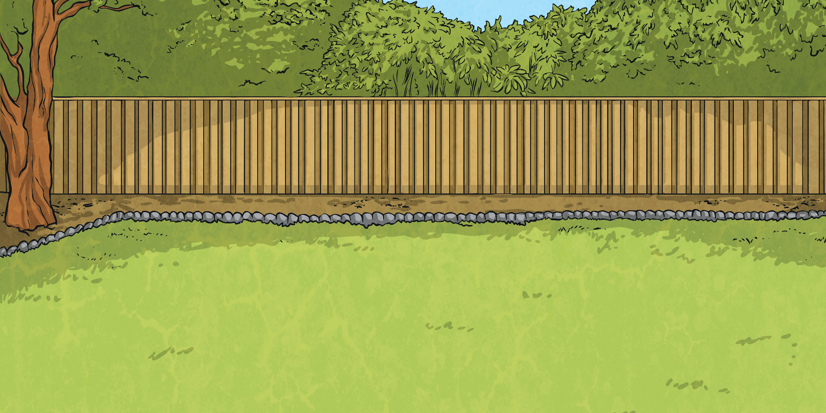
Converting Litres
to Millilitres
A litre is equivalent to 1000ml.
1 litre | 2 litres | 3 litres | 4 litres | 5 litres | 6 litres | 7 litres | 8 litres | 9 litres | 10 litres
1000ml
2000ml
3000ml
4000ml
5000ml
6000ml
7000ml
8000ml
9000ml
10 000ml

Slide 3
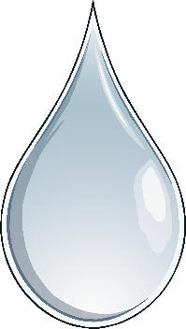


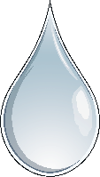
Converting Litres
to Millilitres
How many millilitres in…?
2 litres
7 litres
9 litres
3 litres
2000ml
7000ml
9000ml
3000ml
8 litres
4 litres
6 litres
5 litres
8000ml
4000ml
6000ml
5000ml
?
?
What calculation do we need to do to convert from litres to millilitres?
What do you notice about the answers?
Millilitres are smaller than litres, so there are more of them in the same volume. There are a thousand times as many millilitres in the same volume as litres.
We need to multiply the number of litres by 1000.

Slide 4
Converting Litres
to Millilitres
Sometimes, measurements are written in mixed units, e.g. 5l 500ml. What would we need to do to answer the following questions?
We need to convert the litres to millilitres by multiplying by 1000. We then need to add the extra millilitres on to find the total.
?
How many millilitres in 1l 500ml?
1l = 1000ml
1000ml + 500ml = 1500ml
?
How many millilitres in 2l 250ml?
2l = 2000ml
2000ml + 250ml = 2250ml
?
How many millilitres in 4l 750ml?
4l = 4000ml
4000ml + 750ml = 4750ml

Slide 5


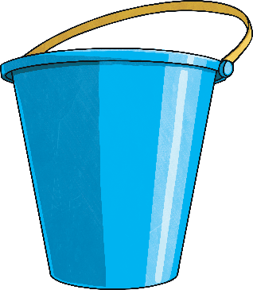
Converting Litres
to Millilitres
How many millilitres in…?
6l 750ml
5l 250ml
3l 500ml
3500ml
6750ml
5250ml

Slide 6
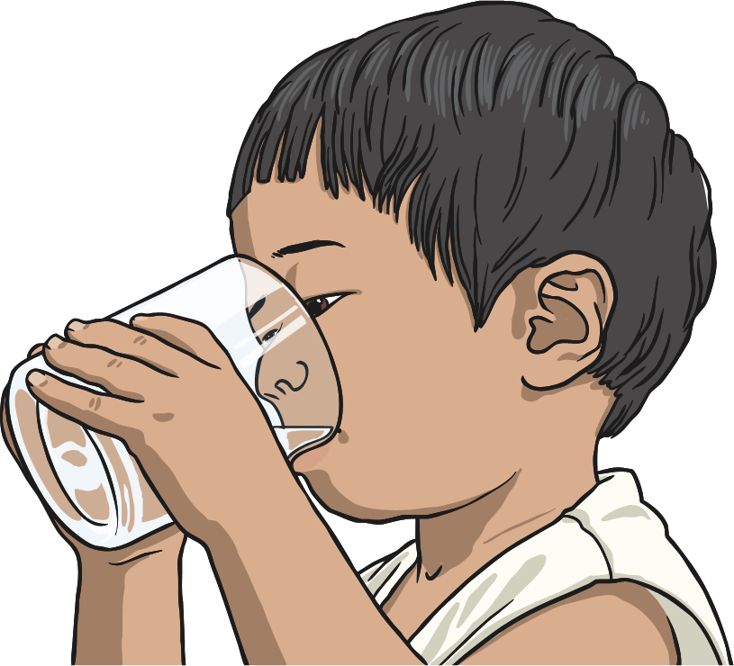
Converting Millilitres
to Litres
To convert from litres to millilitres, we multiply by 1000. What do you think we need to do to convert from millilitres to litres?
We need to divide the number of millilitres by 1000.
8000ml ÷ 1000 = 8l
If this creates a decimal number, the thousandths can be written as millilitres:
6500ml ÷ 1000 = 6.500 = 6l 500ml

Slide 7
Converting Millilitres
to Litres
How many litres in…?
2750ml
8500ml
4000ml
4l
2l 750ml
8l 500ml

Slide 8

Ordering Measurements
Here are 3 measurements:
5000ml
4l 250ml
3500ml
4250ml
First, change the measurements into the same unit.
Now, order the measurements.
3500ml
4l 250ml
5000ml
Key Fact
1 litre = 1000ml

Slide 9
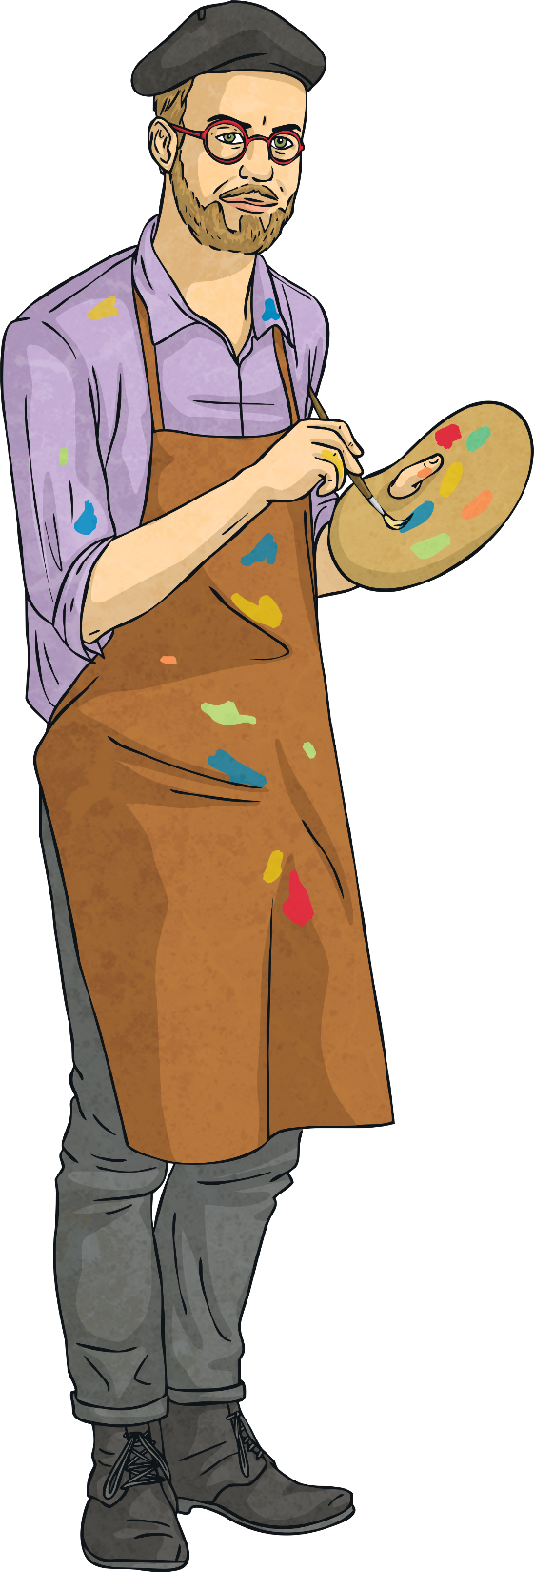
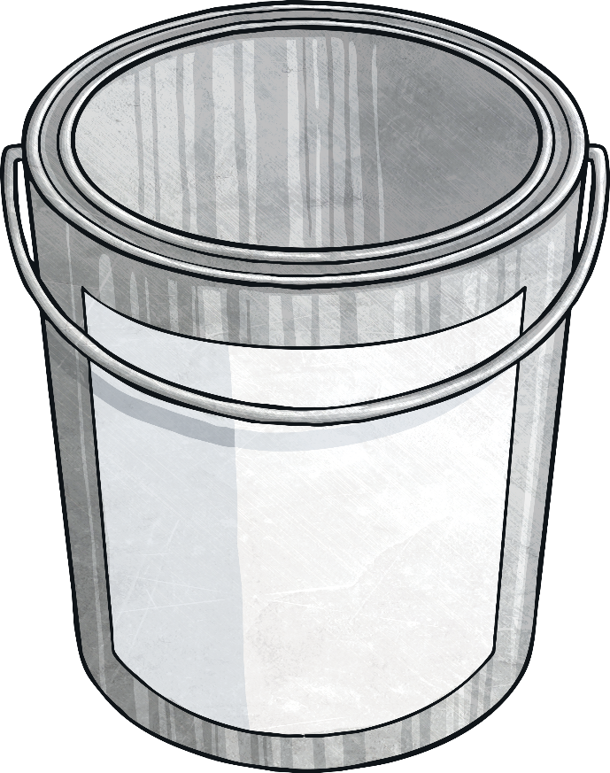
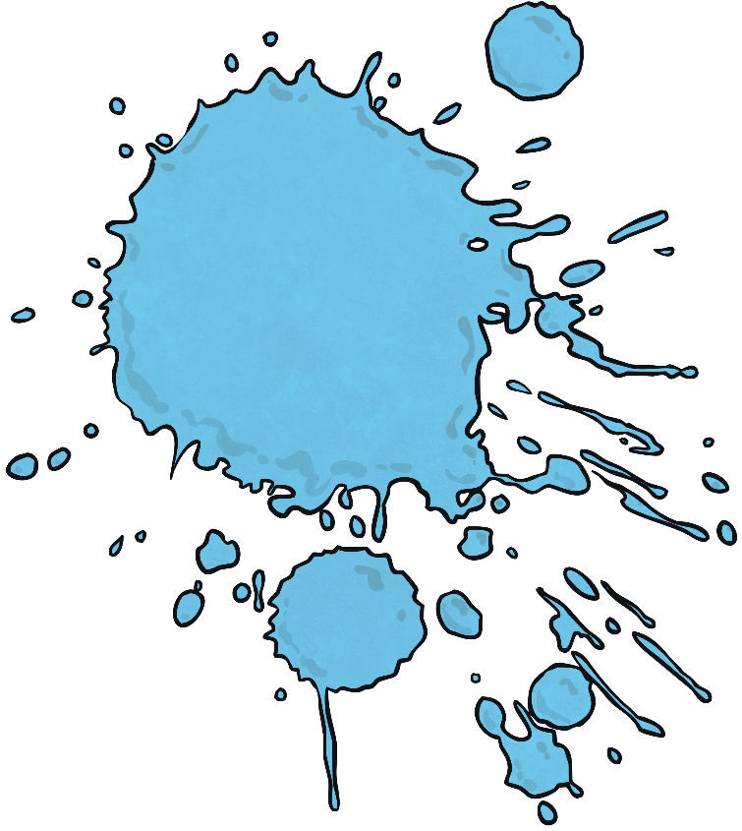
How Much More?
How much more do you need to add to the amount shown to make 5 litres? Write your answer in millilitres.
add
2992ml
2008ml
5l

