Slide 1
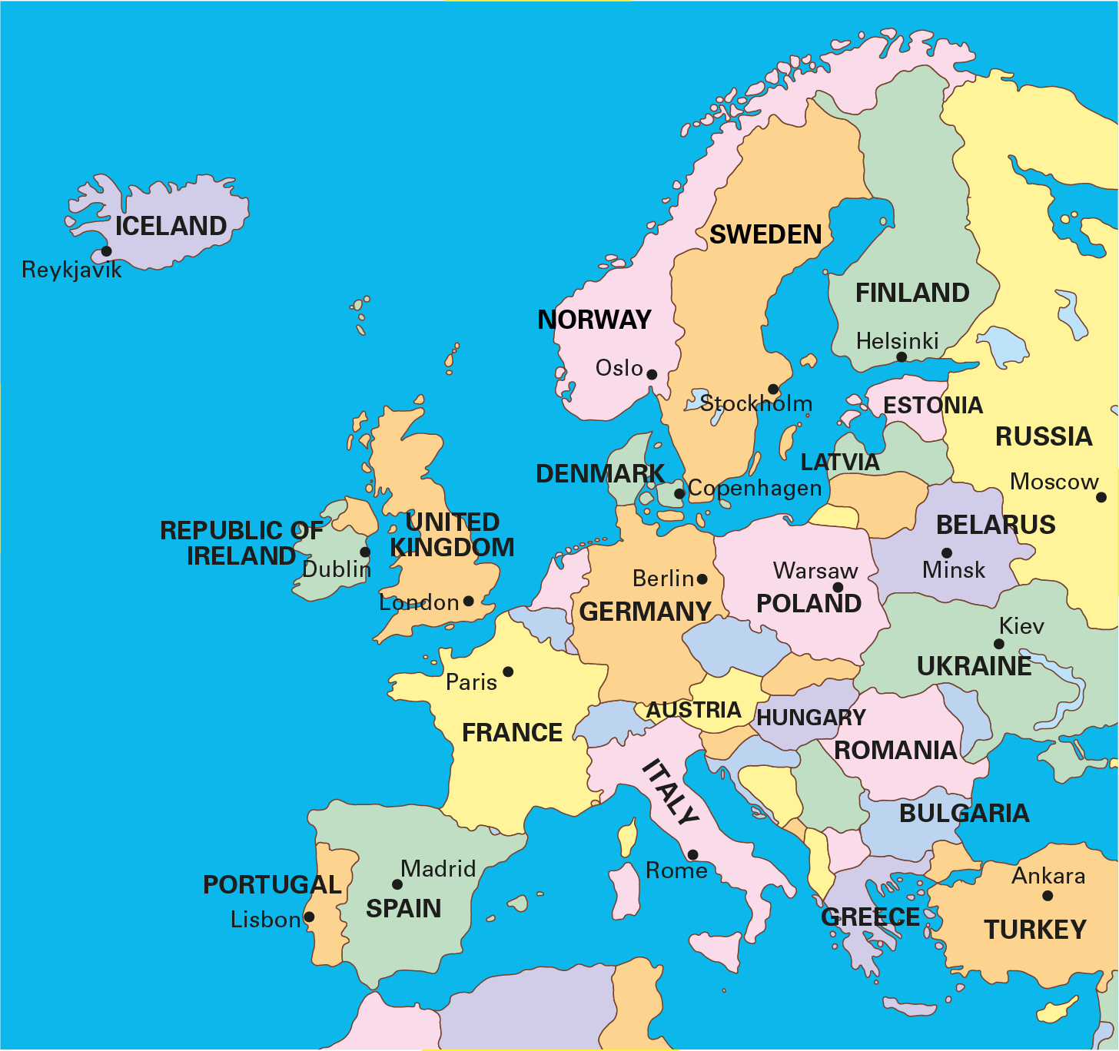
3.1 The part–whole relationship Step 1:1
Notes:
If Europe is the whole, then the United Kingdom is part of the whole.

Slide 2
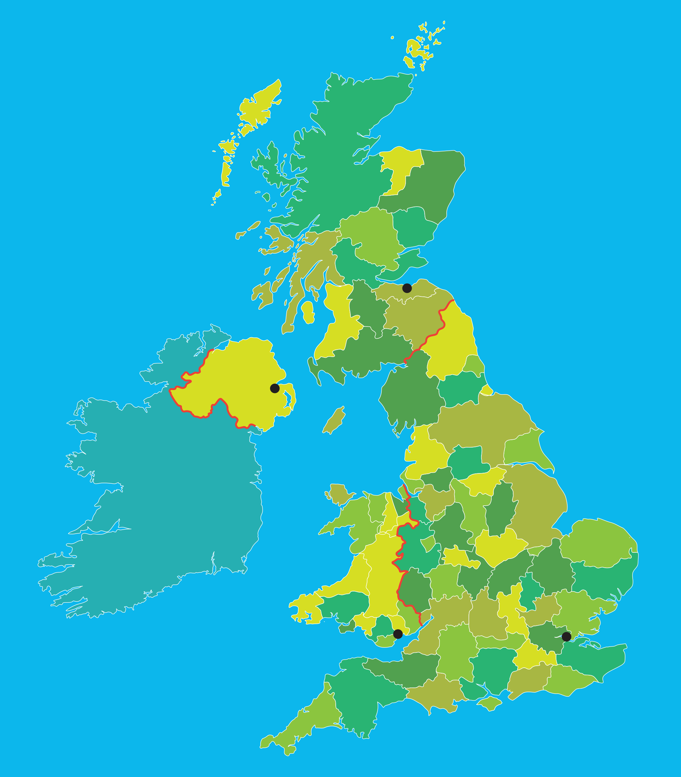
3.1 The part–whole relationship Step 1:2
Scotland
Edinburgh
Northern
Ireland
Belfast
Wales
England
Cardiff
London
Notes:
If the United Kingdom is the whole, then London is part of the whole.

Slide 3
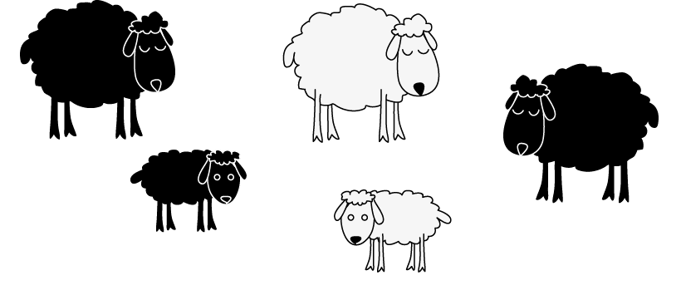
3.1 The part–whole relationship Step 1:4
Notes:
If the group of sheep is the whole, then the black sheep are part of the whole.

Slide 4

3.1 The part–whole relationship Step 1:4
Notes:
If the week is the whole, then Tuesday is part of the whole.

Slide 5
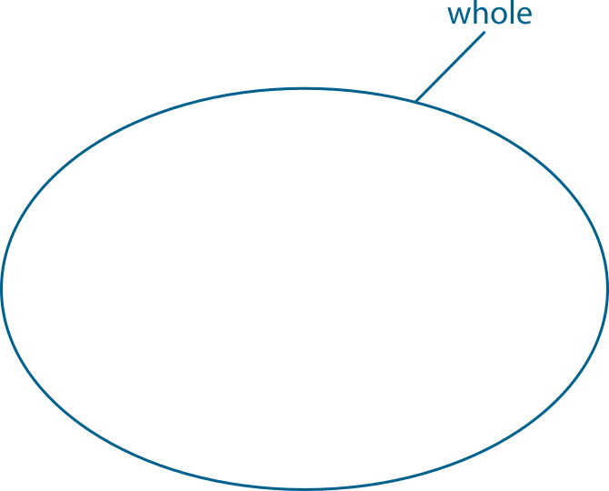
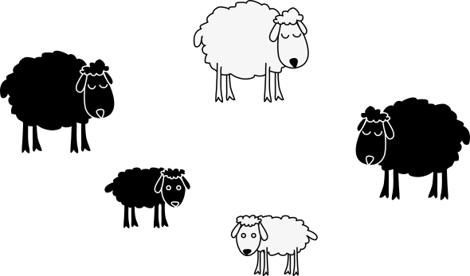
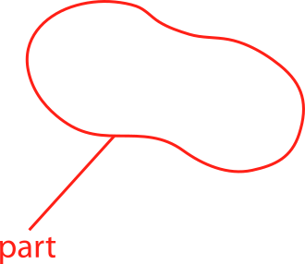
3.1 The part–whole relationship Step 1:5
Notes:
If the group of sheep is the whole, then the lambs are part of the whole.
The part is smaller than the whole.

