Slide 1
English

Slide 2
Monday – starter
Go through the next slides see if you can come up with an opening for your story using each different way of writing an opening

Slide 4

Story Openers
Story openers help to set the tone for the rest of our writing.
A good opening makes the reader want
to read on.
A good opening tantalises the reader with an idea of who, where, when or what is happening (or is going to happen).

Slide 5

Story Openers
Stories can open with a character description.
‘Mr Stink stank. He also stunk’.
from Mr Stink by David Walliams
Example: Phileas Fogg loved the word exactly. His life was very exact and he always did things at the same time everyday.

Slide 6
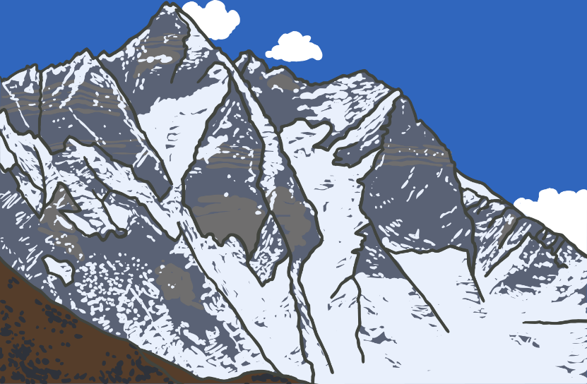
Story Openers
Stories can open with a description of a setting.
‘There was once a gaggle of
mountains, tall and proud,
each with a hat of snow.’
from Stone Goblins,
by David Melling
Example: Phileas Fogg lived in a very posh house in London. He attended a club everyday that was full of books and smart chairs to sit on.

Slide 7
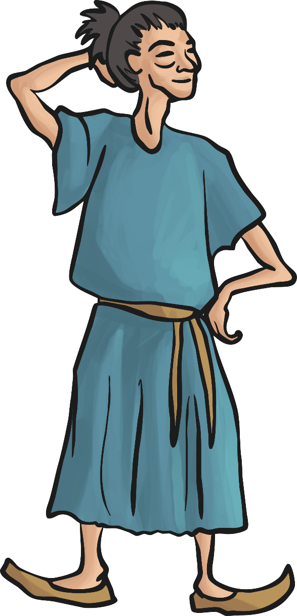
Story Openers
Stories can open with a description of both a character and a setting.
‘A thousand miles ago, in a country east of the
jungle and south of the mountains, there lived
a Firework-Maker called Lalchand…..’
From The Firework-Maker’s Daughter
by Phillip Pullman

Slide 8

Story Openers
Stories can open with dialogue.
‘Molllly!’ Maria shouted to her sister.
‘Would you please shut that window….’
from School for Stars: Second Term
at L’Etoile by Holly and Kelly Willoughby
Example: “did you know you can travel the world in 80 days!” exclaimed Phileas Fogg as he was reading his newspaper.

Slide 9
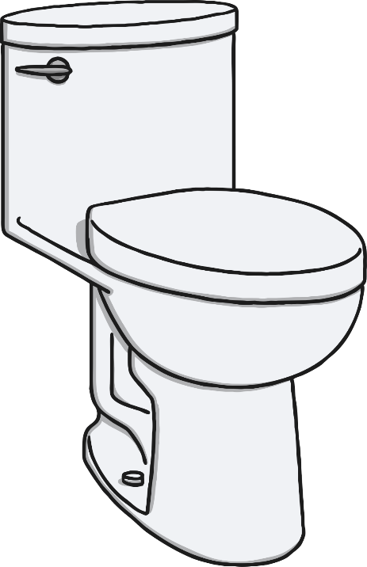
Story Openers
Stories can open with a question.
Good openers sometimes leave the reader with an unanswered question, which can only be answered by reading on.
‘Ever had the feeling your life’s been flushed
down the toilet?’
From The Toilet of Doom by Michael Lawrence
Example: Is it possible to travel around the world in 80 days? You are about to find out. Our story starts…..

Slide 10
Can you write the opening to your stories?
Make sure you set the scene and introduce Phileas Fogg!
Don’t forget: capital letters, full stops, finger spaces, adjectives, careful handwriting

Slide 11
I would like to read some of your stories so please could you write them in your writing book!
I will try and come up with a way you could send me your stories but if they are in that book I can see them when you come back ☺

Slide 12
Tuesday starter – Can you spot my mistakes? phileas fogg finally arrivt in Asia. He couldent believe his eyes He had never seen anyfing like it before. the Great Wall of China was right in front of him. It woz so long that he couldn’t see the end! The sun was shining and it was so calm peaceful he decided to walk all the way across it

Slide 13
Challenges:
Tuesday – can you include words that end with ly?
Wednesday – can you include words that end with est?
Thursday – Can you include words that end with er?
Friday – can you include words that end with ed?

