Slide 2
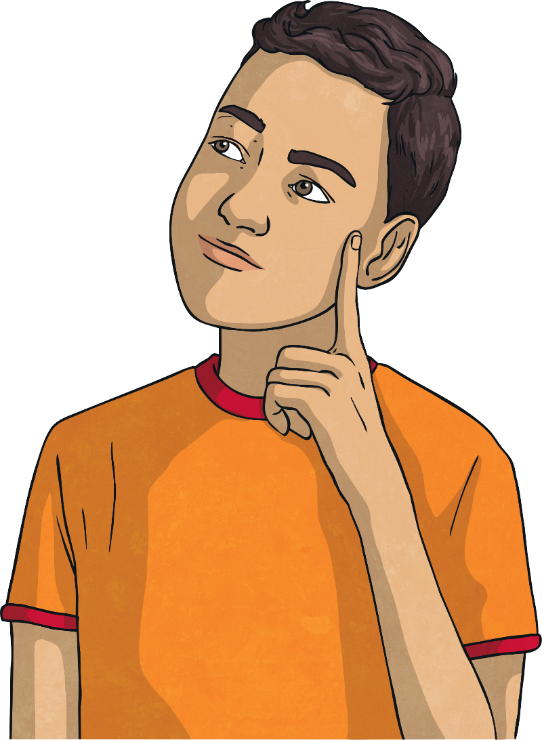
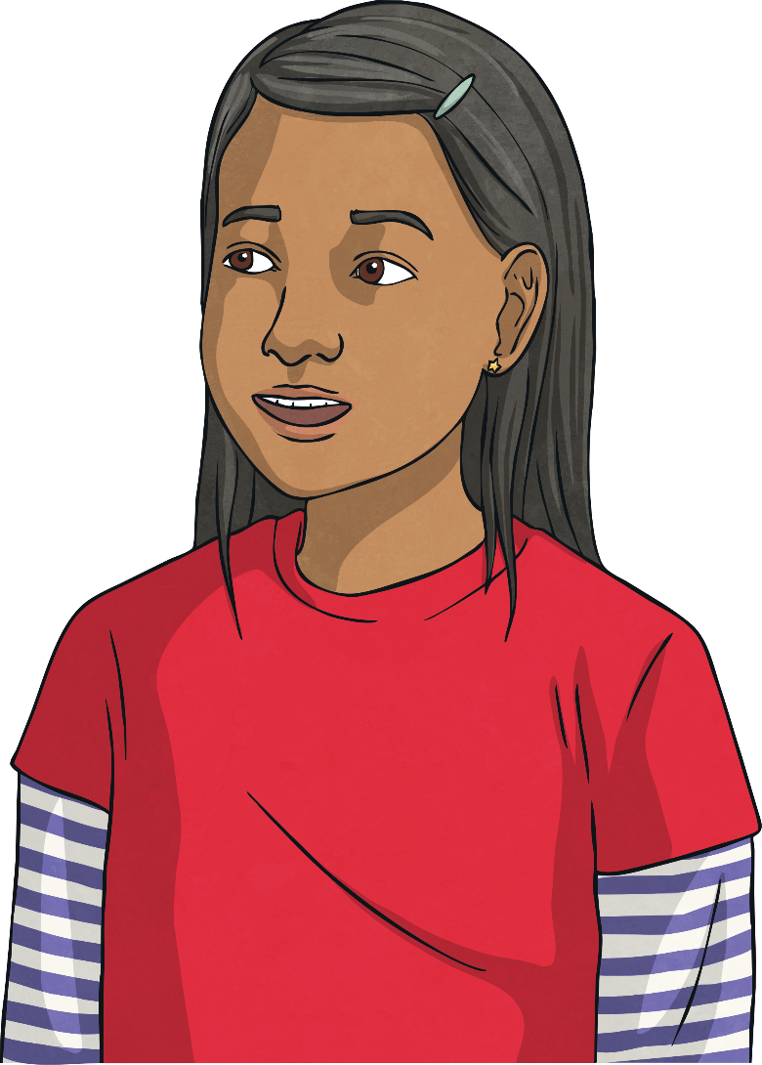
Why do adverts try to influence the way we spend money?
How do they do it?

Slide 3
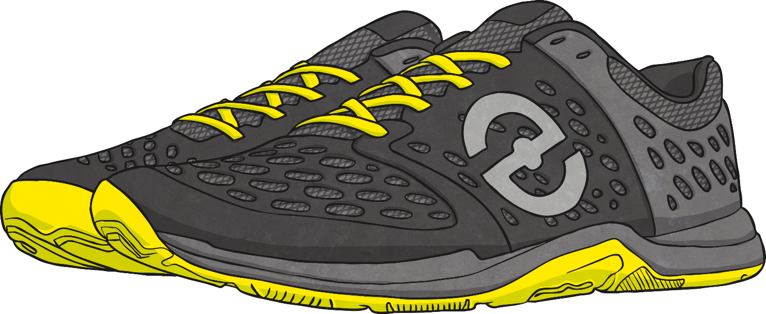
Why Advertise?
We have been thinking about where money comes from and what we can spend it on. Now let’s consider how companies try to influence our spending.
Speedz Trainers
Super cushioned soles for great comfort
Elastic laces for convenience
Bouncy rubber toes for super speed
Run faster than competitors
A brilliant choice for comfort!
Only £59.99
What is this advert trying to do?
How does it try to influence you?
Why is it doing this?
What is good about this advert?

