Slide 1
Year Reception Term 2
Week 20 Lesson 4 /ear/

Slide 2


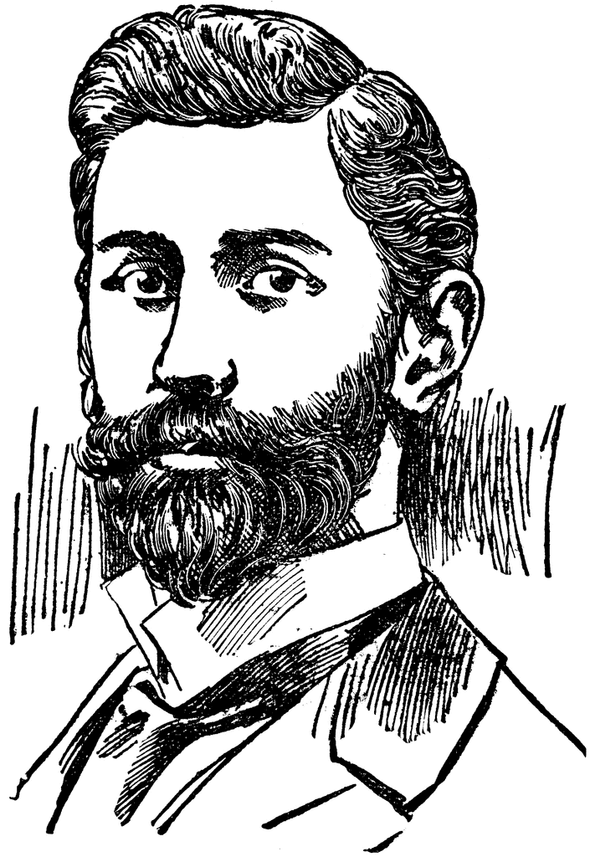
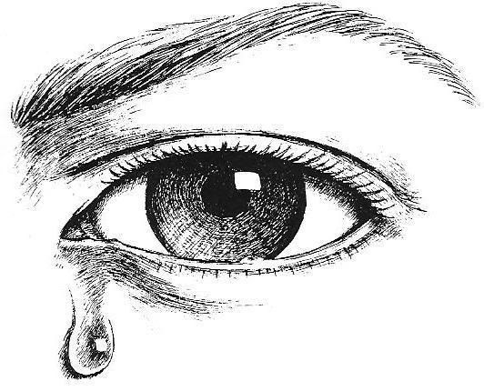
ear
spear
beard
tear

Slide 3
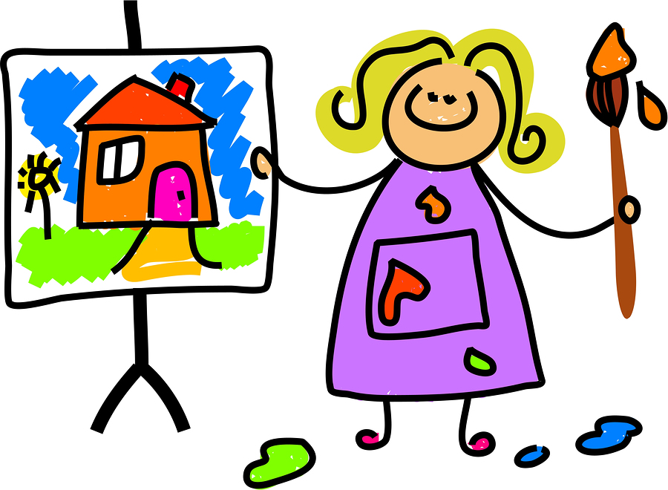


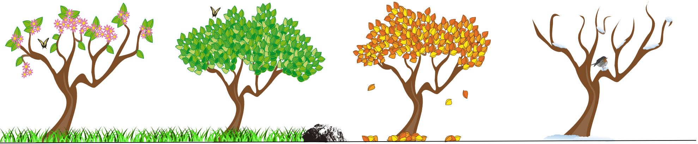
smear
year
clear

Slide 4

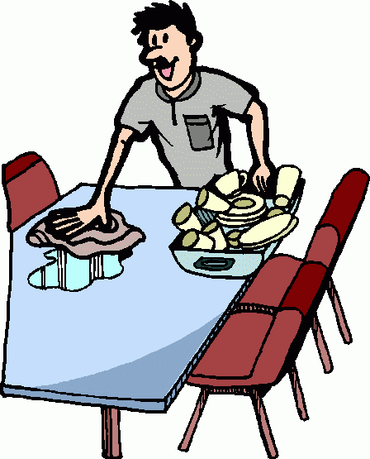
Clear water
A clear day
Clear the table

Slide 5
ear
dear
fear
near
hear
year
Read the above words

Slide 6
If a parrot is near, I hear it with my ear.

