Slide 1



LIFE/work balance
We have started a #LIFEworkbalance campaign and we need your help to complete our LIFE/work balance survey.
We hope to publish the results soon, so please give 15 minutes of your time to help us get a true picture of school life.
Want to be a part of this campaign? Take the survey on our website and share it with your colleagues!
© Classroom Secrets Limited 2020

Slide 2
Year 6 – Spring Block 3 – Algebra – Find a Rule – One Step
About This Resource:
This PowerPoint has been designed to support your teaching of this small step. It includes a starter activity and an example of each question from the Varied Fluency and Reasoning and Problem Solving resources also provided in this pack. You can choose to work through all examples provided or a selection of them depending on the needs of your class.
National Curriculum Objectives:
Mathematics Year 6: (6A1) Express missing number problems algebraically
Mathematics Year 6: (6A2) Use simple formulae
More Year 6 Algebra resources.
Did you like this resource? Don’t forget to review it on our website.
© Classroom Secrets Limited 2019

Slide 3
Year 6 – Spring Block 3 – Algebra
Step 1: Find a Rule – One Step
© Classroom Secrets Limited 2019

Slide 4
Introduction
Match the starting number with the number that is 11 more.
3
73
622
118
89
35
84
14
633
100
129
46
© Classroom Secrets Limited 2019

Slide 5
Introduction
Match the starting number with the number that is 11 more.
3
73
622
118
89
35
84
14
633
100
129
46
© Classroom Secrets Limited 2019

Slide 6
Varied Fluency 1
Using the function below, match the inputs to the correct outputs.
Function:
÷ 7
Inputs:
Outputs:
119
20
140
15
105
17
© Classroom Secrets Limited 2019

Slide 7
Varied Fluency 1
Using the function below, match the inputs to the correct outputs.
Function:
÷ 7
Inputs:
Outputs:
119
20
140
15
105
17
© Classroom Secrets Limited 2019

Slide 8

Varied Fluency 2
Circle the function being used in the function machine below.
Inputs:
Outputs:
Function:
2.5
17.5
?
7
49
+ 15 |  | x 5 |  | x 7
© Classroom Secrets Limited 2019

Slide 9
Varied Fluency 2
Circle the function being used in the function machine below.
Inputs:
Outputs:
Function:
2.5
17.5
x 7
7
49
+ 15 |  | x 5 |  | x 7
© Classroom Secrets Limited 2019

Slide 10
Varied Fluency 3
Work out the missing inputs and outputs for the function machine below.
Inputs:
Outputs:
Function:
89
– 78
-15
© Classroom Secrets Limited 2019

Slide 11
Varied Fluency 3
Work out the missing inputs and outputs for the function machine below.
Inputs:
Outputs:
Function:
89
11
– 78
63
-15
© Classroom Secrets Limited 2019

Slide 12
Varied Fluency 4
Tick the incorrect outputs below.
Inputs:
Outputs:
Function:
17.5
74.5
+ 58
-13
45
49
106
© Classroom Secrets Limited 2019

Slide 13
Varied Fluency 4
Tick the incorrect outputs below.
Inputs:
Outputs:
Function:
17.5
74.5
✓
+ 58
-13
45
49
106
✓
© Classroom Secrets Limited 2019

Slide 14
Now try the Varied Fluency Challenges!
Do questions 1a-4a if you want support to build your confidence.
Do questions 5a-8a if you want a similar challenge to the questions that you have practised.
Do questions 9a – 12a if you want a tougher challenge!
If you want extra practice, look at the ‘b’ challenges that are available for each level of challenge too.

Slide 15

Problem Solving 1
If Milly has 17 grapes and Ken has more than 11, but fewer than Milly, how many grapes could he have?
What function could be used to show this?
Find 3 possible solutions.
Input:
Function:
Output:
?
17
?
© Classroom Secrets Limited 2019

Slide 16
Problem Solving 1
If Milly has 17 grapes and Ken has more than 11, but fewer than Milly, how many grapes could he have?
What function could be used to show this?
Find 3 possible solutions.
Various answers, for example:
– 3, 14 grapes; – 4, 13 grapes; – 5, 12 grapes.
Input:
Function:
Output:
?
17
?
© Classroom Secrets Limited 2019

Slide 17
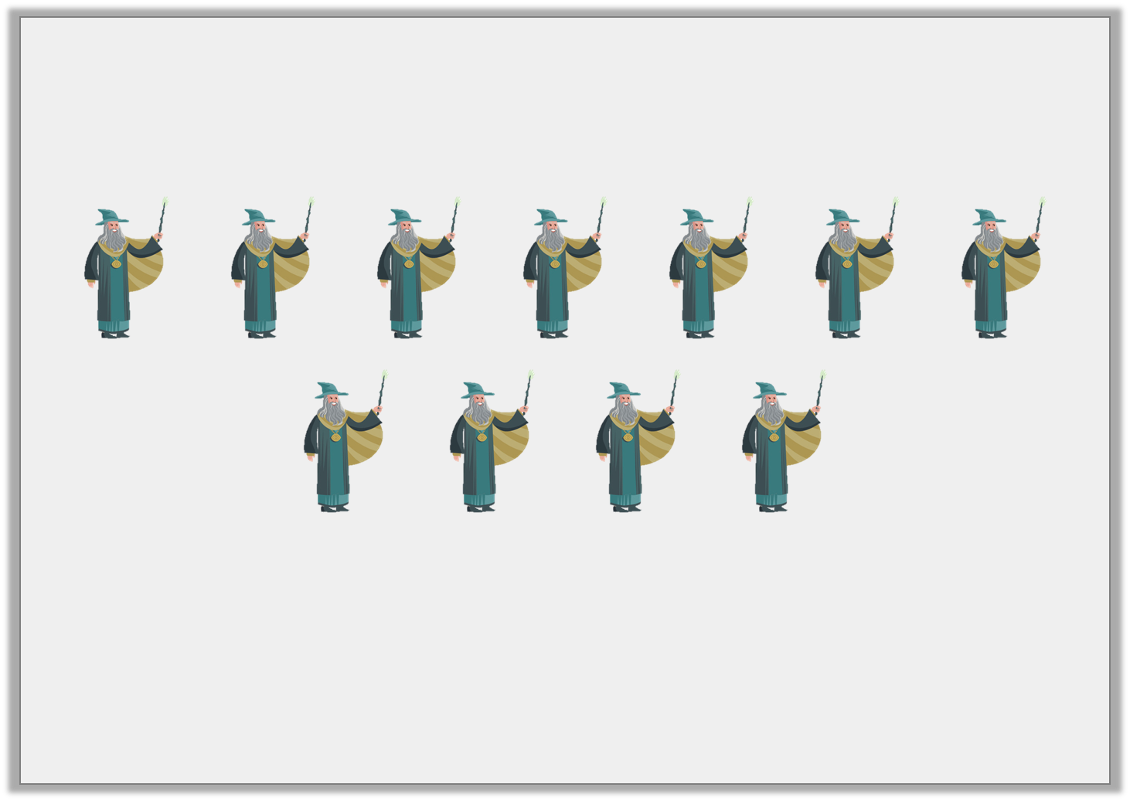
Reasoning 1
If the function for the number of goblins is the number of wizards x 3, how many goblins are there?
Explain your reasoning.
© Classroom Secrets Limited 2019

Slide 18
Reasoning 1
If the function for the number of goblins is the number of wizards x 3, how many goblins are there?
Explain your reasoning.
Various answers, for example:
There are 33 goblins…
© Classroom Secrets Limited 2019

Slide 19
Reasoning 1
If the function for the number of goblins is the number of wizards x 3, how many goblins are there?
Explain your reasoning.
Various answers, for example:
There are 33 goblins. This is because there are 11 wizards; if the function for the number of goblins is the number of wizards x 3, then the calculation to work this out is 11 x 3 = 33.
© Classroom Secrets Limited 2019

Slide 20

Reasoning 2
Four of the cards are inputs or outputs of the function machine below. Circle the odd one out.
Explain your reasoning.
6.2
27
12
18.6
9
Input:
Function:
Output:
÷ 3
?
?
© Classroom Secrets Limited 2019

Slide 21
Reasoning 2
Four of the cards are inputs or outputs of the function machine below. Circle the odd one out.
Explain your reasoning.
12 is the odd one out because…
6.2
27
12
18.6
9
Input:
Function:
Output:
÷ 3
?
?
© Classroom Secrets Limited 2019

Slide 22
Reasoning 2
Four of the cards are inputs or outputs of the function machine below. Circle the odd one out.
Explain your reasoning.
12 is the odd one out because 18.6 ÷ 3 = 6.2 and 27 ÷ 3 = 9.
12 ÷ 3 = 4, but there is no number card for 4 (to match 12).
6.2
27
12
18.6
9
Input:
Function:
Output:
÷ 3
?
?
© Classroom Secrets Limited 2019

Slide 23
Now try the Reasoning and Problem Solving Challenges!
Do questions 1a-3a if you want support to build your confidence.
Do questions 4a-6a if you want a similar challenge to the questions that you have practised.
Do questions 7a – 9a if you want a tougher challenge!
If you want extra practice, look at the ‘b’ challenges that are available for each level of challenge too.

