Slide 2
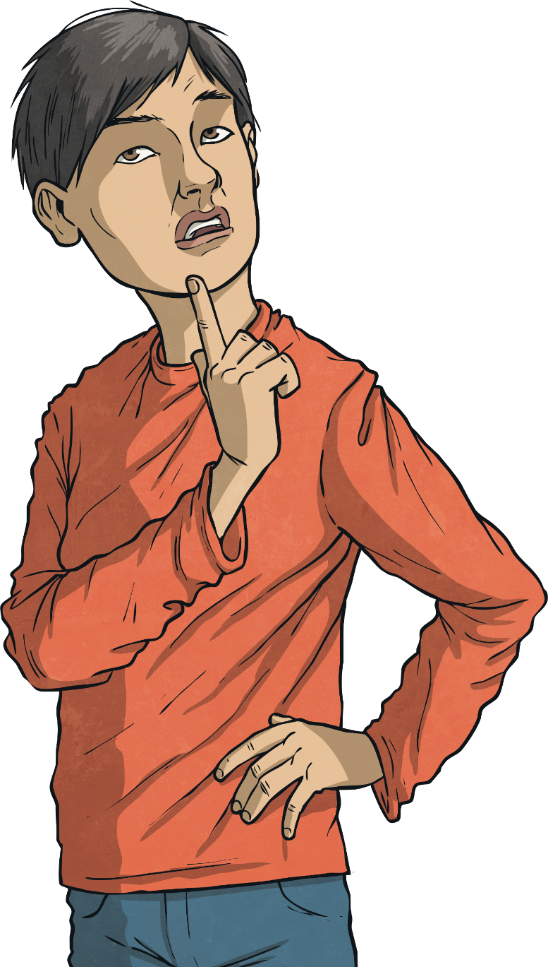

Why do people go to work?
What other ways do people get money?

Slide 3


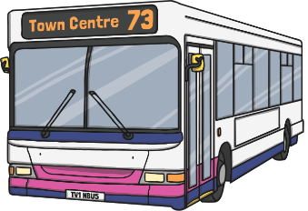



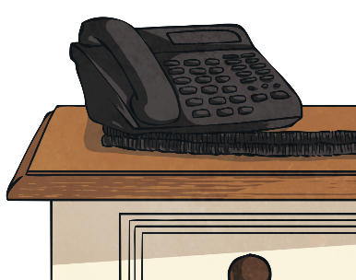
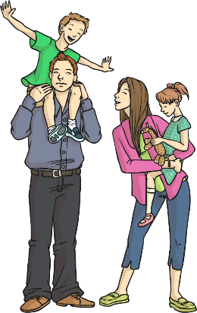
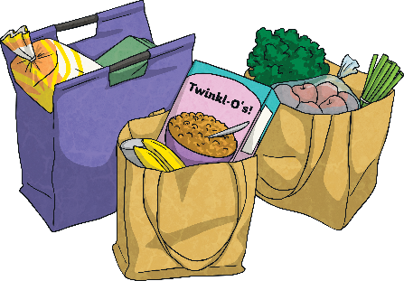
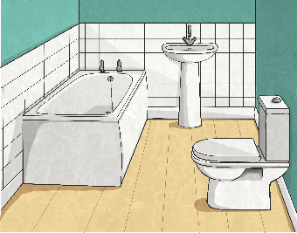

Why Do We Need Money?
Look carefully at this picture. What do you think it shows?
There are lots of costs associated with running a household. These could include: food, heating, water, power, food, phone and TV subscriptions, transport costs as well as lots of other costs. Where does the money come from to pay for all this?

Slide 4

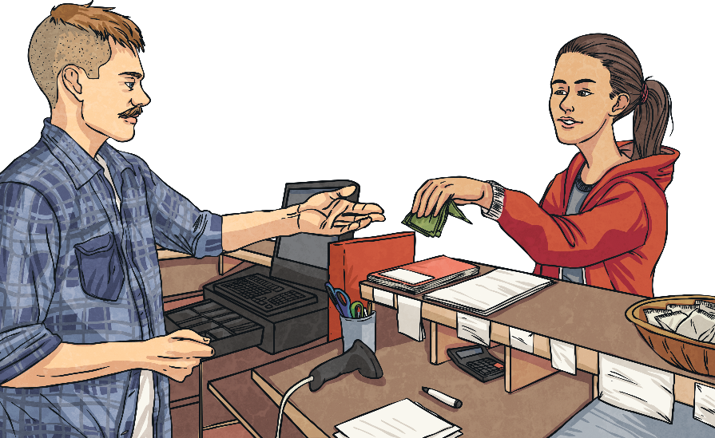
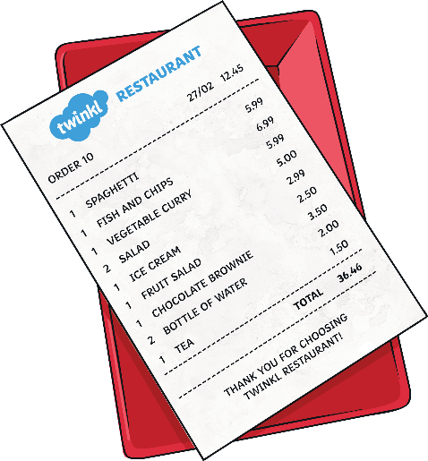
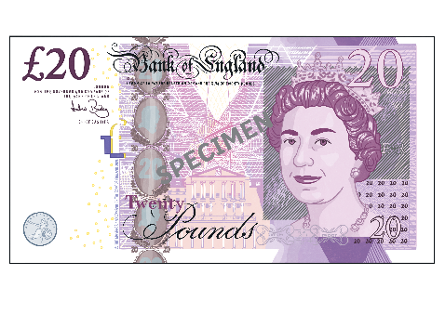
Where Does Money Come From?
Although money can come from lots of different sources, the main source of income for most households is employment. When you have a job, you are employed. You receive wages that are paid every month and this money is used to pay for outgoings.
So, where money comes from and where it goes can look like this:

Slide 5

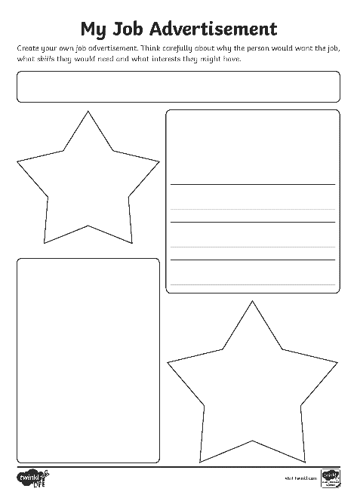
Creating a Job Advertisement
You can now write an advert for a job – think back to our learning last term!
Think carefully about why someone would want to do this job, what skills they might need and what interests they might have too.
Job Advertisement Word Bank
money
employment
work
payment
candidate
wages
position
teamwork
job
career
responsibility
qualifications
leadership
dedicated
role
trustworthy
committed
reliable
salary
skills

Slide 6
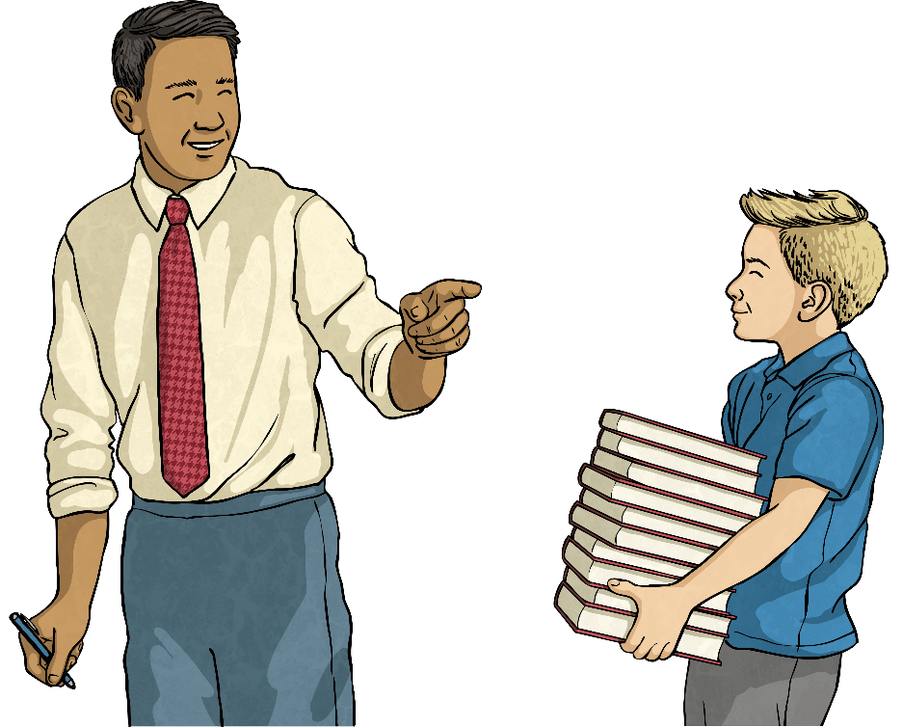
Creating a Job Advertisement
Why is this a good job advert?
Job Title: Teacher
Do you love seeing children learn? Isn’t it fantastic when you can help people? Well this job is for you!
Job Description:
Planning lessons
Helping others make progress
A love of learning
Seeing great people every day
Skills Required:
Hard-working
Good reading writing and maths skills
Well-organised

