Slide 1


Maths
Position and Direction
Year One
Maths | Year 1 | Position and Direction | Turns | Lesson 3 of 3: Humpty Dumpty Turns

Slide 2
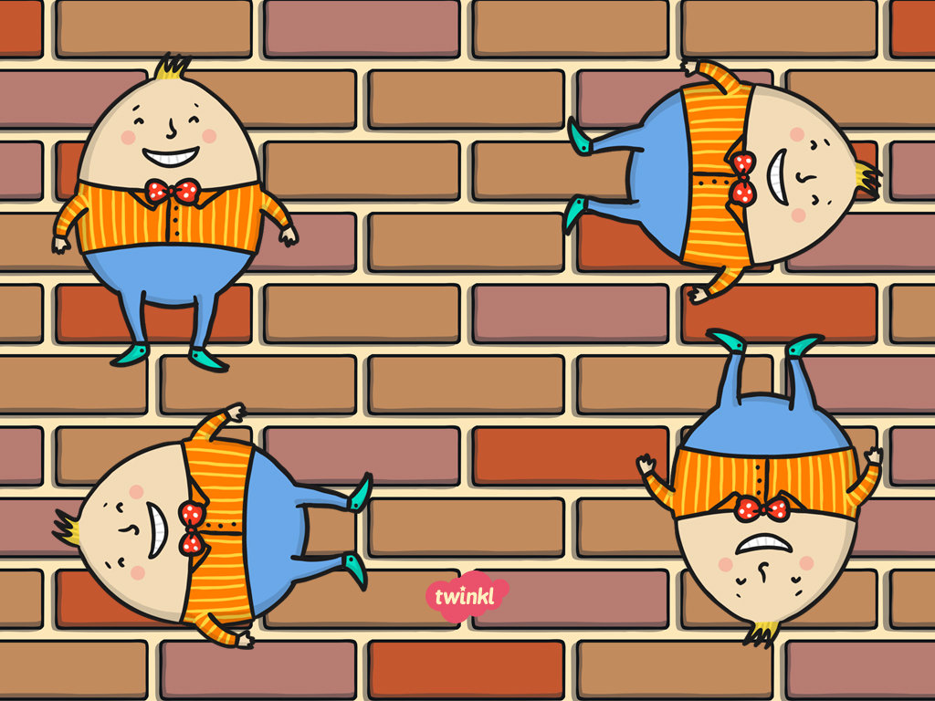
Humpty Dumpty Turns

Slide 3
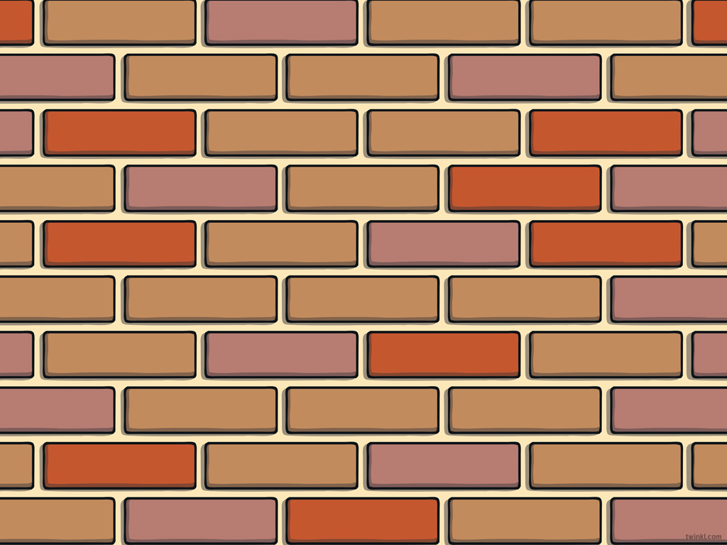
Aim
I can give and follow instructions to move quarter, half, three-quarter and whole turns in clockwise and anticlockwise directions.
Success Criteria
I can identify clockwise and anticlockwise turns.
I can move quarter, half, three-quarter and whole turns.
I can follow instructions to move.
I can give instructions to move.

Slide 4

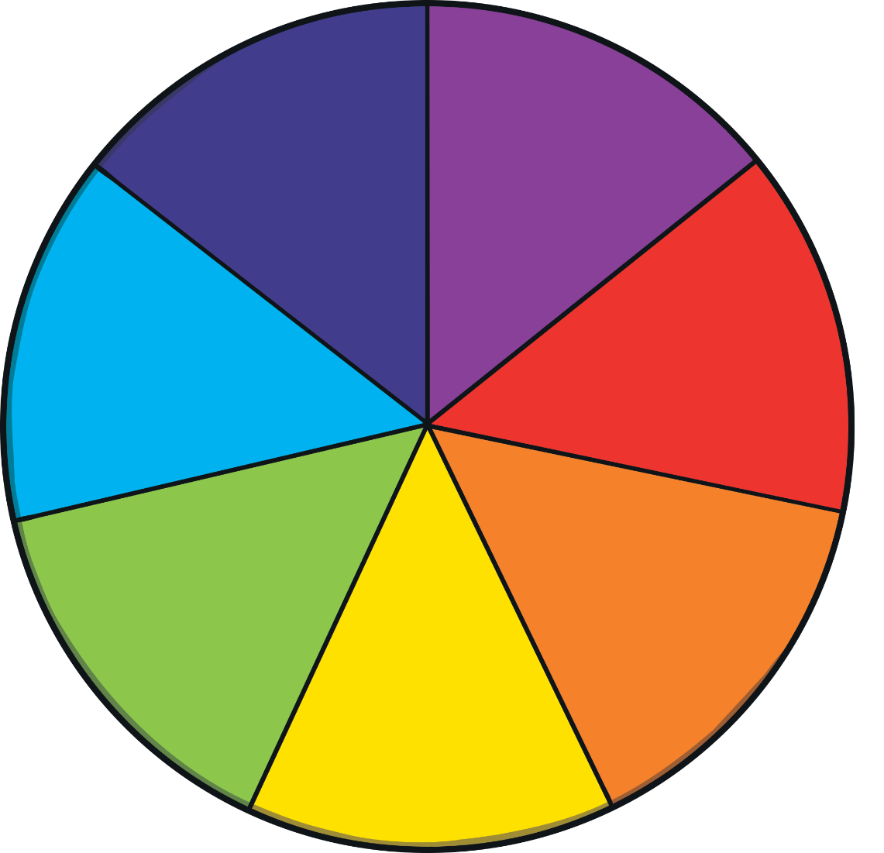
In a Spin
Face the board and move a whole turn anticlockwise.
Move a three-quarter turn anticlockwise.
Move a three-quarter turn clockwise.
Move half a turn clockwise.
Move half a turn anticlockwise.
Move a quarter turn clockwise.
Move a whole turn clockwise.
Move a quarter turn anticlockwise.
Where are you facing?

Slide 5

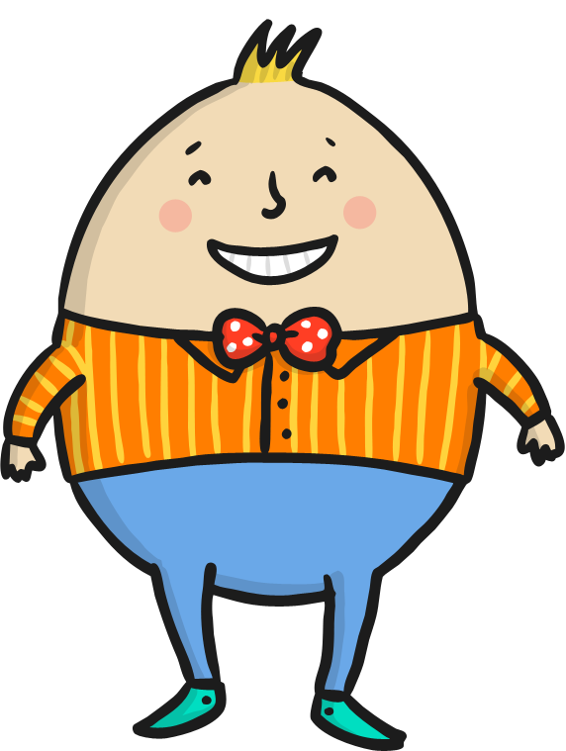
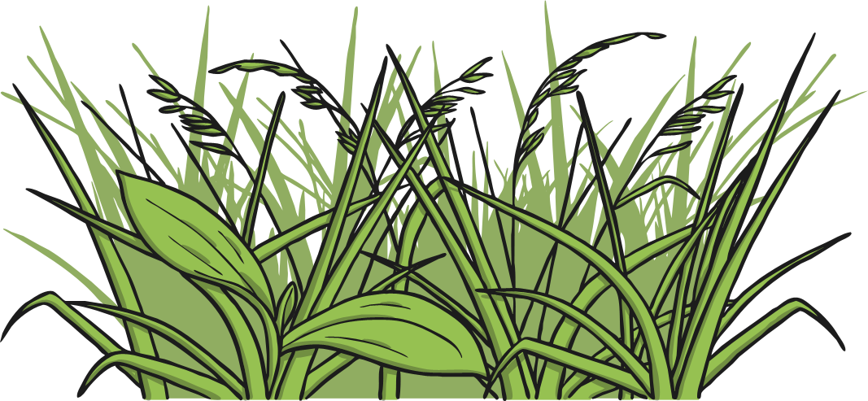
Humpty Dumpty had a Great Fall
Describe Humpty Dumpty’s falls from the wall. Are they in clockwise or anticlockwise directions? Are they whole, quarter, half or three-quarter turns?
a half turn anticlockwise
a half turn clockwise
a whole turn clockwise
a quarter turn anticlockwise
a three-quarter turn clockwise
a quarter turn clockwise

Slide 6

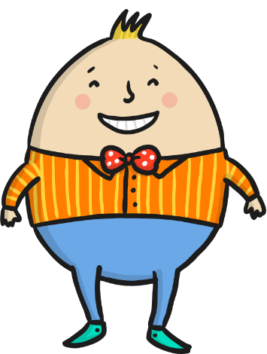
Humpty Dumpty Turns
a whole turn
a half turn
a quarter turn
a three-quarter turn
1 whole
1/1
1 half
1/2
1 quarter
1/4
3 quarters
3/4

Slide 7

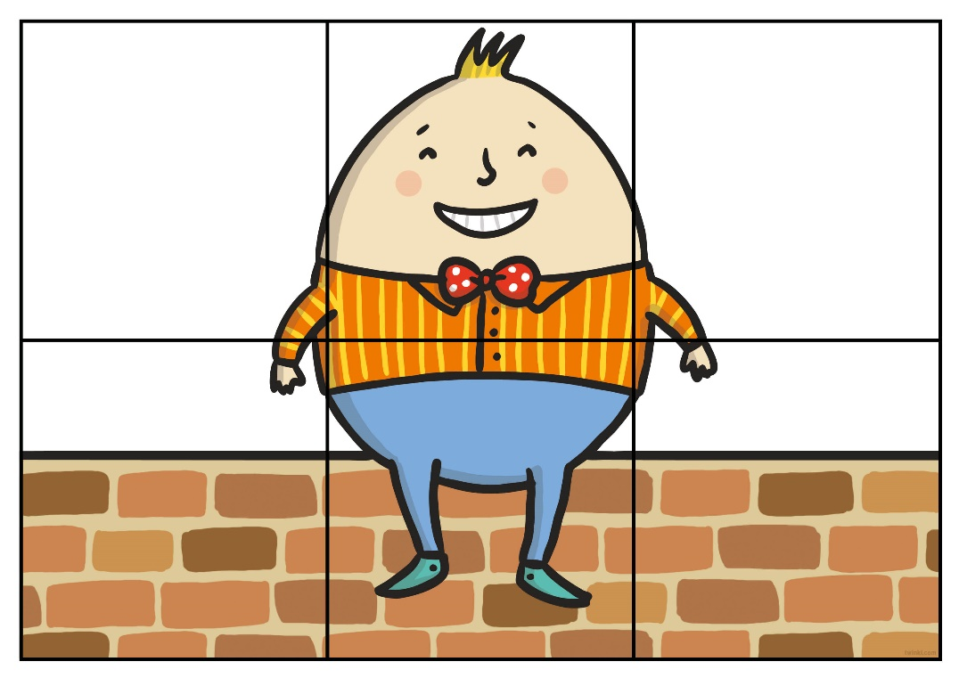
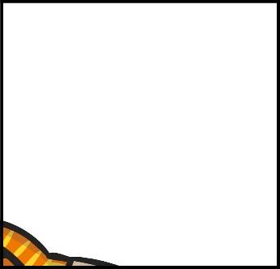
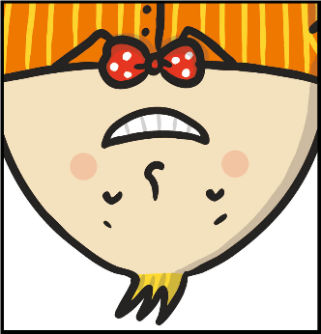
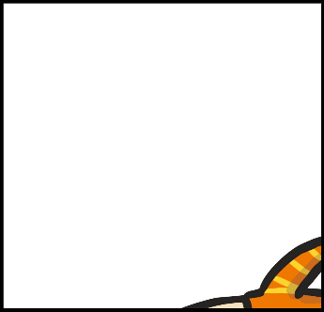
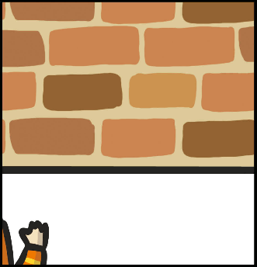
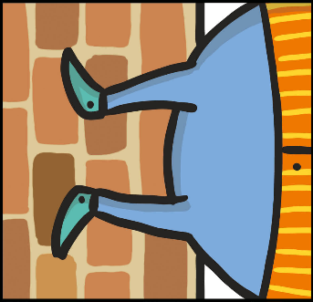
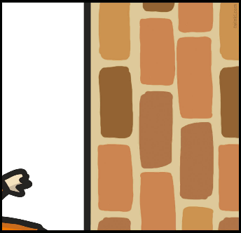
Couldn’t Put Humpty
Together Again
Can you put Humpty Dumpty back together again?
Describe how each piece of the jigsaw moves.
Muddle

Slide 8
Aim
I can give and follow instructions to move quarter, half, three-quarter and whole turns in clockwise and anticlockwise directions.
Success Criteria
I can identify clockwise and anticlockwise turns.
I can move quarter, half, three-quarter and whole turns.
I can follow instructions to move.
I can give instructions to move.

Slide 9
