Slide 1


Year 6 – Spring Block 3 – Algebra – Find A Rule – Two Step
About This Resource:
This PowerPoint has been designed to support your teaching of this small step. It includes a starter activity and an example of each question from the Varied Fluency and Reasoning and Problem Solving resources also provided in this pack. You can choose to work through all examples provided or a selection of them depending on the needs of your class.
National Curriculum Objectives:
Mathematics Year 6: (6A1) Express missing number problems algebraically
Mathematics Year 6: (6A2) Use simple formulae
More Year 6 Algebra resources.
Did you like this resource? Don’t forget to review it on our website.
© Classroom Secrets Limited 2019

Slide 2
Year 6 – Spring Block 3 – Algebra
Step 2: Find a Rule – Two Step
© Classroom Secrets Limited 2019

Slide 3

Introduction
Find the function that the function robot below is using.
Inputs:
Outputs:
10
-5
?
95
80
25
10
© Classroom Secrets Limited 2019

Slide 4
Introduction
Find the function that the function robot below is using.
Inputs:
Outputs:
10
-5
– 15
95
80
25
10
© Classroom Secrets Limited 2019

Slide 5

Varied Fluency 1
Write the outputs for the two-step function machine below.
Inputs:
Outputs:
Functions:
25
45
+ 5
÷ 5
5
© Classroom Secrets Limited 2019

Slide 6
Varied Fluency 1
Write the outputs for the two-step function machine below.
Inputs:
Outputs:
Functions:
25
6
45
+ 5
÷ 5
10
5
2
© Classroom Secrets Limited 2019

Slide 7
Varied Fluency 2
Use the two-step function to match the inputs to the correct outputs.
Functions:
+ 9, ÷ 2
Inputs:
Outputs:
11
10
25
9
9
17
© Classroom Secrets Limited 2019

Slide 8
Varied Fluency 2
Use the two-step function to match the inputs to the correct outputs.
Functions:
+ 9, ÷ 2
Inputs:
Outputs:
11
10
25
9
9
17
© Classroom Secrets Limited 2019

Slide 9
Varied Fluency 3
Complete the two-step function machine below.
Inputs:
Outputs:
Functions:
9.5
6
4
– 8.5
?
0.5
10
6.5
© Classroom Secrets Limited 2019

Slide 10
Varied Fluency 3
Complete the two-step function machine below.
Inputs:
Outputs:
Functions:
9.5
6
4
– 8.5
+ 5
0.5
10
6.5
© Classroom Secrets Limited 2019

Slide 11
Now try the Varied Fluency Challenges!
Do questions 1a-4a if you want support to build your confidence.
Do questions 5a-8a if you want a similar challenge to the questions that you have practised.
Do questions 9a – 12a if you want a tougher challenge!
If you want extra practice, look at the ‘b’ challenges that are available for each level of challenge too.

Slide 12
Problem Solving 1
Insert two functions that could be used to make
the function machine correct.
Input:
Functions:
Output:
11
?
?
28
© Classroom Secrets Limited 2019

Slide 13
Problem Solving 1
Insert two functions that could be used to make
the function machine correct.
Various answers, for example:
x 3; – 5
Input:
Functions:
Output:
11
?
?
28
© Classroom Secrets Limited 2019

Slide 14

Reasoning 1
True or false? Explain your answer.
Suggest what the functions could be.
Inputs:
Function:
Outputs:
3
?
?
9
15
13
I think that the function is x 2 and then add 3 because 3 x 2, then + 3 is 9.
© Classroom Secrets Limited 2019

Slide 15
Reasoning 1
True or false? Explain your answer.
Suggest what the functions could be.
The answer is false because…
Inputs:
Function:
Outputs:
3
?
?
9
15
13
I think that the function is x 2 and then add 3 because 3 x 2, then + 3 is 9.
© Classroom Secrets Limited 2019

Slide 16
Reasoning 1
True or false? Explain your answer.
Suggest what the functions could be.
The answer is false because x 2, then + 3 doesn’t work for an input of 15 to give an output of 13. The function could be ÷ 3, + 8.
Inputs:
Function:
Outputs:
3
÷ 3
+ 8
9
15
13
I think that the function is x 2 and then add 3 because 3 x 2, then + 3 is 9.
© Classroom Secrets Limited 2019

Slide 17
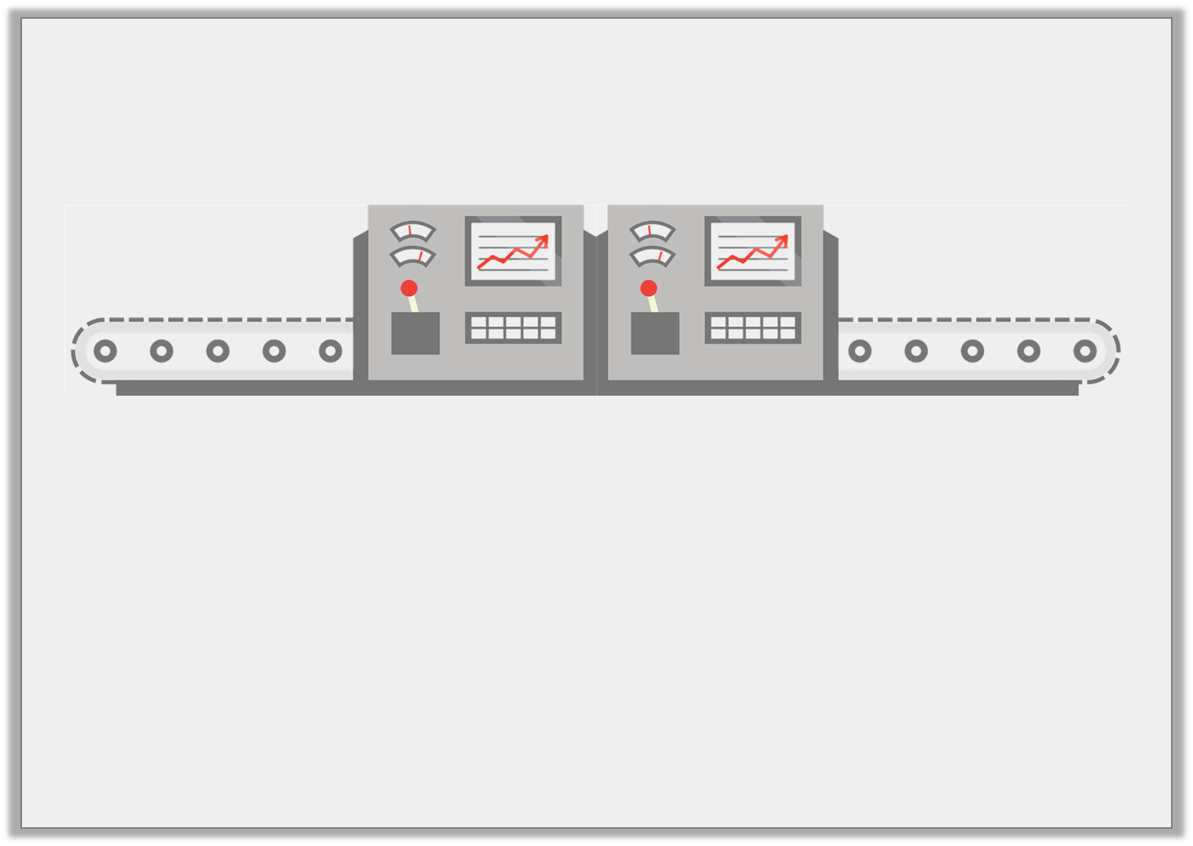
Problem Solving 2
Jaxon is using this function machine.
He puts an input into the function machine to generate an output. He then puts that output into the machine as an input. He now has the output of 40.
What was Jaxon’s original number?
x 5
– 10
© Classroom Secrets Limited 2019

Slide 18
Problem Solving 2
Jaxon is using this function machine.
He puts an input into the function machine to generate an output. He then puts that output into the machine as an input. He now has the output of 40.
What was Jaxon’s original number?
4
x 5
– 10
© Classroom Secrets Limited 2019

Slide 19
Now try the Reasoning and Problem Solving Challenges!
Do questions 1a-3a if you want support to build your confidence.
Do questions 4a-6a if you want a similar challenge to the questions that you have practised.
Do questions 7a – 9a if you want a tougher challenge!
If you want extra practice, look at the ‘b’ challenges that are available for each level of challenge too.

