Slide 1

Parents’ Information Meeting

Slide 2
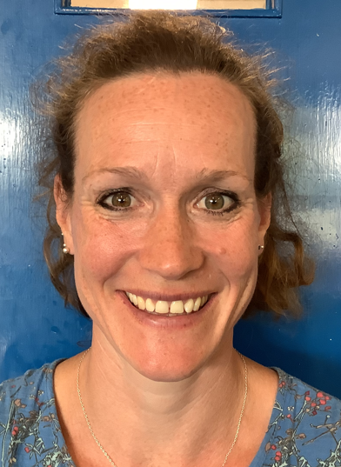
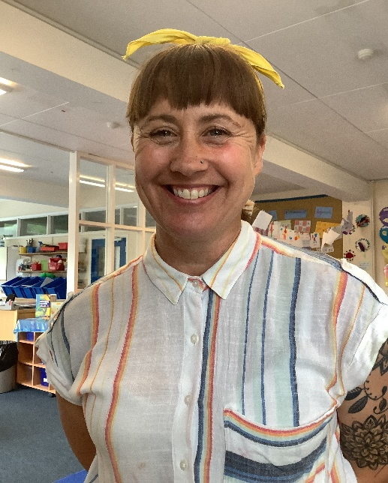
The Class Team
Miss Jones
Teacher
Monday- Wednesday
Mrs Reed
Teaching Assistant
Everyday

Slide 3
Aims of the Session
Today we aim to:
Give you a little bit of information about Reception and starting school
To help you to feel more relaxed about the transition into school

Slide 4

Settling In
All children will have a phased introduction to give them time to settle in
The most important aspects of the first half term are…
  For your child to feel settled at school
  To make friends
  To learn the routines of the classroom

Slide 5

Helping at Home
Talk to your child about school
Show your child their new uniform
Pick a new water bottle
Practice dressing and undressing (make it fun!)
Ensure all items are named

Slide 6
    We follow the Early Years Foundation Stage (EYFS) curriculum.
    Communication and Language
    Physical Development
    PSED
    Literacy
    Mathematics
    Understanding of the World
    Expressive Arts and Designs
Learning in Reception

Slide 7
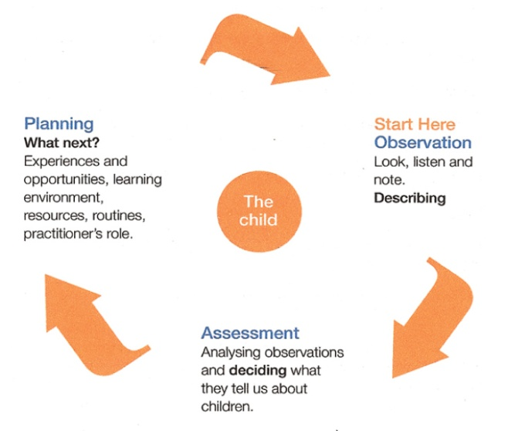
    We monitor children’s progress through observations, which we then use to inform our planning and your child’s next steps in learning.
    The EYFS Curriculum enables practitioners to teach children through a play based curriculum.
The Teaching-Learning Cycle

Slide 8

    Each child is unique and has individual ways of learning.
    The Reception team will make sure that the activities are suited to your child’s unique interests, needs and abilities.
Learning in Reception

Slide 9
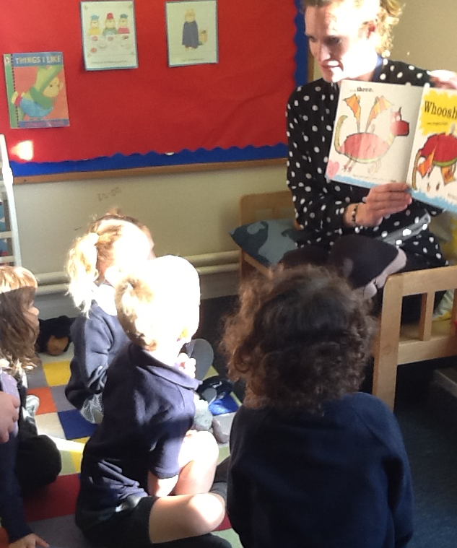
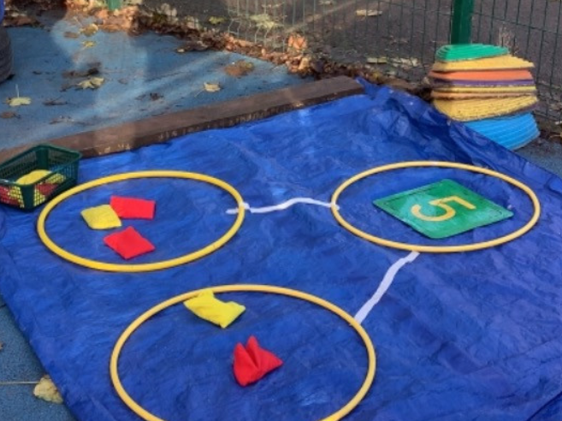
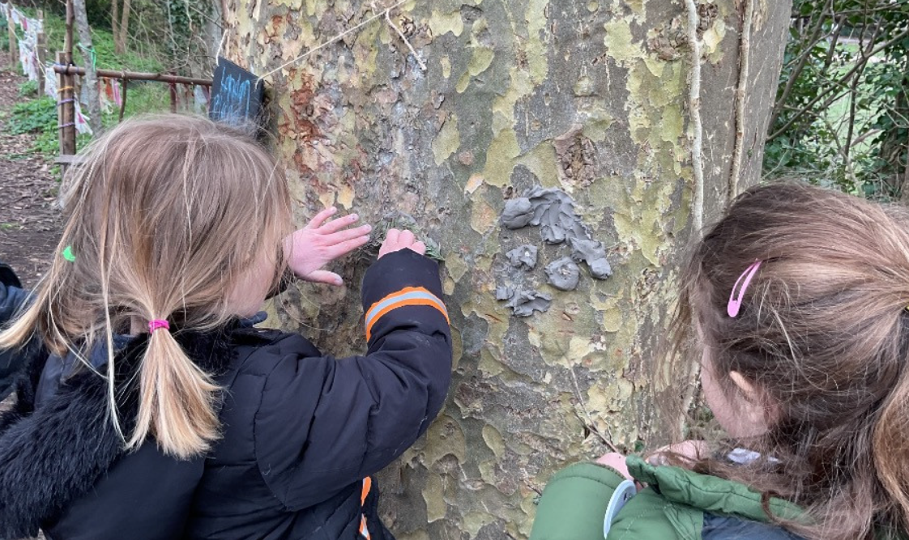
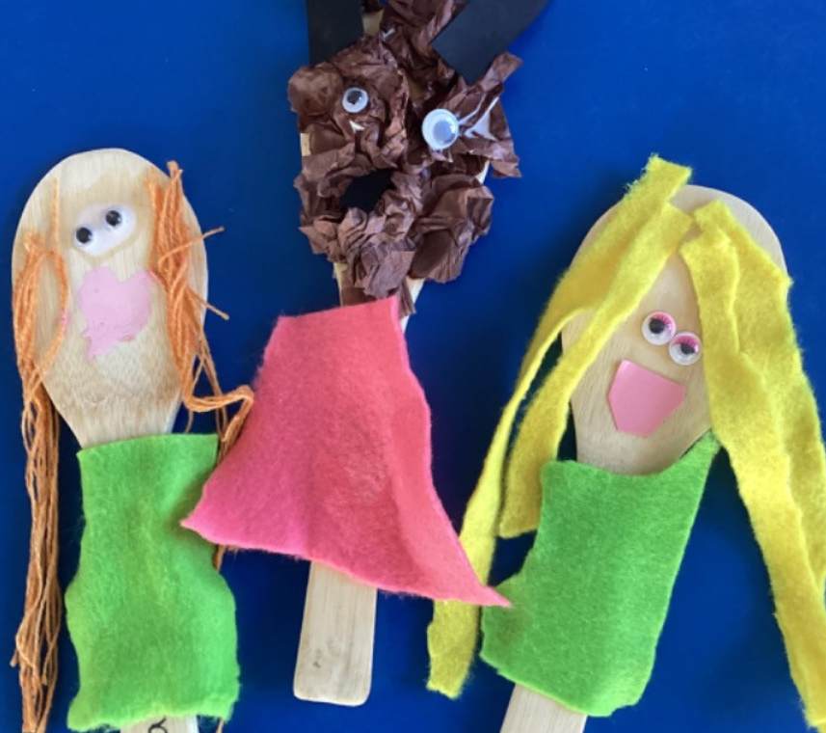
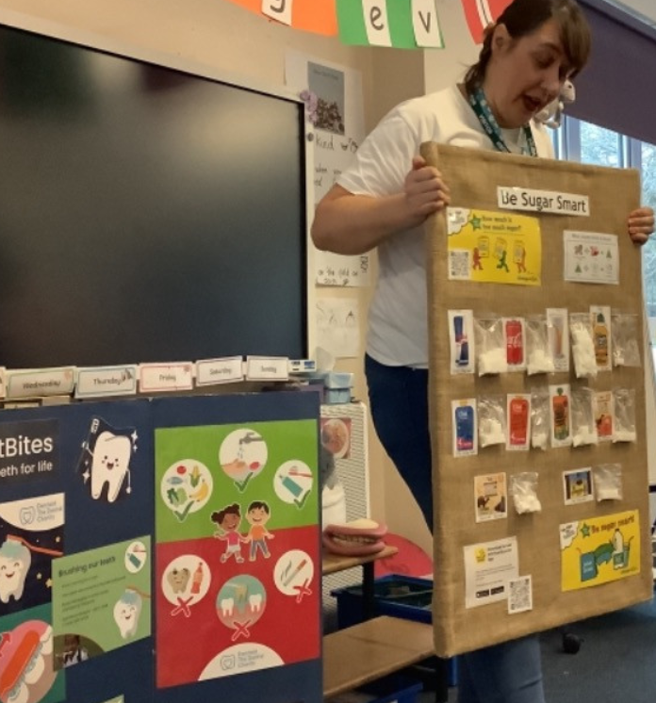
Class Activities and Lessons
In reception we offer an extensive range of lessons and activities.
There are a mixture of guided and independent activities throughout the day.
Learning takes place both inside and outside the classroom.

Slide 10

A School Day
8.40am- School gates open
8.50- School gate closes
10.15- Toilet and Snack time
12- Lunchtime
1- Children return to class
3.15- End of school day

Slide 11
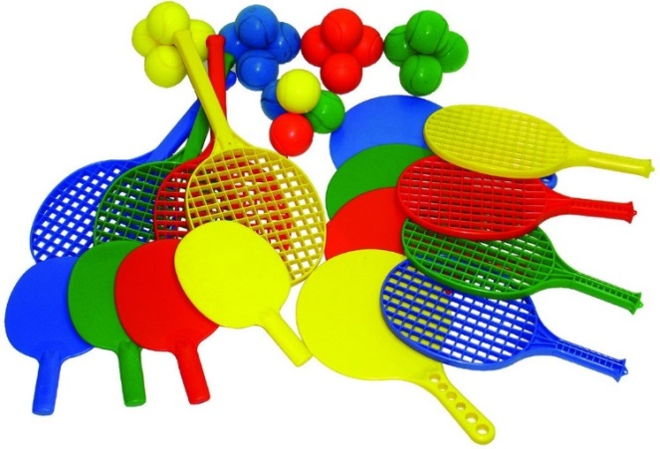
PE
Children take part in a range of learning opportunities which promotes physical development.
P.E. in Reception takes place twice a week.
Your child should have a full PE kit. This can be worn to school on the day that your child has PE.
Days that we will be taking part in PE will be shared in September.

Slide 12

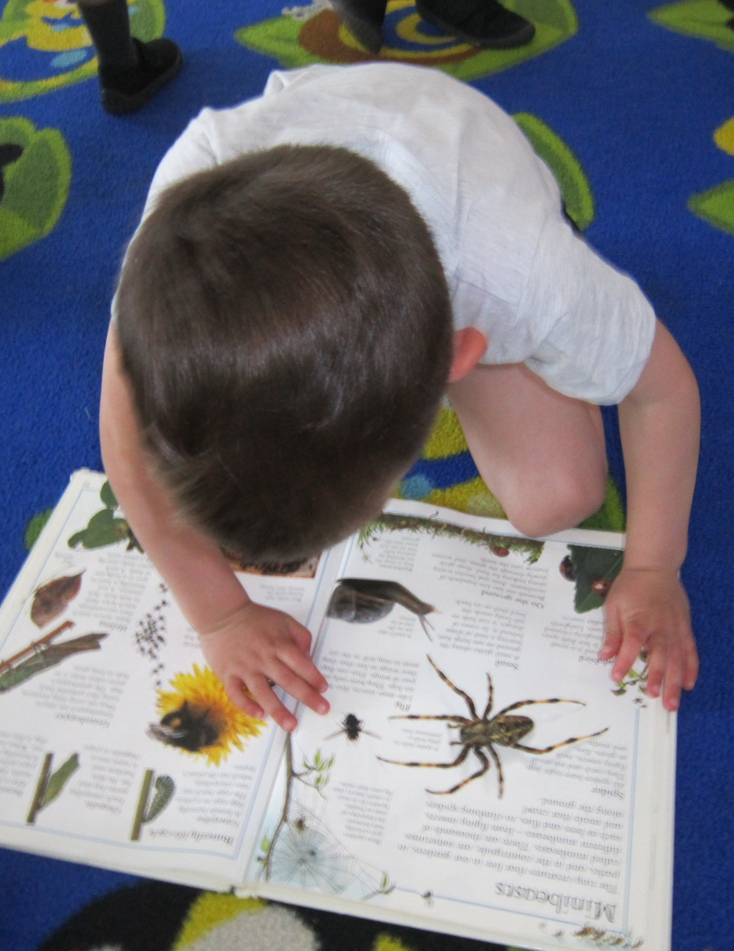
In Reception your child will be given books each week to read at home we will change these each week.
The books match our phonics scheme so support the teaching and learning in school.
Children also take home a school library book each week. These are for you to enjoy sharing together.
We read with the children regularly, this includes reading to the teacher and TA, individually and as a whole class.
Reading Information

Slide 13
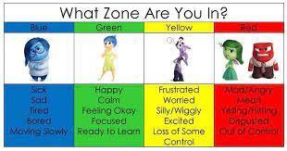
Behaviour System
In the classroom we talk to the children about the ‘Zones of Regulation.’
This is a colour coded system which helps children identify and start to be able to regulate their emotions. We regularly talk to the children about the behavioural expectations of our classroom and school community.
We praise children for their personal and academic successes.
Children’s achievements are celebrated with parents and carers during fortnightly assemblies where children in each class receive the Headteacher’s Award. Parents are informed in advance of their children’s awards and invited to attend.

Slide 14
Food and Drink
Government Legislation means that from Sept 2014, all Reception and KS1 children are entitled to a free school meal.
You can still opt to provide your child with a healthy packed lunch if you wish to do so. We ask that packed lunches contain healthy options for your child and no foods containing nuts or sesame.

Slide 15
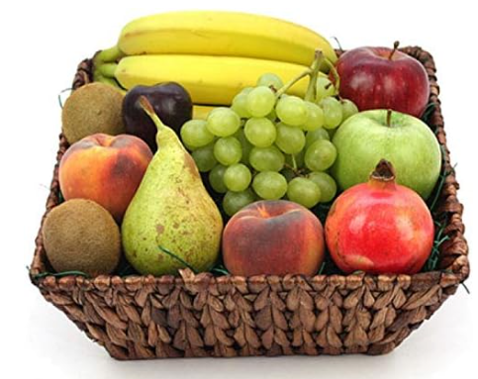
Snack
Children are given a piece of fruit each day.
Children can ‘opt in’ for milk.
You are able to provide a piece of fruit for your child if you wish.

Slide 16

We have a ‘buddy’ system whereby some of the older pupils support the younger children at playtimes and lunchtimes.
Buddies

Slide 17


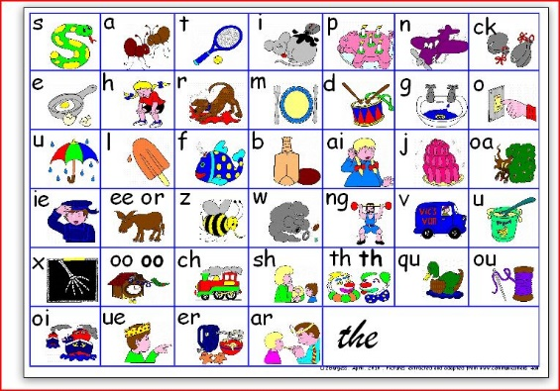
We send home a weekly newsletter which will keep you informed about our learning. We will share suggestions and ideas of how you could support your child’s learning at home.
We upload photos of the children learning at school for you to see. You can also upload photos of your child learning at home.
Communication from the classroom will primarily come through Tapestry – an online platform. We will need your consent to set this up.
Learning at Home

Slide 18
Preschool Visits
We know that transition to school can be a nerve wracking and exciting time for children and adults. To help the children have a smooth transition from their nursery to school we will be visiting as many nurseries as possible over the next few weeks.
During the visit we will get a chance to speak to your child’s key worker and hopefully see your child in action.

Slide 19

Settling Sessions and Parent Consultations
We are looking forward to meeting and getting to know the children over the coming weeks
Our Taster Session is on:
Tuesday 8th July (If your child’s surname begins with A-L)
Wednesday 9th July (If your child’s surname begins with M-Z)
You are invited to attend
On Friday September 5th or Monday September 8th you have the chance to sign up for a 1:1 Parent consultation which will take place in the classroom. Please bring your child.

Slide 20
Starting School
If your child was born between April 2021 and August 2021 they will be in Summer Group.
If your child was born between January 2021 and March 2021 they will be in Spring Group.
If your child was born between July 2020 and December 2020 they will be in Autumn Group.
Tuesday 9th September | Wednesday 10th September | Thursday 11th September | Friday 12th September | Monday 15th September
Summer Group first day 8.40am - 12pm | Summer Group 8.40am - 1.15pm (staying for lunch) Spring Group first day 8.40am - 12pm | Summer Group in all day 8.40am - 3.15pm Spring Group 8.40am - 1.15pm (stay for lunch) Autumn Group first day 8.40am - 12pm | Summer Group in all day 8.40am - 3.15pm Spring Group in all day 8.40am - 3.15pm Autumn Group 8.40am-1.15pm (stay for lunch) | Summer Group in all day 8.40am - 3.15pm Spring Group in all day 8.40am - 3.15pm Autumn Group in all day 8.40am - 3.15pm
From Monday 15th September - all children will attend full time, 8.40am-3.15pm

Slide 21
Uniform
Western Road Community Primary School's Uniform consists of:
Navy school fleece with school logo (optional but these are very warm and ideal for Winter and Spring)
Navy school jumper with or without school logo or navy or mid-grey cardigan
White shirt/blouse with long or short sleeves with or without logo or
White or navy blue polo shirt with or without school logo
Mid-grey or navy trousers or smart shorts, or
Mid-grey or navy skirts (or skorts), pinafore dresses or school summer dresses (blue/white check)
White/navy/grey socks or tights
Plain black or navy school shoes (or plain black or navy trainers with no logos); plain sandals in the Summer terms only.
Plain hair accessories (optional and in school colours preferably). Long hair (past shoulder length) must be tied back.
PE kit:
White T-shirt or polo shirt with school logo (or plain)
Grey or navy shorts or jogging bottoms (plain with no logos)
Trainers or plimsolls

Slide 22

If you have any concerns or questions, please come and speak to one of us or email office@westernroad.e-sussex.sch.uk
Many thanks for coming. We look forward to meeting you and your child!
Finally

