Slide 1


Maths
Position and Direction
Year One
Maths | Year 1 | Position and Direction | Position | Lesson 1 of 3: Through the Woods

Slide 2
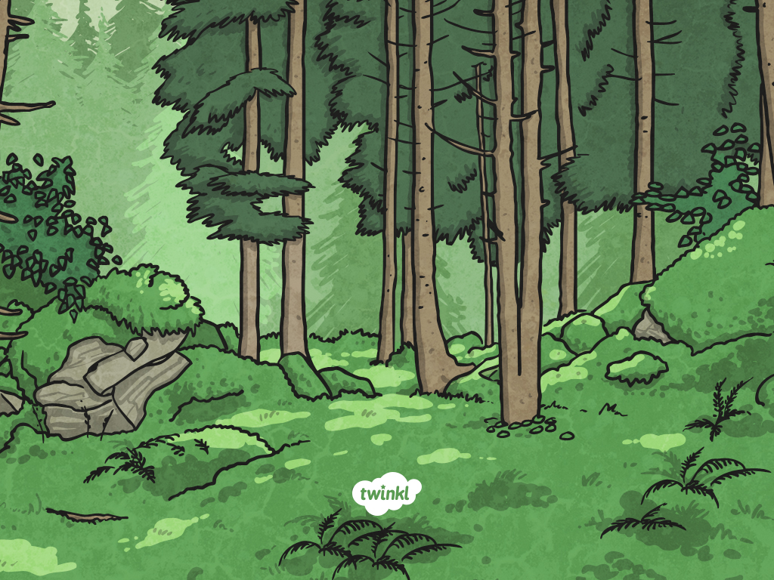
Through the Woods

Slide 3
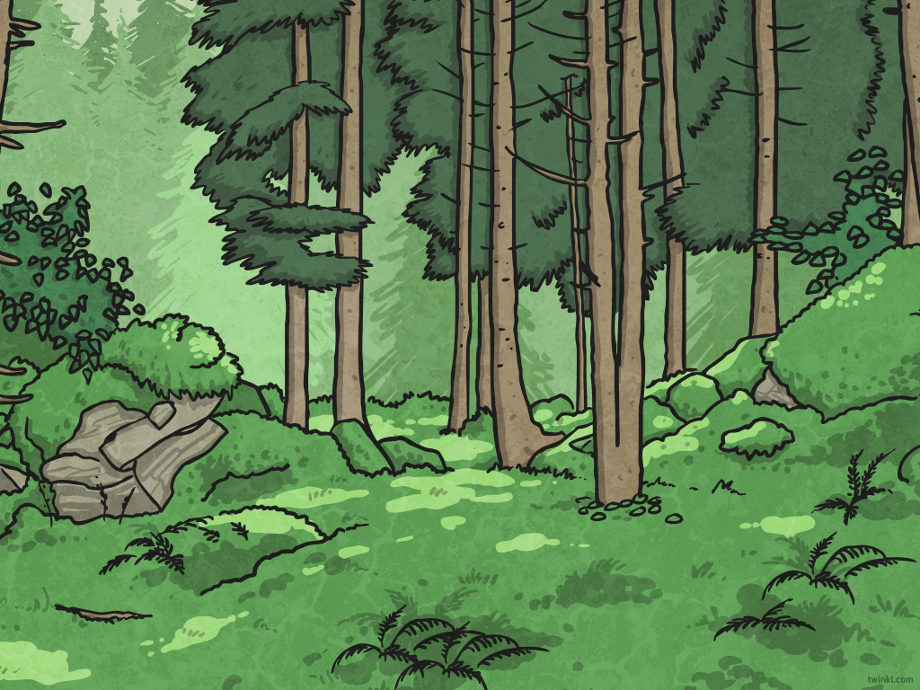
Aim
I can follow instructions for position, direction and movement.
Success Criteria
I can describe movements.
I can copy movements.
I can read or listen to directions and follow a route.

Slide 4
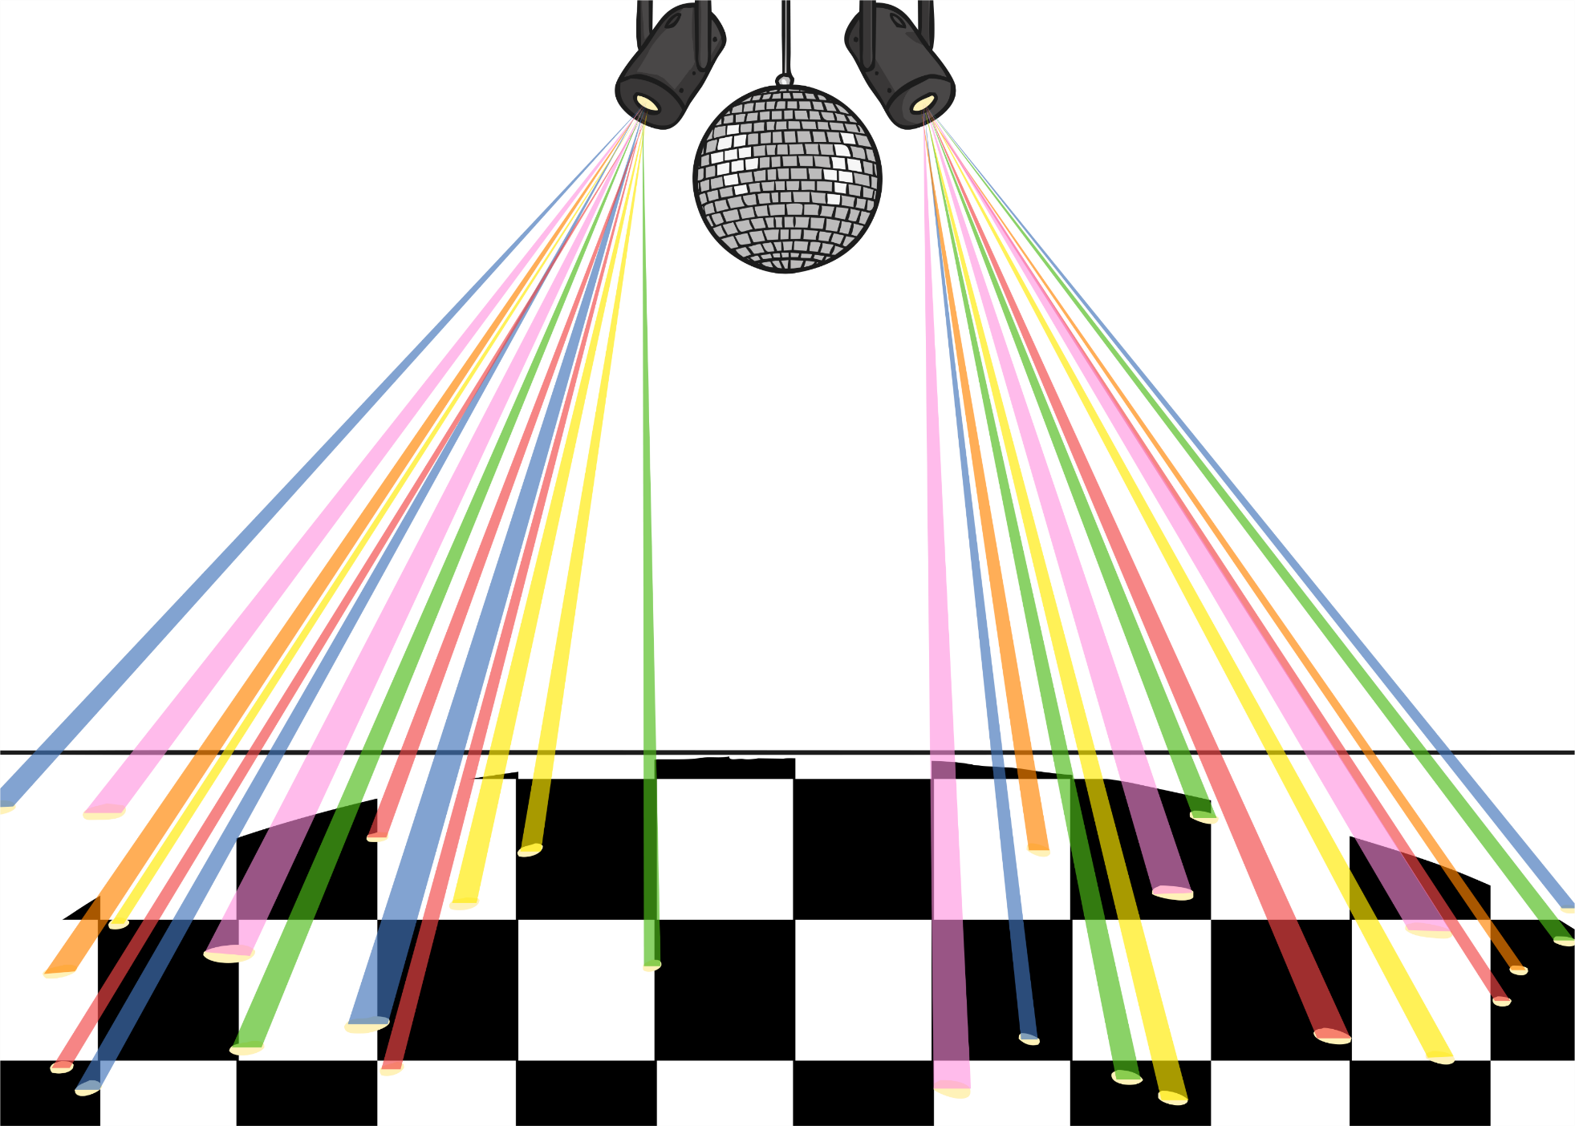

Backwards
Backwards
Backwards
Backwards
Backwards
Backwards
Backwards
Backwards
Backwards
Backwards
Backwards
Forwards and Backwards
Sit in a group as the audience.
I will ask children to come to the front to be the dancers. The person will move to the instructions on the board.
The audience will say out loud the instructions to help them.
Wave!
Wave!
Jump!
Jump!
Spin!
Spin!
Spin!
Hop!
Hop!
Click for game
Go
Forwards
Forwards
Forwards
Forwards
Forwards
Forwards
Forwards
Forwards
Forwards
Forwards
Forwards
Notes:
Click the Go button each time to control each arrow or instruction.

Slide 5
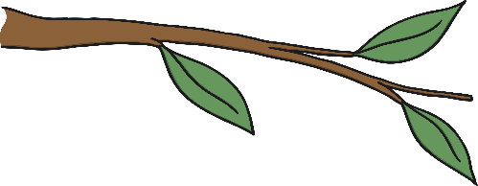

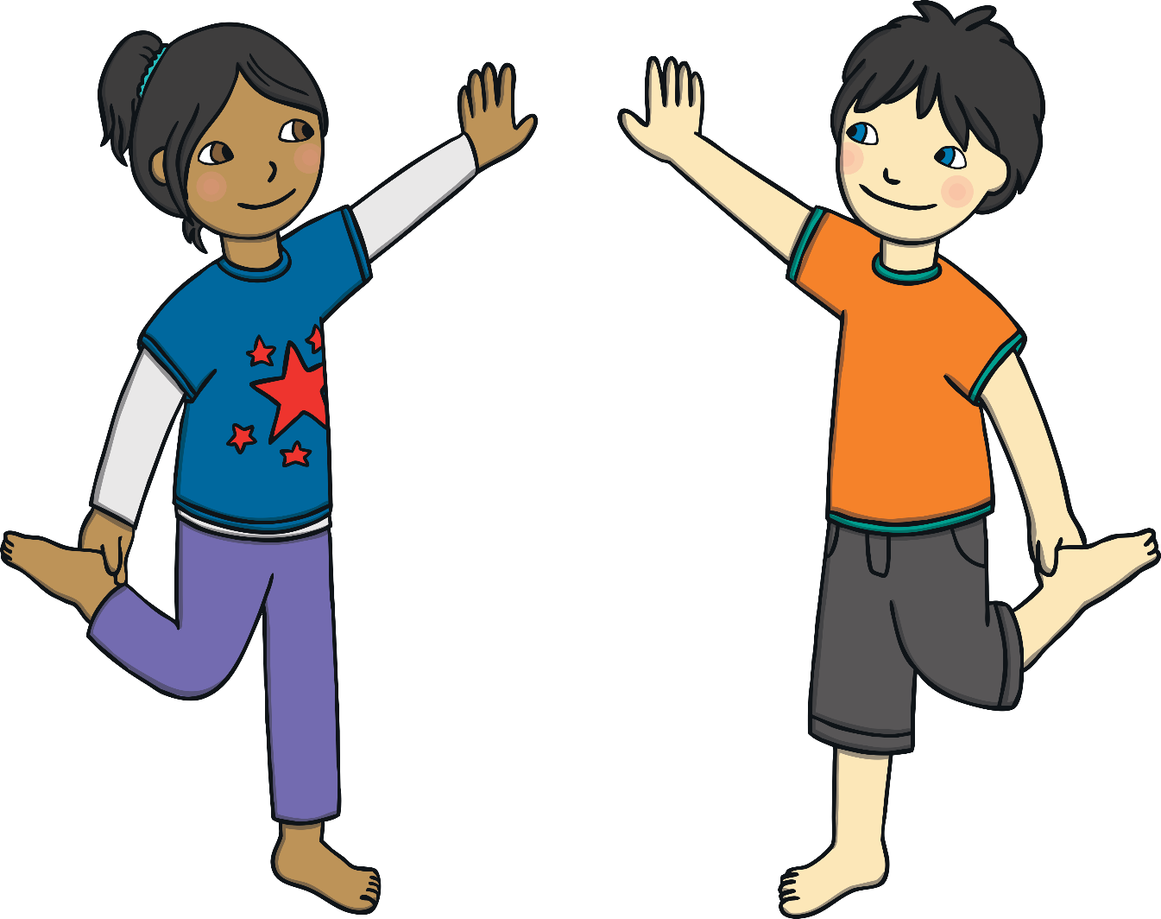



Mirror, Mirror
Copy your partner’s movements as closely as you can.

Slide 6
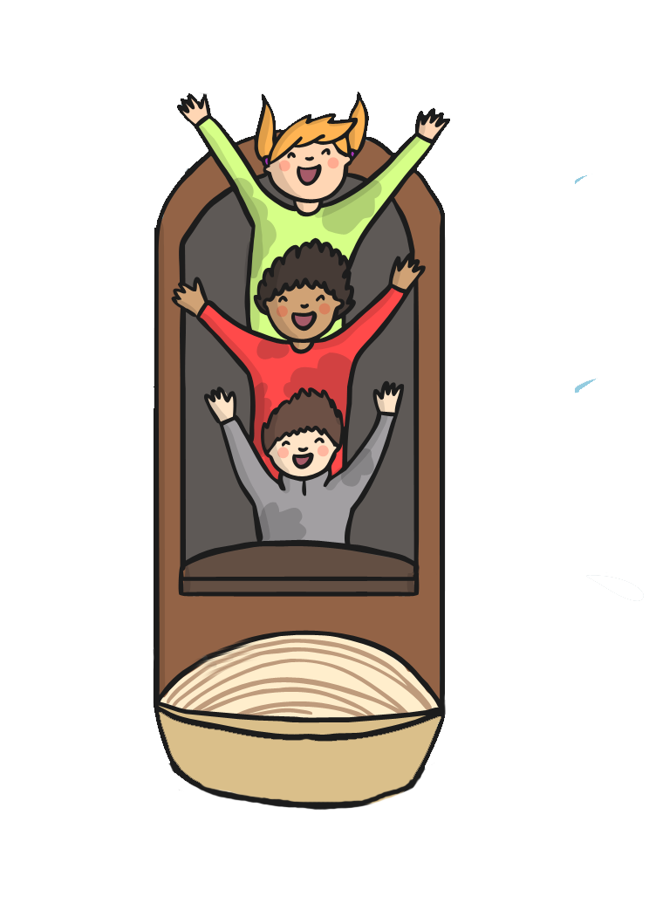
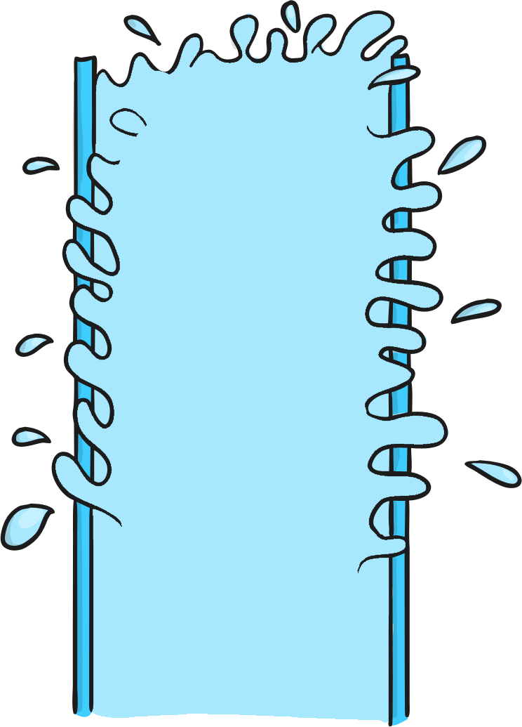
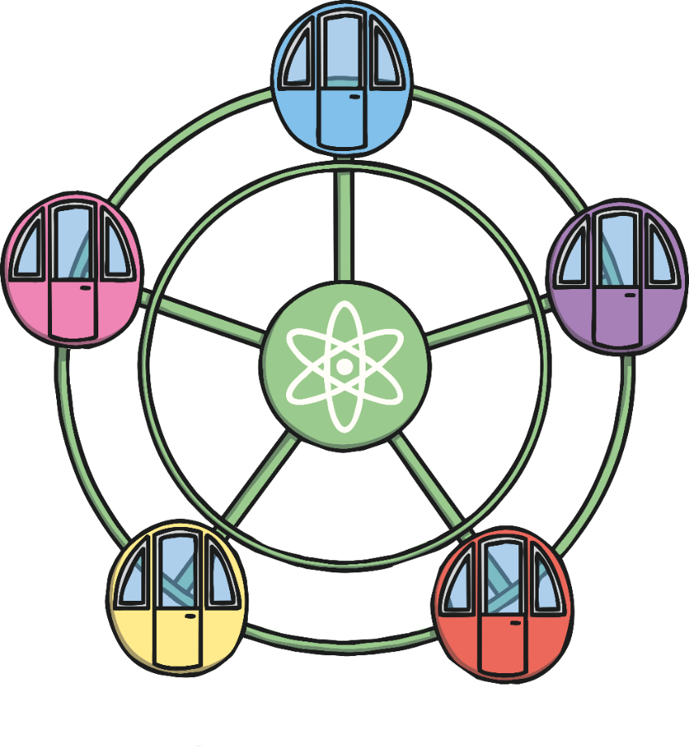
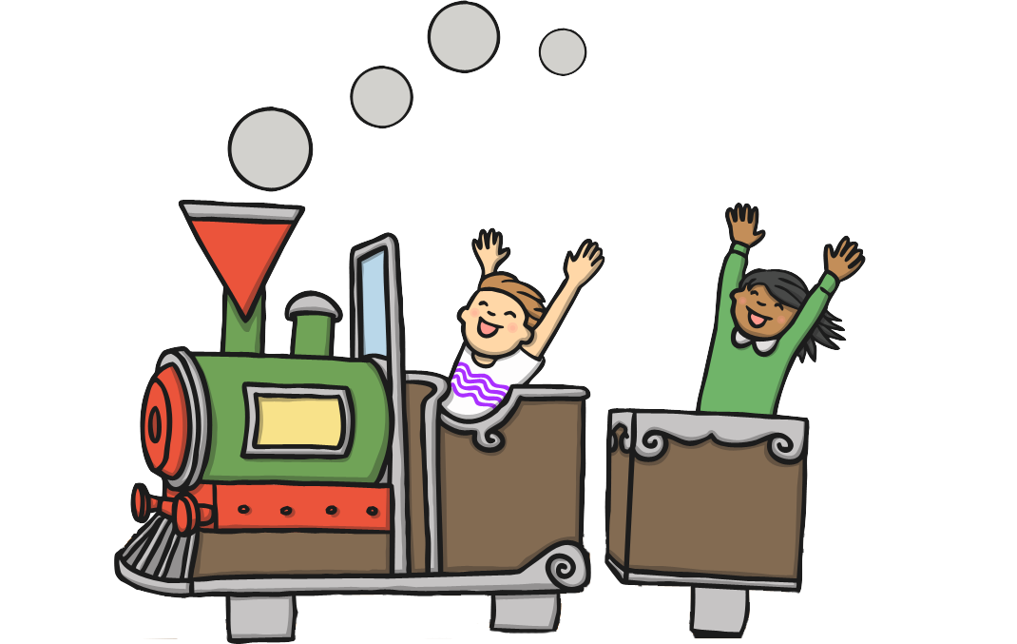
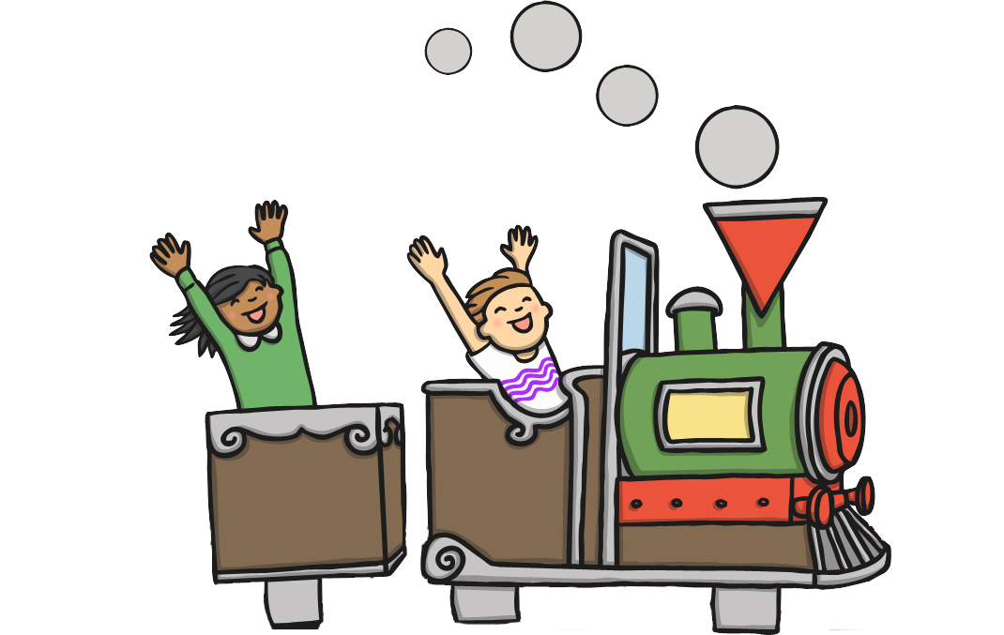
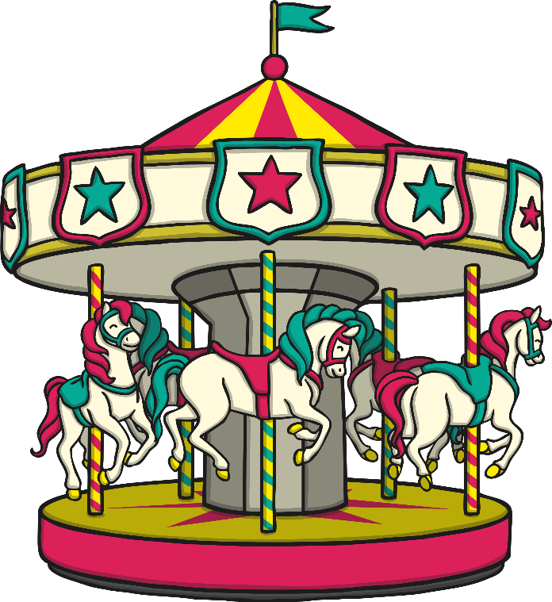
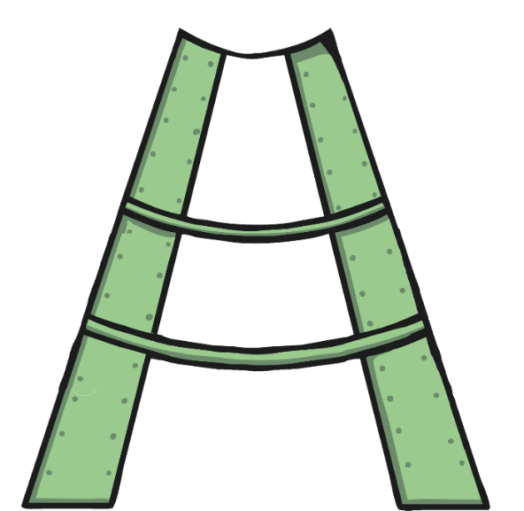
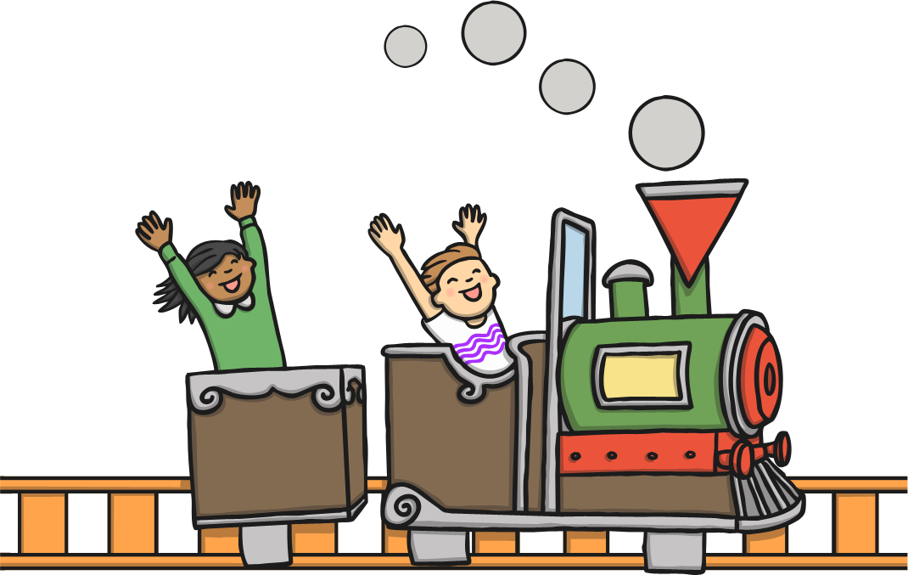
At the Fair
Which rides move to the left or the right?
Which rides move forwards and backwards?
Which rides move up and down?
Which rides spin or turn around?

Slide 7



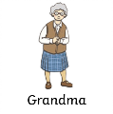

Through the Woods Activity
To Grandma’s Cottage
Turn right.
Forwards 3.
Turn left.
Forwards 3.
Turn right.
Forwards 2.
To Goldilocks’ House
Forwards 3.
Turn right.
Forwards 1.
Turn left.
Forwards 2.
GO!
GO!
Start Here

Slide 8
Aim
I can follow instructions for position, direction and movement.
Success Criteria
I can describe movements.
I can copy movements.
I can read or listen to directions and follow a route.

Slide 9
