Slide 2







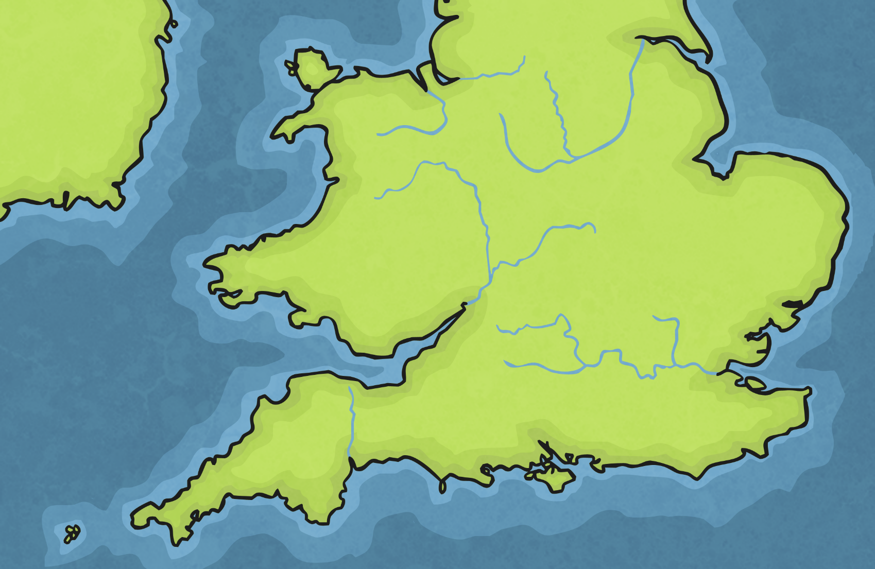
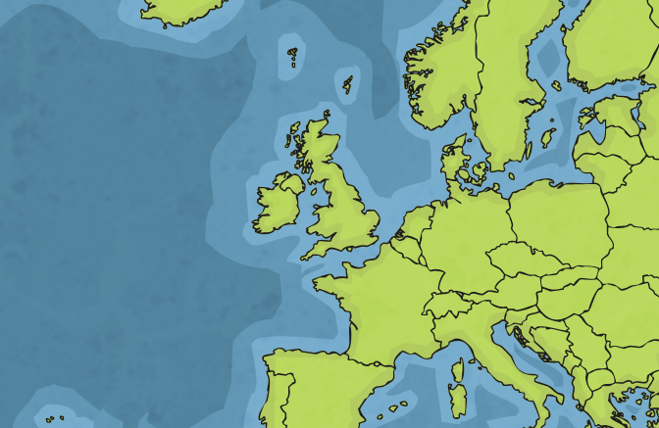

Where Is London?

Slide 3
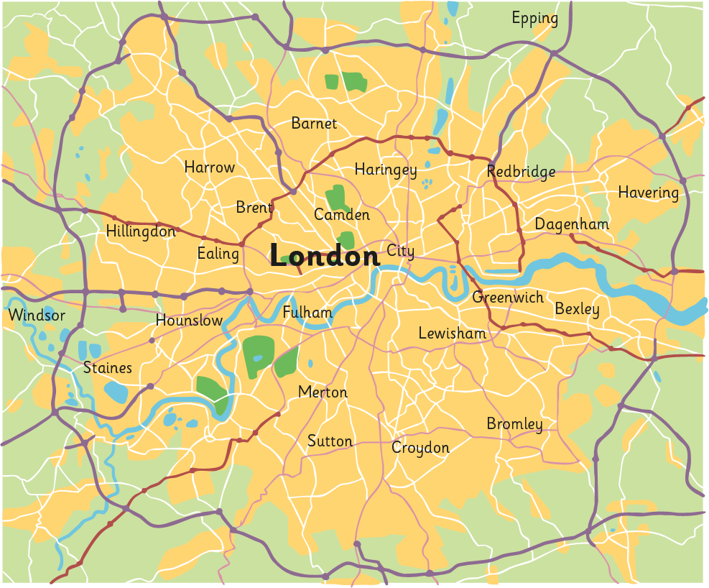
Where Is London?
M25
River Thames
Greater London
City of London

Slide 4

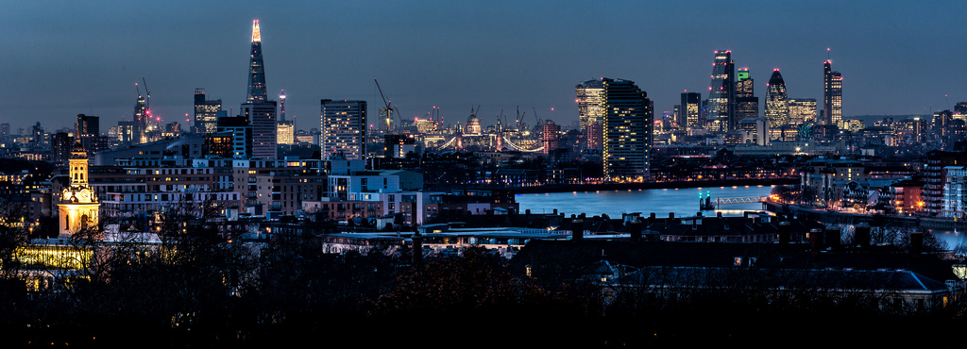
Who Built London?
?
How old do you think London is?
?
Has it always looked like this?
?
Who were the first people to live in London?
Photo courtesy of Davide D’Amico (@flickr.com) - granted under creative commons licence

Slide 5
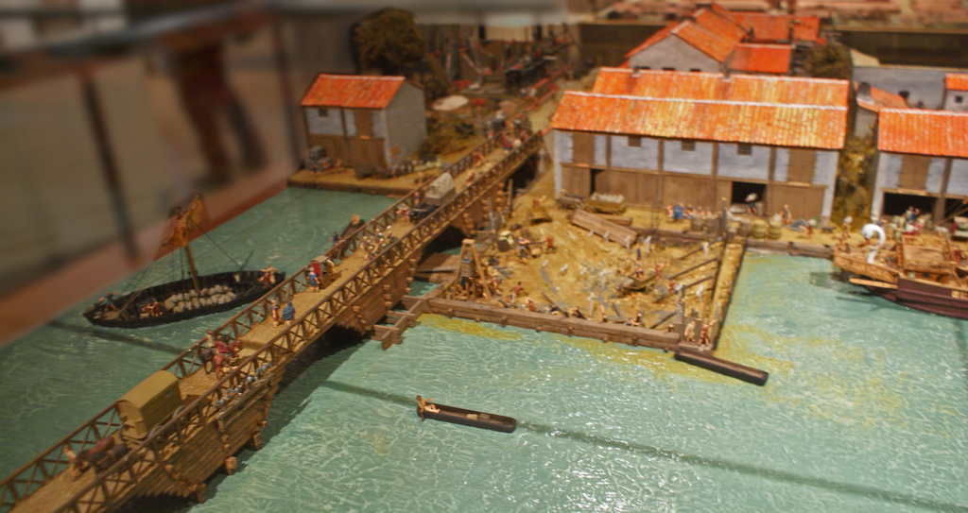
Who Built London?
The Romans invaded Britain in AD 43 and built a settlement called Londinium on the banks of the River Thames.
By AD100, Londinium was the new capital city of Britain and had a population of around 60 000 people!
This model from the Museum of London shows what the north side of the river might have looked like in around AD60.
Photo courtesy of Dick Penn (@flickr.com) - granted under creative commons licence

Slide 6
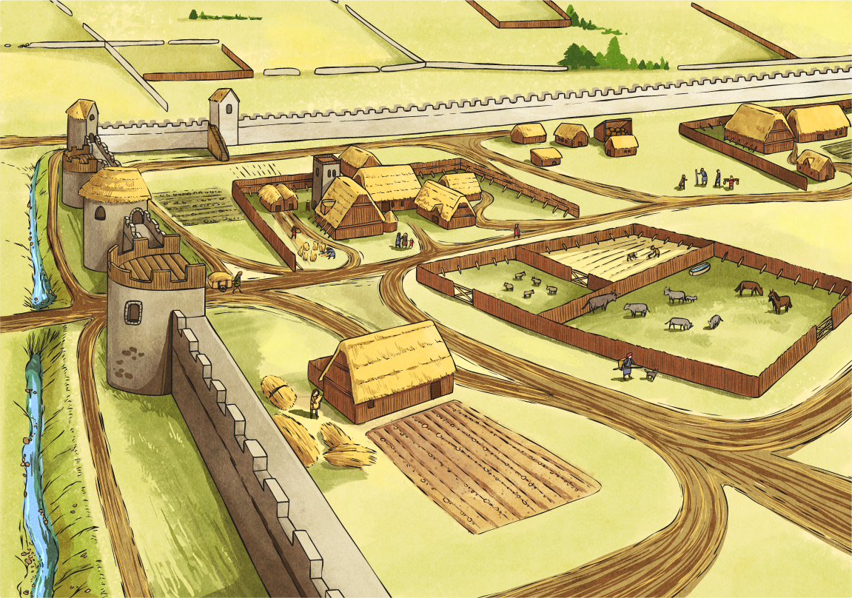


How Did London Change?
After the Romans left in AD 410, an Anglo-Saxon settlement called Lundenwic was built west of the Roman settlement, outside the Roman city walls.
In AD 800, Lundenwic was attacked by Vikings and renamed Lundenburgh.
The population was around 15 000.

Slide 7
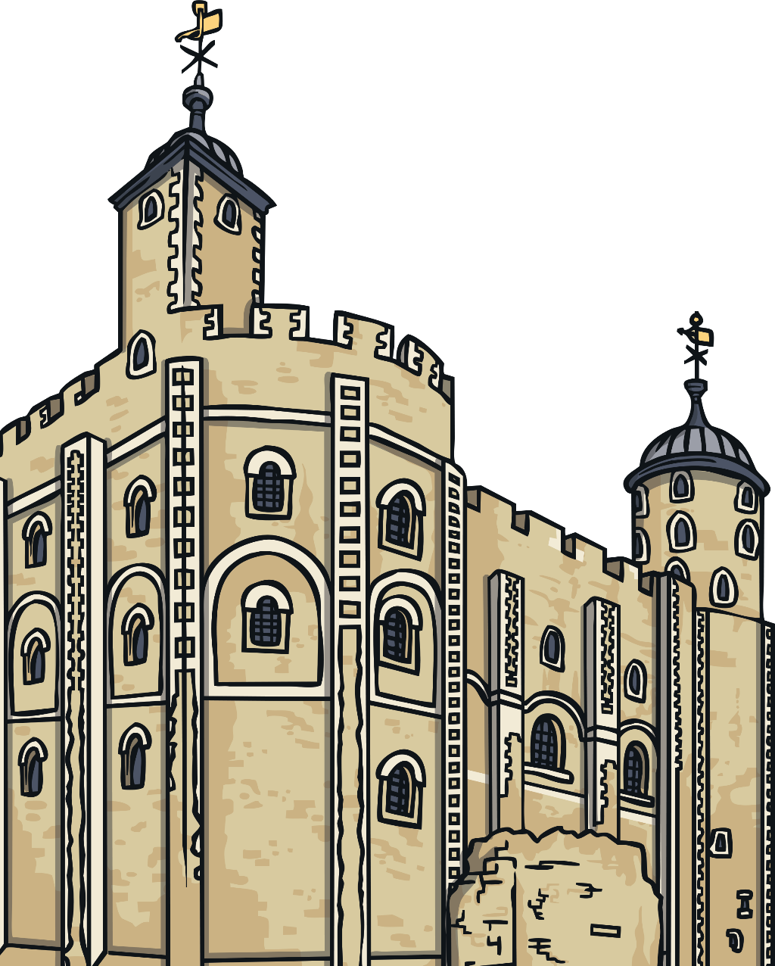
How Did London Change?
After the Norman Invasion of AD 1066, many forts were built, including the Tower of London.
In AD 1209, London Bridge was built to replace many smaller wooden bridges. It was the only bridge crossing the River Thames until AD 1739!
The population was around
80 000.

Slide 8
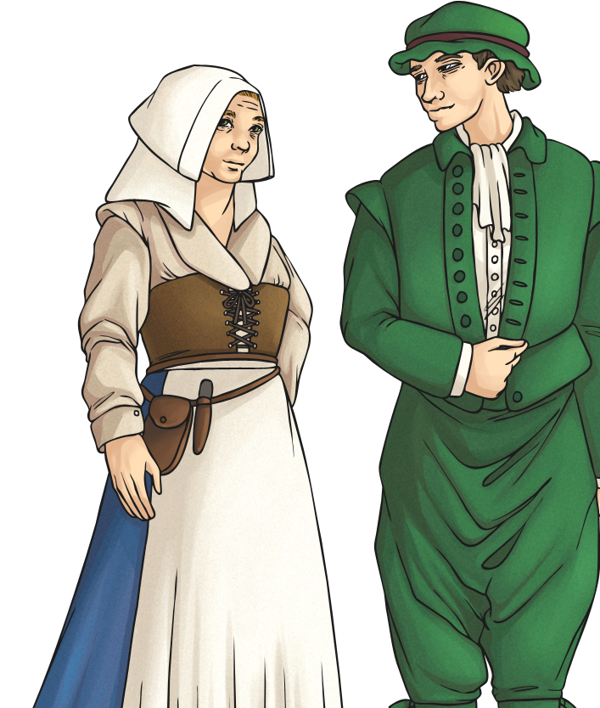
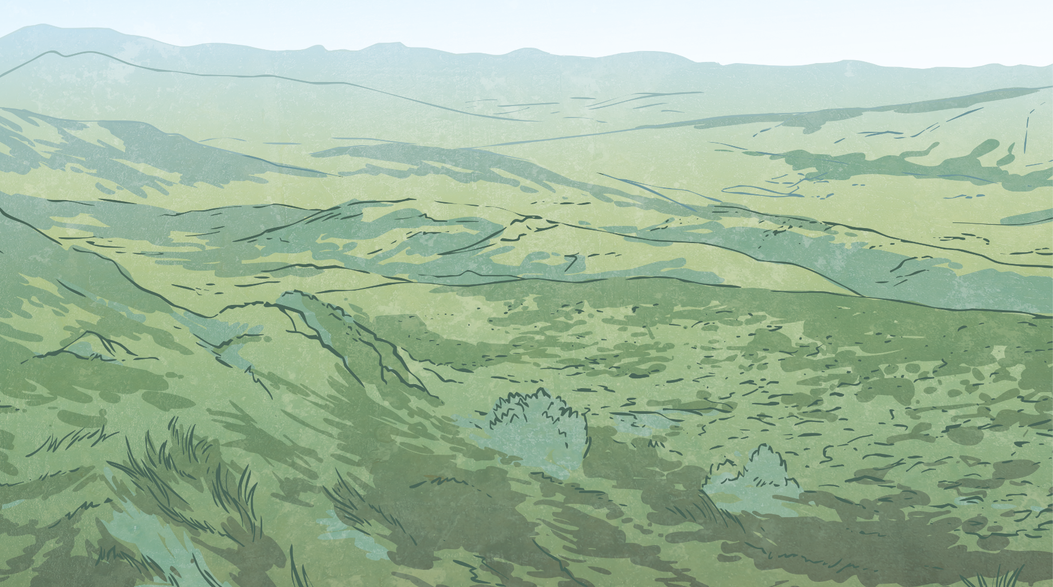
How Did London Change?
Between AD 1485 and AD 1603, the Tudors ruled England.
London was still quite small, but the River Thames provided an important trading link with Russia and the newly-discovered America.
Many trading companies developed.
Immigrants from other parts of the UK and around the world increased the population to 225 000.
Some of Queen Elizabeth I’s courtiers built country villas in the surrounding countryside of Essex and Surrey.

Slide 9
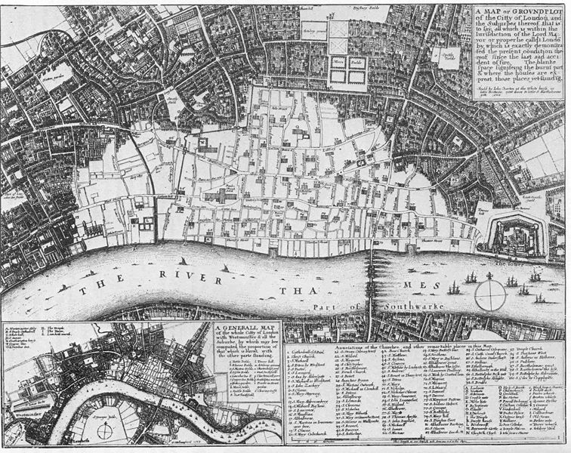
How Did London Change?
?
Can you remember what happened in London in AD 1666?
In the Great Fire of London, over 60% of the city was destroyed (shown in white on the map).

Slide 10
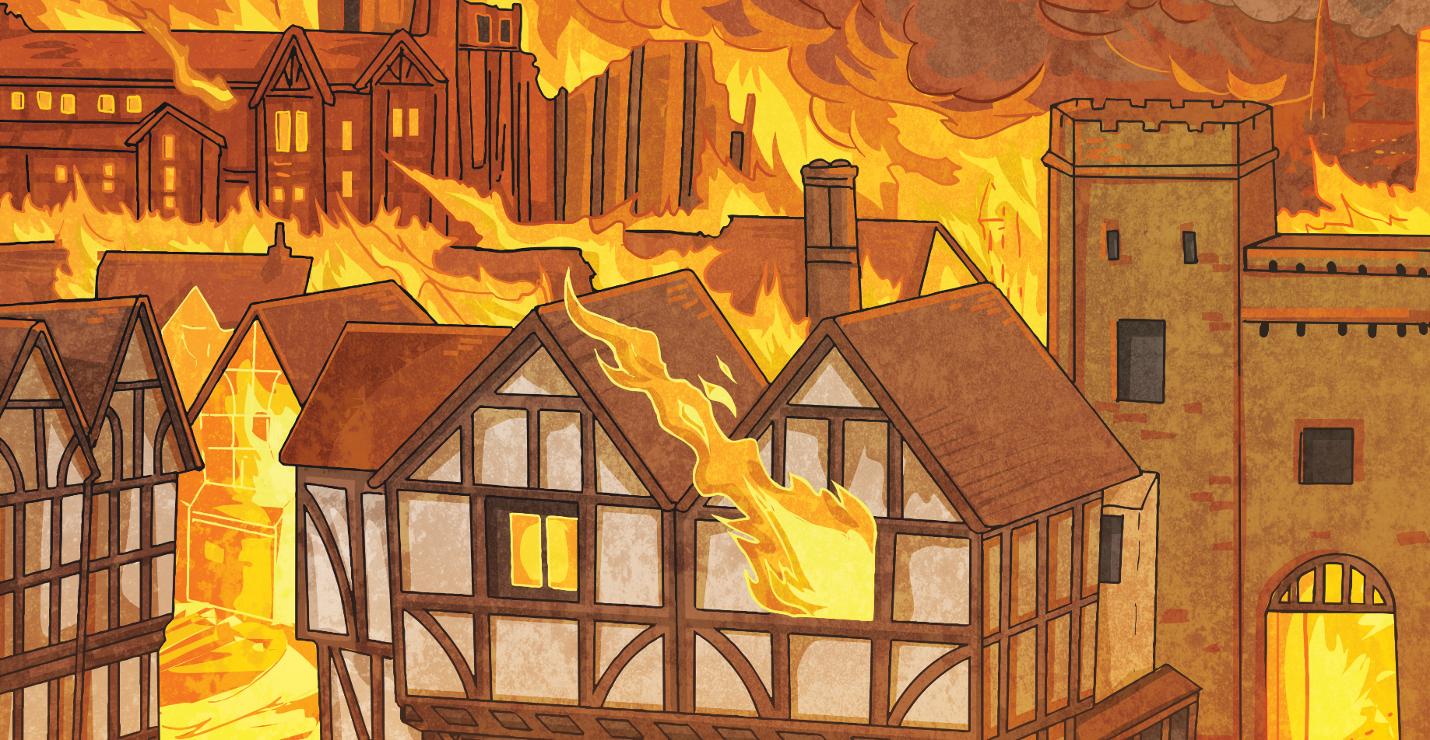
How Did London Change?
New houses were built to the west, close to The Royal Family’s new residence at St James’s Palace.

Slide 11

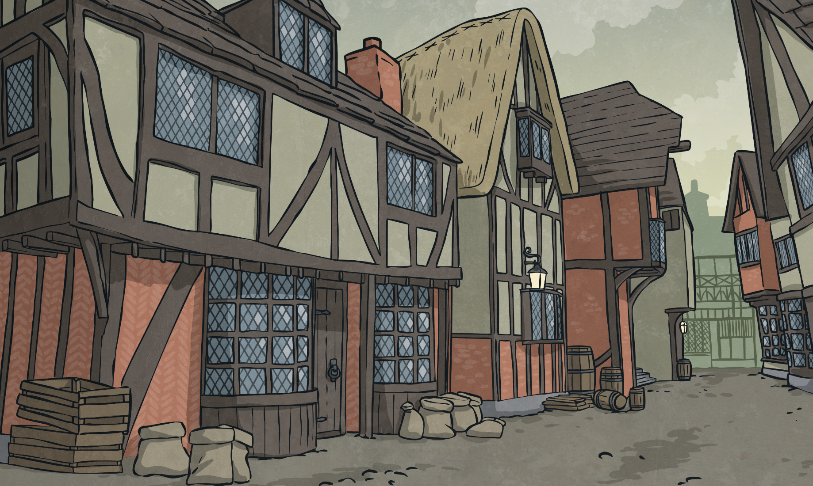
How Did London Change?
The year before the Great Fire, over 60 000 people died because of the Great Plague.

Slide 12
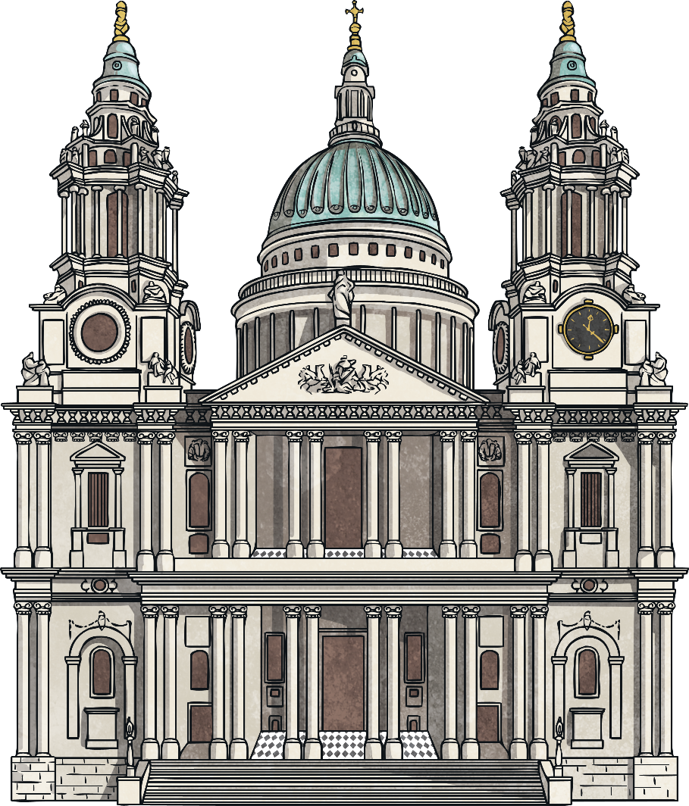
How Did London Change?
AD 1708 saw the completion of St Paul’s Cathedral.
In AD1762, King George III bought Buckingham House to be his new Royal Residence. The population of London was now 1 million.
By the Victorian period, London was the capital of the British Empire.
Trading and finance were becoming important industries.

Slide 13
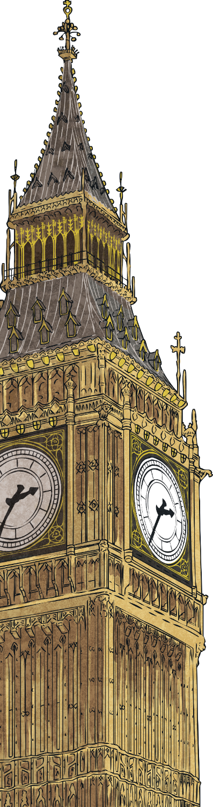
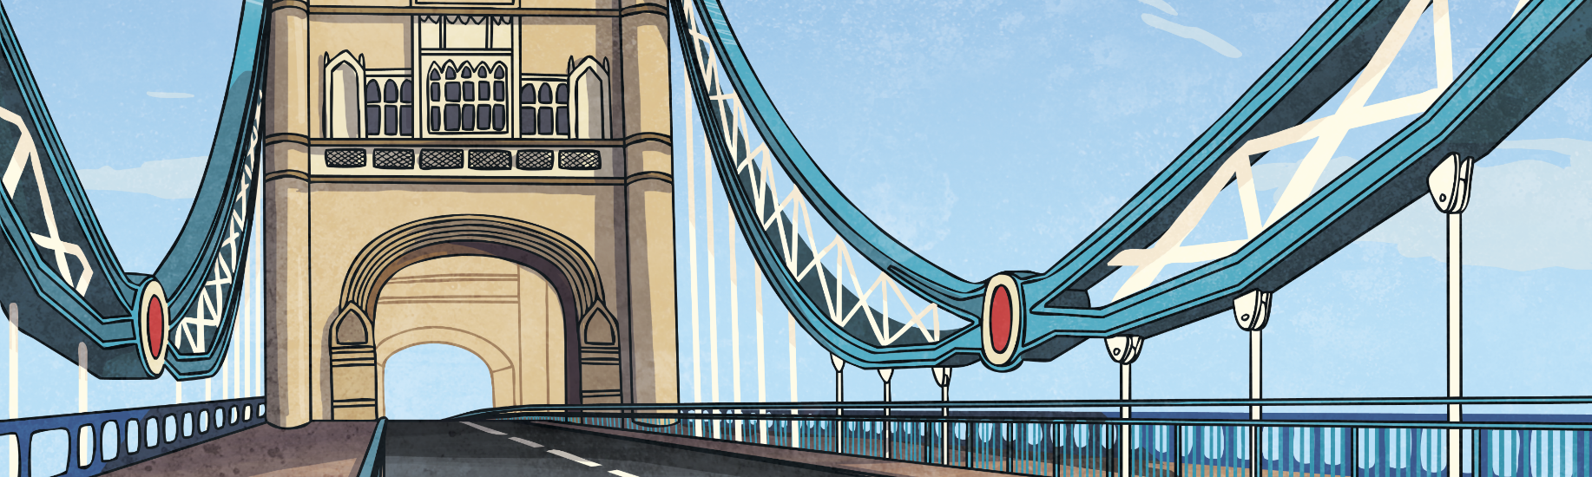
How Did London Change?
Immigrants moved to London and the population rose to 6.7 million.
London grew bigger as new areas of housing were built.
Railways linked London to other parts of the UK.
Landmarks such as Trafalgar Square, Big Ben, the Royal Albert Hall and Tower Bridge were built.

Slide 14
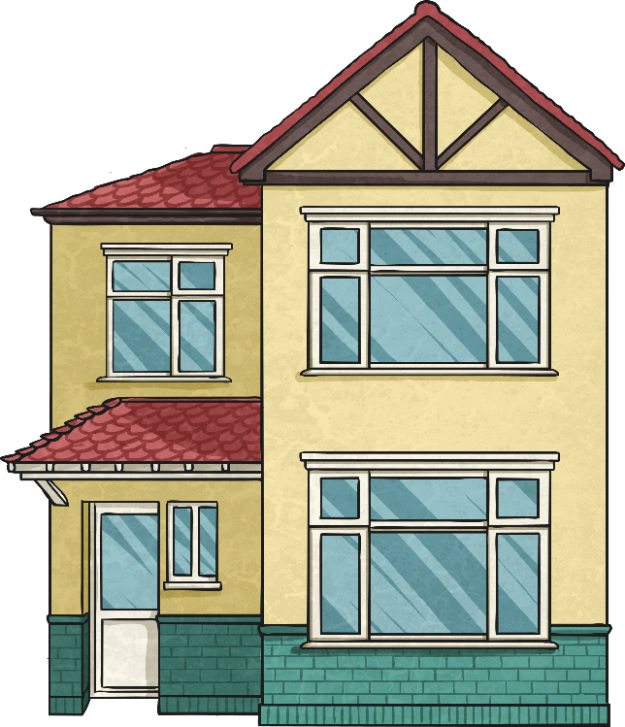
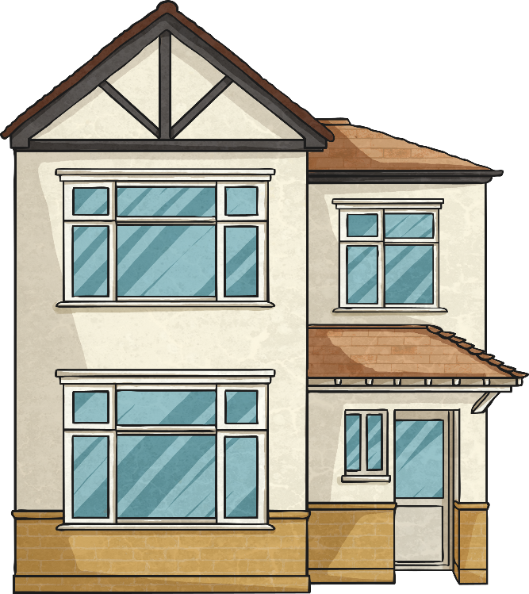
How Did London Change?
In the early 20th Century, London continued to grow.
People wanted bigger, more spacious homes. Semi-detached houses were built in new suburban areas outside London, leading the population to be nearly 9 million.
Landmarks such as Trafalgar Square, Big Ben, the Royal Albert Hall and Tower Bridge were built.

Slide 15
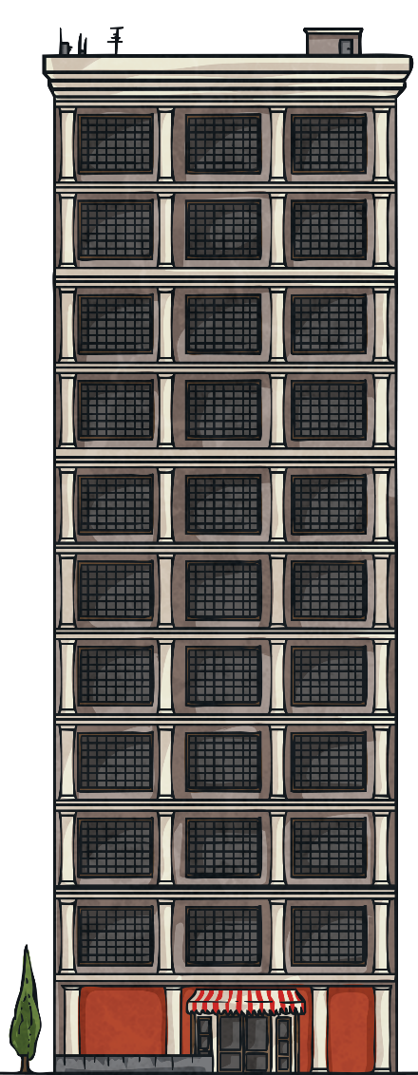
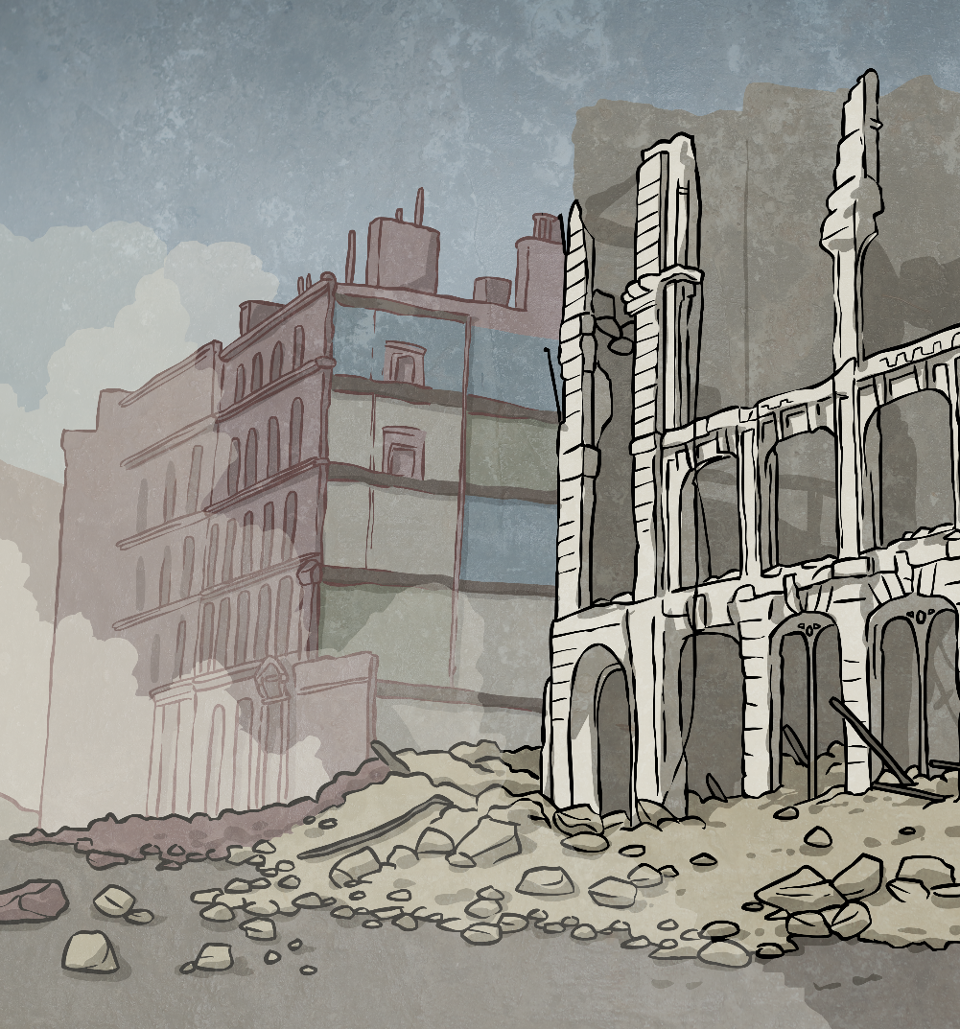
How Did London Change?
After the war ended, high-rise flats were built to replace the destroyed houses.
During the Second World War, areas of London were bombed and many houses and other buildings were destroyed.

Slide 16
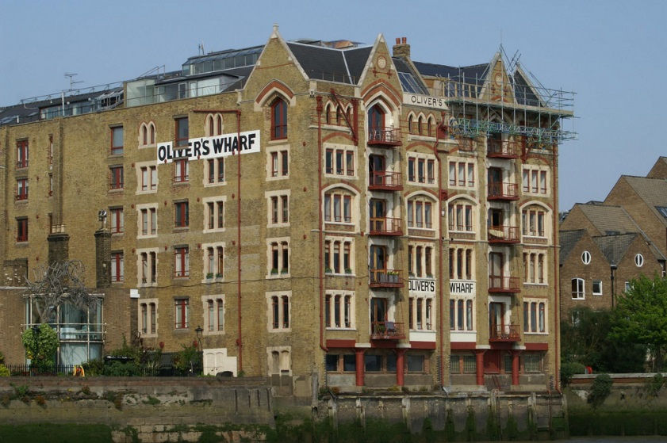
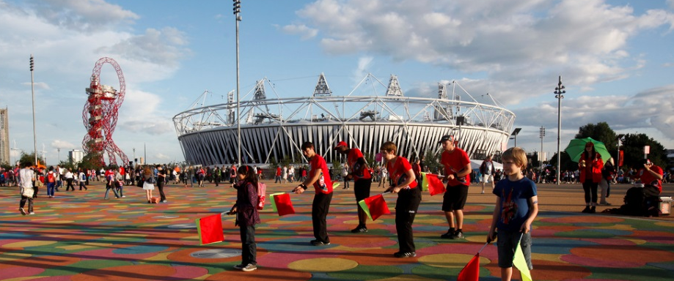
How Did London Change?
In the 1970s and 1980s, the docks that had once been a vital part of London’s trading links with other countries finally closed. Many of the Docklands buildings were converted into housing.
The Thames Barrier was built to protect London from tidal surges travelling up the River Thames.
The new millennium saw many building projects, including the Millennium Dome (now known as the O2 Arena), the Millennium Wheel (The London Eye) and the Queen Elizabeth Olympic Park for the London 2012 Olympic Games.
Photo courtesy of Dave Hamster, and The Department for Culture, Media and Sport (@flickr.com) - granted under creative commons licence

Slide 17
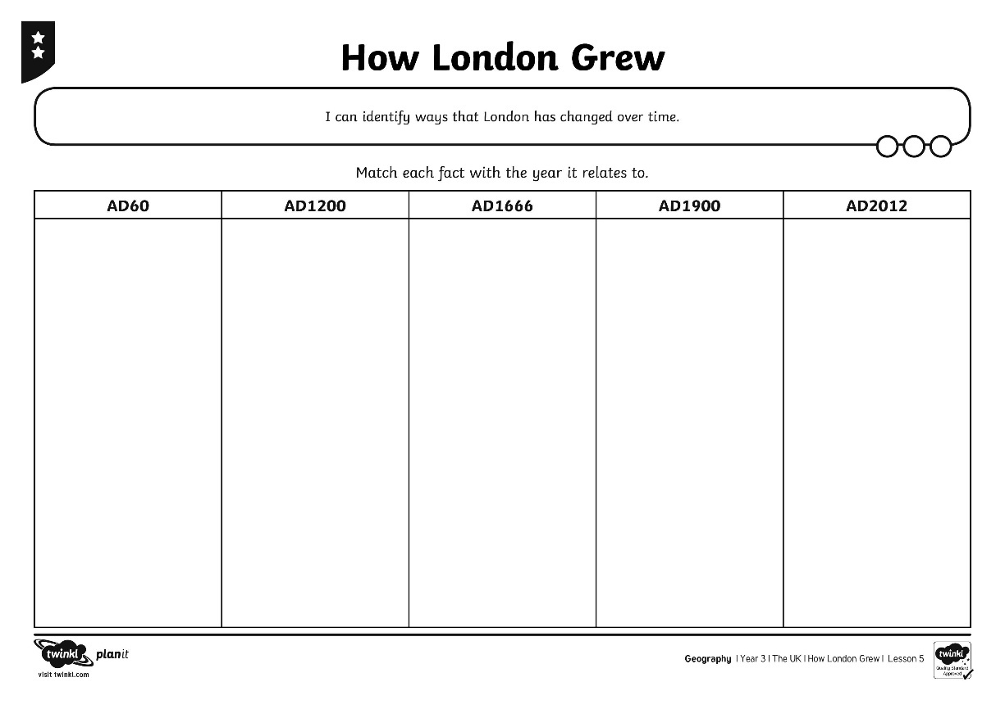
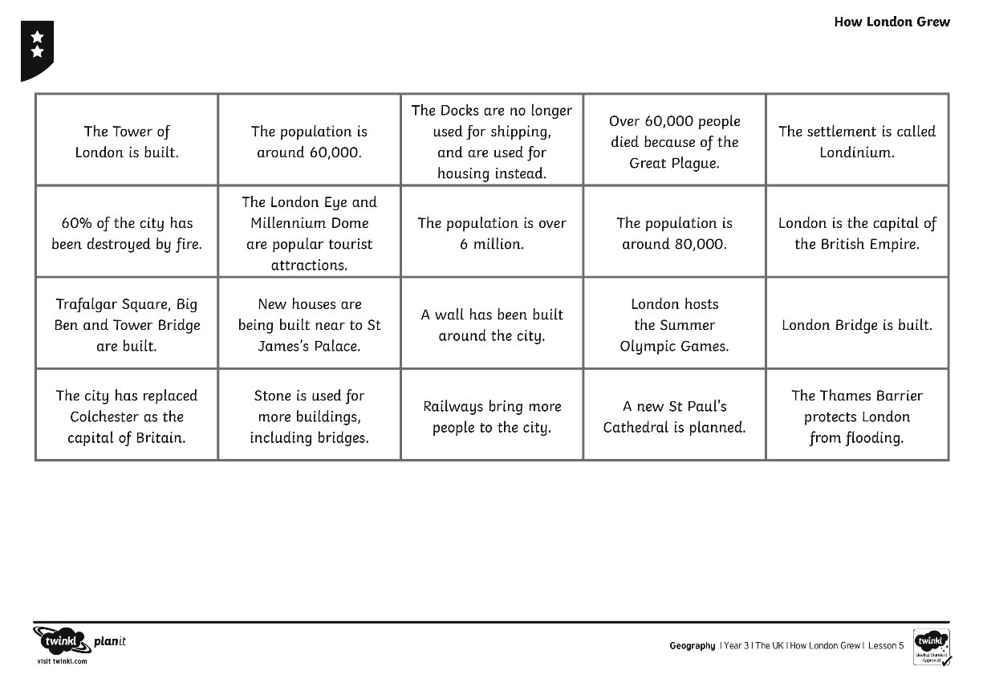
How Has London Grown?
Read the different facts you have been given.
?
Can you match each fact to the year it relates to?

